Slide 1

COVID-19 MONITOR
Europe and central Asia
[Unless otherwise specified, data is as of May 29]

Slide 2
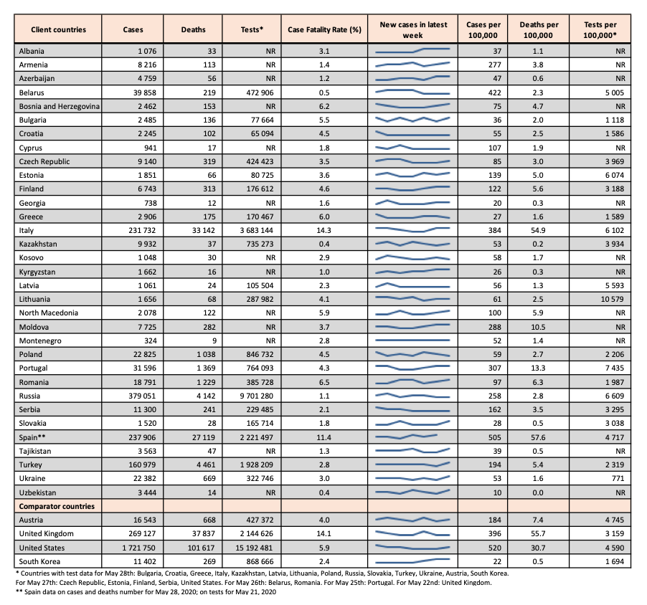
Cases, case fatality rates, and testing
•Cases per 100,000 population range from 10 in Uzbekistan to 505 in Spain.
•Case fatality rates remain below 5% in most client countries, with higher rates in Italy (14.3%) and Spain (11.4%).
•Variation in testing rates (per 100,000) from 771 in Ukraine to 10,579 in Lithuania.
•Testing rates may partially explain variation in reported cases.
•A significant number of countries do not report accurate official testing rates (NR).
•Units for testing are also not consistent across countries (person vs. tests).
•To propose a data source for a country missing testing data, kindly fill this link.

Slide 3
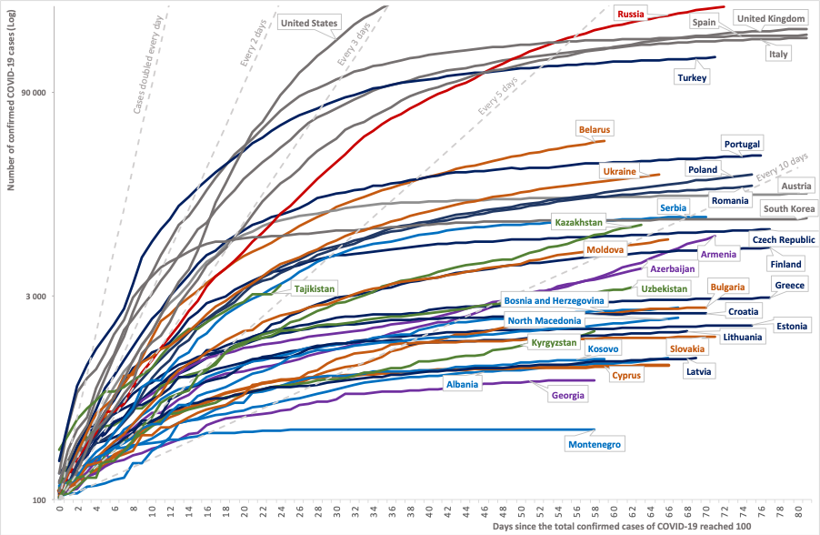
Cumulative case count in client and comparator countries
•This chart plots trajectories in reported total cases for client countries and four comparators, since reporting the 100th case: Austria, United States, United Kingdom, and South Korea.
•The cumulative case count in Armenia, Azerbaijan, and Kazakhstan appears to be rising, at an increasing rate.
•The rising doubling rate for cases for other countries indicates a slowdown in spread of the virus.
Notes:
Restricted to countries with ≥ 100 cases.

Slide 4
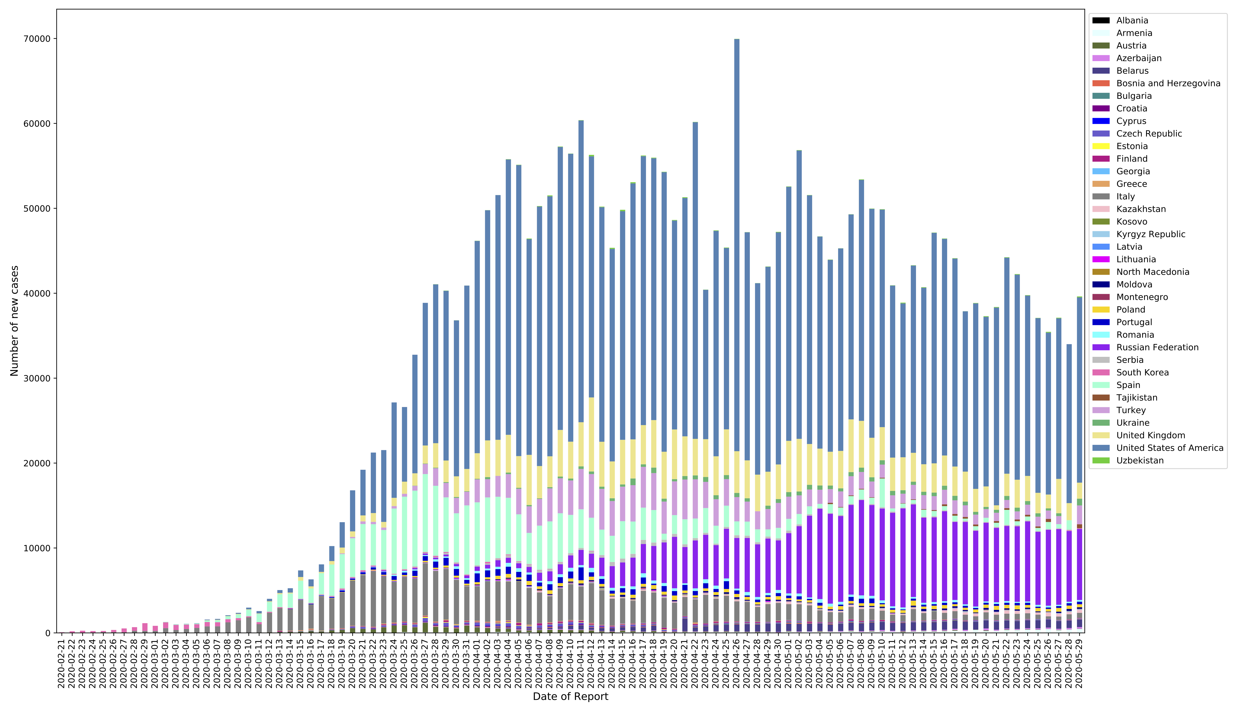
Number of new cases reported daily
​​This chart plots case incidence between February 21st and May 29th among client and comparator countries.
Overall, case incidence appears to be decreasing in most countries in the region.

Slide 5
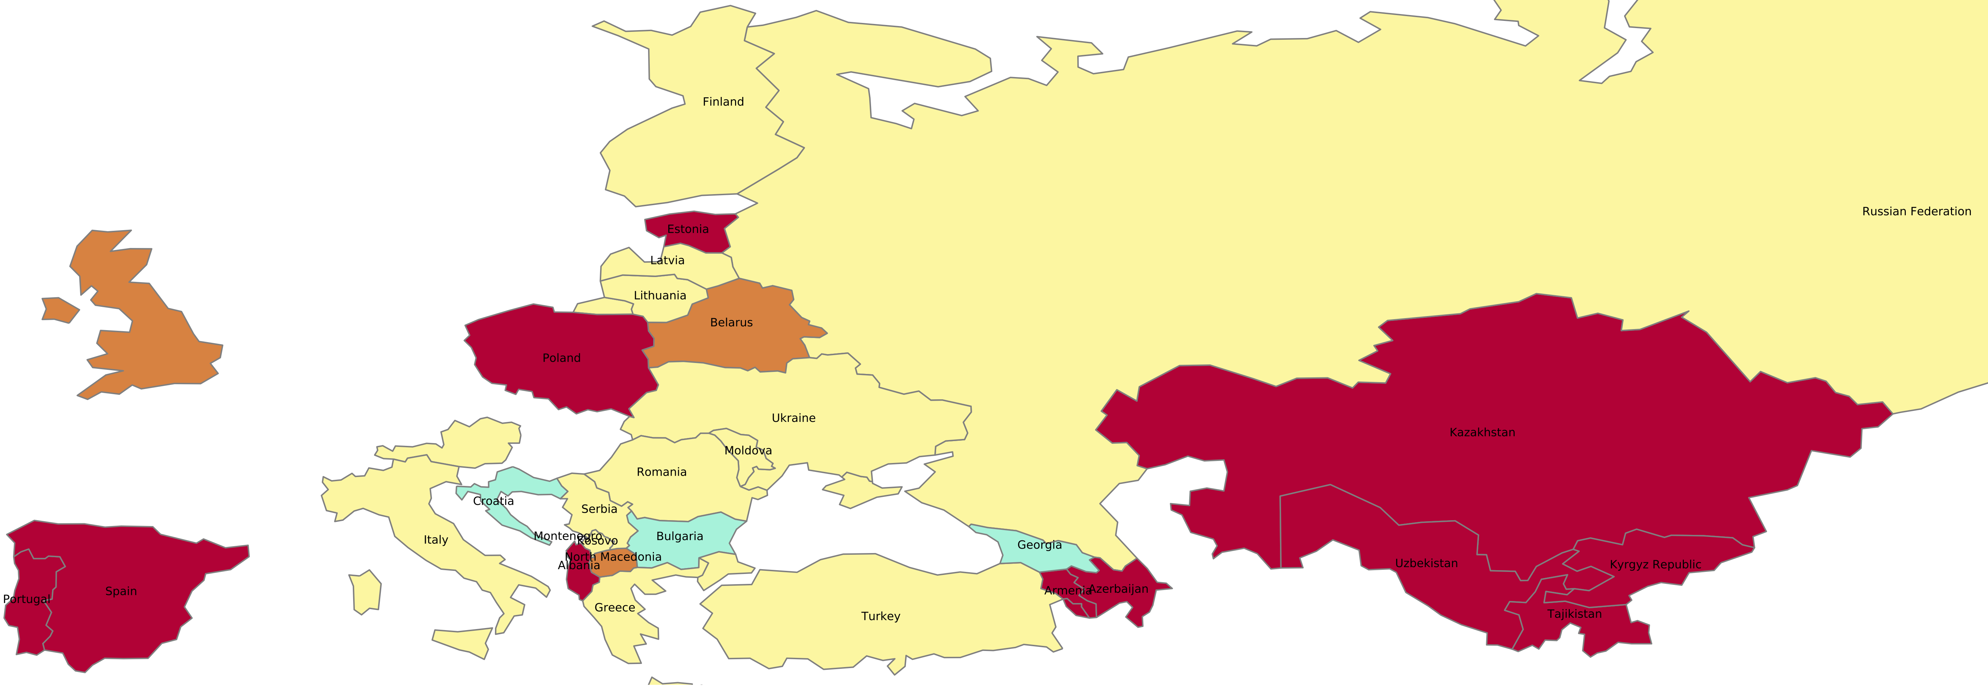
Most recent two-week span: percent change in new cases per 100,000 population
This map plots the change in incidence of cases (in %) between the current week (May 13th to 29th) and the preceding week (May 16nd to 22th).
Case incidence is accelerating in a few countries, with dramatic increases in Spain (60%) and Albania (51%).
Italy has seen a 24% decrease in new cases.
These changes should be interpreted in light of the absolute case count.
Color | Key | Countries
 | -110 to – 50: Dramatic slowing of spread | Croatia, Bulgaria, Georgia.
 | -50 to -5: Spread slowing | Latvia, Greece, Austria, Serbia, Finland, Lithuania, Italy, Kosovo, Turkey, Moldova, Romania , Ukraine, Russian Federation.
 | -5 to 5: Spread contained | Belarus, North Macedonia.
 | 5 to 100: Spread accelerating | Portugal, Poland, Cyprus, Kazakhstan, Tajikistan, Azerbaijan, Uzbekistan, Estonia, Kyrgyz Republic, Albania, Armenia, Spain.
Note: Boundaries were cleared by the World Bank Map Design Cartography and Map Clearance Teams.

Slide 6
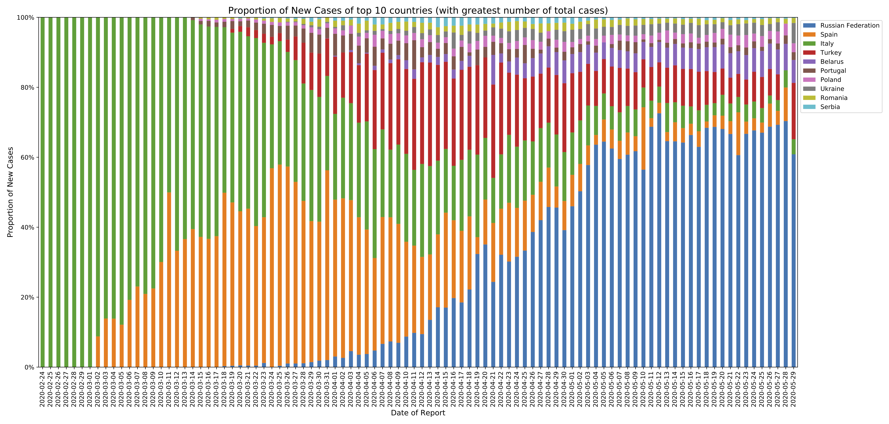
Proportion of new cases in 10 client countries with the highest total number of cases
​
The proportion of new cases in the 10 countries with a high case prevalence, is decreasing.
The overall contribution of Russia to case incidence remains relatively high.

Slide 7
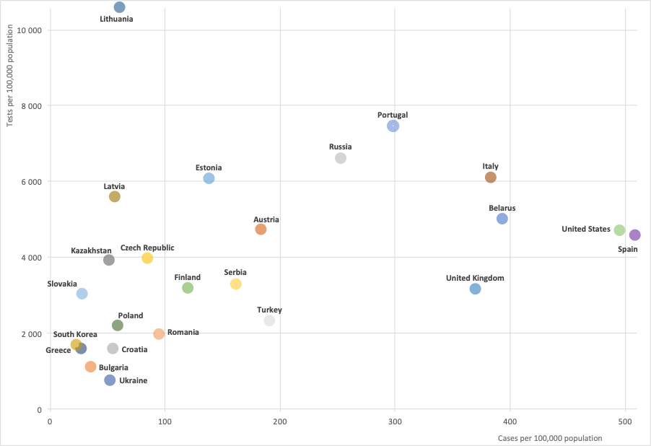
Total cases and tests per 100,000 population
Given the potential for undertesting to limit reported cases, this chart plots total cases and tests per 100,000 population for client and comparator countries.
The cluster of countries in the bottom left-hand corner are relatively low-testers: Ukraine, Bulgaria, Croatia, Greece, Poland, and Romania.
* Countries with data for May 28th: Bulgaria, Croatia, Greece, Italy, Kazakhstan, Latvia, Lithuania, Poland, Russia, Slovakia, Turkey, Ukraine, Austria, South Korea. For May 27th: Czech Republic, Estonia, Finland, Serbia, United States. For May 26th: Belarus, Romania. For May 25th: Portugal. For May 22nd: United Kingdom. For May 21st: Spain

Slide 8
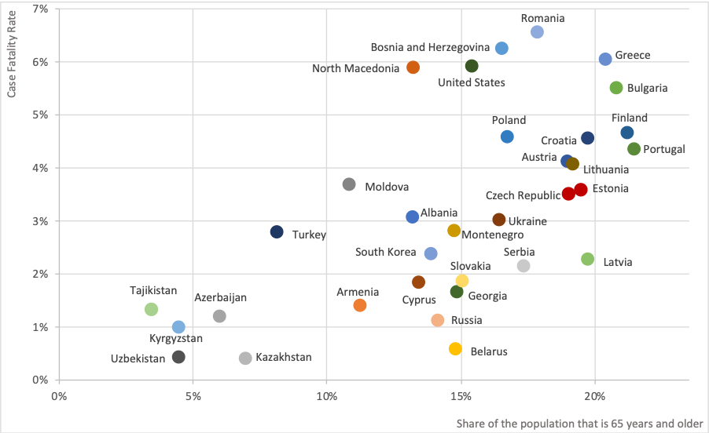
Case fatality rate and share of the population that is 65 years and older
This chart shows the correlation between the case fatality rate and population age structure in client and comparator countries.
A higher share of the population that is at or above 65 years appears to predict a higher case fatality rate, on average.
However, there is also wide variation in case fatality rate among countries with the same share of the population aged 65 years or more.
* Country with data for May 28th: Spain; Outliers in terms of case-fatality rate were omitted: Italy, Spain, and the United Kingdom.

Slide 9
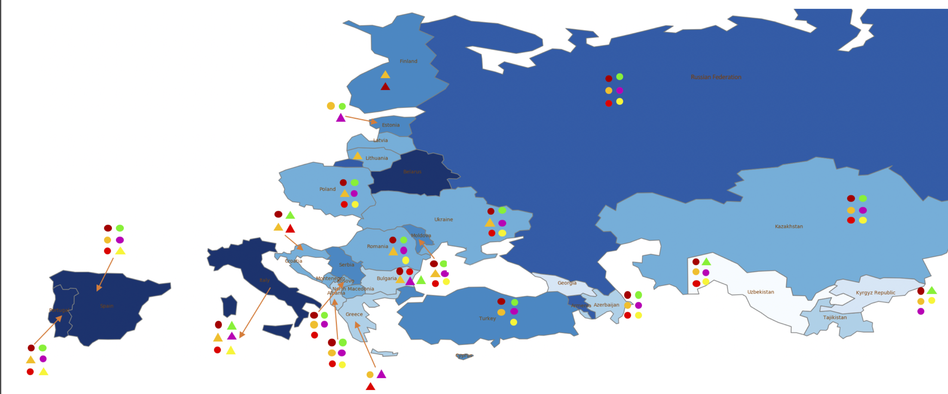
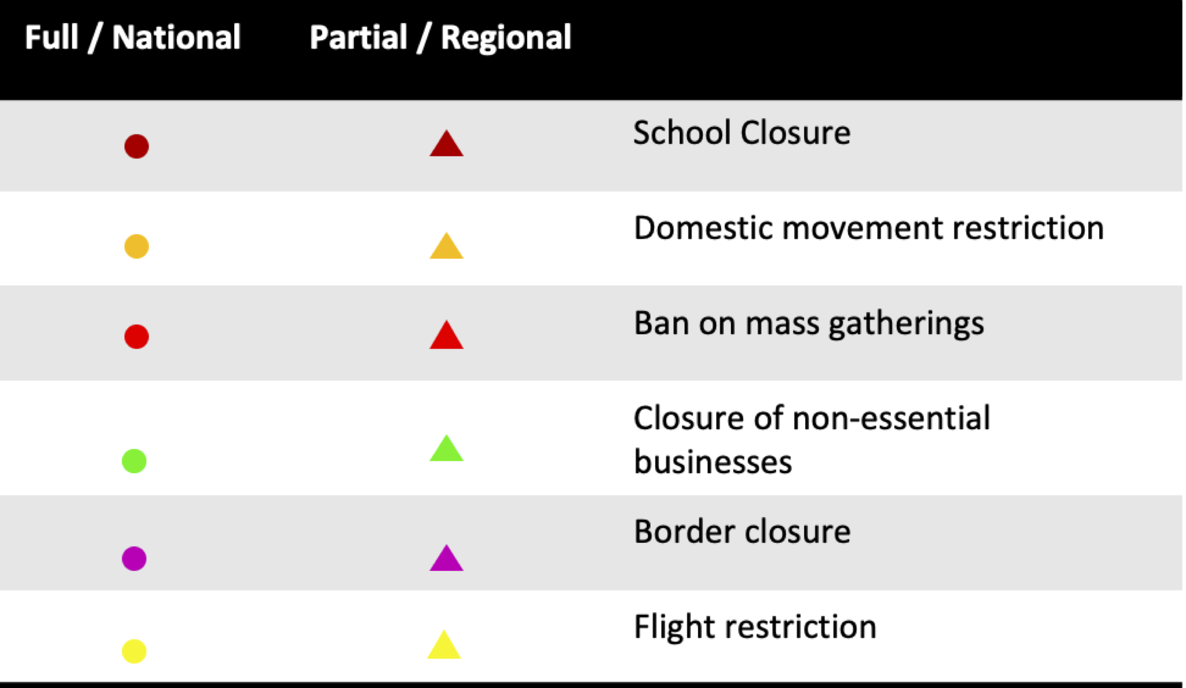
Public health and social measures implemented in the region
Color | Total cases/100,000 | Countries
 | 0-10 | Uzbekistan.
 | 10-25 | Georgia, Kyrgyz Republic, Tajikistan.
 | 25-50 | Greece, Bulgaria, Albania, Azerbaijan, Kazakhstan, Ukraine.
 | 50-100 | Kosovo, Montenegro, Poland, Latvia, Croatia, Lithuania, Romania, North Macedonia.
 | 100-200 | Cyprus, Finland, Estonia, Serbia, Turkey, Moldova, Armenia.
 | 200-300 | Russian Federation, Portugal.
 | 300+ | Belarus, Italy, Spain.
Italy is easing up its restrictions the most, followed by Greece and Bulgaria.
​
Russian Federation, ​Kazakhstan, Azerbaijan, Albania have maximum restrictions.
Countries like Macedonia, Belarus, Lithuania, Georgia, and Latvia have missing data on their policy responses.
Note: Boundaries were cleared by the World Bank Map Design Cartography and Map Clearance Teams.

Slide 10
Countries and data sources
Albania | Georgia | Poland
Armenia | Greece | Portugal
Azerbaijan | Italy | Romania
Belarus | Kazakhstan | Russian Federation
Bulgaria | Kosovo | Serbia
Bosnia and Herzegovina | Kyrgyz Republic | Slovak Republic
Croatia | Latvia | Spain
Cyprus | Lithuania | Tajikistan
Czech Republic | Moldova | Turkey
Estonia | Montenegro | Turkmenistan (no cases)
Finland | North Macedonia | Ukraine
 |  | Uzbekistan
The monitor focuses on client countries in Europe and Central Asia with any lending or non-lending operation, and with available data, as in the Table.
In selected slides, comparator countries are presented, which are significant for their disease trajectories: Austria, United States, United Kingdom, and South Korea.
Data from:
Cases, testing, and deaths: https://ourworldindata.org/coronavirus.
Policy responses: https://ourworldindata.org/policy-responses-covid
Population: provided by task teams or imputed from “our world in data” or the world development indicators.

