Slide 1

COVID-19 MONITOR
Europe and central Asia
[Data is as of May 8th]
Notes:
Data: https://ourworldindata.org/coronavirus (except population data for Kosovo, from World Development Indicators)
Mortality (%) = (cases/deaths)*100
Tests = accurately reported tests. See: https://ourworldindata.org/covid-testing
Cases, Deaths, Tests per 100K = (X/population) *100,000 where X = cases, deaths, or tests
100th case = Days since 100th case was reported
Latest week = New case trends from Saturday, 2nd May to Friday, 8th May, 2020, except otherwise specified.
Population data is as of 2019, except for Kosovo (2018)

Slide 2
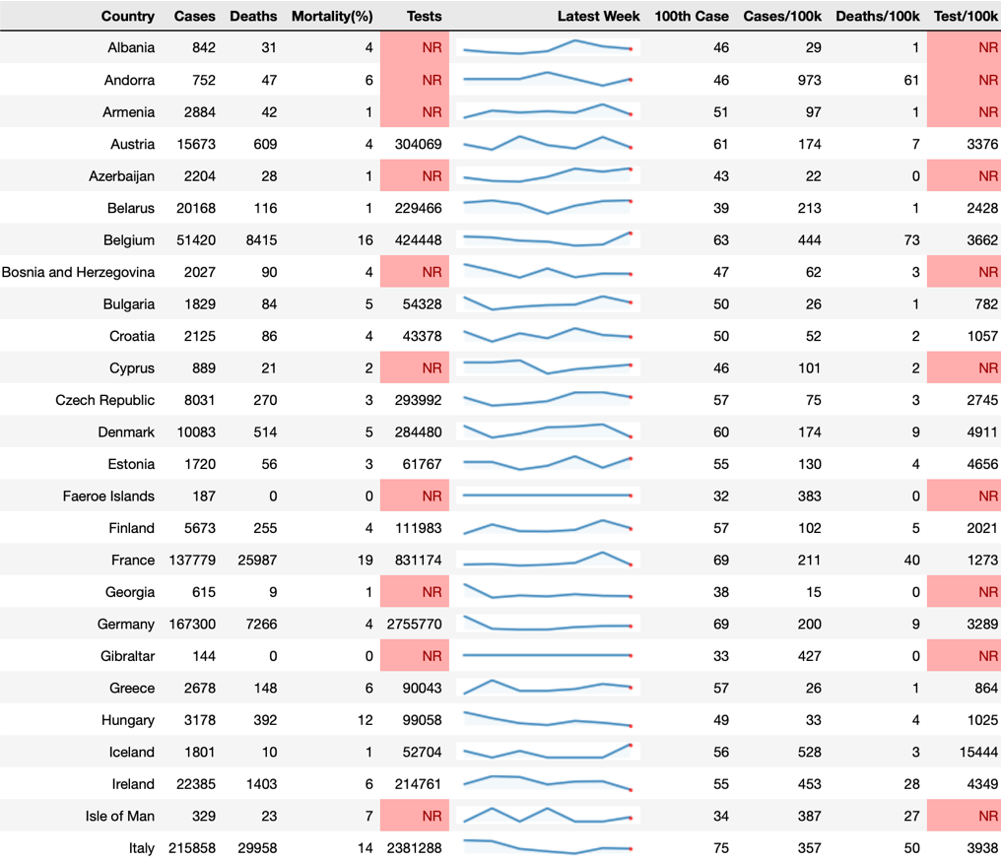
Cases, mortality and testing I
• Single-digit mortality rates in most countries, with higher rates in Belgium (16%), France (19%), United Kingdom (15%), Hungary (12%), Italy (14%), Spain(12%), Netherlands (13%) and Sweden (12%).
• On average, high mortality overlaps with countries with a high proportion of the population above 65 years.
Notes:
Restricted to countries with ≥ 100 cases (does not include all countries in ECA).

Slide 3
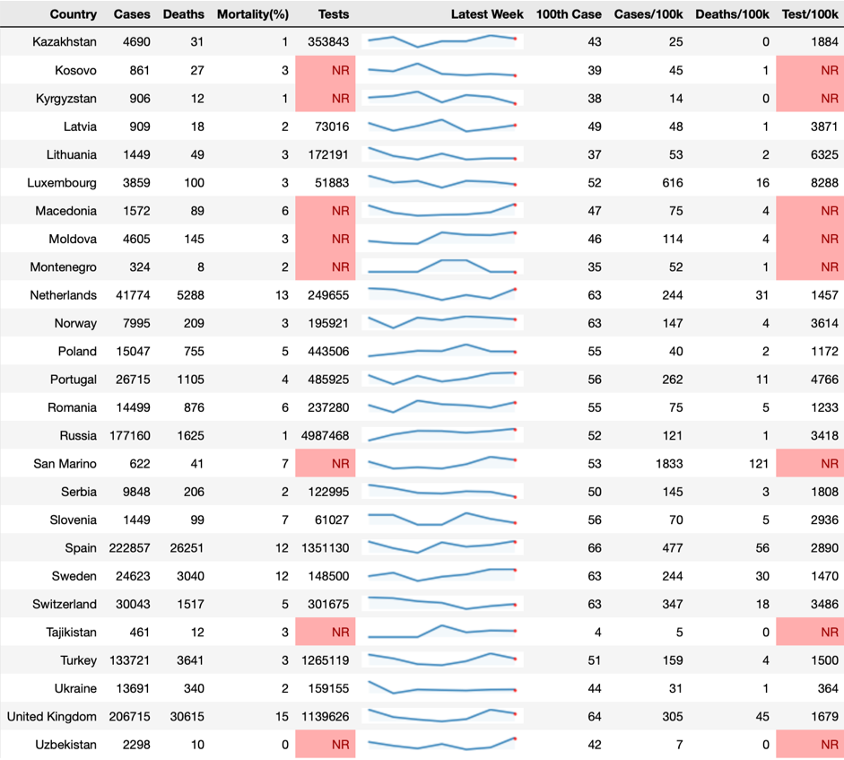
Cases, mortality and testing II
• Among countries with testing data, huge variation in testing across the population, from 364 per 100,000 in Ukraine to 15444 in Iceland.
• Units for testing data are not consistent due to reporting differences across countries (person vs. tests).
Notes:
Restricted to countries with ≥ 100 cases (does not include all countries in ECA).

Slide 4
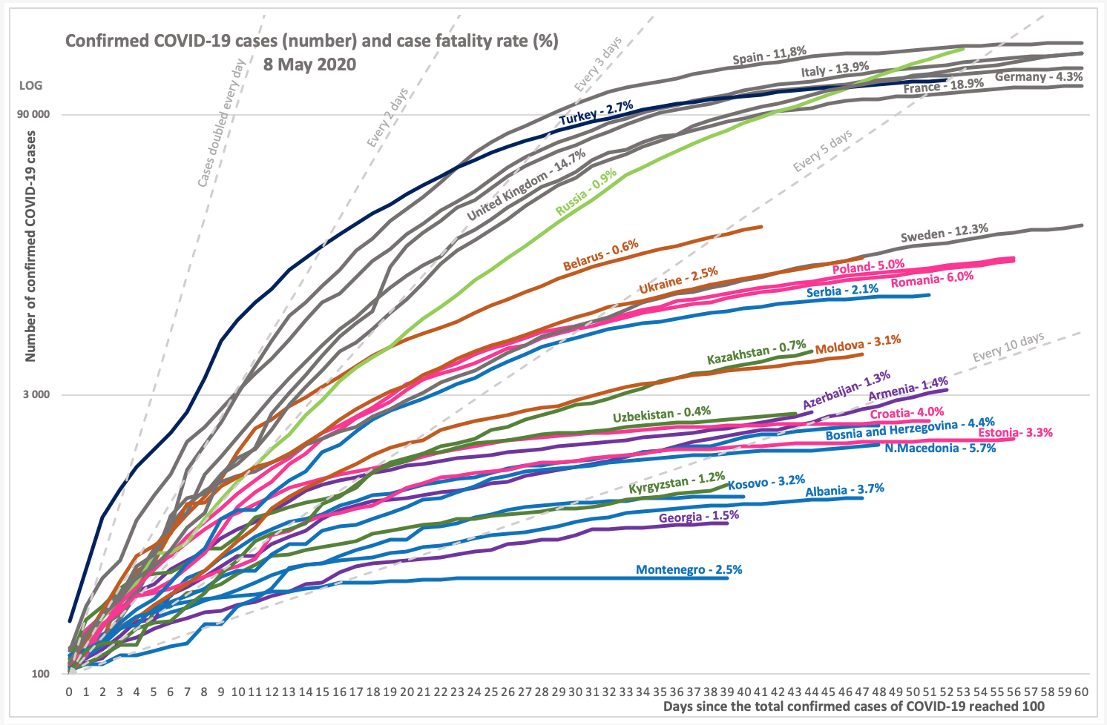
Case fatality rates and trajectory in total confirmed cases
Italy, Russia, Spain, Germany, and France have the highest number of confirmed cases.
The doubling rate for cases appears to be increasing across the region, indicating a slowdown in spread.
Most countries have single digit case fatality (or mortality) rates.
Higher case fatality in France, Italy, Spain, and the United Kingdom may also reflect the case age structure, prevalence of comorbidities, testing rates, and differences in assigning cause of death.
Notes:
Restricted to countries with ≥ 100 cases.

Slide 5
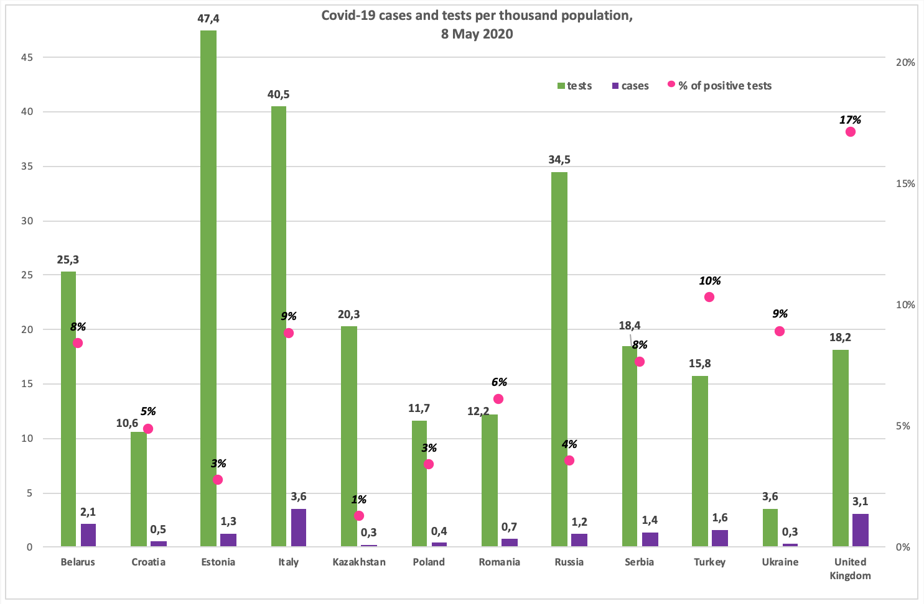
Total cases and tests per 100,000 population
A significant number of countries in the region do not report accurate data on testing (NR).
A high percentage of positive tests – as in the United Kingdom (17%) - may indicate that countries are not testing as extensively as needed to detect all cases.
Countries with low testing rates and total cases – such as Ukraine – may be underestimating disease transmission.
Notes:
https://www.who.int/docs/default-source/coronaviruse/who-china-joint-mission-on-covid-19-final-report.pdf

Slide 6
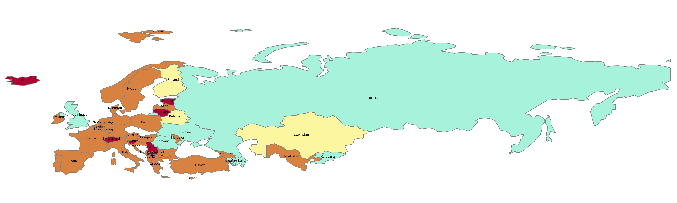
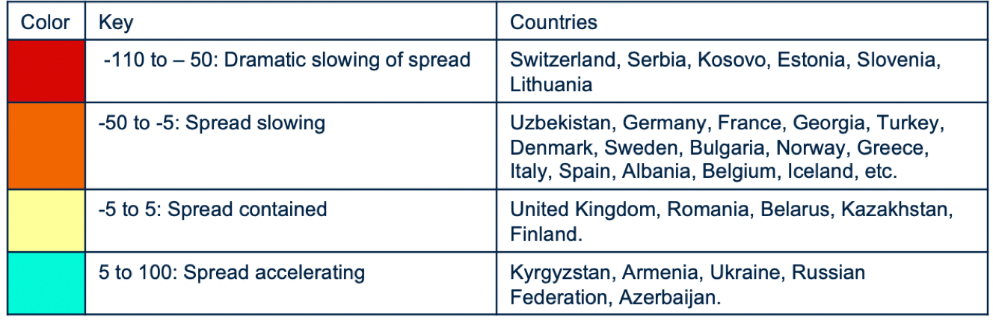
Most recent two-week span: trends in new cases per 100,000 population
•The spread continues to slow or be contained in most countries in the region.
• However, there were dramatic increases in the incidence of new cases relative to the previous week in Armenia (78%), Ukraine (72%) and Russia (62%).
Notes:
([Number of new cases per 100K in week N] – [Number of new cases per 100K in week N-1])/[Number of new cases per 100K in week N-1] in %

Slide 7
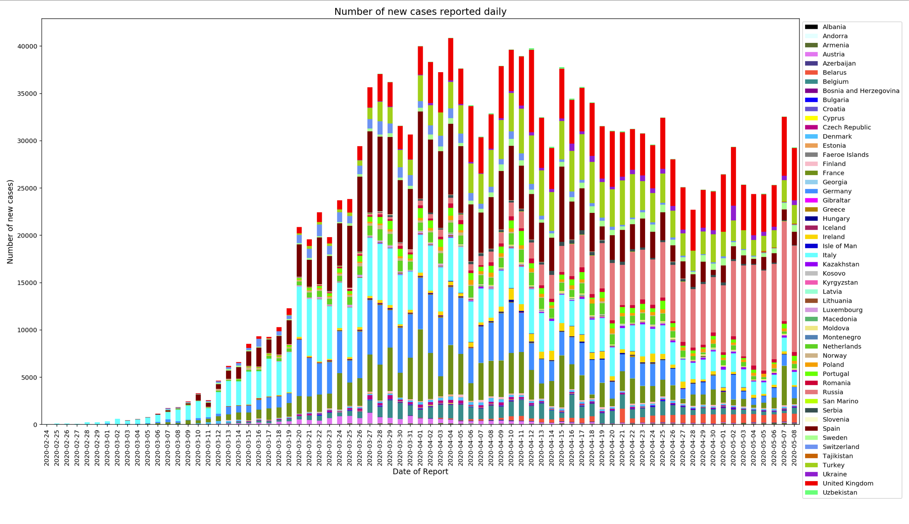
Number of new cases reported daily per 100,000 population
​​
Growth in the number of new cases in Russia and United Kingdom, in absolute terms, and as a proportion of daily new cases in the region.
Decrease in number of new cases in Germany, Italy, Spain and Turkey.

Slide 8
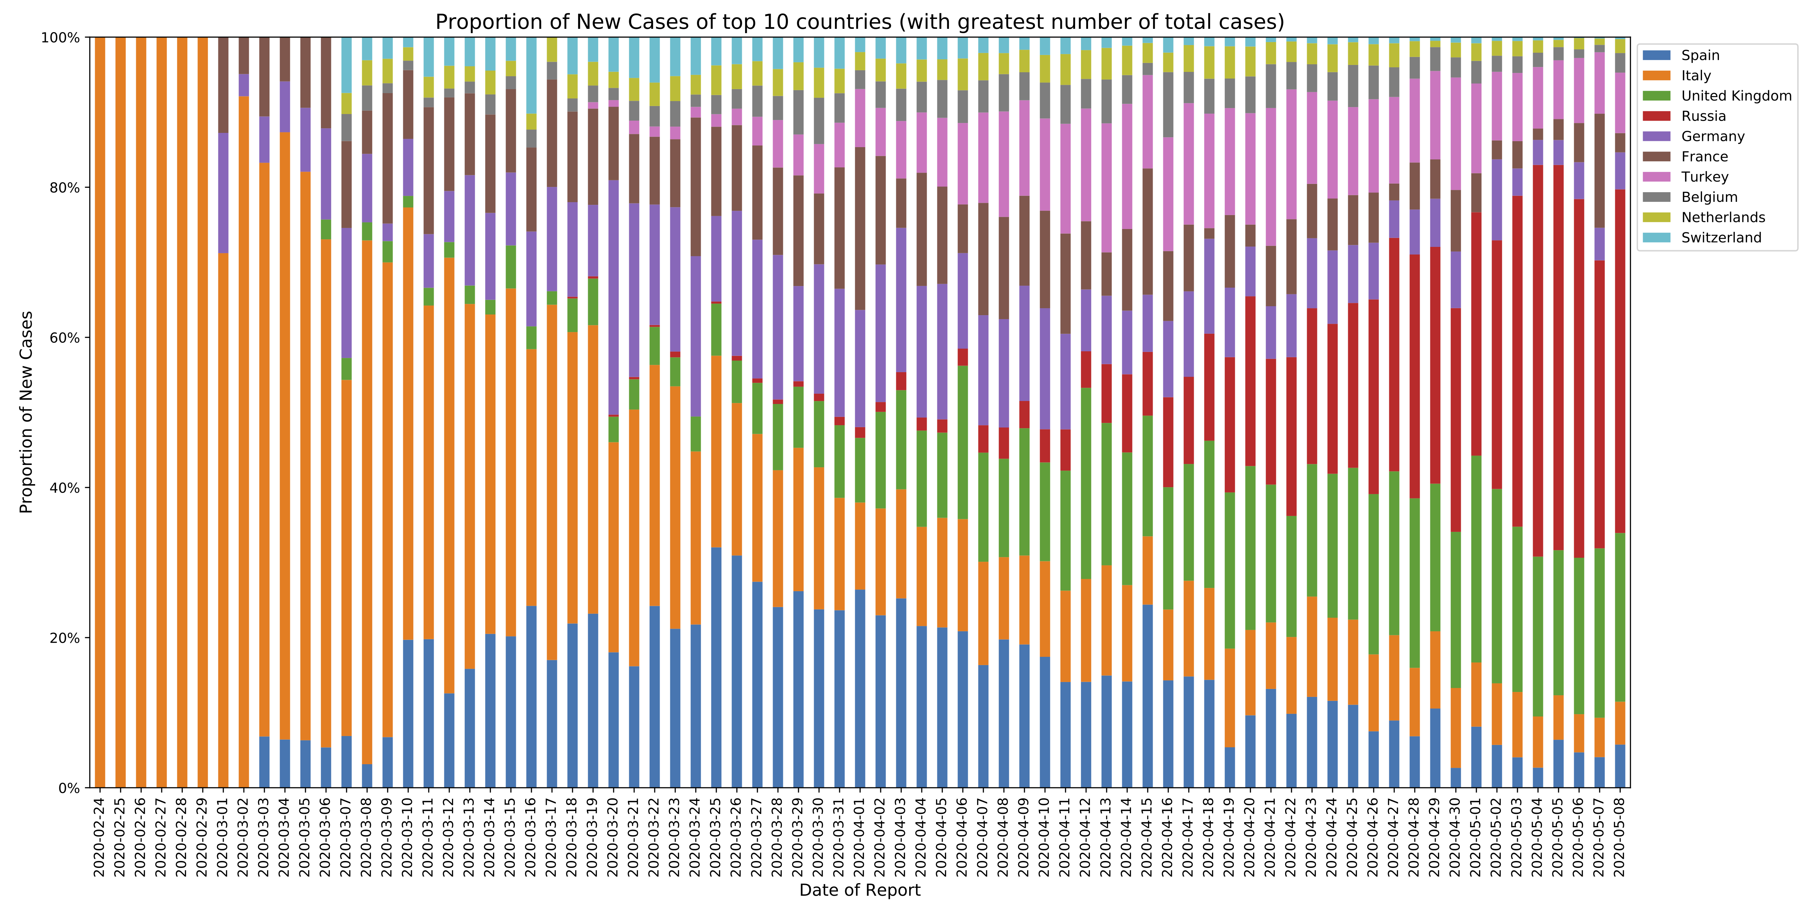
Proportion of new cases in 10 countries with the highest total number of cases
​
Percentage of new cases in Italy, France, Spain and Germany, among the top 10 countries are decreasing.
The percentage of new cases in Russian Federation and United Kingdom is increasing.​
​​

