Slide 1
Update on 2019-nCoV
6 February 2020

Slide 2
Current Situation
(As of 6 Feb, 6AM Geneva Time)
Updates from last 24 hours
China:
  3,697 new confirmed cases (81%, 2,987 cases from Hubei)
  640 severe cases and 73 deaths (70 in Hubei)
  5,328 new suspected cases
Outside China:
  25 new confirmed cases: Japan (12), Republic of Korea (5), Singapore (4), Malaysia (2), Australia (1), USA (1)
Between 31 December 2019 – 6 February 2020
In total, 28,276 confirmed cases including 565 deaths globally
China
  28,060 confirmed cases
    3,859 severe cases
    564 deaths (97% in Hubei Province)
Outside China
  216 cases from 24 countries
    1 death
Notes:
https://docs.google.com/presentation/d/1JsuYUr0As6_-rmbADXRnYR1M0xEWgsMobw6pg98ZVpk/edit#slide=id.g6dd55b928a_3_18

Slide 3
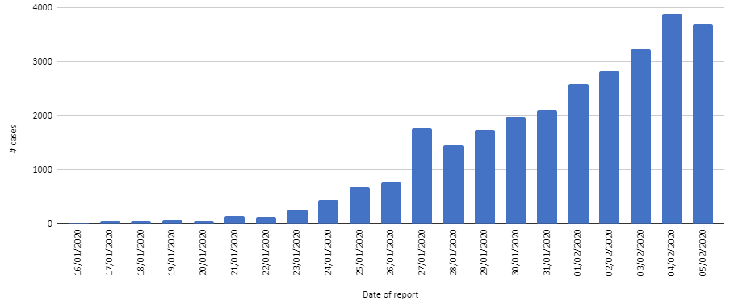
Number of reported confirmed cases in China by day of report
Summary (6 February 6AM)

Slide 4
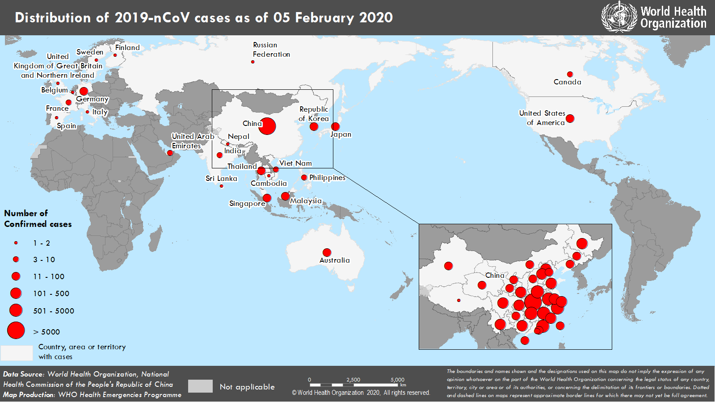

Slide 5
A global Strategic Response Plan
Rapidly establish global/regional coordination and operational support platforms
Support high risk/high vulnerability countries to:
  Identify appropriate coordination mechanism and key technical/operational partners at country level
  Map existing pandemic preparedness capacity/programmes and key gaps based on needs outlined above
  Engage with country level partners including UN country team and local donors to rapidly scale support to national systems to address key gaps
  Establish monitoring mechanisms for key performance indicators
Accelerate priority research and innovation

