Slide 1
Update on 2019-nCoV
7 February 2020

Slide 2
Current Situation (As of 07 Feb, 6AM Geneva Time)
Between 31 Dec 2019 - 07 Feb 2020
In total, 31,481 confirmed cases including 638 deaths globally
China
  31,211 confirmed cases
  4,821 severe cases
  637 deaths: (Hubei Province(618), Heilongjiang(3), Henan(3), Chongqing(2), Hainan(2), Beijing (1), Guizhou(1), Guangdong (1), Hebei (1), Hong Kong SAR (1), Jilin (1), Shanghai(1), Sichuan(1), Tianjin(1))
Outside China
  270 cases from 24 countries
  1 death
Updates from last 24 hours
China:
  3,151 new confirmed cases: 78% (2447 from Hubei)
  962 severe cases and 73 deaths (Hubei (69), Jilin (1), Henan (1), Guangdong (1), and Hainan (1)
  4,833 new suspected cases
Outside China:
  54 new confirmed cases: International conveyance (Japan)(41), Viet Nam(2), Singapore(2), Malaysia(2), Canada(2), United Kingdom(1), Republic of Korea(1), Italy(1), Germany(1), Australia(1)

Slide 3
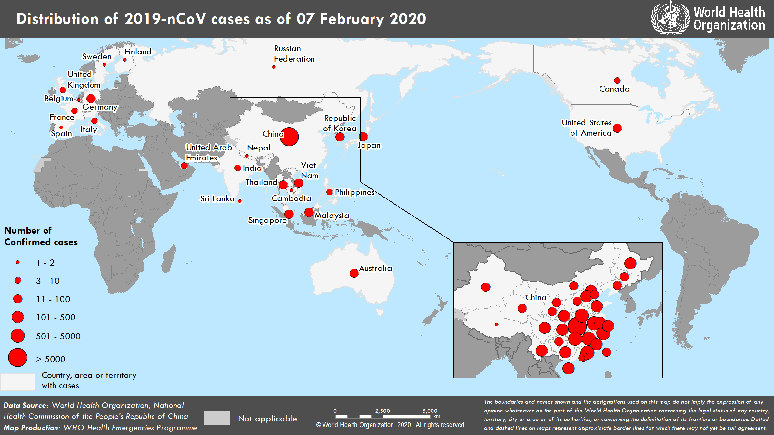

Slide 4
Number of reported confirmed cases in China by day of report
Summary (7 February 6AM)

Slide 5
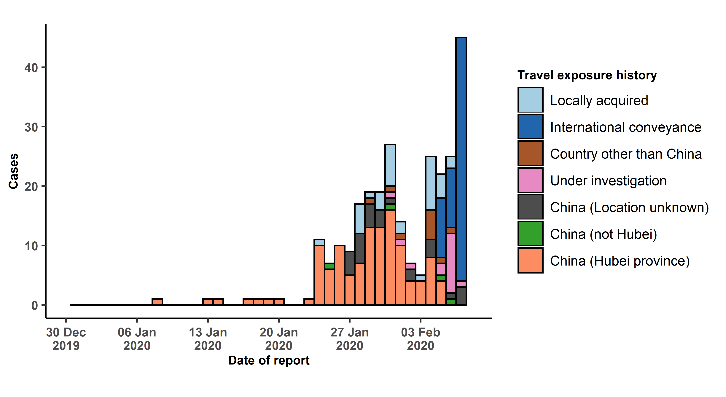
Number of Cases of 2019-nCoV Reported Outside of China by Travel History

Slide 6
Priorities for stopping transmission and mitigating the impact of 2019-nCoV globally
Limit human-to-human transmission
  Reduce secondary infections amongst close contacts and health care workers
  Prevent transmission amplification events and super spreading events
  Prevent further international spread
Identify, isolate and care for patients early
  Equip countries to detect, isolate and care for infected patients
  Provide optimized care
Reduce transmission from animal source
  Identify animal source(s) and limit exposure
Address critical unknowns
  Clinical severity, extent of transmission and infection, treatment options, diagnostics, therapeutics and vaccines
Communicate critical risk and event information to all communities & countering misinformation
Minimize social and economic impact through multisectoral partnerships

Slide 7
Laboratory & diagnostics support
Referral Testing Support for 2019-nCoV
Armed Forces Research Institute of Medical Sciences, Thailand
Erasmus Medical Center, The Netherlands
Hong Kong University, Hong Kong SAR, China
Institute of Tropical Medicine, Nagasaki University, Japan
National Consultant Laboratory for Coronaviruses, Institute of Virology, Charité, and WHO Collaborating Centre for Emerging Infections and Biological Threats, Robert Koch
National Institute for Communicable Diseases, South Africa
National Institute of Health, Thailand
National Institute of Virology, India
National Public Health Laboratory, Singapore
Institut Pasteur Dakar, Senegal
Institut Pasteur, Paris
Public Health England, UK
State Research Center for Virology and Biotechnology, Vector Institute, Russia
United States Center for Disease Control and Prevention, USA
Victorian Infectious Diseases Reference Laboratory, Australia
Global WHO laboratory network
International system of referral laboratories for 2019-nCoV
  aligned with existing capacity and networks including influenza network of labs
  WHO collaborating centers and
  participants from the Global Laboratory Alliance for the Diagnosis of High threat Pathogens (GLAD-HP)
Support with national capacity building and training
250,000 tests being shipped to 159 laboratories across all WHO regions
Laboratory research and development on 2019-nCoV

Slide 8
Clinical management for 2019-nCoV acute respiratory disease
To date, there is no known effective antiviral for 2019-nCoV
  Despite this, some member states are using repurposed antivirals under compassionate use
  A randomized clinical trial is ongoing in China testing lopinavir/ritonavir, with results expected within one month
Current standard of care depends on severity of disease
  WHO is working to ensure that ICU interventions are done safely
  Interim guidance and training materials are available
In preparation for the WHO and GLOPID-R supported Global research summit (11-12 Feb)
  WHO is convening global clinical research experts to develop a prioritized research agenda for clinical management
Ensure optimized standard of care at hospital level
  Implement triage/IPC, monitoring, oxygen, and safe ICU interventions
  Get prepared to enroll into clinical trials when master protocol becomes available

Slide 9
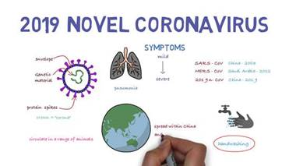
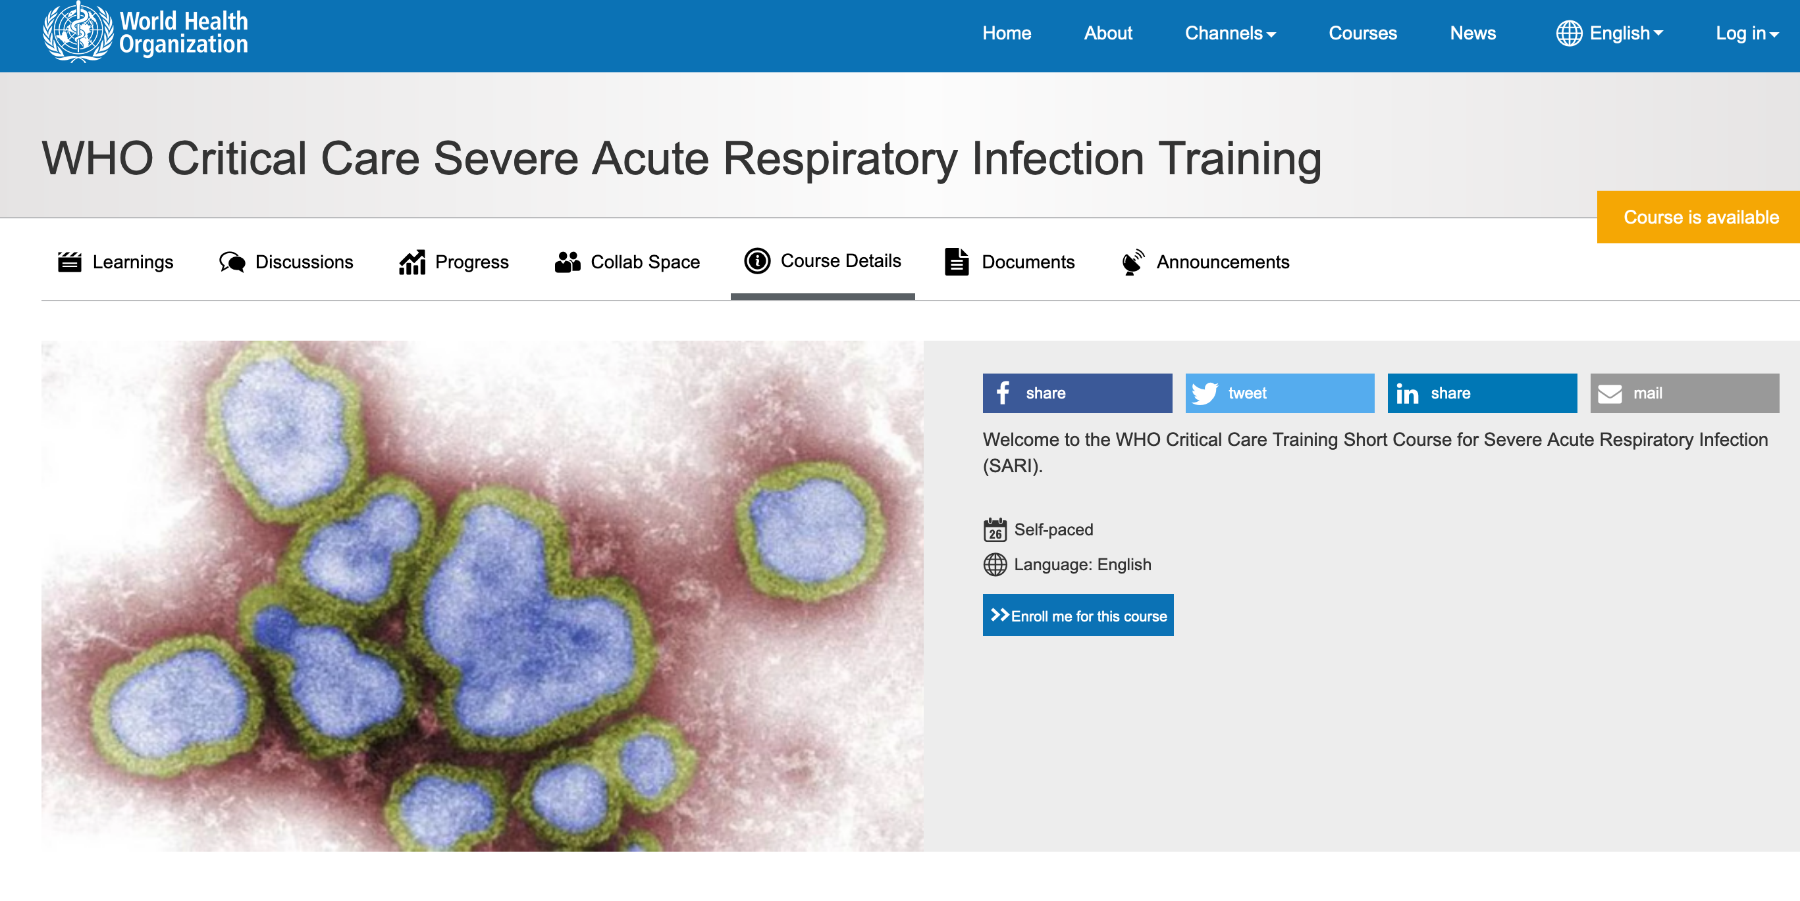
2019-nCoV Training Materials
Published Trainings
Emerging respiratory viruses, including 2019-nCoV: methods for detection, prevention, response and control published 26th Jan https://openwho.org/courses/introduction-to-ncov
  26000 registered users
WHO Critical Care Severe Acute Respiratory Infection course published 7th Feb https://openwho.org/courses/severe-acute-respiratory-infection
  3500 users registered in 24 hours
In the Pipeline (February)
ePROTECT for respiratory diseases – Occupational Health and Safety briefing
Introduction for Go.Data - an outbreak investigation tool for field data collection
Introduction to laboratory diagnostics and kits
French and Spanish versions of already published courses

Slide 10
Translation of WHO Guidance

