Slide 1
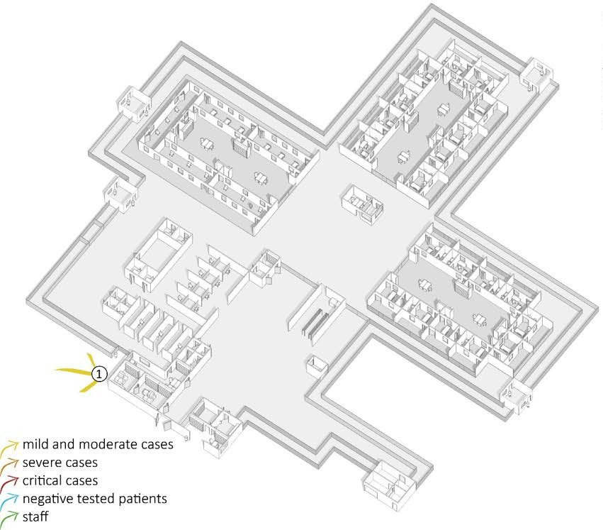
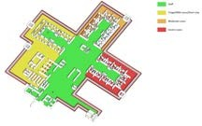
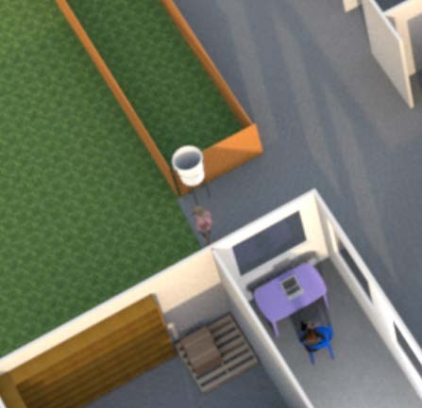

Patient’s flow
Patient’s entry
NOTE: Patients have already been triaged in another medical facility and are referred to the SARI treatment center.
At this point, all patients:
  receive a mask;
  wash their hands; and
  are directed to a dedicated individual booth in the waiting room.
programme

Slide 2
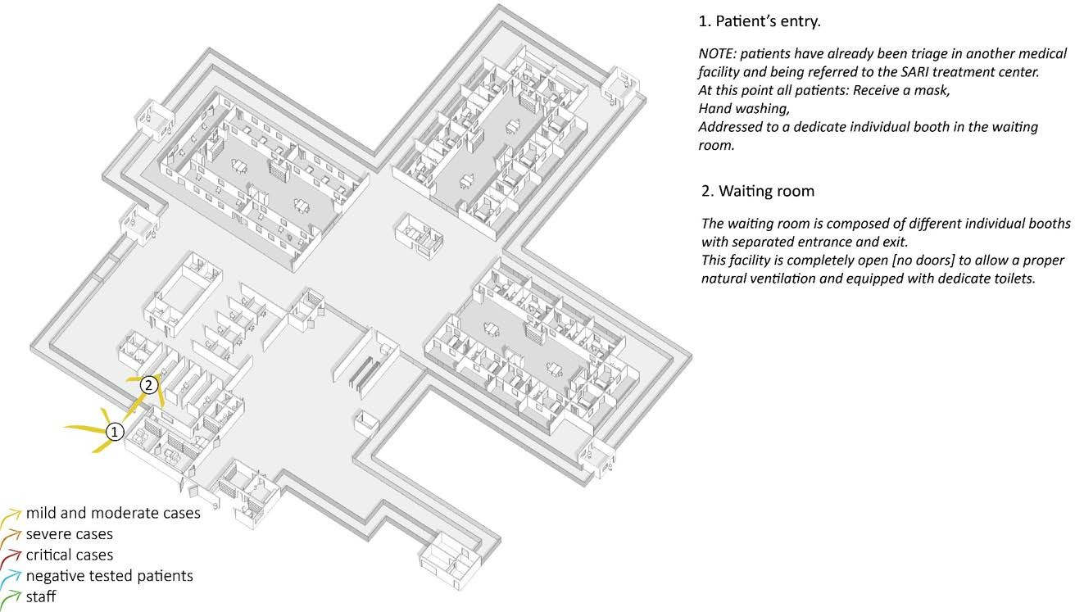
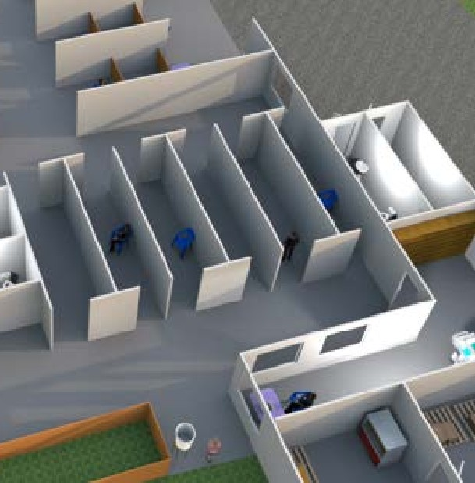
Patient’s flow
2. Waiting room
The waiting room is composed of
different individual separated entrances
booths with and exits. This
facility is completely open [no doors] to allow a proper natural ventilation and is equipped with dedicated toilets.
programme

Slide 3
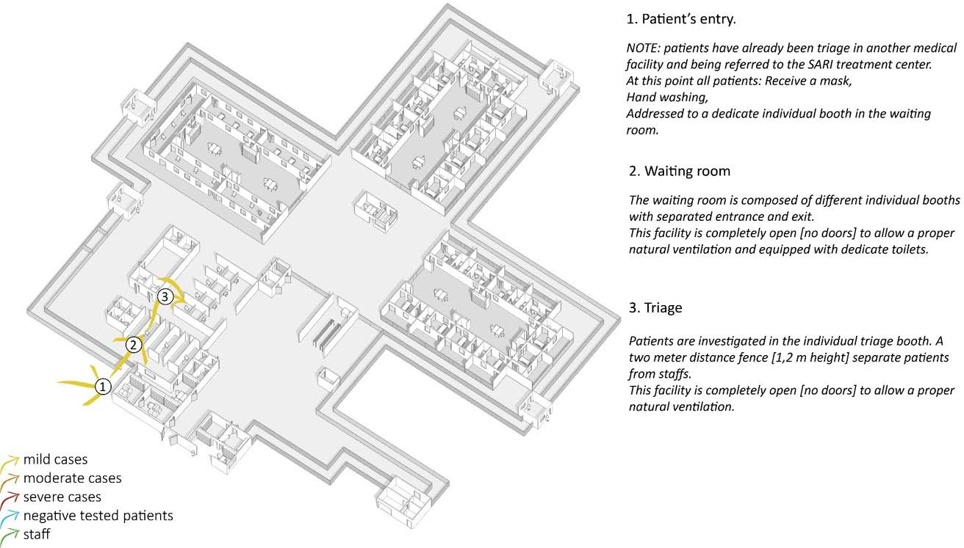
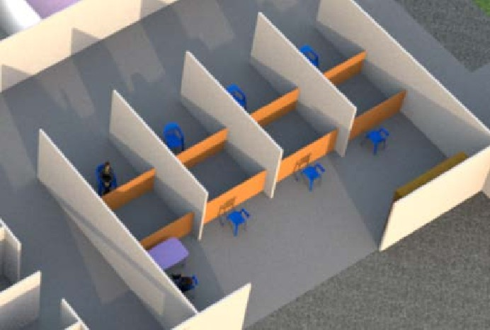
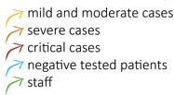
Patient’s flow
3. Triage
Patients are investigated in an individual triage booth. A one (1) meter distance fence [1.2 meter high] separates patients from staff. This facility is completely open [no doors] to allow a proper natural ventilation and is equipped with dedicated toilets.
programme

Slide 4
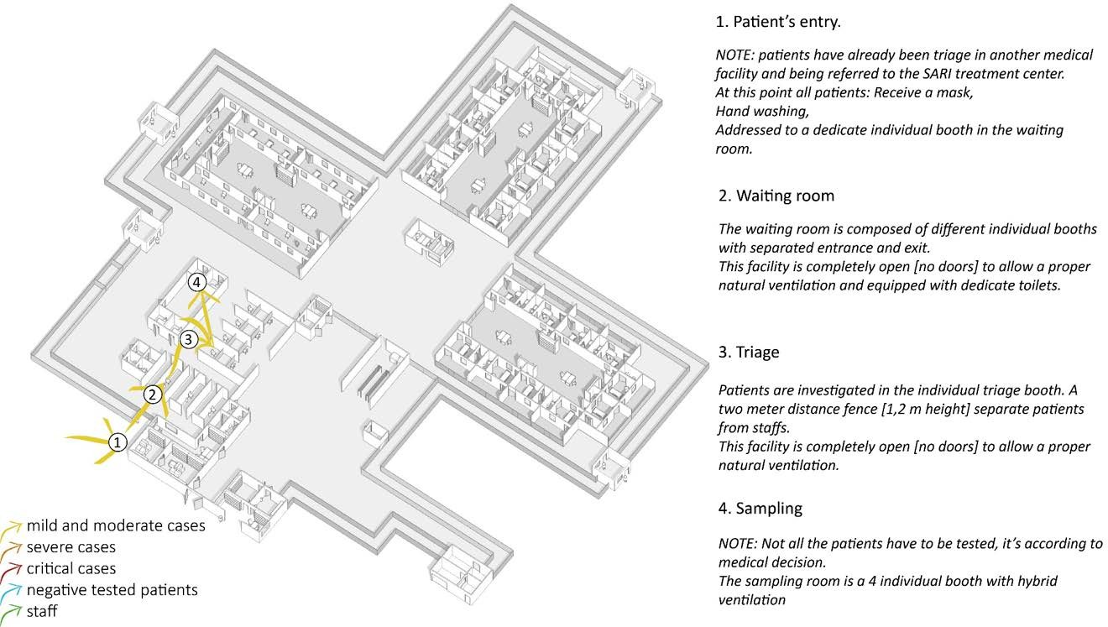
Patient’s flow
4. Sampling
The sampling room has four (4) individual booths with natural or hybrid ventilation.
NOTE: Not all of the patients have been tested, this is according to medical decision.
programme
Notes:
.

Slide 5
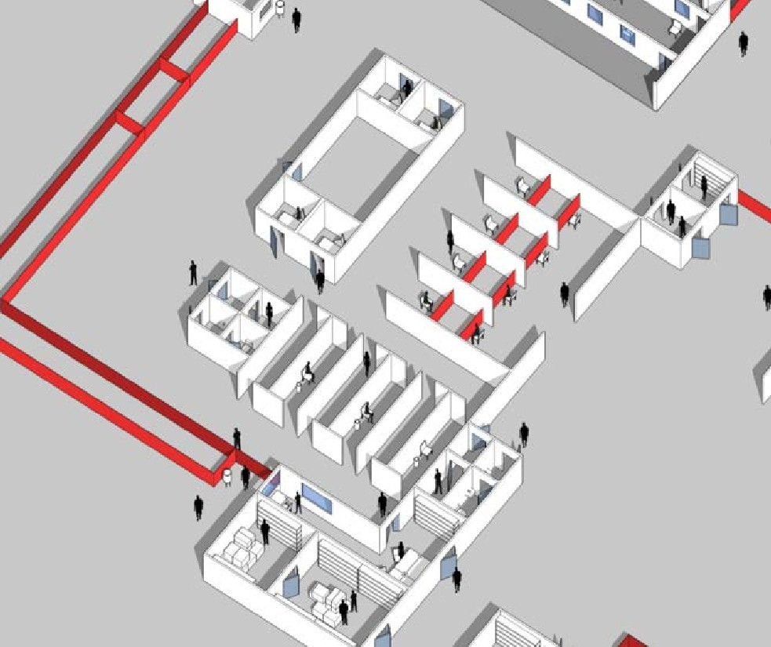

Patient’s flow
1. Patient entry
1
programme

Slide 6

Patient’s flow
Patient entry
Reception/screening
1
2
programme

Slide 7

Patient’s flow
Patient entry
Reception/screening
Waiting room
3
1
2
programme

Slide 8
Patient’s flow
Patient entry
Reception/screening
Waiting room
Patient toilets
4
3
1
2
programme

Slide 9
Patient’s flow
Patient entry
Reception/screening
Waiting room
Patient toilets
Triage
4
5
3
1
2
programme

Slide 10

Patient’s flow
Patient entry
Reception/screening
Waiting room
Patient toilets
Triage
Sampling rooms
6
4
5
3
1
2
programme

Slide 11
Patient’s flow
Patient entry
Reception/screening
Waiting room
Patient toilets
Triage
Sampling rooms
Ambulance entrance
7
6
4
5
3
1
2
programme

Slide 12

Patient’s flow
Patient entry
Reception/screening
Waiting room
Patient toilets
Triage
Sampling rooms
Ambulance entrance
Donning/doffing
7
6
8
4
5
3
1
2
programme

Slide 13

Patient’s flow
Patient entry
Reception/screening
Waiting room
Patient toilets
Triage
Sampling rooms
Ambulance entrance
Donning/doffing
Single fence
[1.2 meter high] is to
identify the centre area*
7
6
8
9
4
5
3
1
2
HEALTH
Recommended spatial distance for IPC is 1 meter. However, in order to facilitate access and movement of health-care workers, 2 meters separation is advised.
EMERGENCIES
programme

Slide 14
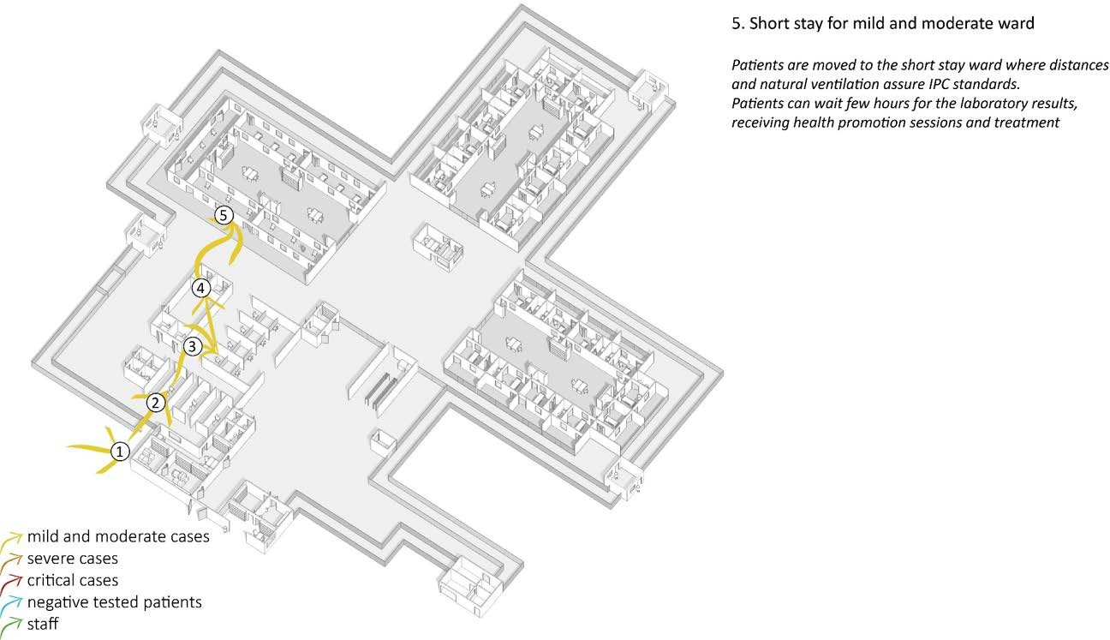
Patient’s flow
5. Short stay for mild and moderate cases
Patients are moved to the short stay ward where distances and natural ventilation assure IPC standards. Patients can wait a few hours for the laboratory results and receive health promotion sessions and treatment.
programme

Slide 15
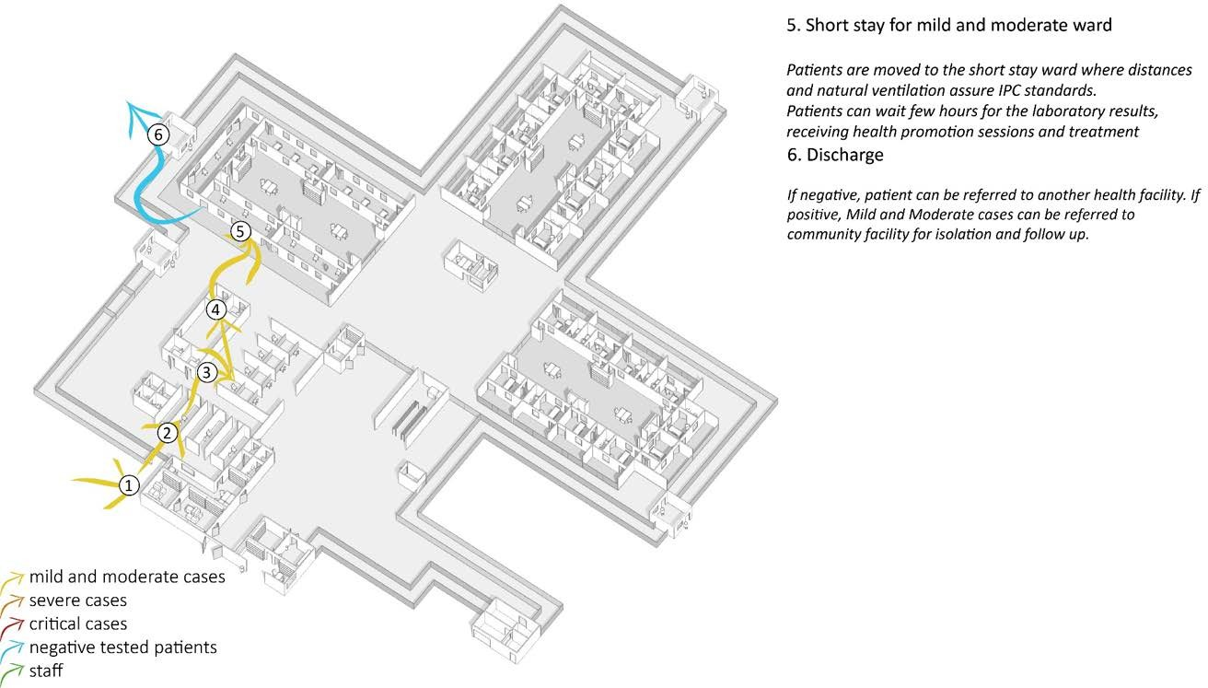
Patient’s flow
6. Discharge
If negative, patients can be referred to another health facility. If positive, Mild and Moderate cases can be referred to community facilities for isolation and follow-up.
programme

Slide 16
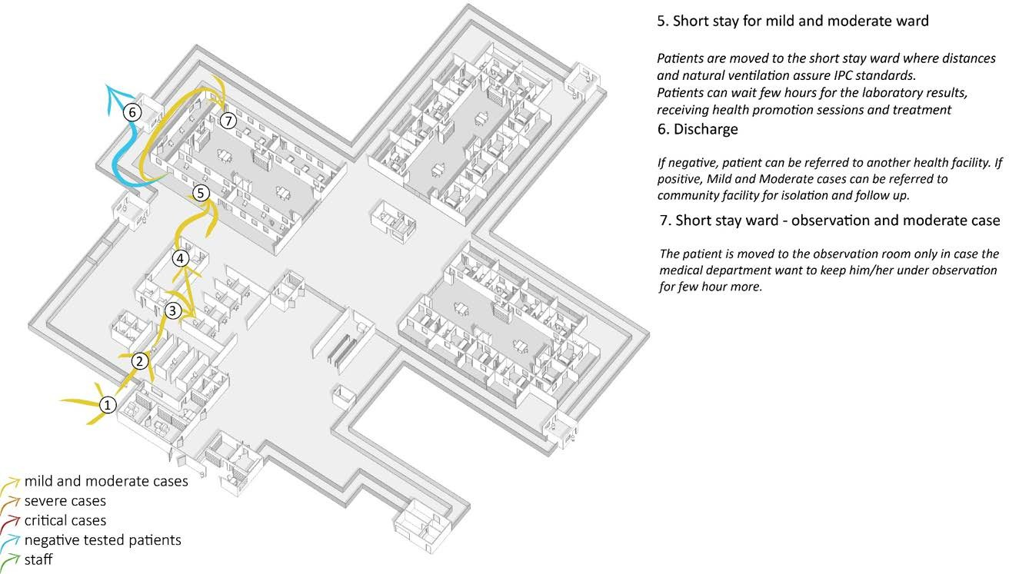
Patient’s flow
7. Short stay ward – Observation and moderate case
The patient is moved to the observation room only in such cases where the medical department wants to keep him/her under observation for a few more hours.
programme

Slide 17
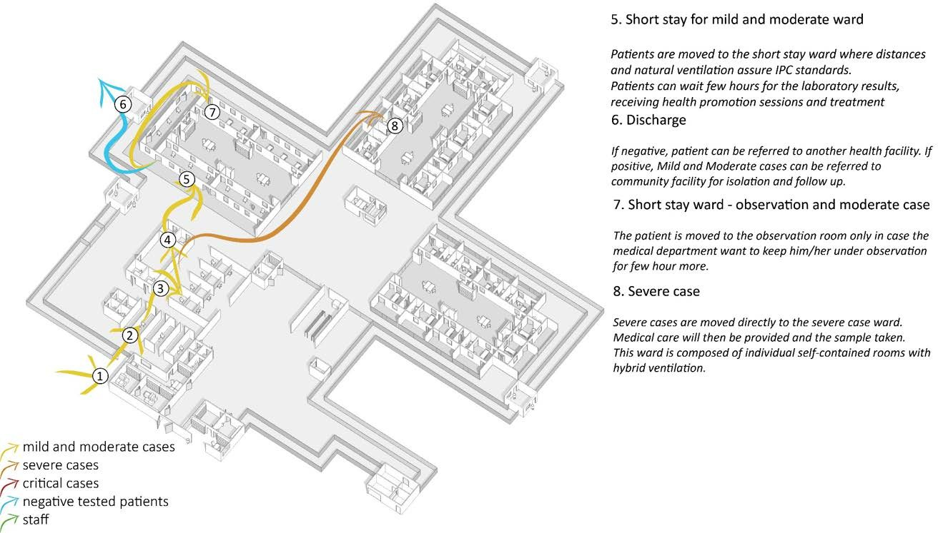
Patient’s flow
8. Severe case
Severe cases are moved directly to the severe case ward. Medical care will then be provided and a sample taken. This ward is composed of individual self- contained rooms with hybrid ventilation.
programme

Slide 18
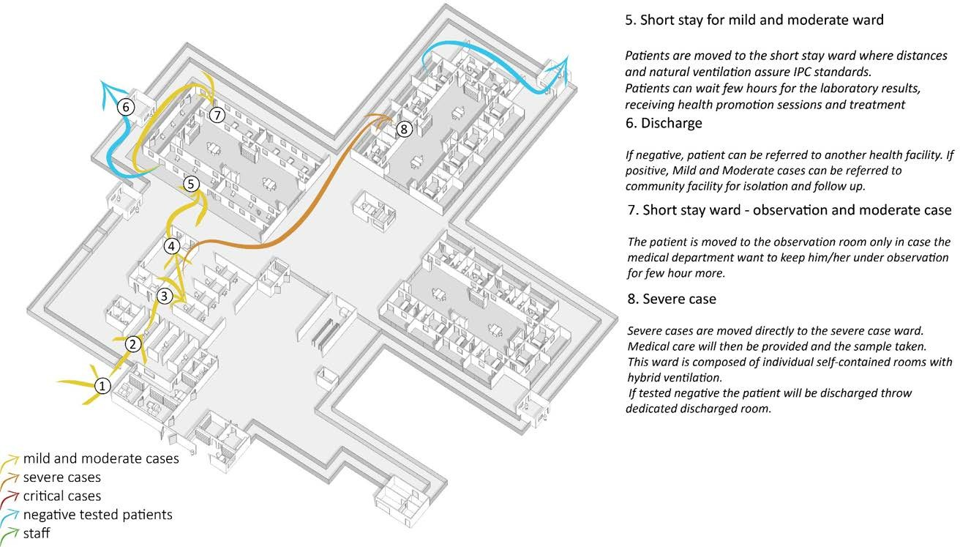
Patient’s flow
8. Severe case
Severe cases are moved directly to the severe case ward. Medical care will then be provided and a sample taken. This ward is composed of individual self- contained rooms with hybrid ventilation.
If tested negative, the patient will be discharged through a dedicated discharge room.
programme

Slide 19
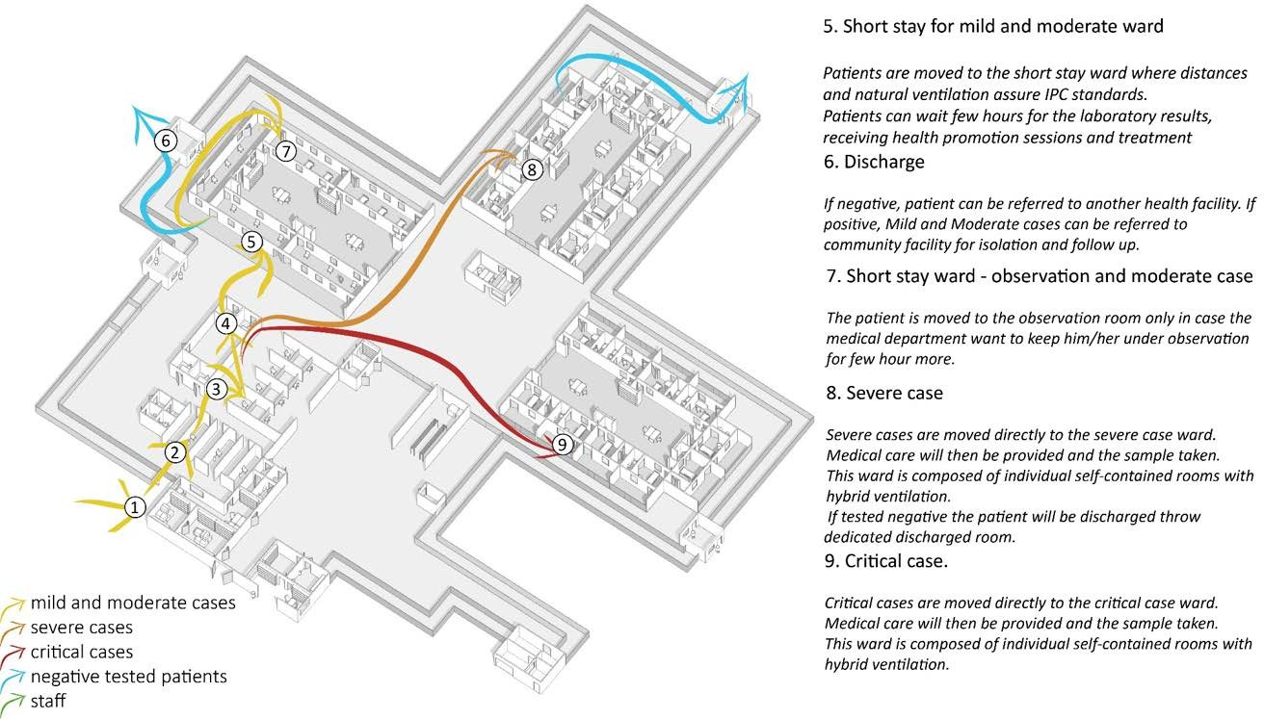
Patient’s flow
9. Critical case
Critical cases are moved directly to the critical case ward. Medical care will then be provided and a sample taken. This ward is composed of individual self- contained rooms with hybrid ventilation.
programme

Slide 20
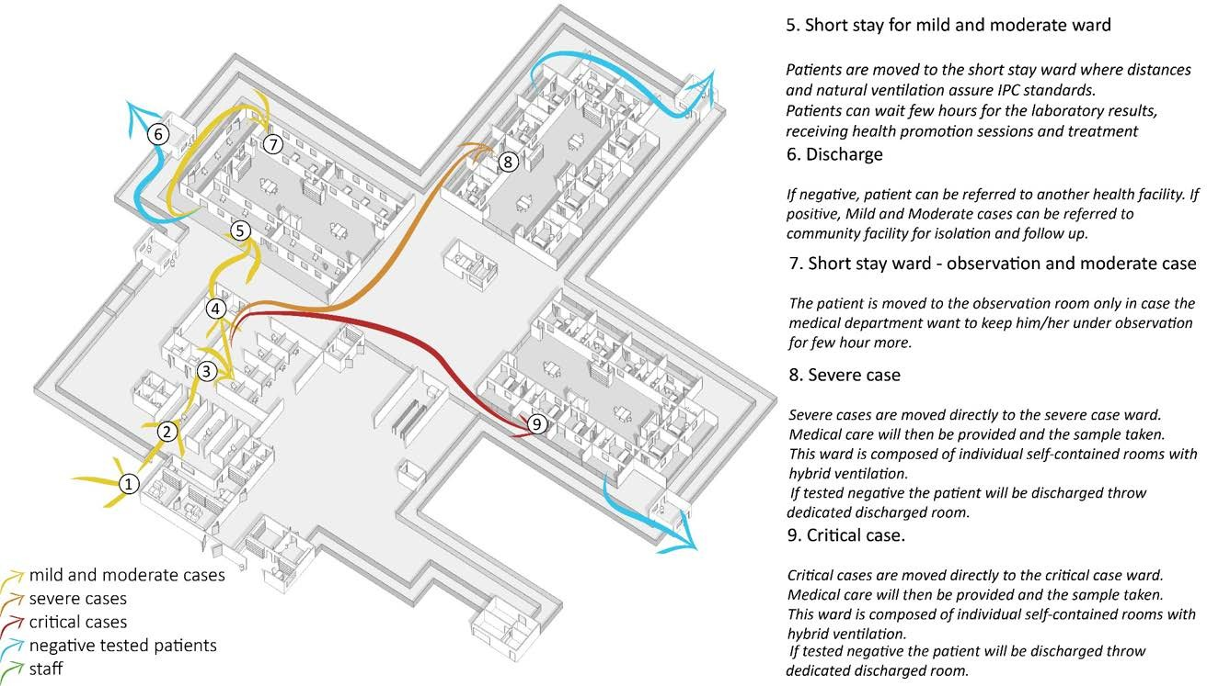
Patient’s flow
9. Critical case
Critical cases are moved directly to the critical case ward. Medical care will then be provided and a sample taken. This ward is composed of individual self- contained rooms with hybrid ventilation.
If tested negative, the patient will be discharged through a dedicated discharge room.
programme

Slide 21
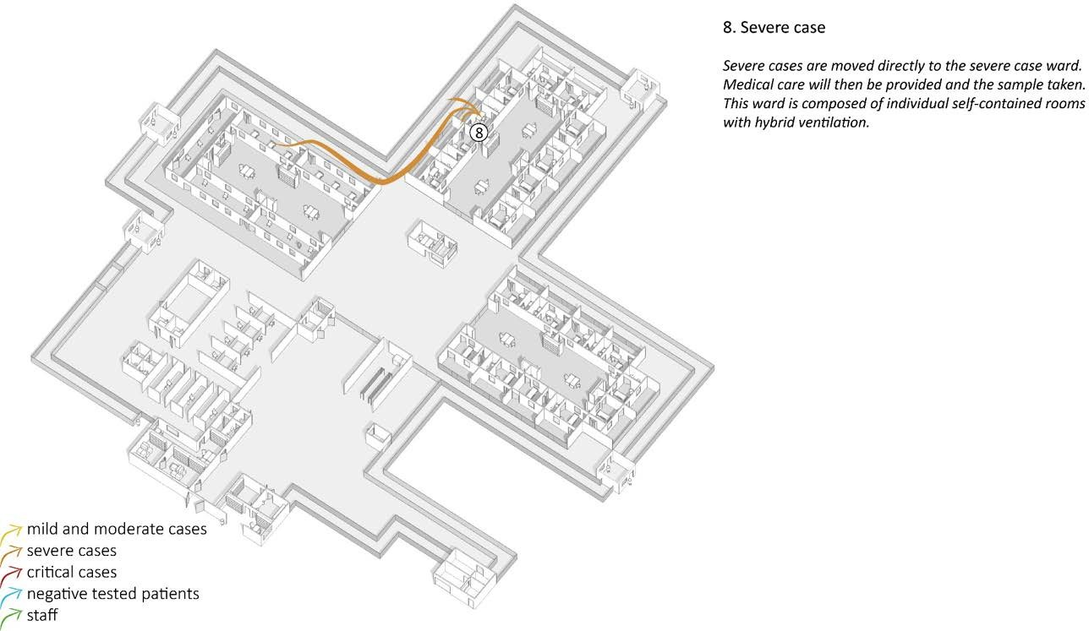
Patient’s flow – Worsening & improving medical condition
Patient journey
Patient’s flow is not unidirectional as, according to medical conditions, patients can be moved from one ward to another.
For, instance a moderate patient’s condition can deteriorate, resulting in the person being move to the severe ward…
programme

Slide 22
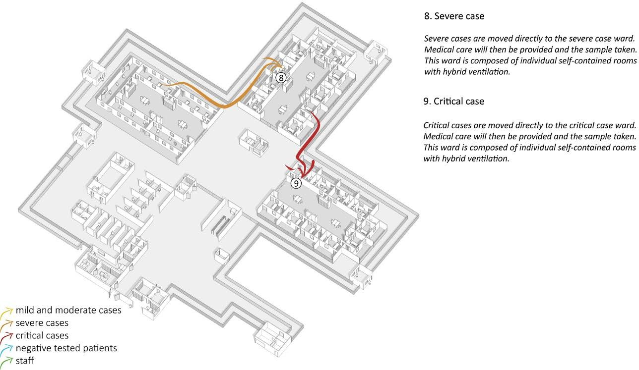
Patient’s flow – Worsening & improving medical condition
Patient journey
Patient’s flow is not unidirectional as, according to medical conditions, patients can be moved from one ward to another.
For, instance a moderate patient’s condition can deteriorate, resulting in the person being move to the severe ward… or to the critical ward.
programme

Slide 23
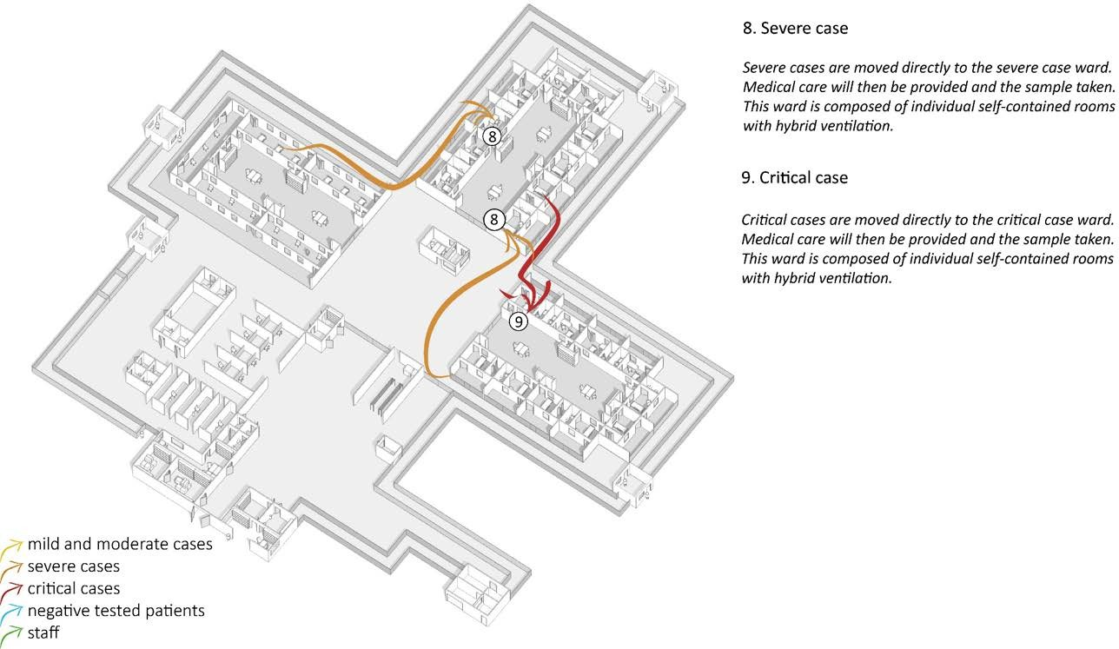
Patient’s flow – Worsening & improving medical condition
Patient journey
Similarly, once medical conditions improve, a patient can be moved to another ward.
For instance, a critical patient’s condition can improve resulting in the person being move to the severe ward…
programme

Slide 24
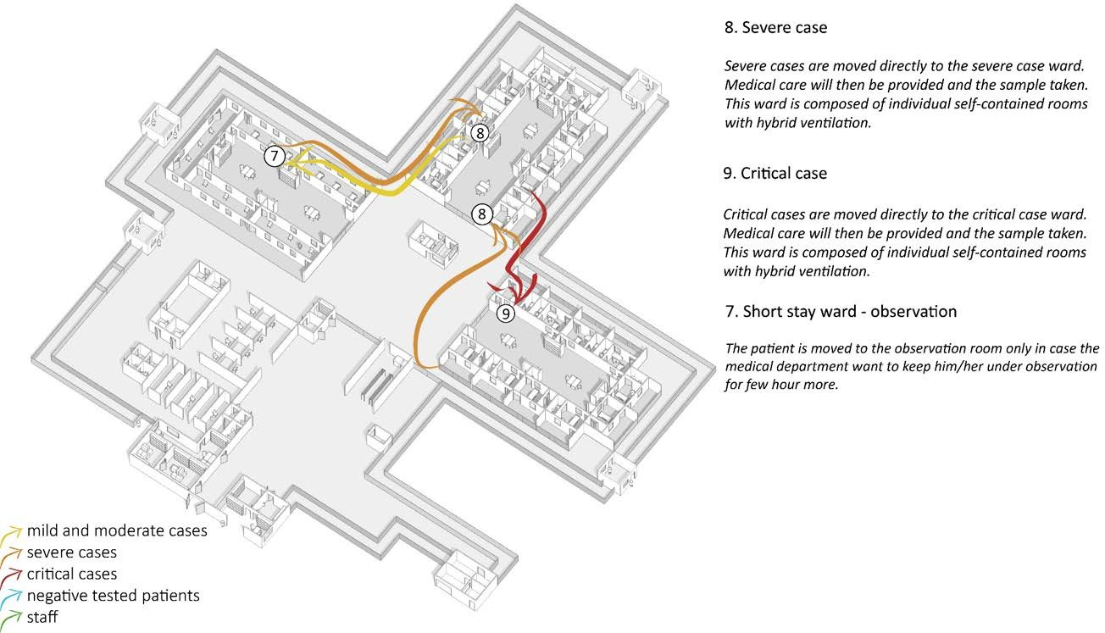
Patient’s flow – Worsening & improving medical condition
Patient journey
Similarly, once medical conditions improve, a patient can be moved to another ward.
For instance, a critical patient’s condition can improve resulting in the person being move to the severe ward… and to the short stay ward…
programme

Slide 25
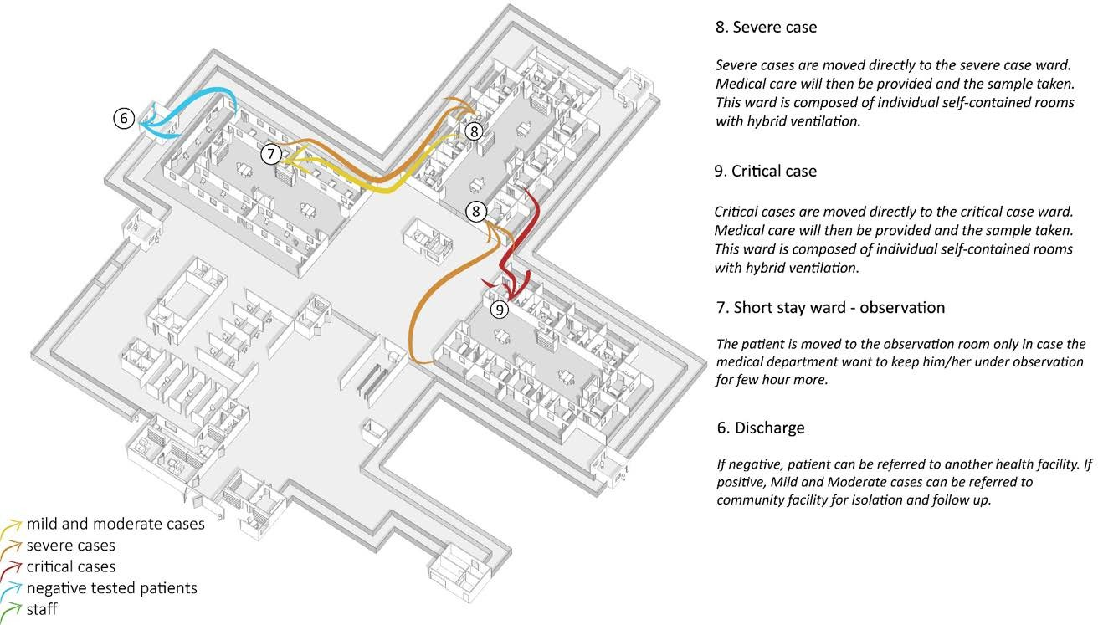
Patient’s flow – Worsening & improving medical condition
Patient journey
Similarly, once medical conditions improve, a patient can be moved to another ward.
For instance, a critical patient’s condition can improve resulting in the person being move to the severe ward… and to the short stay ward…to be finally discharged according to the discharge criteria.
programme

Slide 26
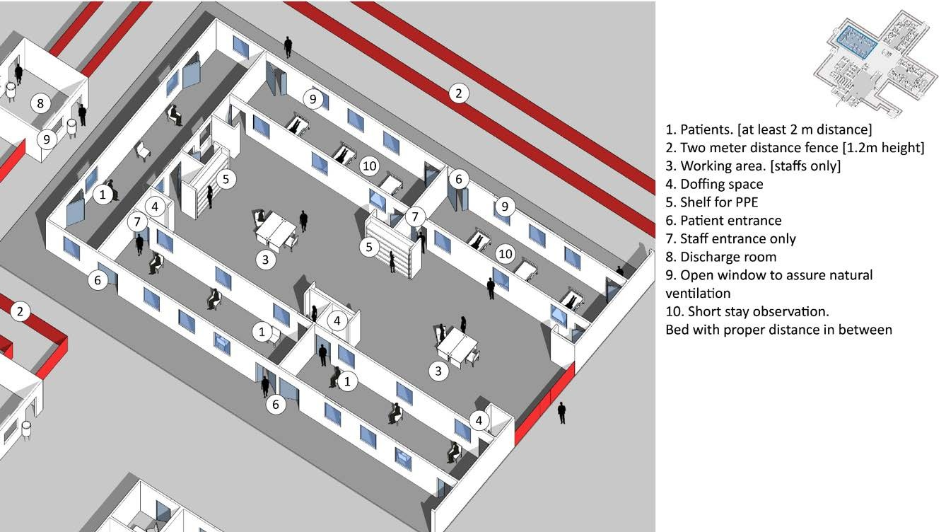
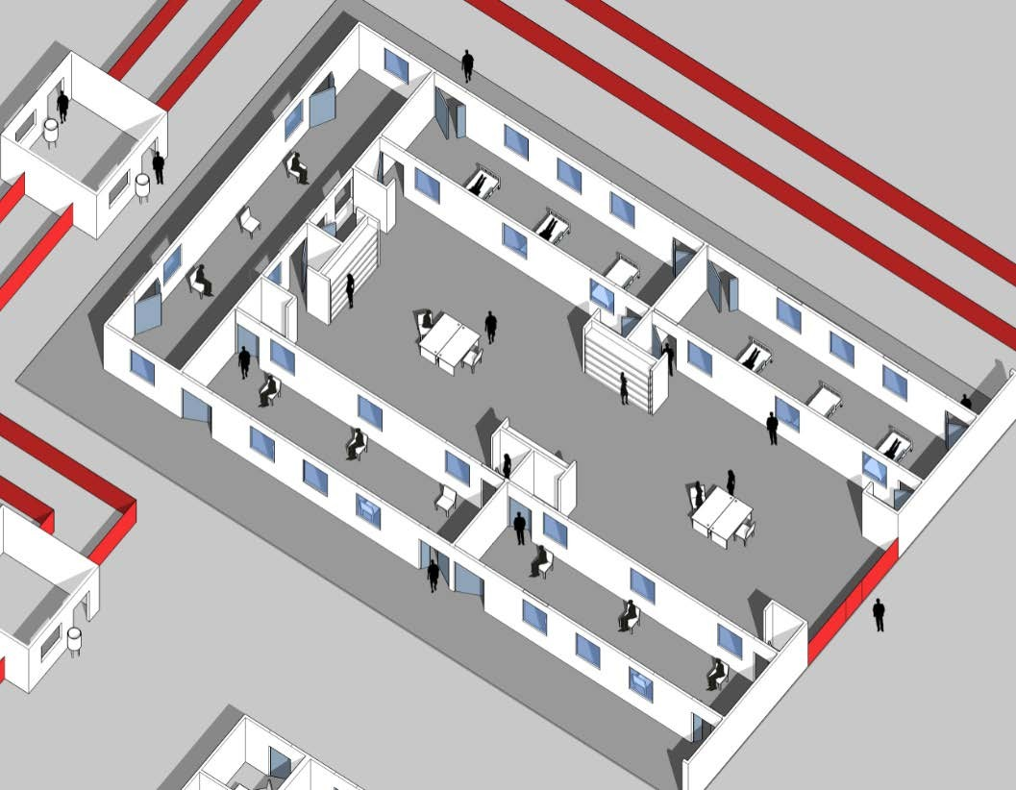
Patient’s flow / mild & moderate cases
programme

Slide 27
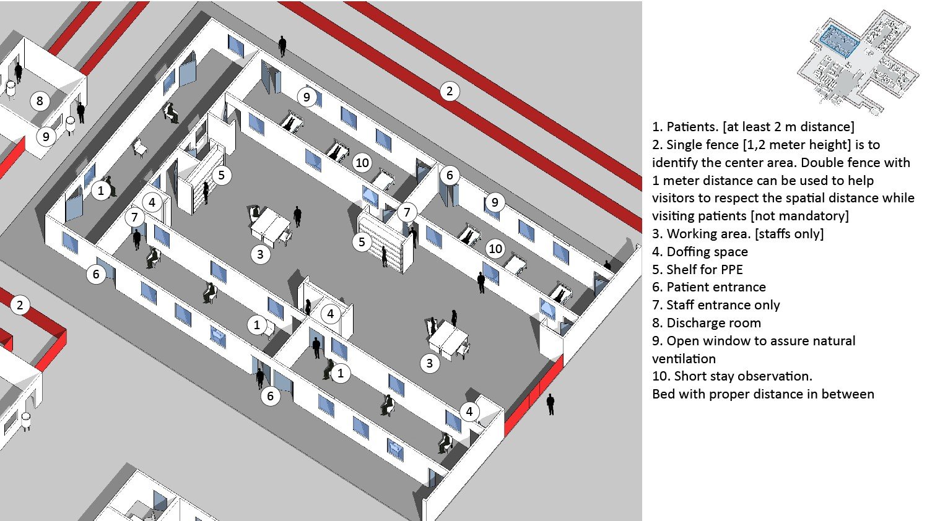

Patient’s flow / mild & moderate cases
1. Patients [2 m distance*]
1
Recommended spatial distance for IPC is 1 meter. However, in order to facilitate access and movement of health-care workers, 2 meters separation is advised.
programme

Slide 28
Patient’s flow / mild & moderate cases
2
Patients [2 m distance*]
Single fence [1.2 meter high] is to identify the centre area. Double fence with 1 meter distance can be used to help visitors to respect the spatial distance while visiting patients [not mandatory]
1
Recommended spatial distance for IPC is 1 meter. However, in order to facilitate access and movement of health-care workers, 2 meters separation is advised.
programme

Slide 29
Patient’s flow / mild & moderate cases
2
Patients [2 m distance*]
Single fence [1.2 meter high] is to identify the centre area. Double fence with 1 meter distance can be used to help visitors to respect the spatial distance while visiting patients [not mandatory]
Working area [Staff only]
3
1
Recommended spatial distance for IPC is 1 meter. However, in order to facilitate access and movement of health-care workers, 2 meters separation is advised.
programme

Slide 30
Patient’s flow / mild & moderate cases
2
Patients [2 m distance*]
Single fence [1.2 meter high] is to identify the centre area. Double fence with 1 meter distance can be used to help visitors to respect the spatial distance while visiting patients [not mandatory]
Working area [Staff only]
Doffing space
4
3
4
1
Recommended spatial distance for IPC is 1 meter. However, in order to facilitate access and movement of health-care workers, 2 meters separation is advised.
programme

Slide 31
Patient’s flow / mild & moderate cases
2
Patients [2 m distance*]
Single fence [1.2 meter high] is to identify the centre area. Double fence with 1 meter distance can be used to help visitors to respect the spatial distance while visiting patients [not mandatory]
Working area [Staff only]
Doffing space
Shelf for PPE
5
4
3
4
1
Recommended spatial distance for IPC is 1 meter. However, in order to facilitate access and movement of health-care workers, 2 meters separation is advised.
programme

Slide 32
Patient’s flow / mild & moderate cases
2
Patients [2 m distance*]
Single fence [1.2 meter high] is to identify the centre area. Double fence with 1 meter distance can be used to help visitors to respect the spatial distance while visiting patients [not mandatory]
Working area [Staff only]
Doffing space
Shelf for PPE
Patient entrance
5
4
3
6
4
1
6
Recommended spatial distance for IPC is 1 meter. However, in order to facilitate access and movement of health-care workers, 2 meters separation is advised.
programme

Slide 33

Patient’s flow / mild & moderate cases
2
Patients [2 m distance*]
Single fence [1.2 meter high] is to identify the centre area. Double fence with 1 meter distance can be used to help visitors to respect the spatial distance while visiting patients [not mandatory]
Working area [Staff only]
Doffing space
Shelf for PPE
Patient entrance
Staff entrance only
7
5
4
3
7
6
4
1
6
Recommended spatial distance for IPC is 1 meter. However, in order to facilitate access and movement of health-care workers, 2 meters separation is advised.
programme

Slide 34

Patient’s flow / mild & moderate cases
8
2
Patients [2 m distance*]
Single fence [1.2 meter high] is to identify the centre area. Double fence with 1 meter distance can be used to help visitors to respect the spatial distance while visiting patients [not mandatory]
Working area [Staff only]
Doffing space
Shelf for PPE
Patient entrance
Staff entrance only
Discharge room
7
5
4
3
7
6
4
1
6
Recommended spatial distance for IPC is 1 meter. However, in order to facilitate access and movement of health-care workers, 2 meters separation is advised.
programme

Slide 35
Patient’s flow / mild & moderate cases
8
2
Patients [2 m distance*]
Single fence [1.2 meter high] is to identify the centre area. Double fence with 1 meter distance can be used to help visitors to respect the spatial distance while visiting patients [not mandatory]
Working area [Staff only]
Doffing space
Shelf for PPE
Patient entrance
Staff entrance only
Discharge room
Windows for natural ventilation
7
5
4
3
7
6
4
9
1
6
9
Recommended spatial distance for IPC is 1 meter. However, in order to facilitate access and movement of health-care workers, 2 meters separation is advised.
programme

Slide 36
Patient’s flow / mild & moderate cases
8
2
10
Patients [2 m distance*]
Single fence [1.2 meter high] is to identify the centre area. Double fence with 1 meter distance can be used to help visitors to respect the spatial distance while visiting patients [not mandatory]
Working area [Staff only]
Doffing space
Shelf for PPE
Patient entrance
Staff entrance only
Discharge room
Windows for natural ventilation
7
5
4
3
7
6
4
9
1
6
9
10. Observation.
Recommended spatial distance for IPC is 1 meter. However, in order to facilitate access and movement of health-care workers, 2 meters separation is advised.
programme

Slide 37
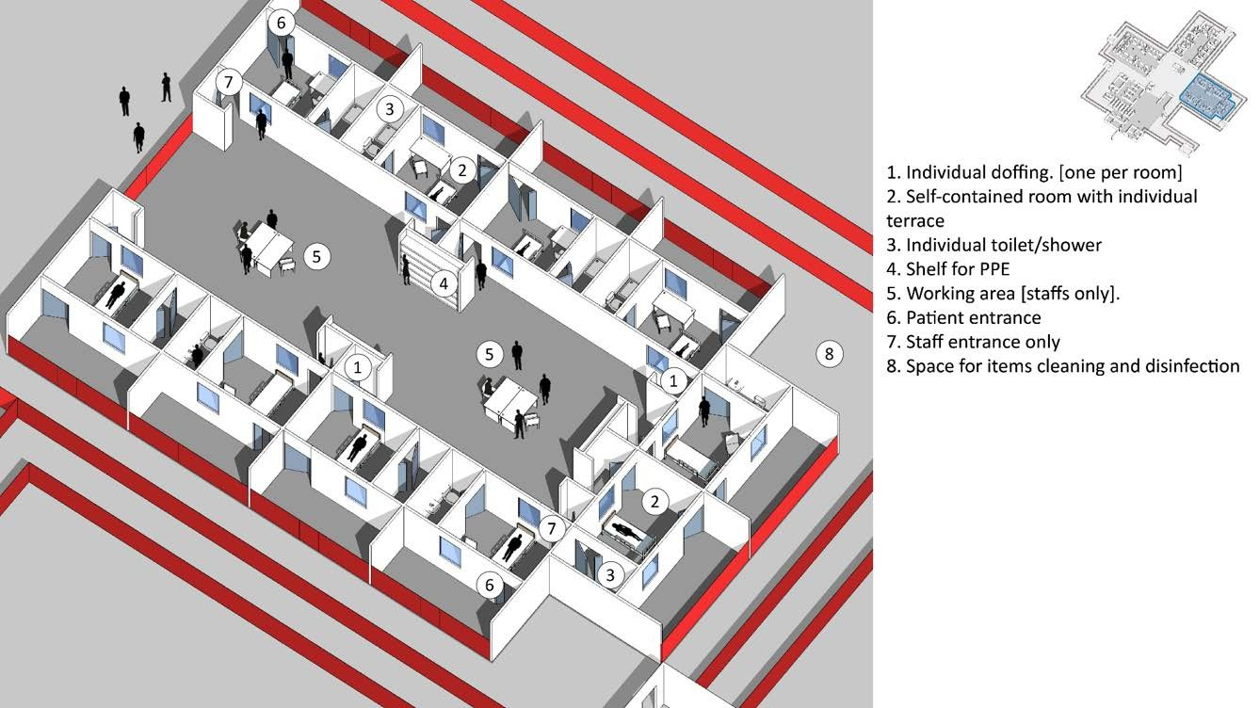
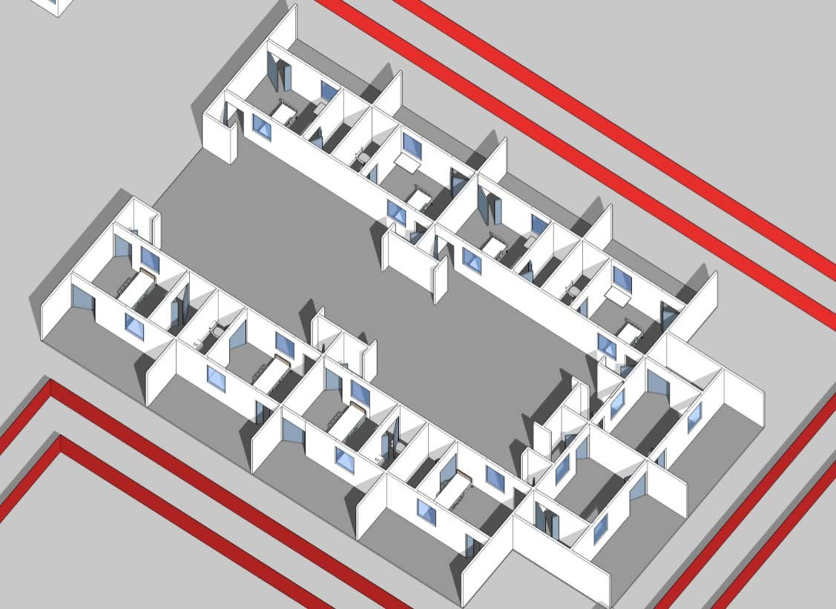
Patient’s flow / severe & critical cases
programme

Slide 38
Patient’s flow / severe & critical cases
1. Individual doffing [one per room]
1
programme

Slide 39
Patient’s flow / severe & critical cases
Individual doffing [one per room]
Self-contained room with individual terrace
1
2
programme

Slide 40
Patient’s flow / severe & critical cases
Individual doffing [one per room]
Self-contained room with individual terrace
Individual toilet/shower
3
1
2
programme

Slide 41
Patient’s flow / severe & critical cases
Individual doffing [one per room]
Self-contained room with individual terrace
Individual toilet/shower
Shelf for PPE
4
3
1
2
programme

Slide 42
Patient’s flow / severe & critical cases
Individual doffing [one per room]
Self-contained room with individual terrace
Individual toilet/shower
Shelf for PPE
Working area [Staff only]
5
4
3
1
2
programme

Slide 43
Patient’s flow / severe & critical cases
Individual doffing [one per room]
Self-contained room with individual terrace
Individual toilet/shower
Shelf for PPE
Working area [Staff only]
Patient entrance
5
4
3
1
6
2
programme

Slide 44
Patient’s flow / severe & critical cases
7
Individual doffing [one per room]
Self-contained room with individual terrace
Individual toilet/shower
Shelf for PPE
Working area [Staff only]
Patient entrance
Staff entrance only
5
4
3
1
6
2
programme

Slide 45
Patient’s flow / severe & critical cases
7
Individual doffing [one per room]
Self-contained room with individual terrace
Individual toilet/shower
Shelf for PPE
Working area [Staff only]
Patient entrance
Staff entrance only
Space for cleaning and disinfection of items.
5
4
3
1
6
8
2
programme

Slide 46
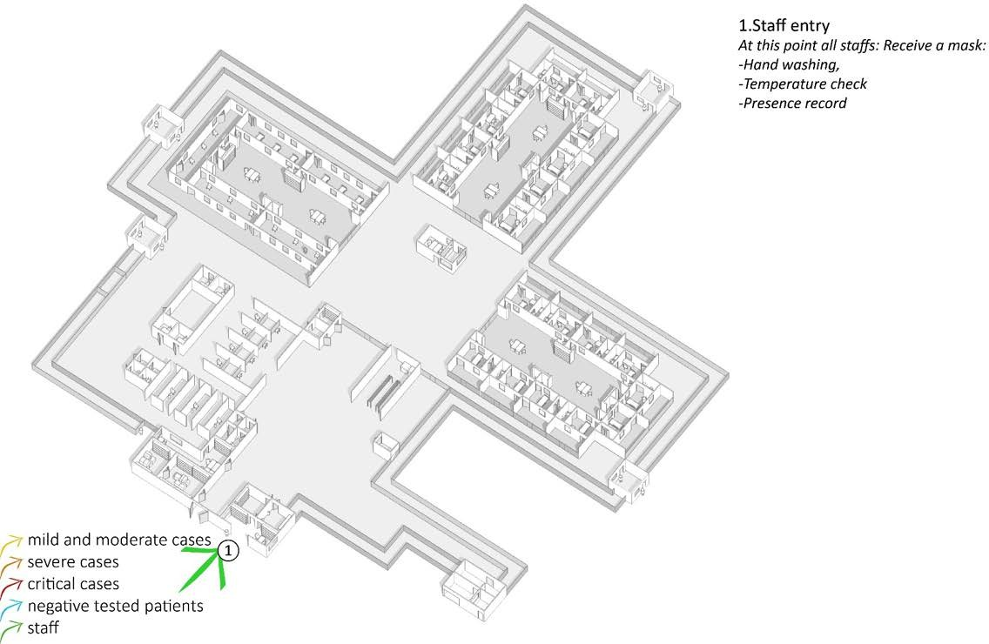
Staff’s flow
Staff entry
At this point all staff:
  receive a mask;
  wash their hands;
  check temperature;
  record presence.
programme

Slide 47
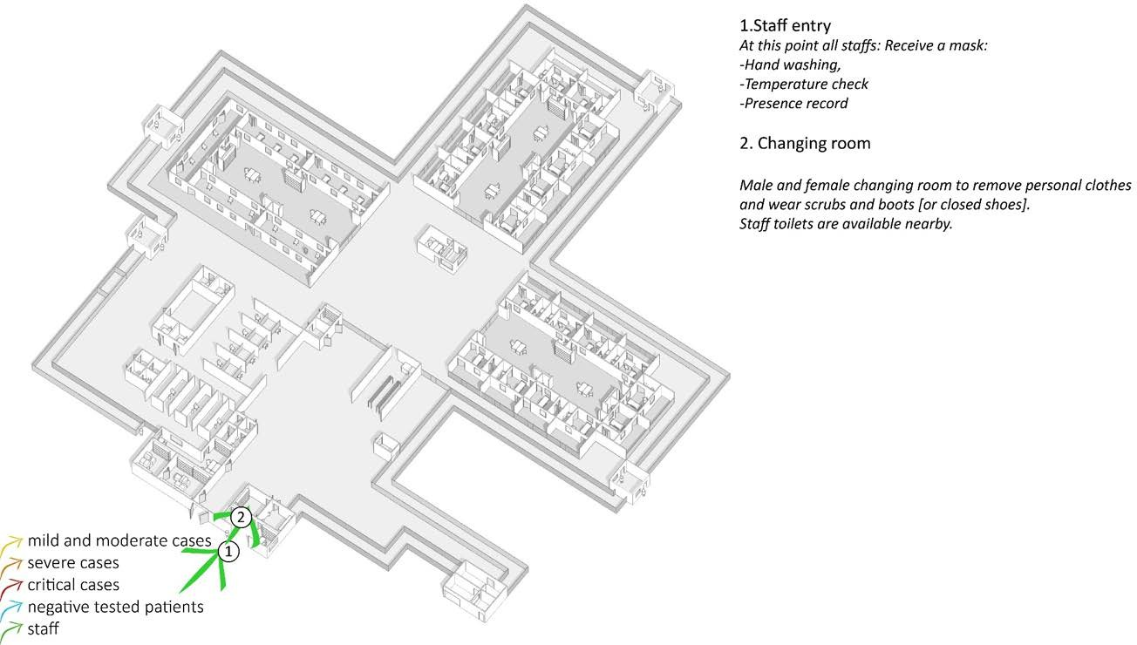
Staff’s flow
2. Changing room
Male and female changing rooms to remove personal clothes and wear scrubs and boots [or closed shoes]. Staff toilets are nearby.
programme

Slide 48
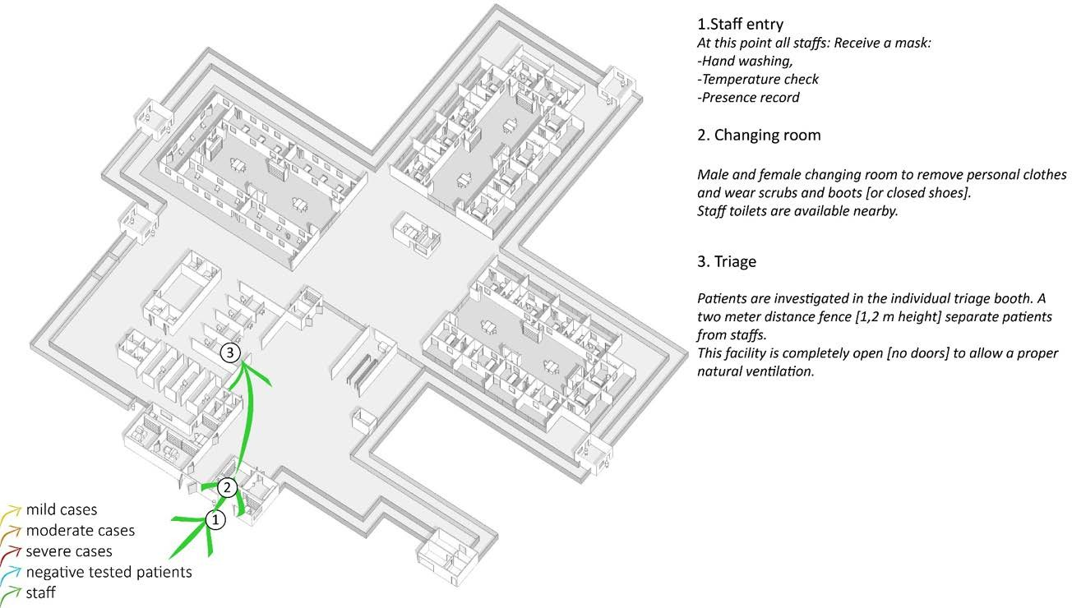
Staff’s flow
3. Triage
Patients are investigated in the individual triage booths. A one (1) meter distance fence [1.2 m high] separates patients form staff. The facility is completely open [no doors] to allow a proper natural ventilation.
programme

Slide 49
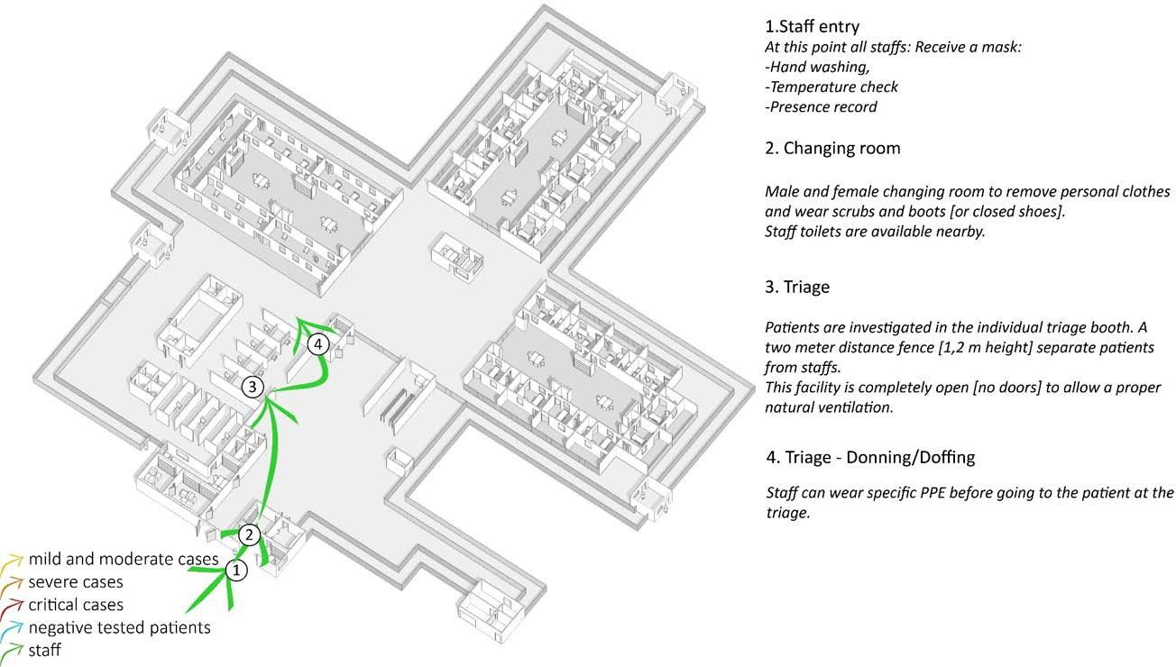
Staff’s flow
4. Triage -Donning/Doffing
Staff can wear specific PPE before going to the patient at the triage.
programme

Slide 50
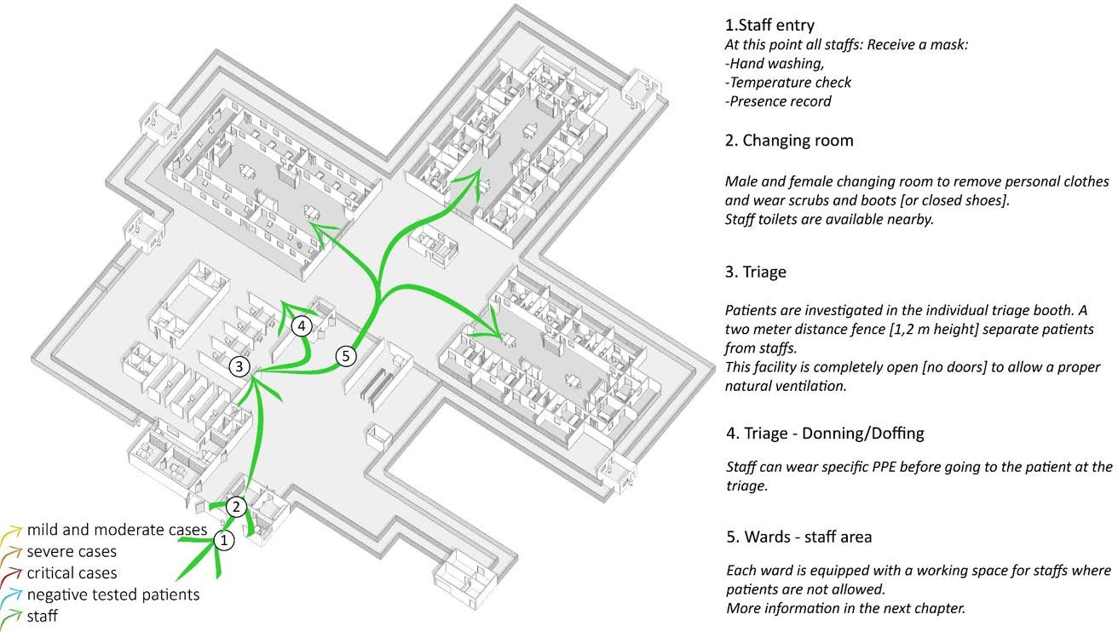
Staff’s flow
5. Wards – Staff area
Each ward is equipped with a working space for staff where patients are not allowed. More information in the next chapter
programme

Slide 51
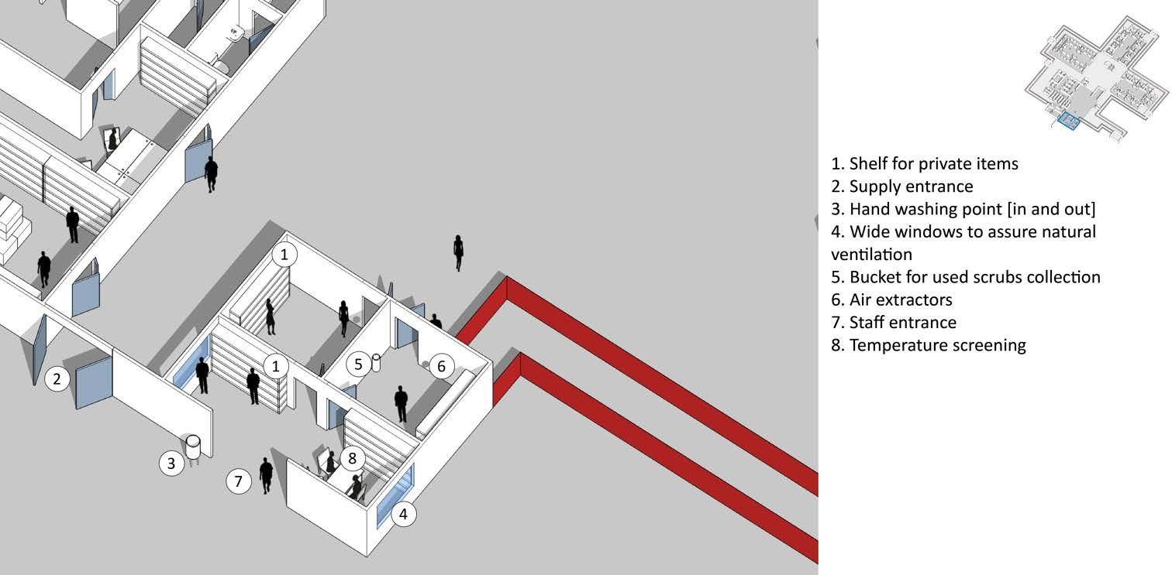
Staff’s flow - Entrance
programme

