Slide 1
MAR law Pathways discussion
September 30th
MoH, Tbilisi

Slide 2
Medically assisted reproduction (MAR) The International Glossary on Infertility and Fertility Care, 2017 definition
Reproduction brought about through various interventions, procedures, surgeries and technologies to treat different forms of fertility impairment and infertility. These include ovulation induction, ovarian stimulation, ovulation triggering, all ART procedures, uterine transplantation and intra-uterine, intracervical and intravaginal insemination with semen of husband/partner or donor.

Slide 3
Assisted reproductive technology (ART) The International Glossary on Infertility and Fertility Care, 2017 definition
All interventions that include the in vitro handling of both human oocytes and sperm or of embryos for the purpose of reproduction. This includes, but is not limited to (procedures), IVF and embryo transfer ET, intracytoplasmic sperm injection ICSI, embryo biopsy, preimplantation genetic testing PGT, assisted hatching, gamete intrafallopian transfer GIFT, zygote intrafallopian transfer, gamete and embryo cryopreservation, semen, oocyte and embryo donation, and gestational carrier cycles. Thus, ART does not, and ART-only registries do not, include assisted insemination using sperm from either a woman's partner or a sperm donor.

Slide 4
EU TISSUES and CELLS DIRECTIVES
Professional and technical requirements
Exceptionally ethical issues
Significant freedom of transposition

Slide 5
Principles governing tissues and cells donation (Article 12)
Voluntary and unpaid donation (compensation limited to reimbursing the expenses and inconveniences related to the donation)
promotion and publicity activities
shall comply with guidelines or legislative provisions of MS
provisions shall include appropriate restrictions or prohibitions on advertising the need for, or availability of, human tissues and cells with a view to offering or seeking financial gain or comparable advantage
Member States submit reports to the Commission by April 2006 and every two years thereafter

Slide 6
Medically assisted reproduction procedures
assisted insemination
sperm from a woman's partner
sperm from donor
IVF and embryo transfer ET
intracytoplasmic sperm injection ICSI
preimplantation genetic testing PGT (PGS, PGD)
gamete cryopreservation
embryo cryopreservation
gametes donation (semen, oocyte)
embryo donation
gestational carrier cycles (surrogate mother)
Homework:
Work group should create a list of acceptable procedures

Slide 7
Users of the MAR
Options:
single woman
single man
married couples
unmarried couples
heterosexual couples
homosexual couples
medical indications - infertile people
- fertility preservation
social indications (limitations ? age, health status....)
Homework:
Work group should propose the list of acceptable users

Slide 8
Users of the MAR
Options:
Residents
Foreigners

Slide 9
Gestational carrier (surrogate mother)
Traditional gestational carrier
The International Glossary on Infertility and Fertility Care, 2017 definition:
a woman who donates her oocytes and is the gestational carrier for a pregnancy resulting from fertilization of her oocytes either through an ART procedure or insemination
B) Gestational carrier
The International Glossary on Infertility and Fertility Care, 2017 definition:
a woman who carries a pregnancy with an agreement that she will give the offspring to the intended parent(s)

Slide 10
A) Traditional gestational carrier
formerly referred to as=Traditional surrogacy = partial surrogacy=genetic surrogacy

Slide 11
A) Traditional gestational carrier
biological relation to the surrogate mother:
child is biologically related to the surrogate mother

Slide 12
A) Traditional gestational carrier
Options:
one (male) intended parent is genetically related to the child
no intended parent is genetically related to the child

Slide 13
B) Gestational carrier
formerly referred to as Gestational surrogacy =host surrogacy=full surrogacy

Slide 14
B) Gestational carrier
biological relation to the surrogate mother:
child is NOT biologically related to the surrogate mother

Slide 15
B) Gestational carrier
Options:
both intended parents are genetically related to the child
one (male or female) intended parent is genetically related to the child
no intended parent is genetically related to the child

Slide 16
Donation
Partner-donation
means the donation of reproductive cells between a man and a woman who declare that they have an intimate physical relationship (Directive 2006/17)
B) Non-partner donation
donation of reproductive cells:
Options:
- MAR from donated oocytes
MAR from donated sperm
MAR from donated oocyte AND sperm (no potential parent is genetically related to the child)

Slide 17
Number of children from one donor
Number of children born from one donor
Could be different for:
Oocytes donor
Sperm donor
Options:
donations limited to the one family – all children born within one family(one couple)
donations for more families

Slide 18
Number of children from one donor
Depends on:
Size of population (impact on increasing of likelihood of consanguinity)
Genetical profile of population (frequency of hereditary deseases)

Slide 19
Donation
embryo donation programme ?

Slide 20
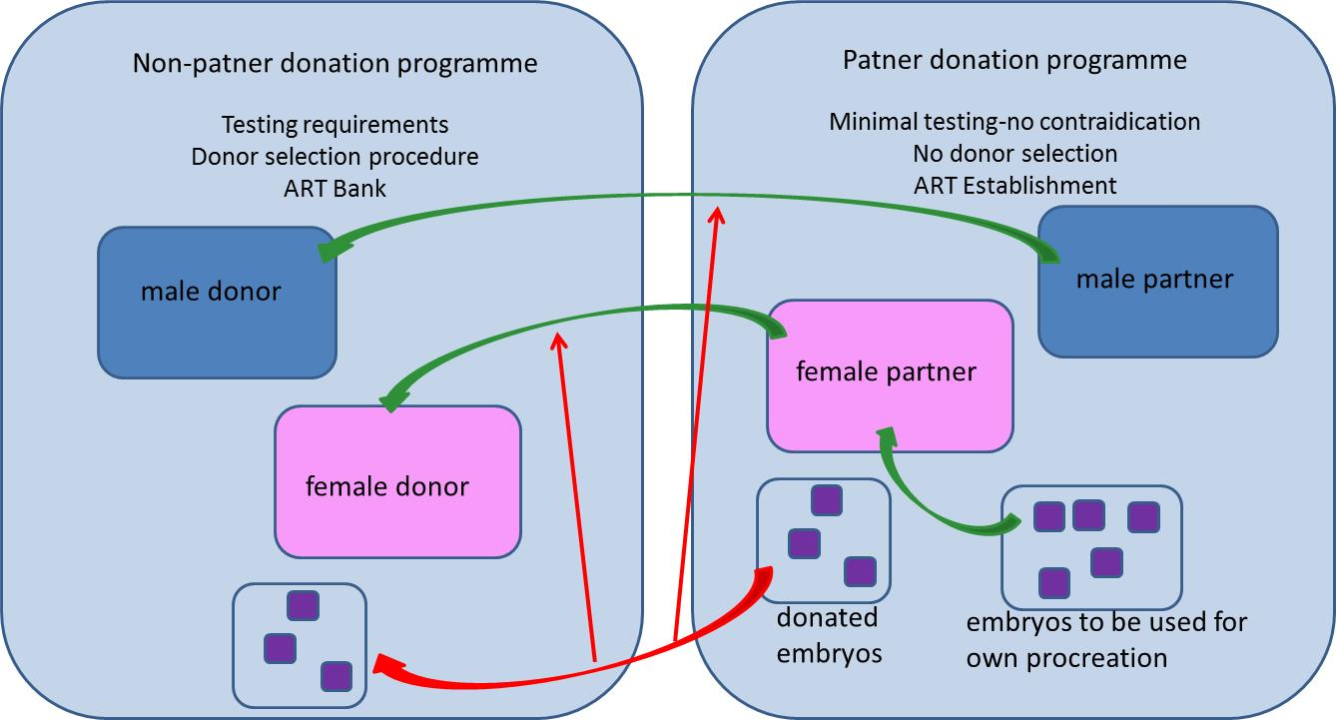
Embryo donation programme

Slide 21
Donation
establishment of national MAR Registry covering both, donors and procedures
-responsibility for data collection and quality control of data
- responsibility for technical maintenance
-physical location (security) of registry

Slide 22
Donation
establishment of the reproductive cells and tissues bank (non-partner donatin)
Oocyte bank
Sperm bank
Embryo bank
Options:
- centralised - one „national”bank (suggestion: public or public-privat partnership)
- decentralised

Slide 23
Fertility preservation
A) Fertility preservation due to medical indications
-advocating-dissemination of information
B) Fertility preservation due to social reasons
-any limits - age, health status.....

Slide 24
import/export
import/export of reproductive cells
From/to EU countries
From/to 3rd countries
import/export of embryos
?

Slide 25
Competent Authority (CA)
Decision on body performing the role of CA
Options:
Single body
Roles separated

Slide 26
Roles and responsibilities of CA
Supervision of tissue and cell procurement and testing
Designation, authorisation/licensing of MAR/ART centers
Inspections and control measures
Vigilance and Surveillance
Report to the EU Commission on the implementation
Report to the EU Commission on SAEs/SARs

Slide 27
Technical reqirements for MAR
Will be described mostly in the by-laws
Suggestion: make EDQM guidelines mandatory
Guide to the quality and safety of tissues and cells for human application 4th Edition
Part E contains the newly developed Good Practice Guidelines (GPGs) for tissue establishments that follow EU Directive

Slide 28
