Slide 1
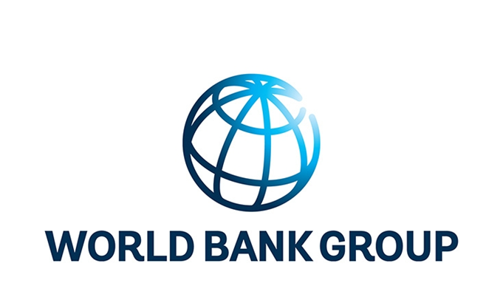





Options for Improving Primary Care Session 8 Global Flagship Course on Health Systems Strengthening: The Challenge of Universal Health Coverage Ian Forde and Nedim Jaganjac World Bank Group

Slide 2
Where are we now and where do we want to get to?

Slide 3


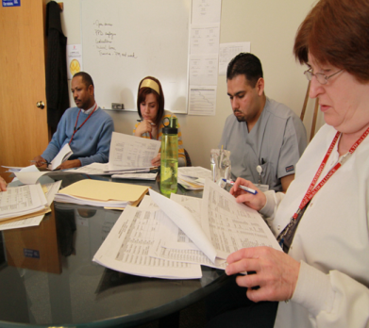
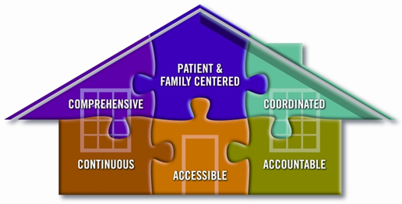
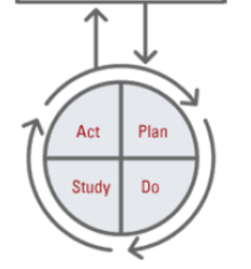
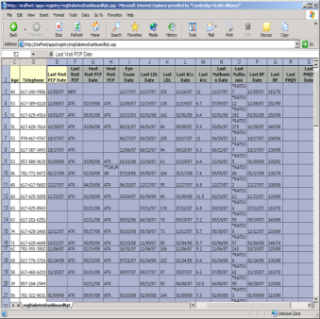
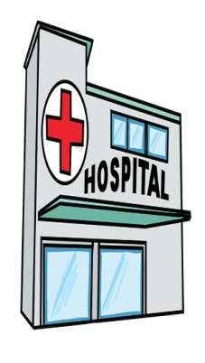
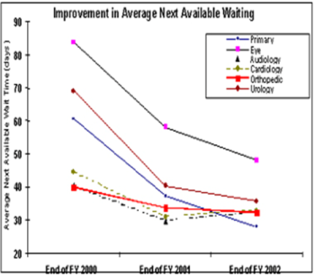
Comprehensive primary care – System hub
Strengthening Primary Healthcare Model
Responsible for a Population
Team-based Care
Care Management
Empanelment
Checklists & Registries
(risk stratification)
Easy Access
Continuous Quality
Improvement
Coordination with
Hospital and Specialists
Source: Janett (2017)
Notes:
Strengthening Primary Care with an Enhanced Care Model
Team Based: Multi-disciplinary teams on site offer comprehensive primary care services and free the physician from routine tasks
Registries and Checklists: Increasing the reliability of the care model by identifying and reliably closing gaps in care
Coordination with Specialists and Hospitals: Referrals, counter-referrals, sharing of key clinical information and smooth transfer between venues of care
Access: Same day and next day appointments available, leveraging mid-level providers and nurses to evaluate and manage acute care. Avoids ER
Care Management: Specialized nurses and social workers to address social barriers to care. Tracking and outreach to patients who need close follow up or who have important gaps in care
Responsible for a population
Empanelment of individual patients with a specific provider or clinical site
Using formal Quality Improvement methods to measure and improve care, especially for patients with chronic disease

Slide 4

Planned Care Model
Manage chronic and intensive conditions
Close gaps in care
Identify and outreach to patients who do not present for care
Avoid secondary complications of the underlying chronic disease

Slide 5
How to keep track of the person who needs care but is not in front of you:
Registry data for your entire population to maintain outreach for screenings and chronic disease management
Pharmacy data to identify chronic diseases
Demographic data for prevention

Slide 6
How do we get there?

Slide 7
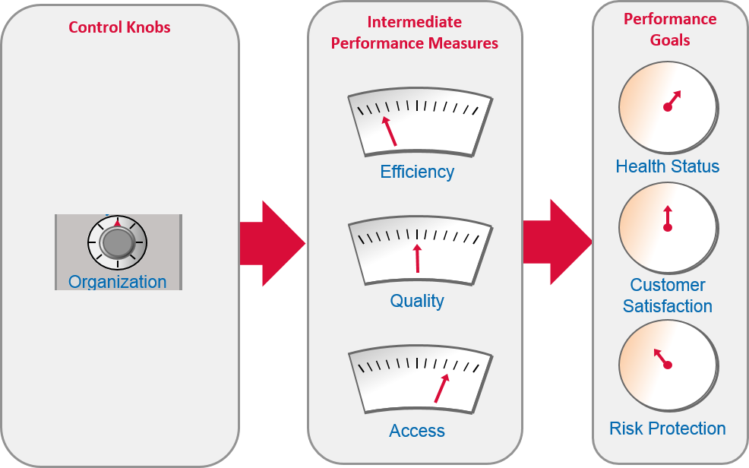
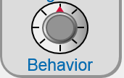
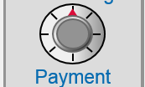
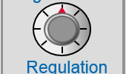
What is the Organization Control Knob?

Slide 8
Incentives and values to improve organizational performance: The Six Keys
1. Incentives on the Organization
2. Incentives on Managers
3. Managers’ Skills, Beliefs and Values
4. Managers’
Leadership
5. Incentives on Workers
6. Workers
’ Skills, Beliefs and Values
Worker Behavior
Organizational Performance

Slide 9
“Organization” refers both to the overall structure of the health care system and to the individual institutions that provide health care services
Mix of organizations delivering health care
Division of activities among these organizations (who does what)
How organization interact (with one another, the sector, and the economy)
Internal structure of organizations (including their processes, workers, managers and the relationships between them)
Macro
Micro

Slide 10
International experience

Slide 11
Findings from Croatia
Case Study 1: Integrated family medicine provided through public health centers, group practices and individual specialists

Slide 12
Design features
Family medicine teams as case managers:
gatekeepers for specialist and hospital care,
coordinate with home / community nurses;
only ones authorized to prescribe.
No specific integrated care guidelines or explicit criteria
Preventive check-ups to visiting patients only
Patients and families involved in treatment plans, depending on interest
Family medicine teams operate IT system:
Prescriptions, lab referrals and some hospital referrals are paperless
Structured modules for chronic conditions
Notes:
Family medicine teams consisting of family medicine specialists or GPs and nurses form the core of the system.
National program: all those who are insured over the age of 7 have to register with a family medicine doctor in order to access the public health insurance system
Family medicine teams may take different forms:
Public health centers owned by regions that employ doctors and nurses
Private medical practices: single doctor owner, who employs one nurse; operate as entrepreneurs in concessions awarded by the counties.
Key feature of this model: Family medicine teams are the case managers:
as gatekeepers for hospital care: GP referral required for everything except emergency care
the only ones authorized to prescribe medicines;
undertake house visits and coordinate with home nurses and community nurses who monitor chronic patients and provide outreach preventive services.
Family medicine teams are expected to provide preventive services and non-complex care, referring others to specialists and hospitals based on clinical judgement.
-- Good cooperation with other specialists employed at primary care and hospital specialists.
There are no specific integrated care guidelines or specific referral criteria
What about service user involvement and support?
Preventive care is provided to those who visit. So, no regular check-up and risk assessment of users besides vertical programs
Patient education, involvement patients and communities in decision making, and patient involvement in treatment plans are somewhat adhoc and based on interest.
Family medicine teams use an IT system and includes electronic patient records.
Prescriptions, lab referrals and some referrals to hospitals are paperless
Structured modules for specific categories that allows doctors to enter data on and monitor patients with specific chronic conditions
Little quality management
Clinical data are not used to improve performance and outcomes

Slide 13
Financing arrangements
No specific financial rewards for better care coordination. However, family doctors rewarded as follows:
Fee-for-service payments for selected preventive and house visits
Bonus for quality indicators, e.g. monitoring and follow-up of chronic diseases
Broader provider payment reforms have:
Hospitals encouraged to shorten length of stay and provide more care through outpatient and day facilities
Primary care providers encouraged to take burden from hospitals and improve horizontal coordination by forming group practices.
Notes:
Family medicine doctors’ payment consists of:
Capitation per registered patient
Fixed payment for running costs including nurses’ salary
In addition:
Fee for service for selected clinical and preventive services including house visits
Bonuses for quality indicators, e.g. monitoring quality measurements for diabetes, COPD, hypertension in the electronic patient records
Provider payment reforms over the last decade or so have forced hospitals to reduce lengths of stay and provide more outpatient and day care.
Primary care providers have been encouraged to increase their own productivity and take some of the caseload off hospitals
To do that, they have also been encouraged to improve horizontal coordination by forming group practices.

Slide 14
Organizational Structures and processes
Structures
Care integration identified as a policy priority in National Health Strategy and reflected indirectly in contracting reforms introduced by HIF
Primary care as gatekeeper well established – taken for granted
Family medicine specialization has increased capacity to provide complex care
Processes
No mechanisms in place to ensure compliance with treatment guidelines
Limited or no monitoring of quality and outcomes
HIF closely monitors and incentivizes sanctions on expenditures side
HIF financially stimulates horizontal coordination across group practices
Notes:
STRUCTURES
The Croatian National Health Strategy 2012-2020: re-organization of care is one of the eight main policy priorities. This is reflected in how the National Health Insurance Fund has reformed contracting to stimulate concessionaires to form group practices
Hospital sector reforms:
Led to shortened LOS and required more complex services to provided at primary care level
This improved coordination and information sharing between primary and secondary levels
The role of primary care as gatekeeper – prescriptions and referrals – is so embedded in the existing system that its taken for granted - not seen specifically as a mechanism to promote care coordination.
Introduction of family medicine specialization has hugely increased provider capacity to care for complex multi-morbid patients: 78% of respondents in the online survey who had completed family medicine specialization reported that they were adequately trained to plan, coordinate and evaluate care of multi-morbid elderly patients (compared to only 7% of respondents with general medicine training)
PROCESSES
No mechanisms in place to ensure compliance with treatment guidelines
Nor is there much monitoring of quality and outcomes : Almost all of the monitoring and sanctions are on the expenditures side through the Health Insurance Fund
The private practices that hold concessions from the HIF face strong incentives to coordinate horizontally
HIF financially stimulates to form group practices
Bonus payment for holding monthly professional meetings
Group practices expected to promote cooperation between doctors – cooperation not financially rewarded but occurs for professional reasons

Slide 15
Findings from Poland
Case Study 1: Integrated primary care provided by the Centrum provider network (CMD)

Slide 16
Design features
Key features:
Health check-ups: Regular patient exams for target age group (30-65)
Diagnostic related groups: integrated health care among the chronic disease / high risk patients through implementation of individually adjusted treatment plan
Patient stratification – 4 streams
Clearly defined care coordinator at each facility
Integrated care guidelines developed by the provider and internal
Users: active involvement of patients and families
IT: high degree of information sharing within provider unit
Notes:
Key features:
Health check-ups: Regular patient exams for target age group (30-65)
Diagnostic related groups: integrated health care among the chronic disease / high risk patients through implementation of individually adjusted treatment plan
Patient stratification – 4 streams
Care coordinator:
Nurse / midwife / medical assistant is the health system guide for the patient providing education and administrative support
Integrated care guidelines developed by the provider and internal to Centrum.
Users: active involvement of patients and families in development of treatment plans
High degree of integration of information within each provider unit – electronic medical records exist. IT system enable doctors to monitor patient visit schedules, own workload, income from the Health Insurance Fund etc.

Slide 17
Financing, Structures & Processes
FINANCING:
National Health Fund: capitation-based financing for primary care + outpatient specialized care
Motivation for program are the savings realized
STRUCTURES & PROCESSES
No specific policy framework
Performance monitoring: systematic collection of clinical data and user feedback
No cooperation with hospitals
Notes:
FINANCING
There are not specific rewards or incentives to Centrum for carrying out care coordination in this way.
Standard capitation based payment and other financing
Providers recognized that short term costs are higher because of increased workload (health check-ups), higher remuneration and investments
Managers report greater savings made under the program, which justify the additional costs.
STRUCTURES AND PROCESSES
No specific underlying policy framework except growing recognition of care coordination as policy priority.
Performance monitoring is done fairly systematically.
GPs and nurses receive monthly information on preventive exams carried out, share of population covered, number of patients with chronic diseases under their care
Information also collected through questionnaires on patient satisfaction and questions about patient engagement in the process.
No cooperation with hospitals in terms of managing patients’ care.

Slide 18
What helped & hindered IN CROATIA?
Enabling factors
Challenges
A strong foundation: family medicine doctors entrusted with gatekeeping and coordination of all non-urgent care.
Layers of health care reforms consistent with long term goals: family medicine specialization, investment in IT, financial incentives
Non-clinical care providers as coordinators (community patronage, palliative care coordinators)
Professional networks encouraged
Lack of overall standards and clinical guidelines and inadequate quality monitoring leads to a lot of variability in care practice
Communication barriers that could be easily improved for which IT solutions could help
Lack of referral criteria blurs provider roles and tasks
Mental health and palliative care: pilots with good results but lack of funding or prioritization at higher levels
Notes:
A primary care model that entrusts family doctors with gatekeeping and coordinating all non-complex care has been a powerful foundation on which successive reforms have been built.
Comprehensive and layered health care reforms were directed by long term strategic goals. For instance, primary care has been subject to a number of reforms over the last decade including the introduction of concessions, raising clinical capacity through the family medicine specialization, large scale investments in information technologies, the introduction of financial incentives such as those to join group practices, organize peer group meetings and record health outcomes, etc.
Employing professionals who do not have direct clinical care responsibilities has been key in improving collaboration and coordination between care providers. Community-outreach nurses and palliative care coordinators have been a major asset
Development of professional collegial networks between the Zagreb-West Primary Health Care Centre and local psychiatric hospitals ensured that patients were looked after in the community during the first days post discharge when the risk of re-hospitalization is greatest.
Challenges:

Slide 19
What helped & hindered IN POLAND?
Enabling factors
Constraints to scaling up
Centrum model:
Leadership and commitment
Explicit guidelines and systematic use of information
For scaling up:
Low ratio of doctors and nurses to population
Long waiting times for specialists
Single payer could promote national policy
Hospital dominate in financing and provision
Frequent changes of legislation
Political influences on how care is organized
Patient preferences for specialist care
Notes:
Centrum model:
Leadership and commitment to a clearly defined coordination model
Explicit guidelines for care integration
Systematic use of information and performance monitoring
For scaling up:
Low ratio of doctors and nurses to population and long waiting times for specialists: creates incentives for horizontal coordination of care
Single payer could promote national policy for care coordination – if there was the policy commitment to scale up this model.
CONSTRAINTS TO SCALING UP
Hospitals are still very much the center of care provision and account for a disproportionately large share of financing. The Centrum model is more or less divorced from the hospital sector – little or no coordination.
Introducing system-wide coordination of care and institutionalization of key processes is a long-term commitment. Currently frequent changes of legislation and political influences on how care is organized makes it difficult
Also, patient preferences for specialist care – shifting care towards primary care is a long-term process.

Slide 20
What does this mean for Armenia?

Slide 21
Thank you!

