Slide 1






Introduction to the Health Financing ‘Control Knob’ Global Flagship Course on Health Systems Strengthening: The Challenge of Universal Health Coverage Ajay Tandon (Lead Economist) Adanna Chukwuma (Health Specialist) World Bank

Slide 2
Session Outline
Review Basics of UHC; What Makes Financing for Health Different?
Health Financing “Control Knob”; What is Health Financing?
Global Health Financing Landscape; How Much & How Are Resources Mobilized & Risks Pooled Across Countries?
Overview of Health Financing Modalities: Options for Resource Mobilization, Risk Pooling, Purchasing

Slide 3
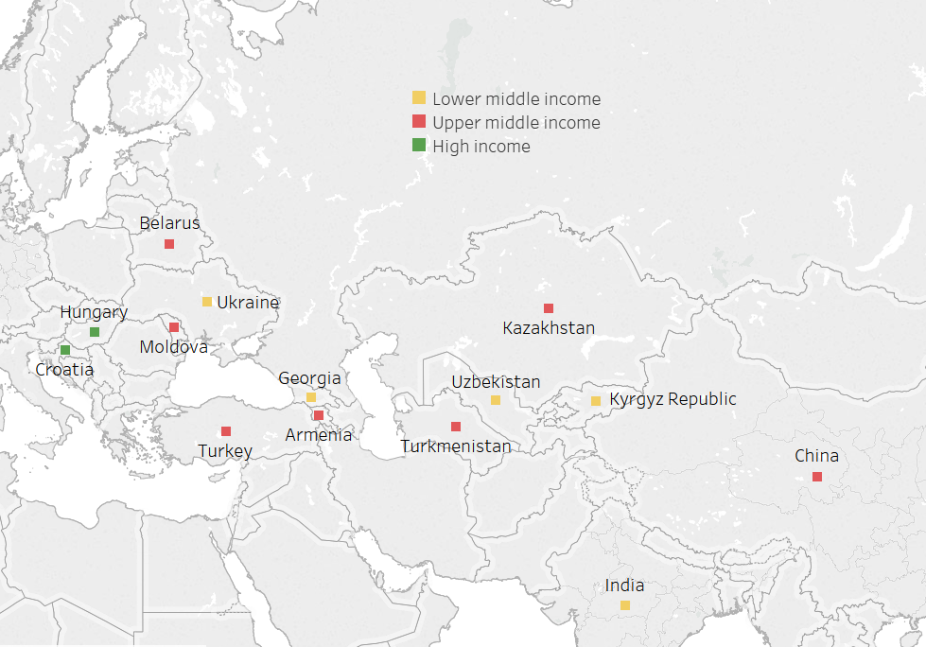

Comparing Armenia

Slide 4
Session Outline
Review Basics of UHC; What Makes Financing for Health Different?
Health Financing “Control Knob”; What is Health Financing?
Global Health Financing Landscape; How Much & How Are Resources Mobilized & Risks Pooled Across Countries?
Overview of Health Financing Modalities: Options for Resource Mobilization, Risk Pooling, Purchasing

Slide 5
What is UHC?
Defining UHC: UHC is about “… ensuring that all people can use the promotive, preventive, curative, rehabilitative, and palliative health services they need, of sufficient quality to be effective, while also ensuring the use of these services does not expose the user to financial hardship.”

Slide 6
Conceptualizing UHC

Slide 7
Conceptualizing UHC
Total health expenditure
Prepaid/pooled health expenditure

Slide 8
Conceptualizing UHC
Three Dimensions:
Population coverage (“breadth”);
Service coverage (“scope”);
Financial coverage (“depth”).
Total health expenditure
Prepaid/pooled health expenditure

Slide 9
Conceptualizing UHC
Three Dimensions:
Population coverage (“breadth”);
Service coverage (“scope”);
Financial coverage (“depth”).
What is Missing:
Quality/efficiency of health care;
Foregone care due to costs/other factors;
Indirect costs of illness/waiting time
Total health expenditure
Prepaid/pooled health expenditure

Slide 10



What is ‘Prepayment’ & ‘Pooling’?
$
$
$
$
$
$
$
$
$
$
$
$
$
$
$
$
$
$
$
$
$
$
$
$
$
$
$
$
$
$
$
$
$
$
$
$
$
Notes:
+ Prepayment, risk pooling, cross-subsidization, compulsion

Slide 11
5-Minute Discussion At Your Tables
Identify -- in your opinion and experience -- THREE of the most important conditions under which a system of prepayment/pooling can work for financing UHC.
Notes:
+ Compulsion, subsidization, not everyone is hit with a health shock at same time, large pool,

Slide 12
Not Everyone Experiences Health Shocks at Same Time
Examples from Armenia, India, Indonesia
Economic quintile | Self-report illness |  |  | Outpatient utilization |  |  | Inpatient utilization
 | Armenia | India | Indonesia | Armenia | India | Indonesia | Armenia | India | Indonesia
Poorest | 4% | 7% | 27% | 11% | 5% | 15% | 4% | 2% | 3%
2nd | 4% | 8% | 28% | 11% | 6% | 16% | 4% | 3% | 3%
3rd | 4% | 9% | 29% | 12% | 7% | 16% | 4% | 4% | 4%
4th | 5% | 12% | 30% | 15% | 10% | 17% | 5% | 4% | 5%
Richest quintile | 5% | 15% | 29% | 19% | 14% | 17% | 5% | 6% | 6%
All | 5% | 10% | 30% | 14% | 8% | 16% | 5% | 4% | 4%
Source: NSSO 71st Round (India); SUSENAS (Indonesia); ILCS (Armenia)
Notes:
+ India is self-report past 15 days; Indonesia and Lao PDR is last 30 days.

Slide 13
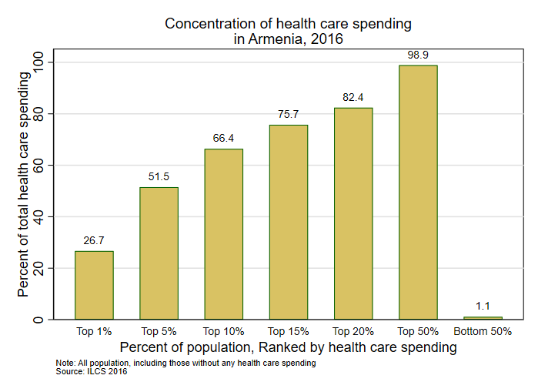
Not Everyone Experiences Health Shocks at Same Time

Slide 14
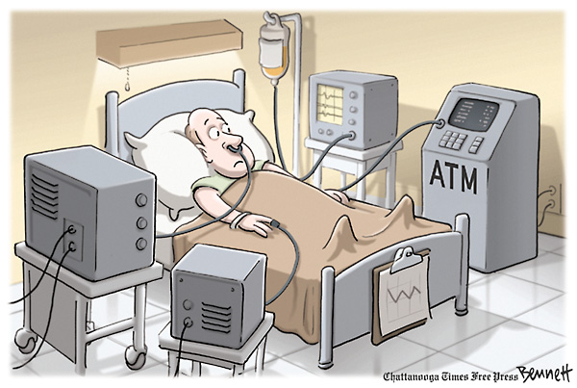
‘The Five U’s’: Health Shocks…
…are unwanted/undesirable.
unlike many other goods/services, people generally do not want to consume medical care unless they have no choice.
…are largely uncertain/unpredictable at the individual level.
…are uncommon, usually concentrated in a relatively small share of the population.
…occur in unison with financial shocks.
direct OOP health-related expenditures and indirect costs due to inability to work, etc.
…protection from risk of adverse financial consequences are undervalued, especially by the young and healthy.
Notes:
+ UHC recognizes this health shock-financial shock duality and these characteristics make it desirable for health to be financed using prepaid/pooled sources and mechanisms, not OOP.

Slide 15
Advantages of Prepayment/Pooling
Pooling refers to the collection and management of risks such that large, unpredictable individual financial risks become more predictable when distributed and aggregated across all members of the pool.
Logic being that each individual in the pool is risk averse and would prefer to pay a relatively small predictable amount (prepayment) to avoid facing the risk of an unpredictable and large financial shock when a health shock occurs.
Whereas pooling ensures predictability of aggregate health expenditures and the potential for redistribution across individual health risk categories, prepayment provides various options for financing these risks equitably and efficiently.

Slide 16
Compulsion & Subsidization Necessary for UHC
Cross-subsidy from rich to poor
(equity subsidy)
Cross subsidy from productive to non-productive part of life cycle
Cross-subsidy from low-risk to high-risk
(risk subsidy)
$
$
$
$
Resource endowment
$
$
Resource endowment
Resource endowment
High risk
Productive
Non-productive
Low risk
Poor
Rich
Health risk
Income
Age
Notes:
+ Cross-subsidization is intrinsic to pooling

Slide 17
Fragmentation Reduces Redistributive Capacity
Aim of pooling is to improve financial protection and equity in resource distribution
Fragmentation is the enemy and can be addressed through reforms in the pooling of funds...
Pooling structure determines redistributive capacity
For UHC objectives, a good pooling arrangement is compulsory, large, and covers diverse health risks
…but specific way to do this depends on the nature of your fragmentation problem
Source: Joe Kutzin
Notes:
+ Cross-subsidization is intrinsic to pooling

Slide 18
Some Common Problems with Prepayment/Pooling
Adverse Selection
If no compulsion, low-risk individuals may opt-out of risk pool.
Can be overcome by prepayment differentials, mandatory enrollment, government subsidies.
Moral Hazard
Excessive consumption of medical services by individuals who don’t pay out-of-pocket (OOP).
Often reason why there are co-payments and “caps”.
Principal-Agent Problem
Information asymmetry between supplier (doctor) and demander (patient), hence potential for “overutilization” of diagnostic tests and other care especially if paid for by fee-for-service (supplier-induced demand).
Risk Amenability
Requires that not everyone gets hit with a health shock at the same time. Amenable risks are usually those that are infrequent, uncommon, and unexpected.

Slide 19
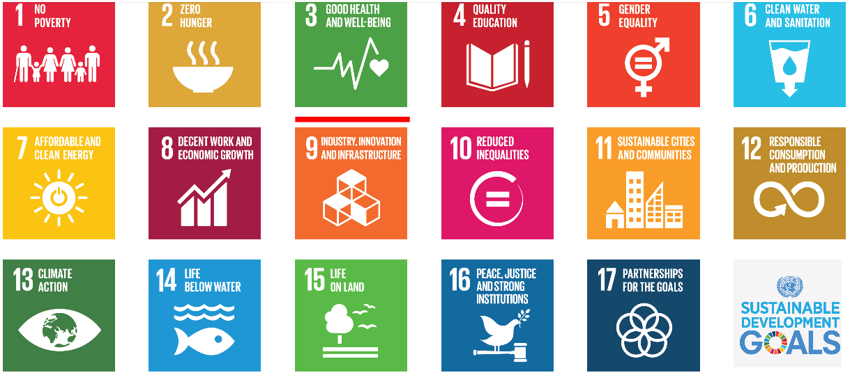
UHC is an SDG
SDG 3: “ensure healthy lives and promote well-being for all ages”
Target 3.8:
Achieve universal health coverage
Indicator 3.8.1: Coverage of essential health services
Indicator 3.8.2: Financial protection from OOP when seeking care

Slide 20

WHO-WB Recommended UHC Monitoring Tracer Indicators
Preventive/Promotive:
Proportion with access to modern contraceptives
Antenatal care coverage
Skilled birth attendance.
DTP3 vaccine coverage
Non-smoking rates in the population
Proportion with access to improved sanitation
Proportion sleeping under bed net
Prevalence of normal blood pressure.
Mean fasting plasma glucose.
Cervical cancer screening.
Treatment:
Diabetes treatment coverage
Hypertension treatment
TB cases detected and cured
People with HIV receiving ART
Financial Protection:
Proportion of households with “large” OOP spending as share of consumption
Proportion of households impoverished or pushed deeper into poverty as a result of “large” OOP spending

Slide 21
Large Vs Impoverishing OOP Health Expenditures
“Large” OOP expenditure:
Percentage of households whose OOP health expenditure exceeds 10% and 25% of total consumption expenditure
Impoverishing OOP expenditure:
Percentage of households who are impoverished and pushed deeper into poverty by OOP heath expenditures, using national, US$1.90, and/or US$3.10 poverty lines
Consumption line pre-OOP
“Large” OOP
Impoverishing, as pushed into poverty
Large because OOP>10/25%, but not impoverishing
Impoverishing, as pushed deeper into poverty
Poverty line
Impoverishing because OOP pushes below, or further below, the poverty line
Cumulative % of households

Slide 22
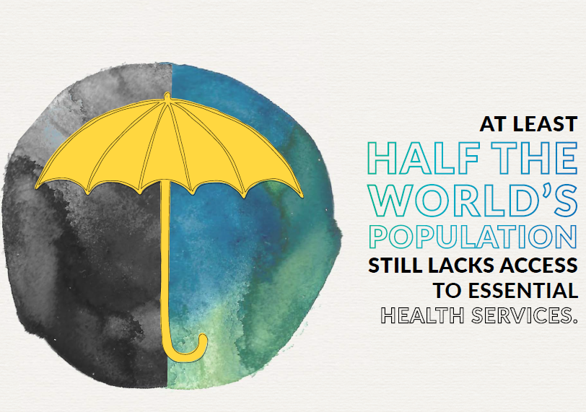
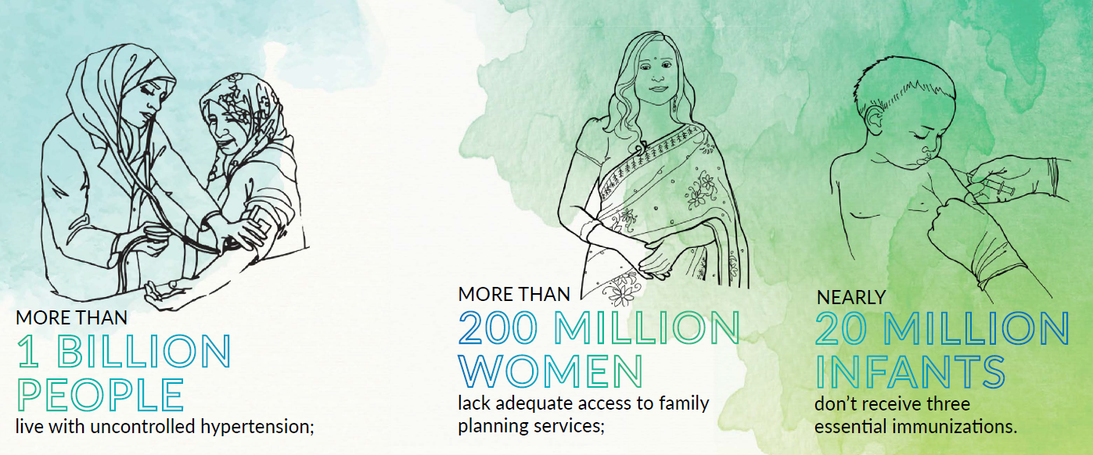
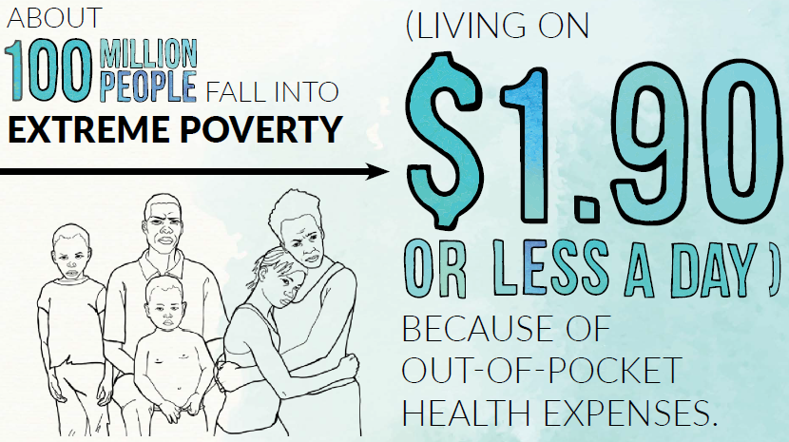
WHO-WB Recommended UHC Monitoring Tracer Indicators

Slide 23
WHO-WB Recommended UHC Monitoring Tracer Indicators
Country | Preventive/Promotive |  |  |  |  |  | Treatment |  | Financial Protection
 | DTP3 | Tobacco | Water | Sanitation | Blood Glucose | Blood Pressure | ARV | TB | Prepaid/ pooled | Not Impoverished
Armenia | 94% | 72% | 99% | 92% | 89% | 75% | 45% | 65% | 19% | 99%
Belarus | 97% | 72% | 98% | 94% | 92% | 73% | 46% | 71% | 64% | 100%
China | 99% | 74% | 96% | 75% | 91% | 81% | -- | 81% | 64% | 87%
Croatia | 92% | 64% | 100% | 97% | 93% | 68% | -- | 50% | 85% | 100%
Georgia | 91% | 70% | 93% | 85% | 87% | 74% | 39% | 68% | 44% | 90%
Hungary | 99% | 70% | 100% | 98% | 92% | 70% | 62% | 62% | 70% | 100%
India | 88% | 88% | 88% | 44% | 91% | 74% | 56% | 43% | 35% | 79%
Kazakhstan | 99% | 74% | 91% | 98% | 88% | 73% | 43% | 84% | 64% | 100%
Kyrgyz Republic | 92% | 74% | 87% | 97% | 90% | 73% | 39% | 67% | 42% | 97%
Moldova | 88% | 76% | 87% | 78% | 92% | 70% | 34% | 72% | 55% | 99%
Russia | 97% | 61% | 96% | 89% | 92% | 73% | 36% | 72% | 60% | 100%
Turkey | 96% | 73% | 99% | 96% | 86% | 80% | -- | 76% | 84% | 100%
Turkmenistan | 99% | -- | 94% | 97% | 88% | 75% | -- | 67% | 24% | --
Ukraine | 50% | 69% | 98% | 96% | 93% | 73% | 40% | 57% | 46% | 100%
Uzbekistan | 99% | 87% | 91% | 100% | 89% | 74% | 29% | 59% | 48% | --
Upper middle | 89% | 74% | 94% | 86% | 88% | 76% | 53% | 63% | 67% | 93%
ECA | 91% | 70% | 93% | 92% | 91% | 73% | 45% | 69% | 52% | 99%

Slide 24
Session Outline
Review Basics of UHC; What Makes Financing for Health Different?
Health Financing “Control Knob”; What is Health Financing?
Global Health Financing Landscape; How Much & How Are Resources Mobilized & Risks Pooled Across Countries?
Overview of Health Financing Modalities: Options for Resource Mobilization, Risk Pooling, Purchasing

Slide 25
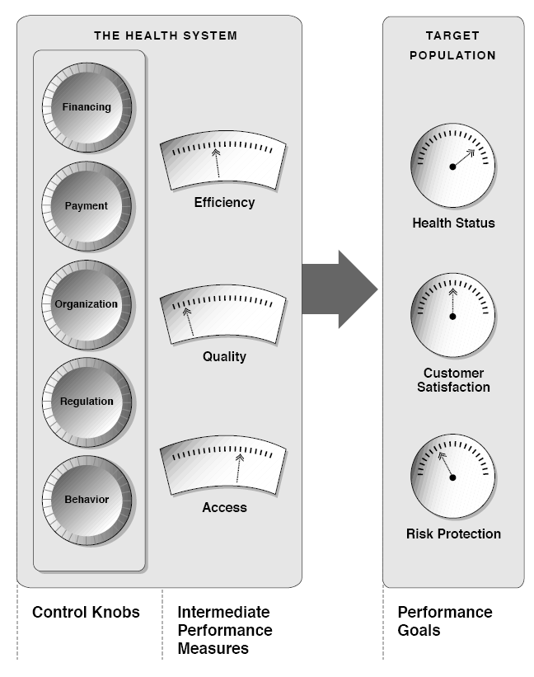
Health Financing ‘Control Knob’
Education
Transport
Water and Sanitation
Energy
Urban planning
Financing
Sports
Industry
Utility
…
The Health Sector
Human capital and economic development and wellbeing

Slide 26

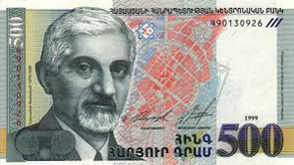
Narrow Concept
Health Financing As Mobilizing of Financial Resources

Slide 27








Broader Concept of Health Financing
Revenue collection
Risk pooling
Resource allocation
Provider payment
Purchasing

Slide 28



Health Financing Objectives & Functions
Health financing is concerned with the mobilization, accumulation, allocation, and utilization of resources in order to help countries make progress towards objectives such as UHC;
Revenue collection
IDEALLY
Raise sufficient and sustainable revenues in an efficient and equitable manner from compulsory prepaid sources
Risk pooling
Pool health risks efficiently and equitably and maximize redistributive capacity by reducing fragmentation of pools
Resource allocation
Define explicit benefits package commensurate with revenues and service delivery capacity and have mechanism to expand over time
Provider payment
Assure allocation of resources and purchasing of health services in an equitable as well as in a technical and allocative efficient manner, moving away from rigid and open-ended provider payment systems as needed
Purchasing
The amount of money spent on health matters, but countries cannot spend their way to UHC: where money comes from and how resources are allocated and utilized is just as important.

Slide 29
The Central Role for Strategic Purchasing in UHC
Purchasing becomes strategic or active when purchasers deliberately design and use arrangements for selecting the health goods and services to buy, determine which providers to buy from, and pay the providers to deliver the covered services.
Passive Purchasing
Phased Process
Strategic Purchasing
Non-selective contracting.
Pay by historic norms.
Limited quality control.
Selective contracting.
Pay for quality, access, efficiency.
Quality control and incentives.

Slide 30
Session Outline
Review Basics of UHC; What Makes Financing for Health Different?
Health Financing “Control Knob”; What is Health Financing?
Global Health Financing Landscape; How Much & How Are Resources Mobilized & Risks Pooled Across Countries?
Overview of Health Financing Modalities: Options for Resource Mobilization, Risk Pooling, Purchasing

Slide 31
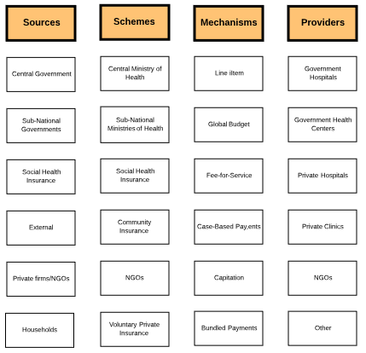
Health Financing System
How are resources collected?
What services are provided?
Who provides services? How are providers paid?
How are resources pooled? How many pools

Slide 32
Health Systems Financing → Who Bears Financial Risk
General Government Revenues
Social Health Insurance
Agent bears risk
Community-Based Health Insurance
Case-Based Payments
OOP payments
Patient bears risk
Provider bears risk
Capitation
Payments

Slide 33
Session Outline
Review Basics of UHC; What Makes Financing for Health Different?
Health Financing “Control Knob”; What is Health Financing?
Global Health Financing Landscape; How Much & How Are Resources Mobilized & Risks Pooled Across Countries?
Overview of Health Financing Modalities: Options for Resource Mobilization, Risk Pooling, Purchasing

Slide 34
Global Health Financing Landscape
Notes:
+ Large variations in total health expenditures: from <US$20 in Central African Republic, Burundi, and Mozambique to almost ~US$10,000 in Norway, Switzerland, USA
+ <2.5% in PNG, Lao PDR, Bangladesh to >15% in USA, Sierra Leone, Marshall Islands.

Slide 35
Health Expenditures Rise with National Income
Notes:
+ Large variations in total health expenditures: from ~US$18 in Madagascar, Central African Republic, and Democratic Republic of Congo (DRC) to almost ~US$10,000 in Norway, Switzerland, USA

Slide 36
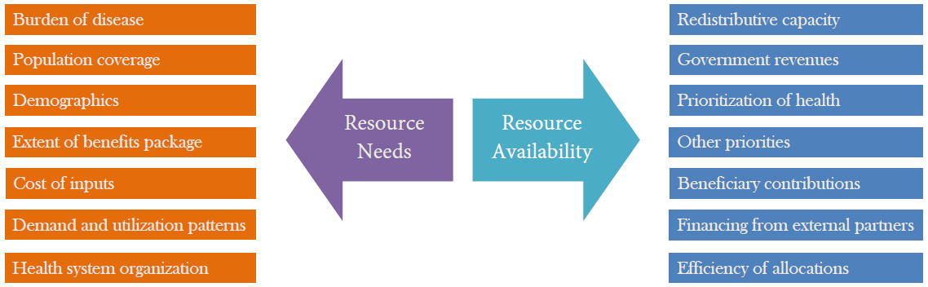
Non-Income Determinants Are Also Important

Slide 37
Health Financing Modalities
General Government Revenue
Social Health Insurance (SHI)
External Sources
Voluntary Private Insurance
Community-Based Health Insurance
Out-of-Pocket (OOP)
Each modality typically associated with different instruments for revenue generation, pooling, and purchasing of health services.
Some form of prepayment/pooling in all modalities except OOP.
Rarely do we see a “pure” form exist and all countries are hybrids.
From health financing perspective, UHC entails move away from OOP towards prepayment/pooling (typically general government revenue financing).

Slide 38
Composition of Health Financing
Notes:
+ Countries are ranked by income status

Slide 39
Composition of Health Financing
Notes:
+ Countries are ranked by income status

Slide 40
5-Minute Discussion At Your Tables
Identify – based on what you have seen and heard so far – at least THREE empirical trends evident from global data on health financing across countries.

Slide 41
Global Health Financing Landscape
Color coded by largest source of financing

Slide 42
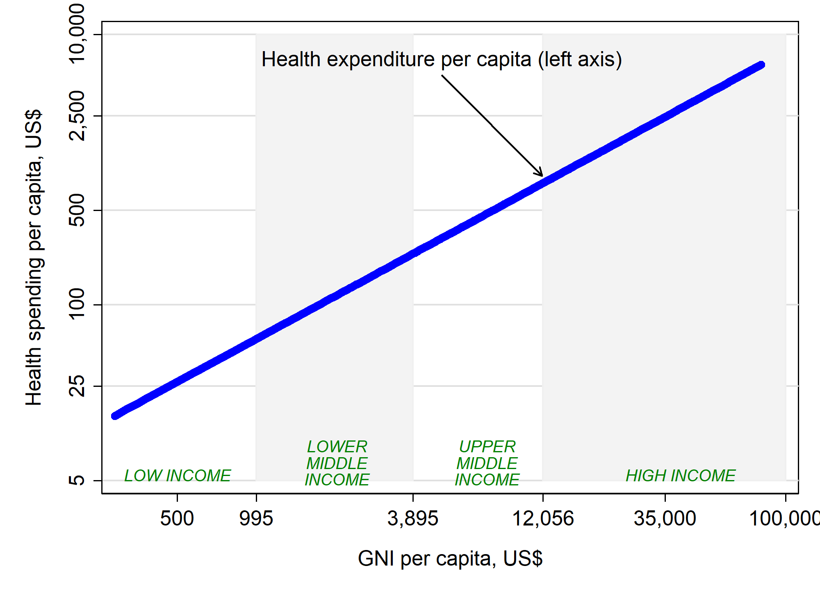
‘Health Financing Transition’

Slide 43
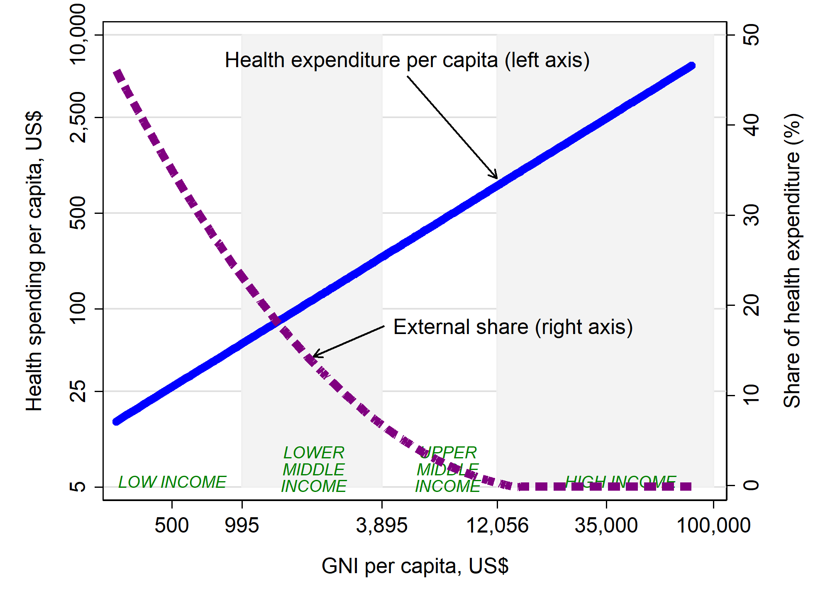
‘Health Financing Transition’

Slide 44
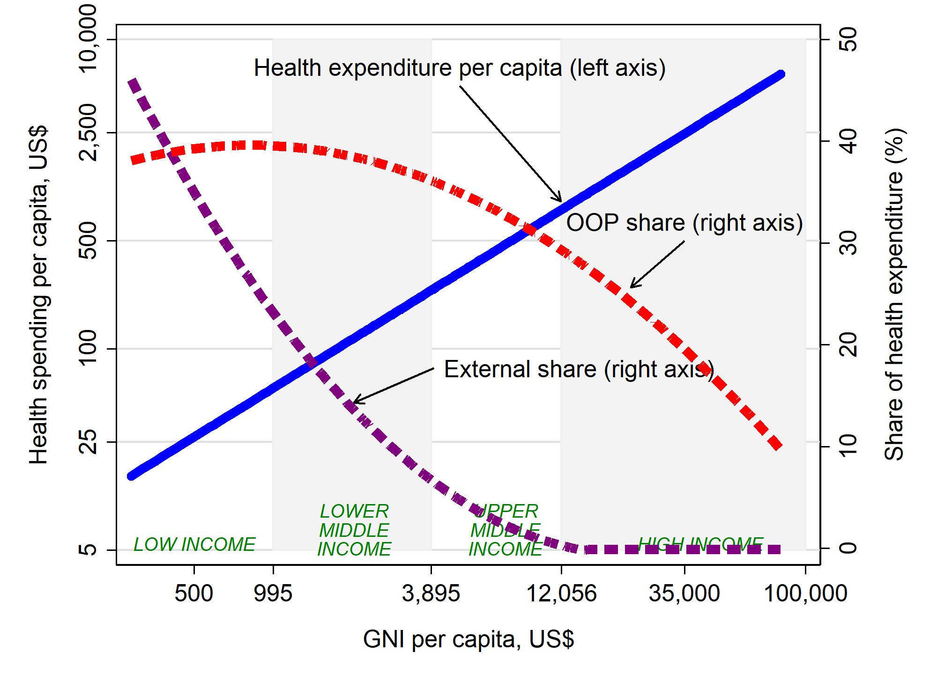
‘Health Financing Transition’

Slide 45
Key Take-Away Messages
UHC is a health system objective and health financing is intrinsic to UHC: everyone should have access to quality health care when needed without suffering financial hardship as a result.
Health financing is one of several ‘control knobs’ for making progress towards UHC; discussions around health financing are an entry point to improve health system performance and cannot be disconnected from other ‘control knobs’.
Health financing objectives include mobilization, accumulation, definition of explicit benefits, allocation, and utilization of resources in order to help countries make progress towards UHC.
Different health financing modalities are associated with differences in how resources are raised, pooled and how health services are purchased: rarely do countries follow a ‘pure’ model.
Rising health spending, increasingly sourced from domestic public sources and away from external and OOP financing, is an empirical trend that characterizes the ‘health financing transition’
Reducing dependence on OOP payments especially for the poor and vulnerable – and increasing the share of general government revenue financing and allocating it in ways that does so -- is key for UHC.

