Slide 1
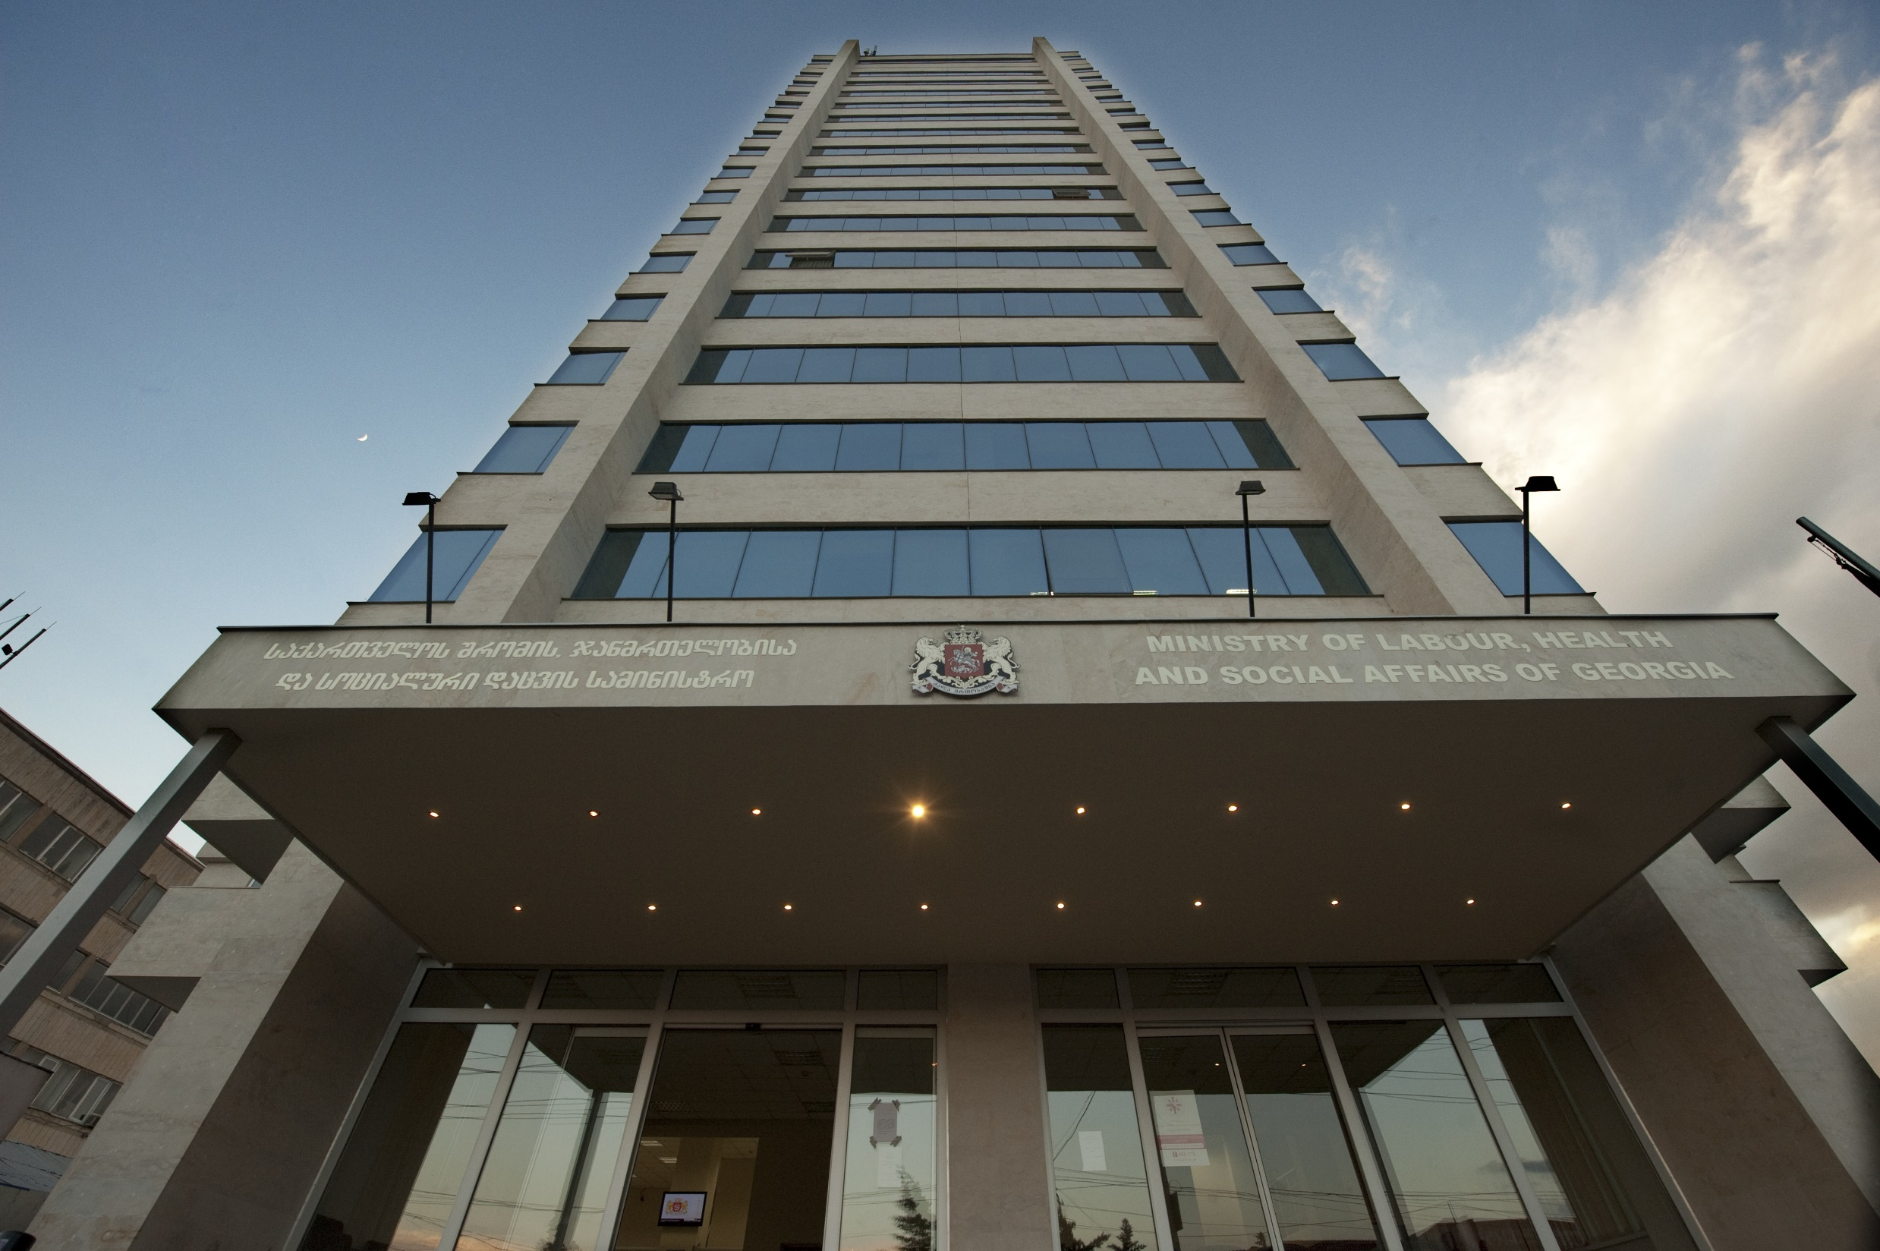

Slide 2

Ministry
Ministry of Labour, Health and Social Affairs
11 Department
20 Regional Office
5 Agency
5 LEPL
62 District Office

Slide 3




Network
MoLHSA’s Global Network (GGN)
20 Regional and 62 Disctrict Offices, 3400 Employee
One Point To Get Data
One Point for Administration
One Point of Management

Slide 4
Georgia Health System – Quick Facts
Mix of state and private funded schemes covering 98.3% of population.
State Funded Healthcare Schemes (beneficiaries):
Universal Health Care Program (UHC) – 2M
State funded health insurance program – 1.5M
Other state funded healthcare programs – 232K
Private/corporate Schemes:
Private voluntary health insurance – 653K
Health Insurance Companies – 12
Health Service Delivery Capacity:
Hospitals – 267
PHC Units – 390
Rural doctors – 1400
Total Population
4.48 million

Slide 5

Information Systems In Ministry
Projects
HMIS
Health Information Management System.
SIMS
Social Information Management System.
CEMR
Central Electronic Medical Records.
SSA
Modules
Social Service Agency’s Management Modules.
LMIMS
Under Construction.
Labor Market Information Management System
Notes:
5

Slide 6
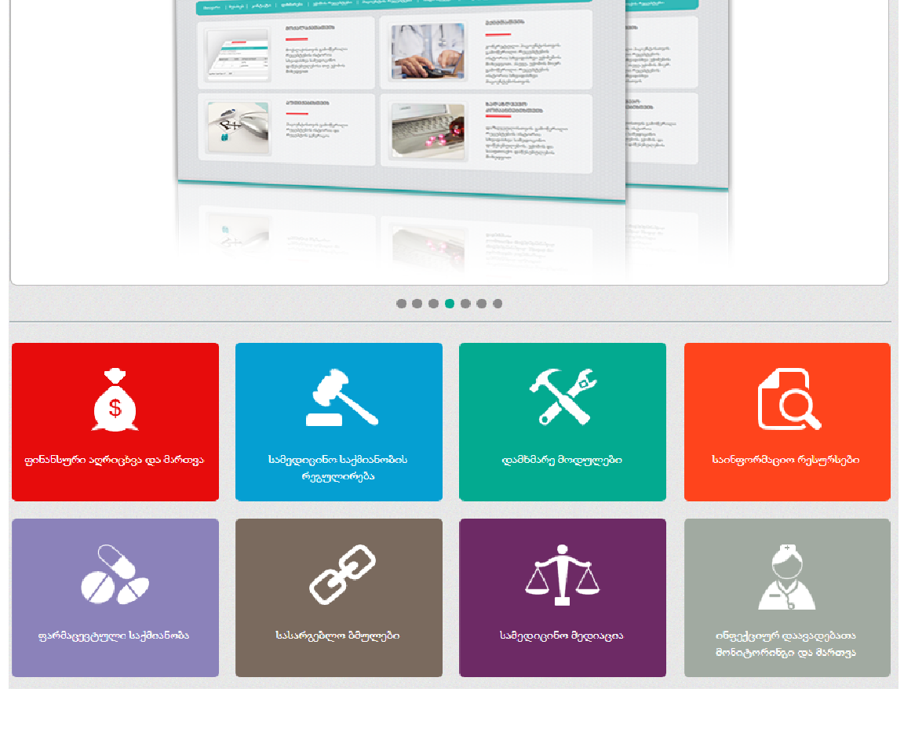
eHealth Modules (HMIS)
ehealth.moh.gov.ge
Target Group – 198,539
Basic Benefit Package – 1,492,665
Veterans Package - 665
Psychiatric Care Program – 29,959
Dialysis Program – 1,926
Contingent of rural Doctors – 1,320,000
Notes:
6

Slide 7
Ratinale for Building the HMIS
Problems
✗
1. Data quality and standardization issues
Double data
Different Standarts
✗
2. Information asymmetry and fragmentation
Defferent Data Flow
…
✗
3. Limited data for informed policy
Decision-making
…
✗
4. Limited administrative resources
…Need For Optimization
…

Slide 8
HIMS eHealth Module
With SubModules
E-Reporting for Insurance
Companies
Beneficiary Registration
Module
Case Registration Module
Healthcare Program Financing
Module
HMIS ehealth.moh.gov.ge
Guarantee Administration
Module
Notes:
8

Slide 9
Why HMIS Matters?
Purpose of HMIS System Benefits
Evidence-based decision and policy making
Common standards
Real-time information exchange
Standardized and transparent processes including service quality
Organized financial and medical data
Improved effectiveness and control of healthcare programs, cost reduction
Statistics and analysis
Notes:
9

Slide 10
HMIS Coverage and Impact
Fiscal impact (last 5 months)
>$16M reimbursed to health facilities
>93K beneficiary duplications eliminated resulting in savings of $61K
Users of the HMIS
80% of hospitals and PHC units
100% of rural doctors
>39K doctors registered
7000 active unique users
Unique patients served
1,794,548 patients

Slide 11
EMR

Slide 12
cEMR Project Objectives
Phase -1
Deliver an effective solution that can be replicated
5. Create a foundation EMR Citizen read only view of a citizen’s medical record that can be accessed using their mobile device.
6. Provide Train the Trainer Training
4. Create a foundation GP portal as defined in workshops
3. Create a foundation Citizen portal as defined in workshops
2. Enable the collection of patient-related activity data
1. Develop a system to store electronic medical records (EMR)

Slide 13






Doctors
Hospital
Doctors’ Portal
Simple forms
HL7 web services
MoLHSA
EMR application & repository
wHospital Framework Manager
Citizens
Citizens’ Portal
Mobile EMR

Slide 14
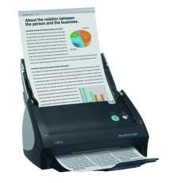

If everyone can share the information electronically
Better access to patient information
Reduced administration costs
Better patient care
ADT / HIS
Data Driven
EMR
Data+Text
Driven
RIS
Data+Text
Driven
HL7
HL7
HL7
Integration Engine / Information Bus
XDS
HL7
XDS
HL7
DICOM
Documents
DMS
Content Driven
PACS
Data+DICOM
Driven
DICOM

Slide 15

GP Portal
Insertion of new patients into the patient list for the Operational Unit
Search and selection of patients already in the Operational Unit Patient List
Patient Consent Management
Patient Authorisation Management
Appointment Scheduling
Patient Clinical Forms Functionality
Patient Clinical View Functionality
Patient Lab Results Functionality
Patient Visit Functionality
Document Versioning and Audit Trail

Slide 16
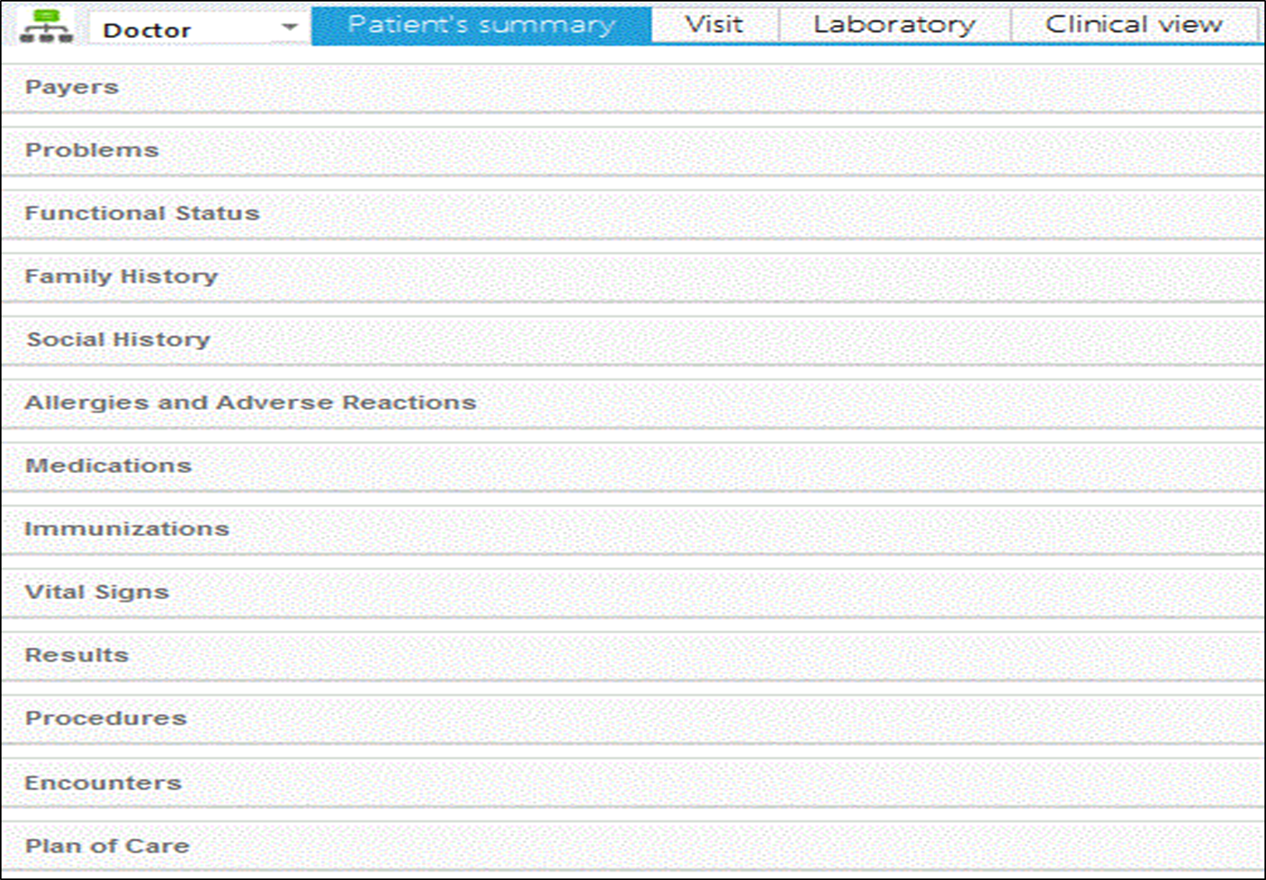

Slide 17
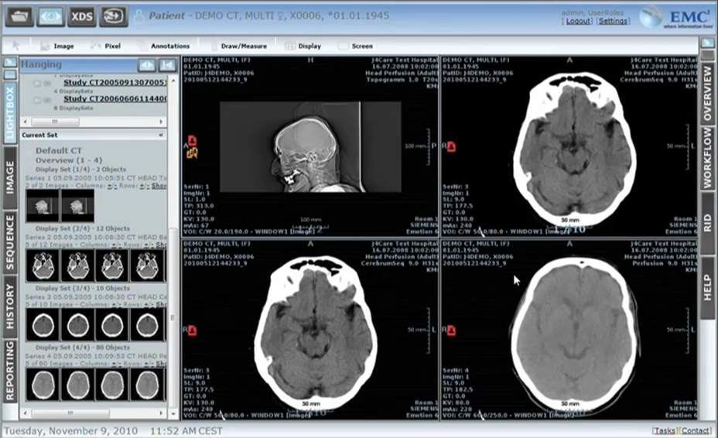

Slide 18
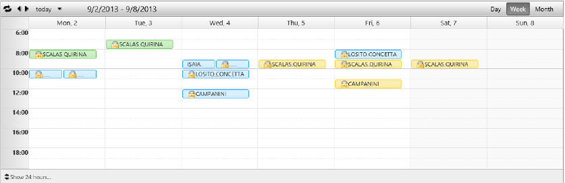
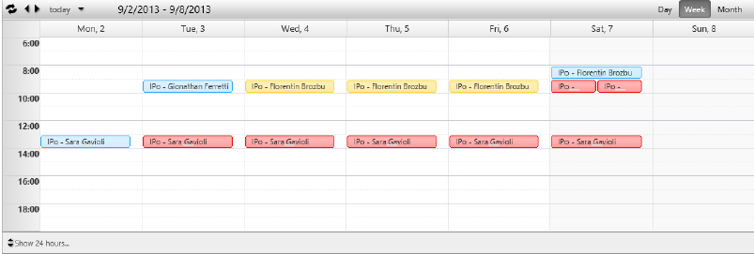

Slide 19
Hospital Portal
Inpatient Admission and Discharge
Outpatient Patient List
Patient Consent Management
Patient Authorisation Management
Patient Summary Functionality
Patient Clinical View Functionality
Patient Laboratory Functionality
Hospital Forms Functionality

Slide 20
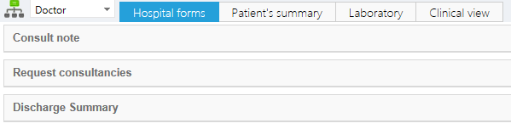
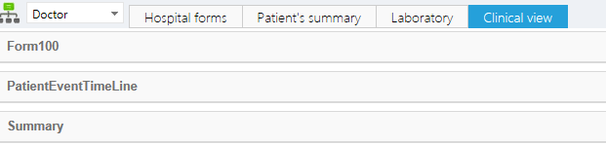

Slide 21
GP / Hospital Portal - Benefits
Usage of system ensures compliance with MoLHSA regulations
Avoids possibility of misdiagnosis / mis-prescribing
On-line access to information about doctor/ patient encounter – With patient consent or directly in case of emergency
Allows visibility of previous encounters to enable better health management, disease prevention, treatment and rehabilitation
Support effective administration practices

Slide 22
MoLHSA Portal
Centralised system
Ensure compliance with regulations
Collation of statistical data
Epidemiological
Operation unit
Creation of new forms
Able to view patient records and monitor the quality of services

Slide 23
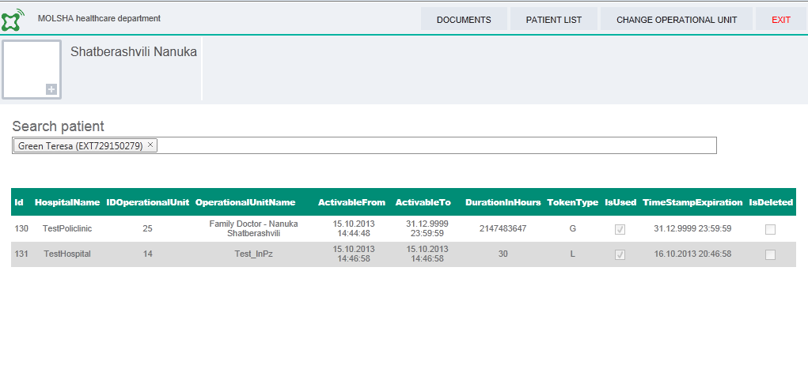

Slide 24
MoLHSA Portal - Benefits
Enables users from different agencies or departments to view unified patient history
Single source of information
Improved HealthCare Management
Information to improve decision making
Information to improve Regulatory compliance

Slide 25
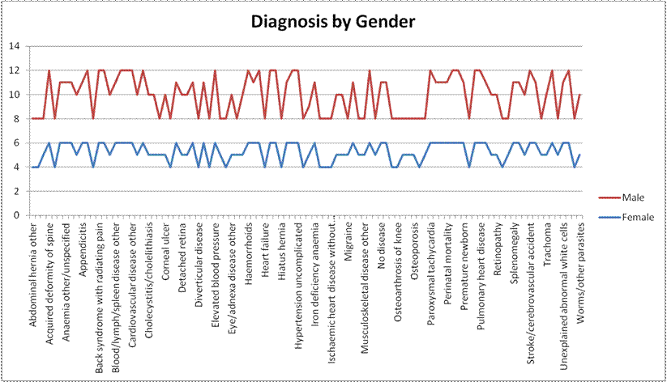

Slide 26
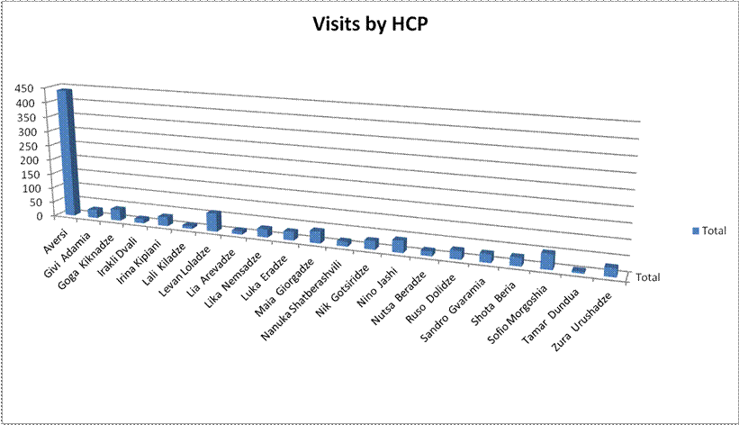

Slide 27
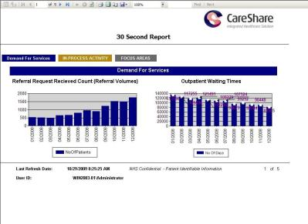
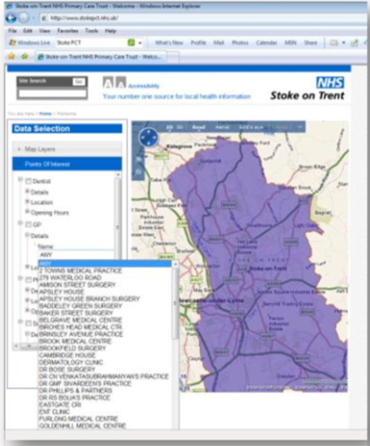
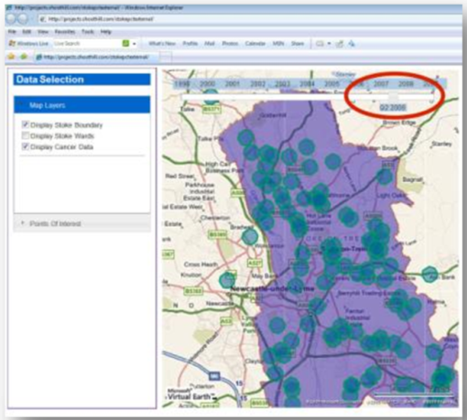
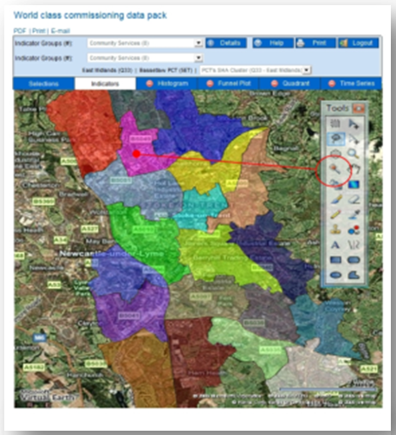
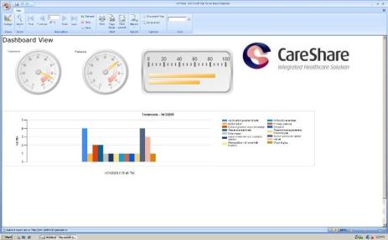
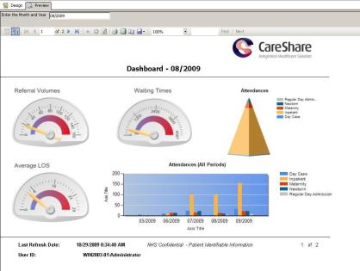
© Copyright 2013 EMC Corporation. All rights reserved.

Slide 28
Citizen Portal
Patient cEMR Summary
Patient cEMR details for each Operational Unit attended
Lab Results Viewer
Document Viewer
Surveys
Mobile Application Configuration
Manage Consent
Manage Authorisation

Slide 29
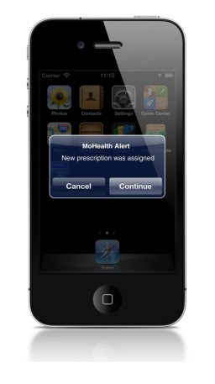

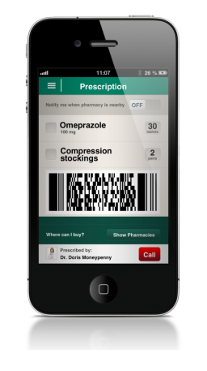
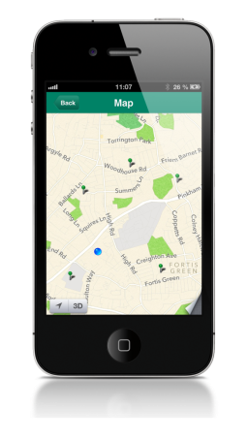

Prescription Issued to Citizen, Accessed on Phone, Data pulled from HIP, GPS and Maps linked to Dispensary Locations

Slide 30
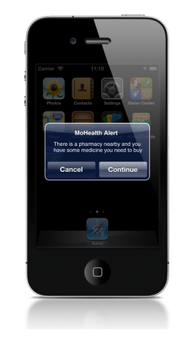
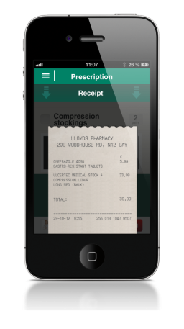
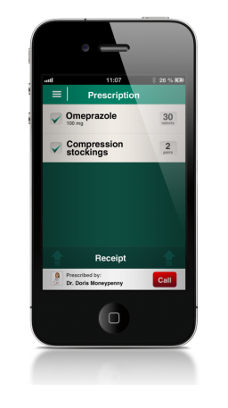

Arrived at drug dispensary, Fulfilled by Chemist, Contactless Payment, Written back to Central EMR, Receipt Stored on Device

Slide 31
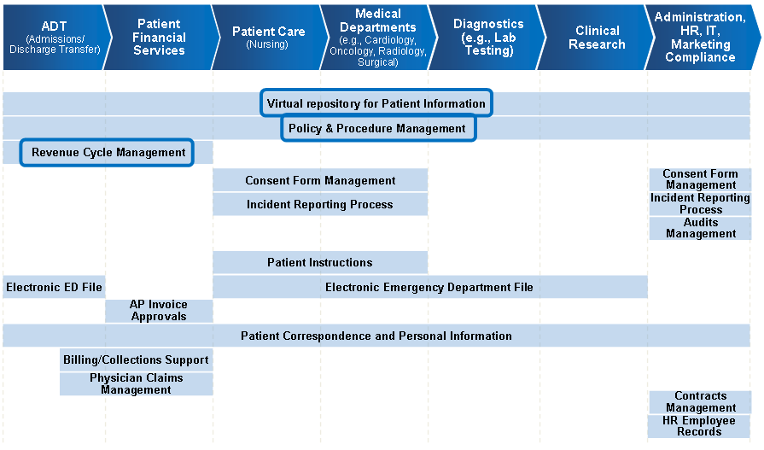
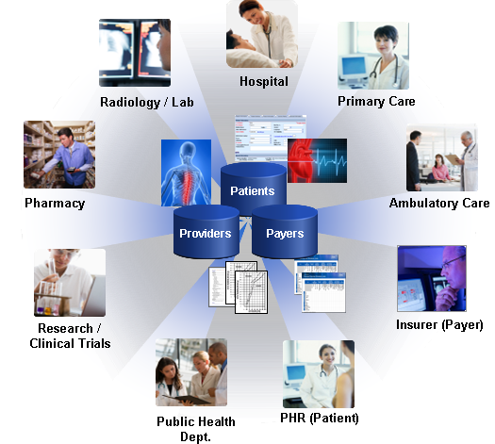
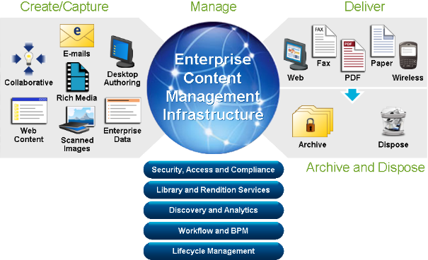
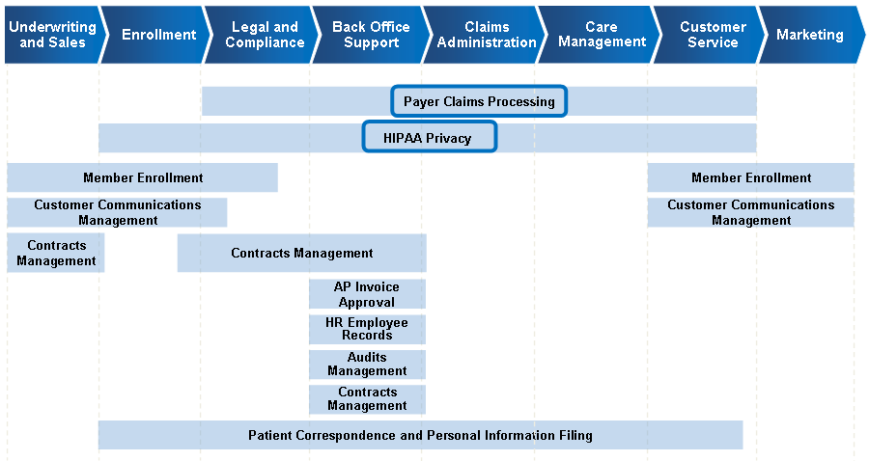
Healthcare Transformation
Adoption of a Platform Strategy
Implementation of Point Solutions in a Phased Approach
Build an Information Ecosystem
Supplier
Provider
Payer
Public Health
Step 1
Step 2
Step 3
Notes:
Title
Month Year
31
31

Slide 32
Strategy on 2014-2016 years
Integration
HIMS Modules Synchronization with cEMR.
One Integration Framework and Standard.
eHealth Information Management System.
HSSP
HIMS + Standards+
CEMR
Notes:
32
32

Slide 33

Steps and Goal
Roadmapping
2016 CEMR With eHEalth Modules and Pacient Portal.
GOAL
Step2
2015 Systems Piloting and Implementation in in Hospitals
Step1
2014 IT Reorganisation, Competition Center, Integration.

Slide 34
Universal Health Care Program
Healthy Citizen
cardio surgery
5568
Childbirth and caesarean section
105180
Urgent inpatient services
369305
Chemo, hormone and radiation therapy 68857
Urgent outpatient services
1119632
1668542 citizen

Slide 35

Referral services program
Healthy Citizen
31 558 - case
61 123 750 - GEL

Slide 36


Hepatitis C elimination program
Healthy Citizen
3100 patient

Slide 37
Thank You

