Slide 1


Developing National Health Strategy of Georgia
Dr Lajos Kovács
PAR Project
March 2021

Slide 2
Content
1. Developing National Health Strategy
  PAR Project, EU Support, Implementing Team
2. Outline of National Health Strategy
  Overarching Goals
  Situational Analysis
  Vision, Mission, Principles and Strategic Objectives
  Strategic Framework, Specific Objectives, Indicators and Targets
  Resource Plan
  Implementation, Risks and Assumptions
3. Health System Strengthening versus Health System Reform
  Health System Strengthening and Novel Solutions of Health System Reform
4. Developing Strategy
  Ownership and Leadership / Ministry of Health and UHC Board
  Roadmap / Working Groups and Policy Dialogue
  National Health Strategy document

Slide 3
1. Developing National Health Strategy
Public Administration Reform Project
Funded by the European Union
Implemented by Sofreco, France
Health component: support to MoIDPLHSA
  Support to developing NHS
  Support to response to COVID-19
Implementing Team:
  Experts in Health Policy and Strategic Planning
  Expert in Policy Planning
  Expert in Developing and Costing Action Plan
Deliverables
  Guide to NHS Development
  Outline of NHS

Slide 4
2. Outline of National Health Strategy
Overarching Goals
Situational Analysis
Vision, Mission, Principles, Challenges and Strategic Objectives
Strategic Framework, Specific Objectives, Indicators and Targets
Resource Plan
Implementation, Risks and Assumptions

Slide 5
Overarching Goals
Linkages to the policy and national development frameworks
  2014-2020 State Concept of Healthcare System of Georgia for 'Universal Health Care and Quality Control for the Protection of Patients' Rights serves as a national policy framework
  The Healthcare and Social Issues Committee of the Parliament of Georgia developed a vision for developing the healthcare system in Georgia by 2030
Linkages to international development frameworks
  Sustainable Development Goals
  Association Agreement with European Union
Process for development of National Health Strategy and the layout of the strategic plan document
  Policy Planning, Monitoring and Evaluation Handbook prepared by the Administration of the Government of Georgia and published in the Decree of the Government of Georgia No. 629 of 20 December 2019 on the approval of the rules of procedure for development, monitoring and evaluation of policy documents

Slide 6
Situational Analysis
Understand the population | Understand the service environment | Identify the health service needs
Profile the population (demography and trends) | Scan the environment (including impact of environment on health status) | Identify health issues (including current and projected needs for health care)
Profile and understand the health status of the population (epidemiology and trends) | Profile the geographical context (including physical access to health services) | Identify health service issues (including current and projected issues)
Profile the health status (risk factors and determinants of health) | Profile service arrangements (including organization and quality of service delivery) | Develop an approach to categorise and analyse needs
Methodology | PESTEL Analysis | SWOT Analysis
Stakeholder Analysis | Problem Tree Analysis | Assessment of health system functions and building blocks

Slide 7
Vision and Mission
Vision
People and communities in Georgia receive the quality health services they need, and are protected from health threats, without suffering financial hardship
Mission
Reinforce health services into a modern high performing quality health system, that is patient-centred, accessible, equitable, efficient and innovative.
Improve quality of life of the population through the prevention of communicable and non-communicable diseases, promote healthy lifestyles and an environment conducive to health.
Harness the full potential of Information and Communication Technology to empower people to live healthy lives.
Ensure the available human, financial and physical resources lead to the achievement of better health outcomes.

Slide 8
Principles
Health is a basic human right | Equity | Shared values among all stakeholders
Good Health is a priority need of the population | Accountability | Governance and leadership
Health is a driver of socio-economic development | Transparency and solidarity | Efficiency and cost-effective use of resources
Vision for developing the healthcare system in Georgia by 2030
Protection of human rights in healthcare and the inviolability of honour and dignity in both civilian and penitentiary systems;
Fair distribution of lifelong healthcare risk management between an individual, the market and the government;
Compatibility with the country’s economic and demographic development trends and the general vision of social policy;
Focus on primary healthcare, integrated service-based approaches and declaring disease prevention and primary healthcare as the fields of priority;
Exclusive responsibility of the state for public health and public health programs;
Common rules on the healthcare market: equal coexistence of public and private sector representatives under general, homogenous regulations.

Slide 9
Challenges
Fragmented health system
Limited health expenditures and inefficiencies
Poor health status and epidemiology
Poorly regulated and heavily privatized and monopolized healthcare market
Lack of regulatory and legislative frameworks for effective public-private partnerships
Poor health infrastructure in rural areas
Insufficient human resources for health – especially, nurses
Poorly regulated continuous professional development
Weak regulations of the pharmaceutical system – leading to high OOP on pharmaceutical products
Need for capacity building at the Ministry and its agencies

Slide 10
Common areas of support
Strengthen Primary Healthcare - including family medicine and digital health;
Reduce risks of catastrophic health expenditures – out-of-pocket payments on pharmaceuticals and other;
Improve public-private partnerships - hospital, insurance and pharmaceutical sectors;
Increase access to health services across the country – avoid unequal distribution of health outcomes, over-diagnosis;
Improve legal and regulatory frameworks - contracting service providers and updating clinical guidelines;
Optimize health financing – introducing the DRGs and increase efficiency of the UHC program;
Underpin Human Resources for Health – addressing shortage of nurses, ensuring continuous medical education, reducing brain drain and responding to unequal distribution of wages;
Strengthen infrastructure in public hospitals while maintaining partnerships with private clinics;
Operationalize monitoring and evaluation frameworks - country-focused indicators which can also offer the bass for global monitoring, monitoring program inputs, processes and results; tracking health systems performance; and evaluation.
Advance the national preparedness strategy to ensure resilience of the health system;
Reach the consensus with all actors within the health sector and beyond and develop common strategic directions for the NHS.

Slide 11
Strategic objectives
Strengthen governance
Ensure adequate and sustainable funding and improve efficiency of health financing
Build up human capital
Develop efficient pricing system and ensure supply of high quality, effective and safe medicines;
Extend digitalization and e-health solutions and develop health management information system
Strengthen health care delivery system and improve quality of health care services
Ensure effective public health services

Slide 12
Indicators and Targets
Indicator | Baseline 2021 | Target 2025 | Data Source
Life expectancy at birth |  | increase
Healthy life expectancy |  | increase
Infant mortality rate |  | reduction
Under five mortality rate |  | reduction
Maternal mortality ratio |  | reduction
Mortality from cardiovascular diseases, cancer, diabetes and chronic respiratory diseases |  | reduction
Universal Health Coverage |  | increase

Slide 13
Strategic Goal 1 Strengthen governance
Strengthen planning, monitoring and evaluation – National Health Strategy
Ensure accountability and transparency
Improve management capacities at central and subnational levels
Increase autonomy of public health facilities
Strengthen public health administration (e.g. surveillance, epidemiology, and laboratory services)
Develop national health information system
Strengthen intersectoral cooperation
Improve cross-programmatic efficiency
Introduce health in all policy in public administration

Slide 14
Strategic Goal 2. Ensure adequate and sustainable funding and improve efficiency of health financing
Introduce strategic purchasing of health services
Increase public funding for health and improve mobilization of resources
Promote equity in the allocation of financial resources
Ensure adequate and sustainable financing for health
Develop efficient financing techniques to improve efficiency of financing of health care services
Improve efficiency of financing through efficient management of financial resources and management of health facilities
Develop public-private partnership in health system

Slide 15
Strategic Goal 3. Build up human capital
Improve Human Resources planning and development
  (qualification standards, job descriptions, performance assessment, continuous professional development, employment conditions, incentive system, innovative research, etc.)

Slide 16
Strategic Goal 4. Develop efficient pricing system and ensure supply of high quality, effective and safe medicines
Develop efficient pricing system for medicines
Ensure supply and access of high quality, effective and safe medicines

Slide 17
Strategic Goal 5. Extend digitalization and e-health solutions and develop health management information system
Adjust regulatory framework for HMIS/digital health
Strengthen digital infrastructure of health facilities
Build capacities of health information personnel
Develop and introduce new telemedicine and e-health solutions

Slide 18
Strategic Goal 6. Strengthen health care delivery system and improve quality of health care services
Strengthen person-centred community-based integrated primary health care
Define and ensure basic benefit package for the entire population covered for primary health care
Develop health promotion, prevention, diagnosis, treatment and management of diseases at all levels of care
Consider integrating vertical programmes into integrated primary health care
Reduce morbidity and mortality from infectious diseases by improved vaccination
Reduce premature mortality due to non-communicable diseases
Promote health and healthy life-style
Facilitate equal access to quality health care services to all people
Provide equitable physical and economic access of the population to essential medicines

Slide 19
Strategic Goal 7. Ensure effective public health services

Slide 20
Resource Plan
It is crucial to assess the needs and to plan the use of the various resources that will be required to undertake the interventions.
The strategy should consider what resources (e.g. financial, human resources) already exist, and what additional resources will be required over the period of the implementation.
Please also refer to the note on methodology for budgeting and costing Action Plan.

Slide 21
Implementation
Governance, coordination, and implementation arrangement: Who will do what and when? How to mobilize resources? What are the potential sources of funding?
Monitoring and Evaluation Plan: What are the indicators? Periodicity for indicator monitoring? What are the sources of data and methods of data collection? How will we measure progress, plan for strategic plan refreshment? Periodicity for indicator monitoring and reviews and evaluations (annual reviews, mid-term reviews, end evaluation).
To ensure that monitoring and evaluation is facilitated, a monitoring and evaluation plan should be developed indicating the activities to be undertaken, when and by whom. The Action Plan should be costed, and the cost of the plan included in the overall cost of the strategic plan.

Slide 22
Risks and Assumptions
It is especially important to understand the risks associated with the implementation of the strategic plan. Risk analysis refers to analysis of factors which may influence the implementation of the plan and hence the achievement of objectives. It is necessary to identify both internal and external risks, and alternative strategies that may be needed to manage the risk.
Assumptions describe situations and conditions, which are necessary for success, but which are largely beyond the control of the governing or implementing organisations. Thus, it is needed to look at the institutional context (e.g. laws, political commitments, trends in financing) in addition to other possible impact of the environment.

Slide 23
3. Health System Strengthening versus Health System Reform
Strategic goal
To achieve Universal Health Coverage, which ensures equitable access to affordable and quality health services.
  Access to quality services needed
  With financial risk protection
  For everyone

Slide 24
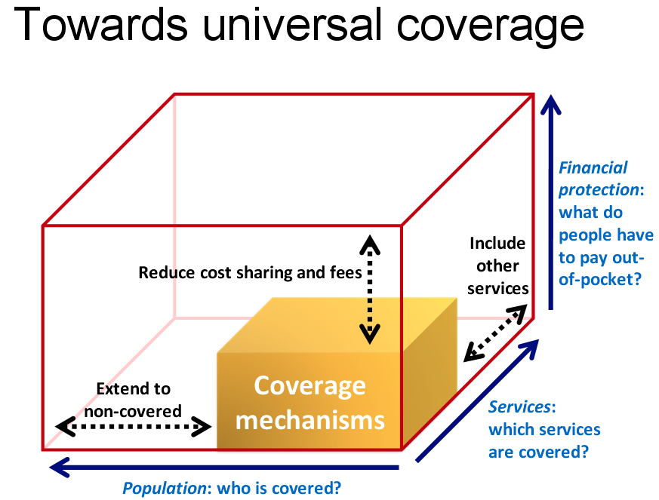
Source: WHO, World Health Assembly, 2013.

Slide 25
Health System Reform - Novel Solutions
Strengthen governance – Public Administration Reform
Ensure adequate and sustainable funding and improve efficiency of health financing – Capitation + Result-based component in Primary Health Care, Result-based financing (DRGs/tariffs) in hospital financing, Strategic purchasing
Build up human capital – Qualification Standards for Health Professionals, and Continuous Professional Development
Ensure efficient pricing system and supply of high quality, effective and safe medicines – National Drug Policy / New Law
Extend digitalization and e-health records and develop health management information system
Strengthen health care delivery system and improve quality of health care services – PHC Gatekeeping, Health Care Accreditation System
Ensure effective public health services – Post-COVID-19 strategies

Slide 26
4. Developing National Health Strategy
Ownership and Leadership
  Ministry of Health
    UHC Board (Objectives, Members, Accountability, Operation, etc.)
Roadmap
  Working Groups
  Policy dialogue and communication
National Health Strategy Document

Slide 27
Thank you for your attention!

