Slide 1


COVID-19 MONITOR
Europe and central Asia
[Unless otherwise specified, data is as of March 26]
03/28/2021

Slide 2
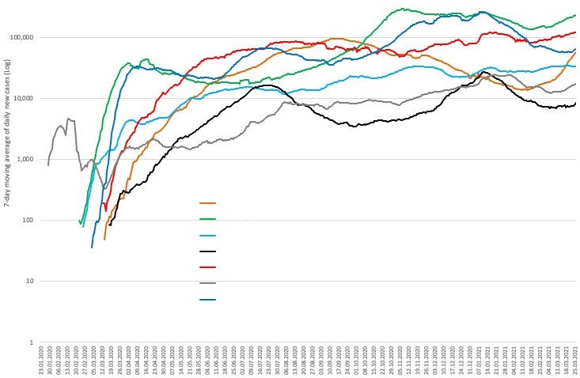
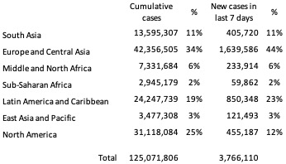
Cumulative and new COVID-19 cases by World Bank region in all countries

Slide 3
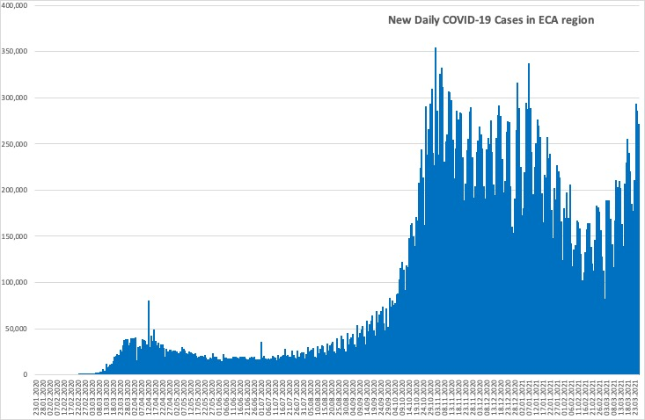
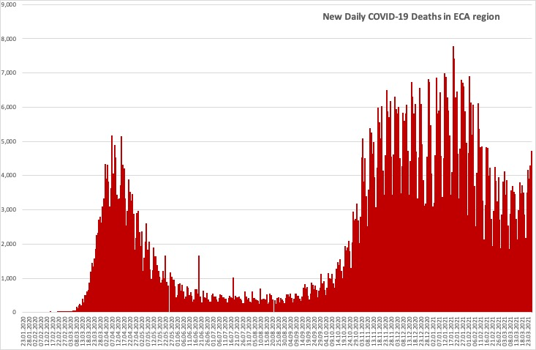
Daily COVID-19 cases and deaths in the region in all countries
A third wave of cases has commenced across countries in the region.

Slide 4




COVID-19 cases, mortality, vaccination, and testing in client countries
CASES
DEATHS
VACCINATION
TESTS
Total:
26,065,034 cases
Last week:
+ 1,000,131 (4%)
Total:
544,132 deaths
Last week:
+ 18,924 (4%)
Total:
61,189,049 doses
Last week:
+ 9,240,549 (18%)
Total:
347,508,148 tests
Last week:
+ 8,197,105 (2%)
Last week: 19th - 26th March 2021

Slide 5
Country-level: cases, mortality and testing
Client countries | Cases per 100,000 | Deaths per 100,000 | Tests per 100,000 | Vaccines per 100,000 | Case Fatality Rate, % | Test Positivity Rate, %
Albania | 4,317 | 76.8 | 18,949 | 2,181 | 1.8 | 22.8
Armenia | 6,355 | 115.8 | 27,928 | NR | 1.8 | 22.8
Azerbaijan | 2,510 | 34.2 | 27,980 | 5,070 | 1.4 | 9.0
Belarus | 3,363 | 23.4 | 56,245 | 319 | 0.7 | 6.0
Bosnia and Herzegovina | 4,635 | 177.9 | 22,008 | NR | 3.8 | 21.1
Bulgaria | 4,679 | 181.3 | 29,383 | 6,189 | 3.9 | 15.9
Croatia | 6,461 | 143.2 | 36,974 | 10,195 | 2.2 | 17.5
Cyprus | 5,020 | 28.3 | 349,880 | 14,778 | 0.6 | 1.4
Czech Republic | 14,058 | 239.8 | 109,317 | 14,484 | 1.7 | 12.9
Estonia | 7,644 | 63.7 | 84,032 | 17,728 | 0.8 | 9.1
Finland | 1,349 | 14.7 | 69,878 | 16,211 | 1.1 | 1.9
Georgia | 7,493 | 100.2 | 87,176 | NR | 1.3 | 8.6
Greece | 2,326 | 72.3 | 58,919 | 14,665 | 3.1 | 3.9
Italy | 5,780 | 177.7 | 80,291 | 14,970 | 3.1 | 7.2
Kazakhstan | 1,547 | 17.2 | 45,097 | 589 | 1.1 | 2.8
Kosovo | 4,688 | 100.9 | NR | NR | 2.2 | NR
Kyrgyzstan | 1,375 | 23.4 | 13,018 | NR | 1.7 | 10.6
Latvia | 5,308 | 99.0 | 96,935 | 6,669 | 1.9 | 5.5
Lithuania | 7,812 | 129.6 | 84,654 | 17,333 | 1.7 | 9.2
North Macedonia | 6,014 | 173.7 | 29,269 | NR | 2.9 | 20.5
Moldova | 8,352 | 176.9 | 30,943 | 1,146 | 2.1 | 27.0
Montenegro | 14,363 | 198.3 | 53,128 | 2,369 | 1.4 | 27.0
Poland | 5,706 | 133.7 | 30,250 | 14,995 | 2.3 | 18.9
Portugal | 7,976 | 163.7 | 87,089 | 14,650 | 2.1 | 9.2
Romania | 4,771 | 117.6 | 36,898 | 14,422 | 2.5 | 12.9
Russia | 3,032 | 65.0 | 80,926 | 7,221 | 2.1 | 3.8
Serbia | 8,212 | 72.9 | 48,080 | 32,782 | 0.9 | 17.2
Slovakia | 6,517 | 171.9 | 42,354 | 15,971 | 2.6 | 15.4
Spain | 6,911 | 159.3 | 88,927 | 15,005 | 2.3 | 7.8
Tajikistan | 146 | 1.0 | NR | NR | 0.7 | NR
Turkey | 3,787 | 37.0 | 45,017 | 17,427 | 1.0 | 8.4
Ukraine | 3,978 | 79.0 | 18,848 | 459 | 2.0 | 20.5
Uzbekistan | 246 | 1.9 | 4,143 | NR | 0.8 | 5.9
Cases per 100,000 population range from 146 in Tajikistan to 14,363 in Montenegro.
Case fatality rates remain below 4.0% in all client countries.
There is significant variation in testing rates per 100,000 population from 4,143 in Uzbekistan to 349,880 in Cyprus.
The test positivity rate ranges from 1.4% in Cyprus to 27.0% in Montenegro.
The vaccination per 100,000 population ranges from 319 in Belarus to 32,782 in Serbia.
* Data on vaccination number for
Belarus is the latest available, specifically as of March 12, 2021
Kazakhstan is the latest available, specifically as of March 18, 2021
Cyprus is the latest available, specifically as of March 20, 2021
Russia is the latest available, specifically as of March 22, 2021
Estonia, Ukraine is the latest available, specifically as of March 25, 2021

Slide 6
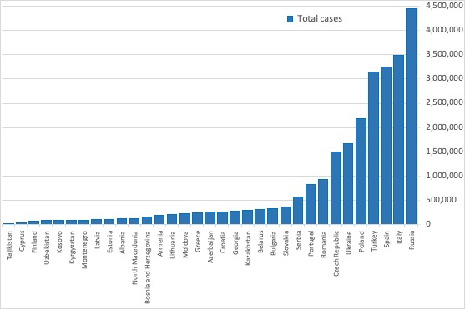
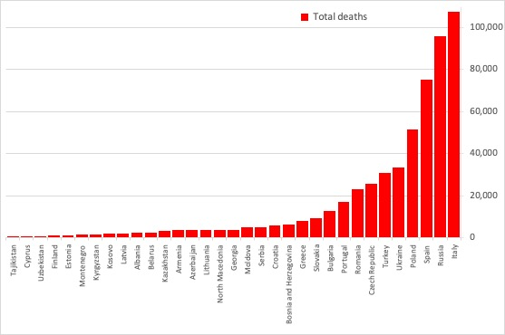
Total cases and deaths in client countries
Countries with the highest number of cases and deaths:
• Cases: Russia (4.451 M), Italy (3.488 M),Spain (3.255 M), Turkey (3.149 M), Poland (2.189 M).
• Deaths: Italy (107,256), Russia (95,410), Spain (75,010), Poland (51,305), Ukraine (33,068).
Countries with the lowest number of cases and deaths:
• Cases: Tajikistan (13,308), Cyprus (43,971), Finland (74,754), Uzbekistan (81,960), Kosovo (84,172).
• Deaths: Tajikistan (90), Cyprus (248), Uzbekistan (624), Finland (817), Estonia (847).

Slide 7
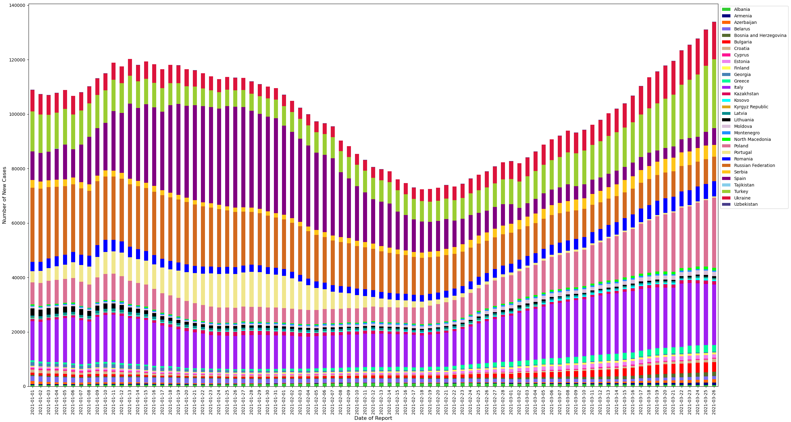
Rolling 7-day average of new cases
​This chart plots the 7-day average of new cases between January 1st and March 26th among client countries.
The contributions of Poland and Turkey have been increasing relative to the other countries.
Note: Given the spike in case reporting on Monday, we re-distribute equally across Saturday, Sunday, and Monday in this case.

Slide 8
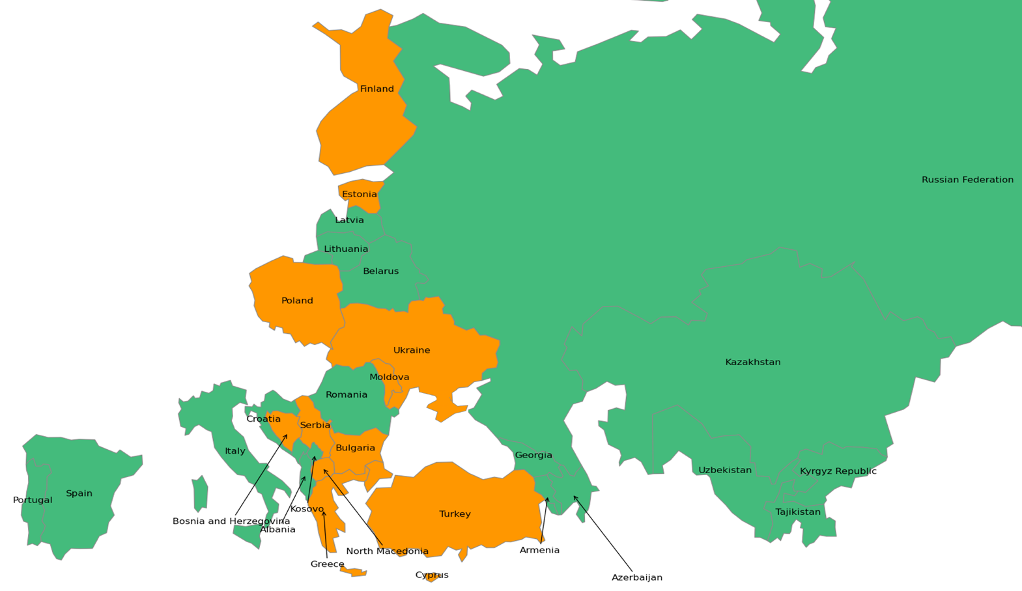
Most recent two-week span: percent increase in total cases
This map shows the % change in the total cases in the current week (March 19th to March 26th) compared to the preceding week (March 13th to March 19th)
Estonia (9%), Bulgaria (9%) and Poland(8%) have recorded the highest percentage increases in total cases.
Estonia has recorded percentage increase above 10% for four consecutive weeks.
Color | Percent Increase | Countries
 | 0% - 5% | Kazakhstan, Uzbekistan, Russian Federation, Tajikistan, Kyrgyz Republic, Armenia, Belarus, Romania, Lithuania, Latvia, Albania, Croatia, Portugal, Spain, Italy, Azerbaijan, Georgia, Montenegro, Kosovo.
 | 5% - 10% | Ukraine, Poland, Moldova, Estonia, Bulgaria, Greece, Turkey, Finland, Cyprus, Bosnia and Herzegovina, North Macedonia, Serbia.
 | > = 10% | Estonia.
Note: Boundaries were cleared by the World Bank Map Design Cartography and Map Clearance Teams.

Slide 9
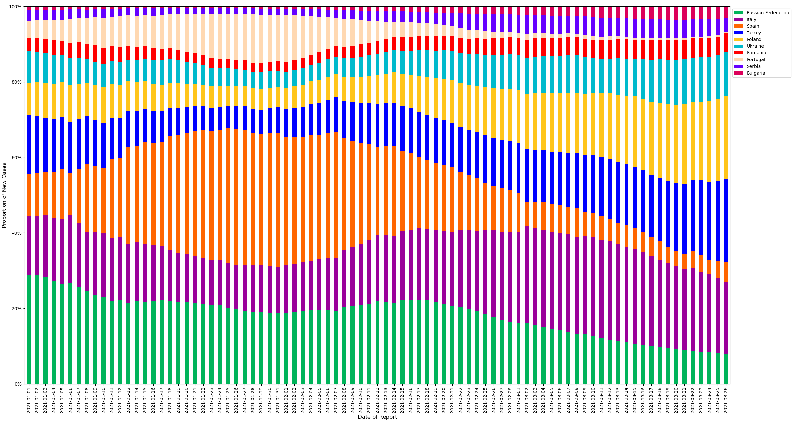
Relative contributions of the 10 client countries with highest case incidence
​This chart plots the proportion of new cases of the total cases in the region between January 1st and March 26th among countries with the highest levels of case incidence.
The 7-day rolling average is computed to adjust for variation in reporting.
The percentage contribution of cases in Turkey, Poland and Italy is increasing.

Slide 10
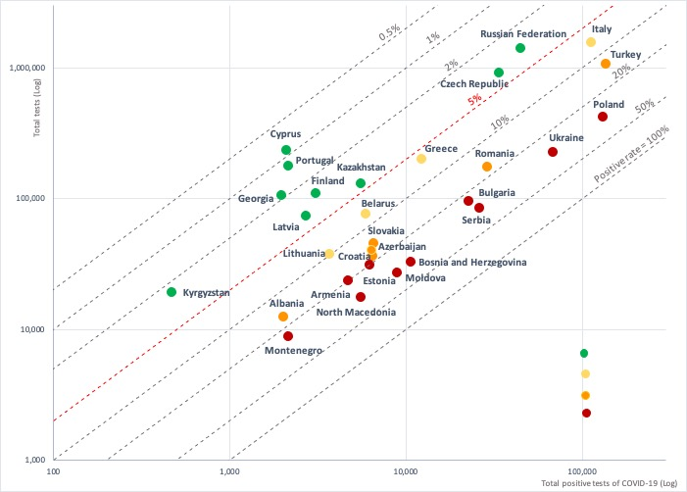

Test positivity rate: total positive COVID-19 tests versus total tests conducted
A test positivity rate of less than 5% is one criterion for informing adjusting of public health and social measures by WHO.
The following countries have testing rates above 5% indicating the need to increase testing and slow transmission:
Armenia, Bosnia and Herzegovina, Bulgaria, North Macedonia, Moldova, Montenegro, Poland, Serbia, and Ukraine have positive rates of above 20%;
Albania, Azerbaijan, Croatia, Estonia, Romania, Slovakia, and Turkey have positive rates of 10-20%;
Belarus, Greece, Italy, Lithuania, and Spain have positive test rates of 5-10%.

Slide 11
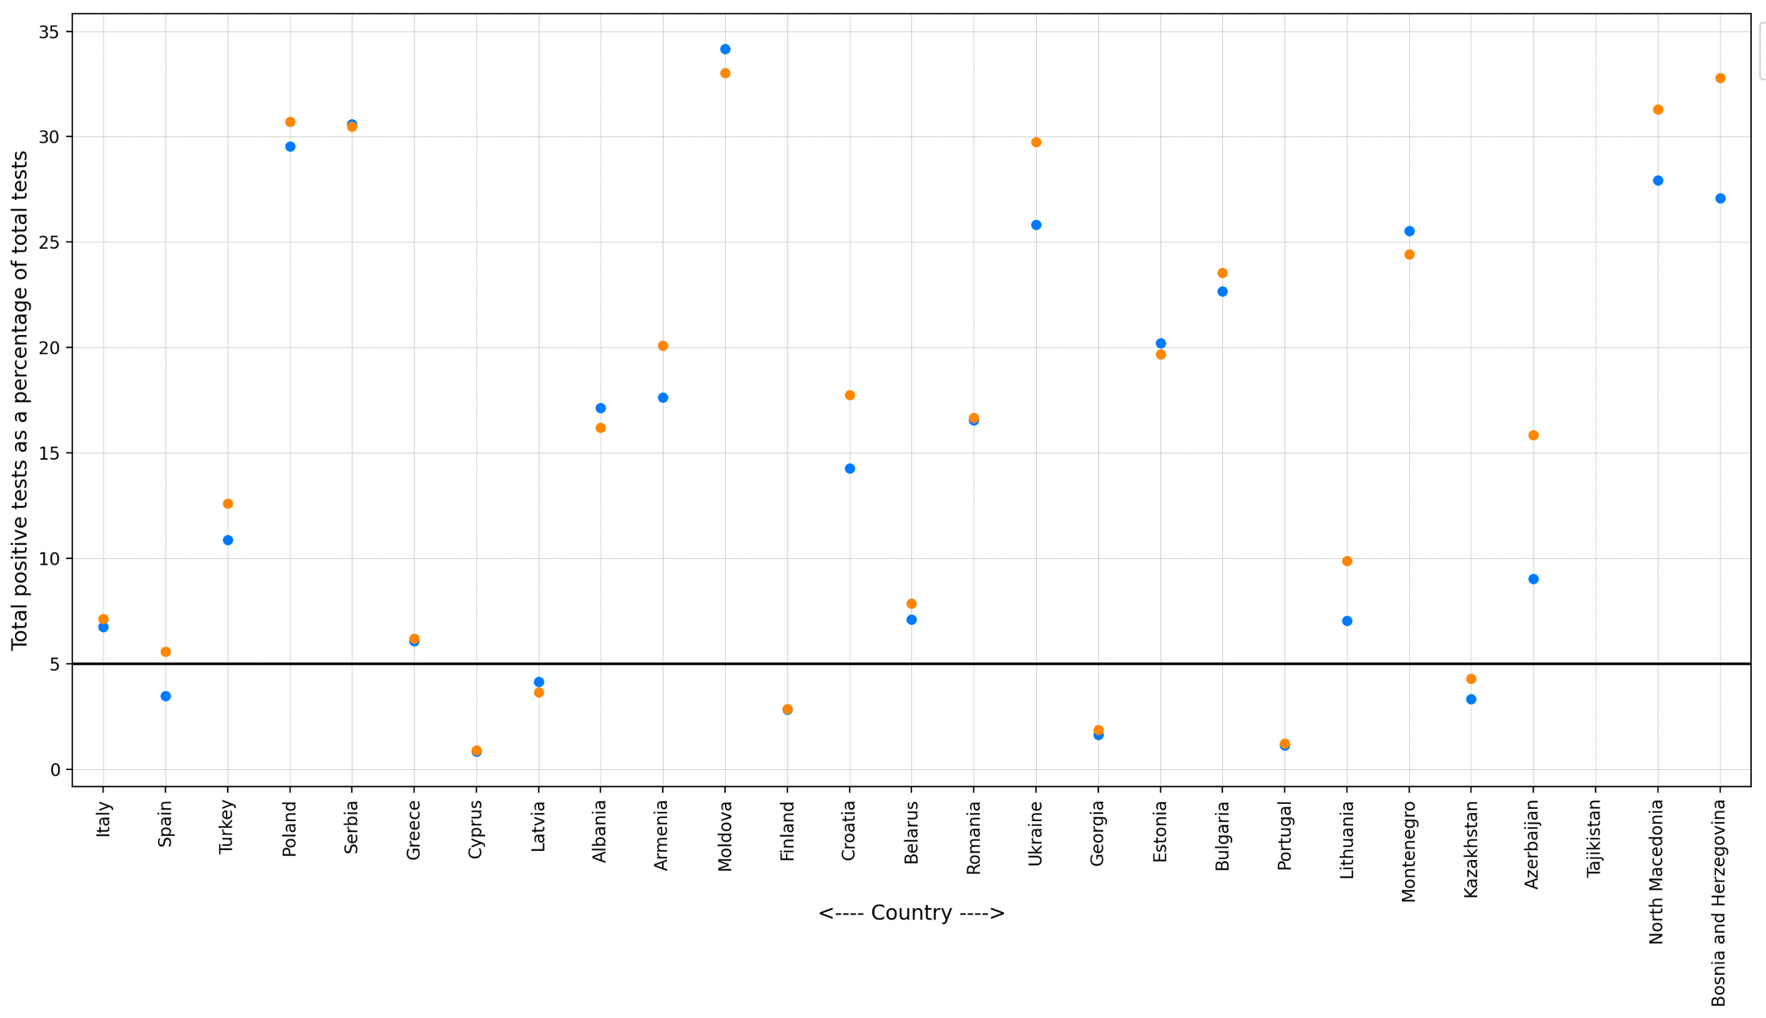
Most recent two-week span: change in test positivity rate
This graph plots the test positivity rate the current week (March 13th to March 19th) compared to the preceding week (March 6th to March 12th).
Over the past week, the test positivity rates in Greece increased from below 5% to above 5%.
Poland, Moldova and Serbia have recorded rates above 25% for two consecutive weeks.

Slide 12
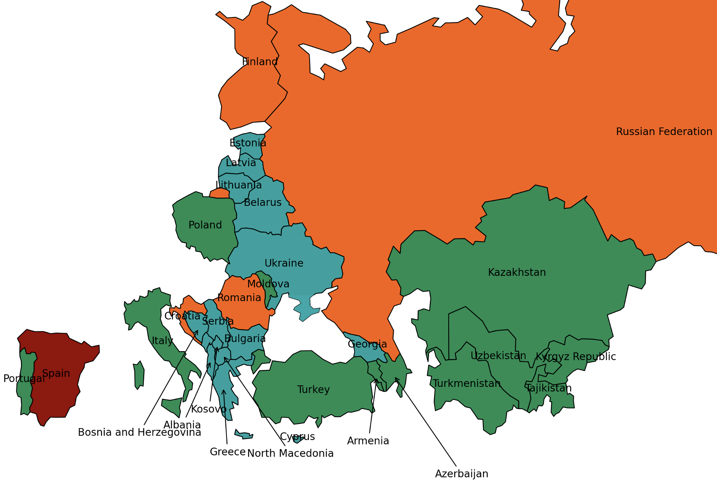
Spread of Coronavirus variants of concern in client countries
This map shows the number of Coronavirus variants of concern (B1.1.7, B.1.351, P.1) present in the client countries up until March 19th.
Variants of concern appear to be more infectious than other circulating Coronaviruses.
Coronaviruses from the B.1.1.7 lineage are thought to be roughly 50 percent more infectious as its transmissibility is greater 40% with increase in virulence/mortality.
Variant B.1.351 has a transmissibility greater than 50%, with a potential for immune escape.
P.1, first found in Japan is a close relative of the B.1.351 lineage, and is also potentially associated with reinfections.
Spain (B1.1.7, B.1.351, P.1) has reported the three Coronavirus variants of concern.
Color | Total Variants | Countries
 | 0 | Kazakhstan, Uzbekistan, Tajikistan, Kyrgyz Republic, Turkmenistan, Armenia, Poland, Moldova, Turkey, Portugal, Italy, Azerbaijan.
 | 1 | Belarus, Ukraine, Lithuania, Latvia, Estonia, Bulgaria, Greece, Albania, Georgia, Cyprus, Bosnia and Herzegovina, North Macedonia, Serbia, Montenegro, Kosovo.
 | 2 | Russian Federation, Romania, Croatia, Finland.
 | 3 | Spain.
Note: Boundaries were cleared by the World Bank Map Design Cartography and Map Clearance Teams.

Slide 13
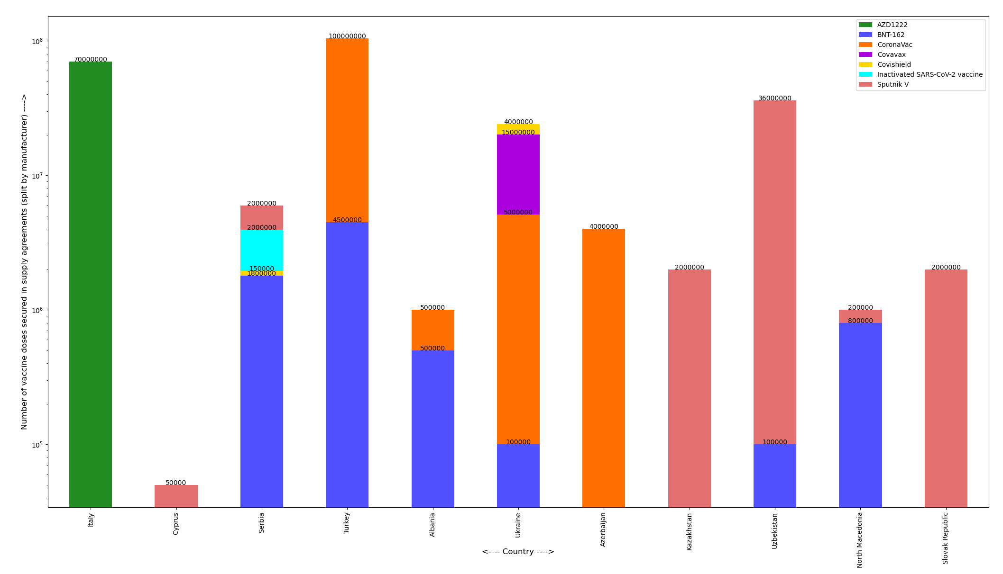
Total number of vaccine doses secured by agreements by manufacturer type
This chart plots the total number of vaccine doses covered until March 26th among client countries with respect to publicly announced agreements, including supply agreements for government purchases and licensing agreements between companies.
Countries not shown do not have data on number of secured doses by manufacturer.

Slide 14
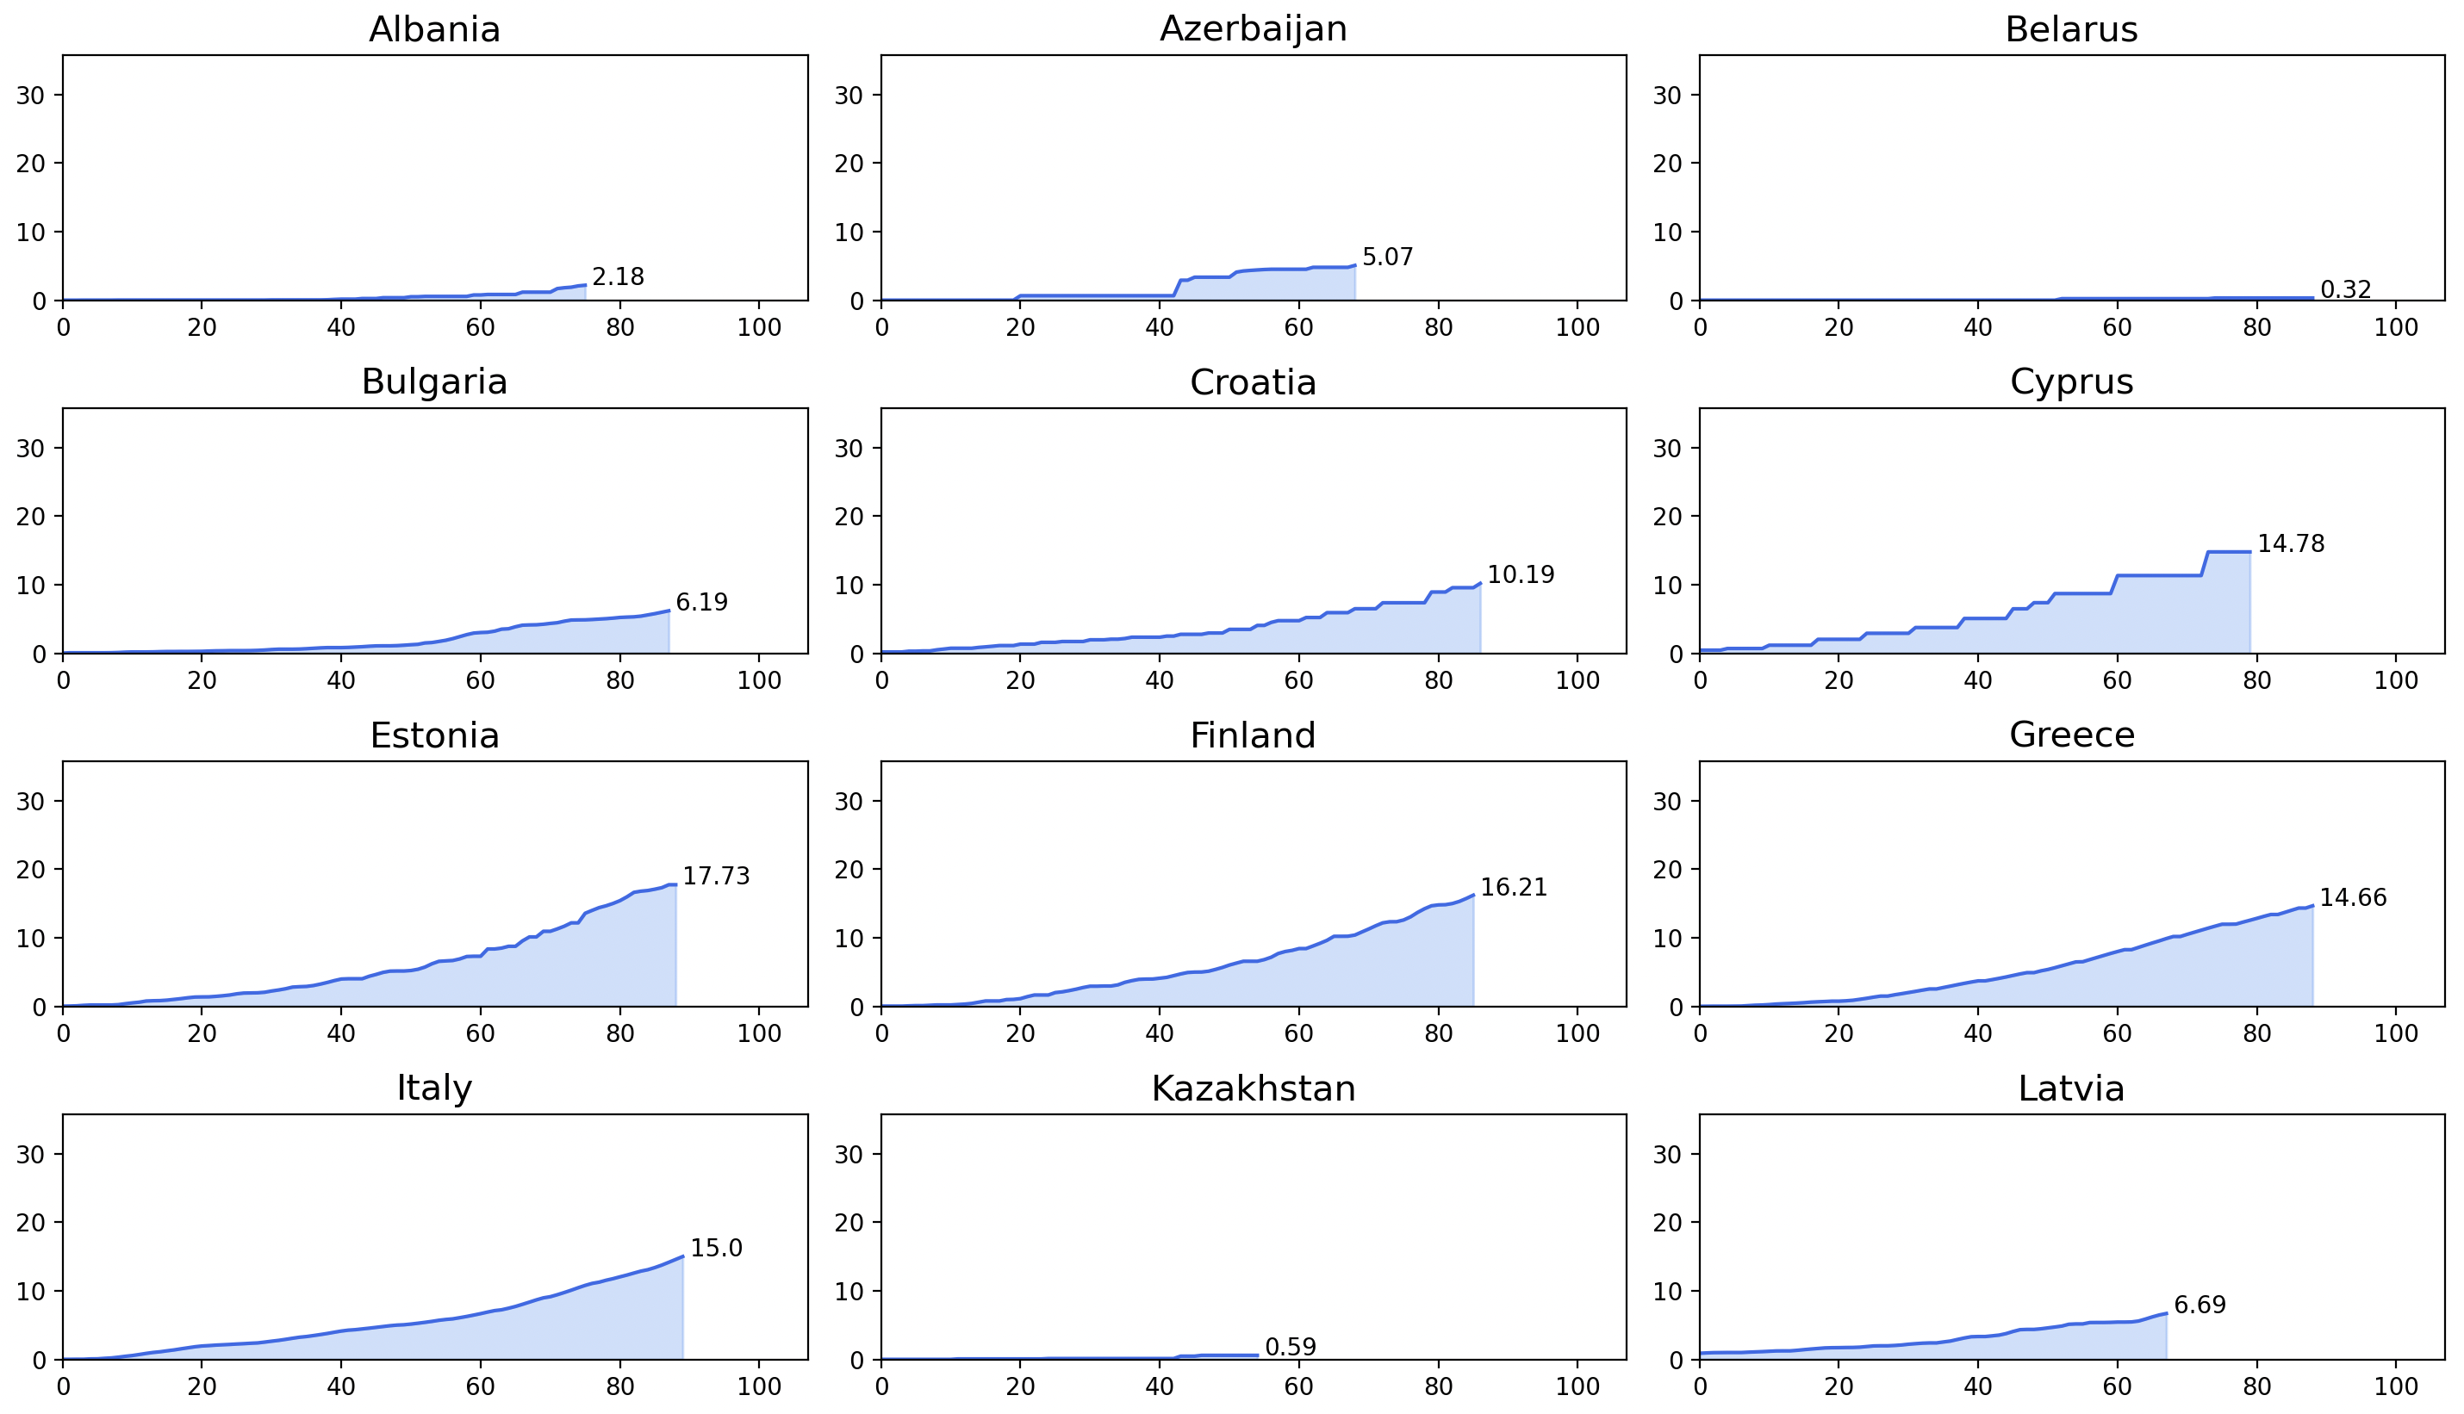
Total vaccine doses administered/delivered per 100 people in client countries (A)
This chart plots the total vaccine doses administered/delivered per 100 people up until March 26th among client countries.
Rate of vaccinations is highest in Serbia followed by Turkey and it is lowest in Kazakhstan.

Slide 15
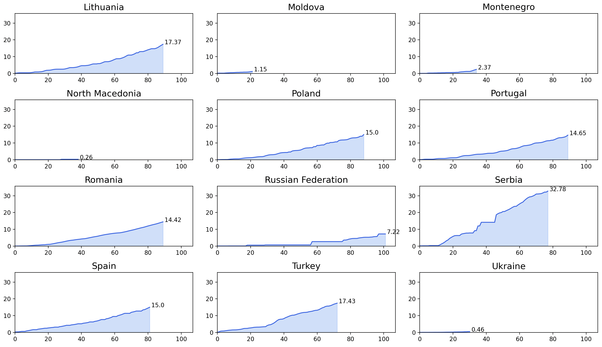
Total vaccine doses administered/delivered per 100 people in client countries (B)
This chart plots the total vaccine doses administered/delivered per 100 people up until March 26th among client countries.
Rate of vaccinations is highest in Serbia followed by Turkey and it is lowest in Kazakhstan.

Slide 16
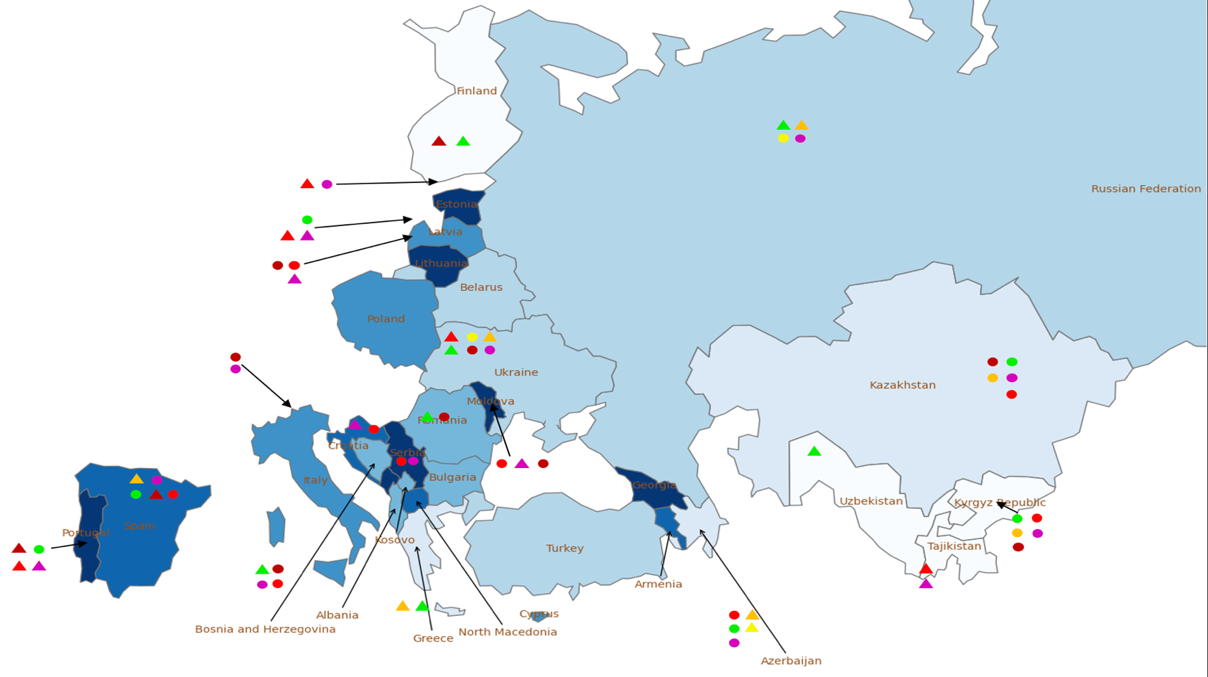
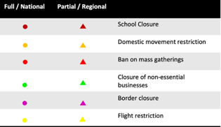
Public health and social measures implemented in the region
Color | Total cases /100,000 | Countries
 | 0 - 1500 | Uzbekistan, Tajikistan, Kyrgyz Republic, Finland.
 | 1500 - 3000 | Kazakhstan, Greece, Azerbaijan.
 | 3000 - 4000 | Russian Federation, Belarus, Ukraine, Turkey.
 | 4000 - 5000 | Romania, Bulgaria, Albania, Bosnia and Herzegovina, Kosovo.
 | 5000 - 6000 | Poland, Latvia, Italy, Cyprus.
 | 6000 - 7000 | Armenia, Croatia, Spain, North Macedonia.
 | 7000+ | Moldova, Lithuania, Estonia, Portugal, Georgia, Serbia, Montenegro.
The Chinese government will provide Kyrgyzstan with free COVID-19 vaccines, Chinese Ambassador Du Dewen said during a meeting with Kyrgyz Foreign Minister Ruslan Kazakbaev.
Ukraine has agreed on the supply of 500,000 doses of Indian-made COVISHIELD vaccine against COVID-19.
Russia has introduced its third registered coronavirus vaccine for general use, CoviVak, developed by the state-run Chumakov Research Center, is a two-dose, whole-virion vaccine that uses complete, but inactive, particles of the SARS-CoV-2 virus that causes Covid-19.
Note: Boundaries were cleared by the World Bank Map Design Cartography and Map Clearance Teams.

Slide 17
Countries and data sources
The monitor focuses on client countries in Europe and Central Asia with any lending or non-lending operations, and with available data, as in the Table.
Data:
  Cases and deaths: https://ourworldindata.org/coronavirus
  Testing: https://www.worldometers.info/coronavirus/
  Policy responses: https://ourworldindata.org/policy-responses-covid
  Population: provided by task teams or imputed from “our world in data”.
  Vaccine manufacturer: https://www.unicef.org/supply/covid-19-vaccine-market-dashboard
  Variants:
    https://cov-lineages.org/global_report.html
    https://www.nytimes.com/interactive/2021/health/coronavirus-variant-tracker.html
Albania | Georgia | Poland
Armenia | Greece | Portugal
Azerbaijan | Italy | Romania
Belarus | Kazakhstan | Russian Federation
Bulgaria | Kosovo | Serbia
Bosnia and Herzegovina | Kyrgyz Republic | Slovak Republic
Croatia | Latvia | Spain
Cyprus | Lithuania | Tajikistan
Czech Republic | Moldova | Turkey
Estonia | Montenegro | Turkmenistan (no cases)
Finland | North Macedonia | Ukraine
 |  | Uzbekistan

