Slide 1


COVID-19 MONITOR Europe and central Asia
[Unless otherwise specified, data is as of February 12]
02/15/2021

Slide 2
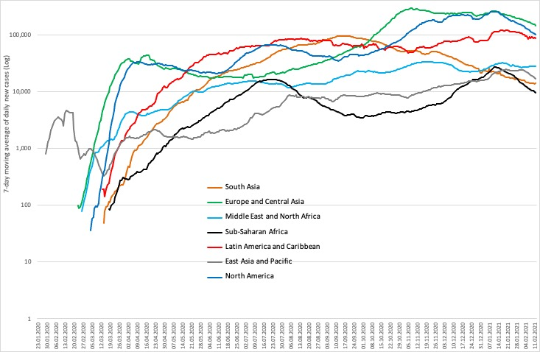
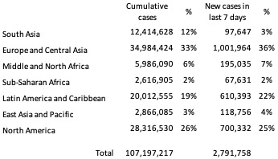
Daily new COVID-19 cases by World Bank regions (all countries)

Slide 3




Regional overview: COVID-19 cases, mortality, vaccination, and testing in client countries
CASES
DEATHS
VACCINATION
TESTS
Total:
21,517,205 cases
Last week:
+ 629,077 (3%)
Total:
449,992 deaths
Last week:
+ 17,544 (4%)
Total:
18,526,138 doses
Last week:
+ 6,002,796 (48%)
Total:
286,422,850 tests
Last week:
+ 9,723,994 (4%)
Last week: 5th – 12th February 2021

Slide 4
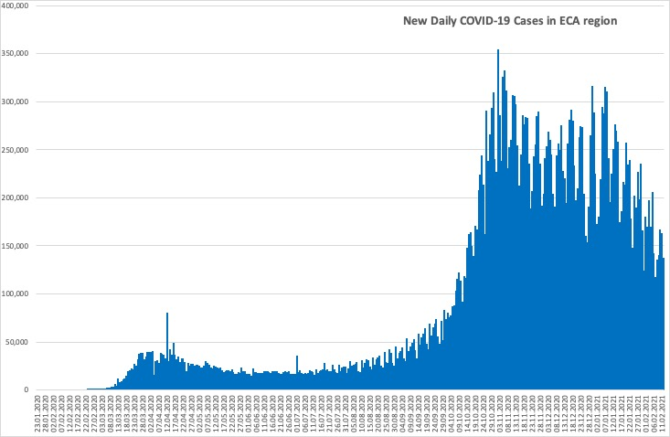
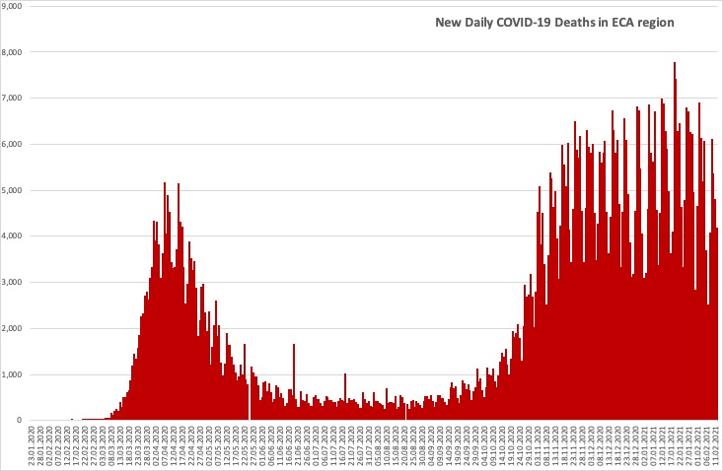
Daily new COVID-19 cases and deaths in ECA region
Countries in the region are seeing a second wave of cases and a second peak in deaths.

Slide 5
Country-level: cases, mortality and testing
Client countries | Cases per 100,000 | Deaths per 100,000 | Tests per 100,000 | Vaccination per 100,000 | Case Fatality Rate, % | Test Positivity Rate, %
Albania | 3,183 | 53.6 | 14,085 | 39 | 1.7 | 22.6
Armenia | 5,694 | 105.8 | 22,812 | NR | 1.9 | 25.0
Azerbaijan | 2,303 | 31.5 | 24,689 | 646 | 1.4 | 9.3
Belarus | 2,820 | 19.5 | 49,357 | NR | 0.7 | 5.7
Bosnia and Herzegovina | 3,587 | 139.6 | 17,900 | NR | 3.9 | 20.0
Bulgaria | 3,294 | 138.0 | 21,777 | 1,075 | 4.2 | 15.1
Croatia | 5,800 | 129.2 | 30,720 | 2,759 | 2.2 | 18.9
Cyprus | 3,686 | 25.0 | 164,737 | 6,356 | 0.7 | 2.2
Czech Republic | 10,043 | 167.4 | 64,089 | NR | 1.7 | 15.7
Estonia | 3,837 | 36.6 | 62,634 | 4,951 | 1.0 | 6.1
Finland | 895 | 12.8 | 54,847 | 4,717 | 1.4 | 1.6
Georgia | 7,096 | 89.4 | 64,538 | NR | 1.3 | 11.0
Greece | 1,587 | 56.7 | 43,343 | 4,718 | 3.6 | 3.7
Italy | 4,469 | 154.2 | 59,130 | 4,833 | 3.4 | 7.6
Kazakhstan | 1,335 | 16.8 | 34,240 | NR | 1.3 | 3.1
Kosovo | 3,553 | 85.8 | NR | NR | 2.4 | NR
Kyrgyzstan | 1,337 | 22.5 | 10,859 | NR | 1.7 | 12.3
Latvia | 4,003 | 75.9 | 68,717 | 1,941 | 1.9 | 5.8
Lithuania | 6,906 | 109.8 | 73,721 | 5,582 | 1.6 | 9.5
North Macedonia | 4,647 | 143.0 | 23,206 | NR | 3.1 | 20.0
Moldova | 6,295 | 135.2 | 24,712 | NR | 2.1 | 25.5
Montenegro | 10,930 | 141.4 | 40,366 | NR | 1.3 | 27.1
Poland | 4,109 | 105.3 | 23,783 | 5,396 | 2.6 | 17.3
Portugal | 7,602 | 146.3 | 75,577 | 4,557 | 1.9 | 10.1
Romania | 3,903 | 99.3 | 29,287 | 5,199 | 2.5 | 13.3
Russia | 2,723 | 53.1 | 72,207 | 2,657 | 1.9 | 3.8
Serbia | 6,001 | 60.3 | 39,545 | 10,330 | 1.0 | 15.2
Slovakia | 5,022 | 105.1 | 34,497 | 5,179 | 2.1 | 14.6
Spain | 6,488 | 137.5 | 75,971 | 5,144 | 2.1 | 8.5
Tajikistan | 146 | 1.0 | NR | NR | 0.7 | NR
Turkey | 3,093 | 32.8 | 37,628 | 4,094 | 1.1 | 8.2
Ukraine | 3,124 | 60.8 | 15,403 | NR | 1.9 | 19.6
Uzbekistan | 239 | 1.9 | 4,143 | NR | 0.8 | 5.8
Cases per 100,000 population range from 146 in Tajikistan to 10,930 in Montenegro.
Case fatality rates remain below 4.5% in all client countries.
There is significant variation in testing rates per 100,000 population from 4,143 in Uzbekistan to 164,737 in Cyprus.
The test positivity rate ranges from 1.6% in Finland to 27.1% in Montenegro.
The vaccination per 100,000 population ranges from 39 in Albania to 10,330 in Serbia.
* Data on vaccination number for
Azerbaijan is the latest available, specifically as of February 6, 2021
Albania is the latest available, specifically as of February 9, 2021
Russia is the latest available, specifically as of February 10, 2021
Croatia, Cyprus, Portugal, Romania, Serbia, and Spain is the latest available, specifically as of February 11, 2021

Slide 6
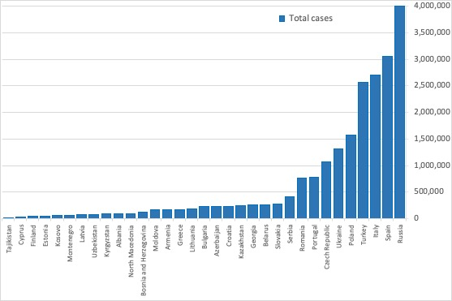
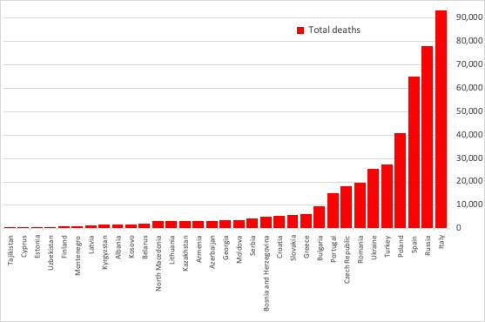
Total cases and deaths in client countries
Countries with the highest number of cases and deaths:
• Cases: Russia (3.997 M), Spain (3.056 M), Italy (2.697 M), Turkey (2.572 M), Poland (1.577 M).
• Deaths: Italy (93,045), Russia (77,911), Spain (64,747), Poland (40,424), Turkey (27,284).
Countries with the lowest number of cases and deaths:
• Cases: Tajikistan (13,308), Cyprus (32.228), Finland (49,572), Estonia (50,993), Kosovo (63,805).
• Deaths: Tajikistan (90), Cyprus (219), Estonia (486), Uzbekistan (622), Finland (710).

Slide 7
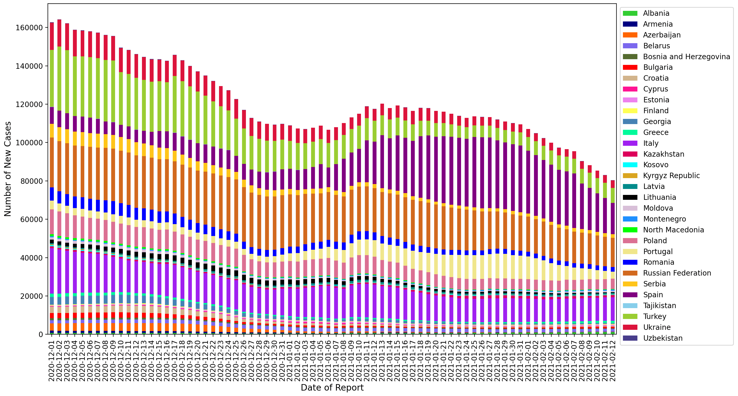
Rolling 7-day average of new cases
​This chart plots the 7-day average of new cases between December 1st and February 12th among client countries.
The contributions of Portugal and Spain have been decreasing relative to the other countries.
Note: Given the spike in case reporting on Monday, we re-distribute equally across Saturday, Sunday, and Monday in this case.

Slide 8
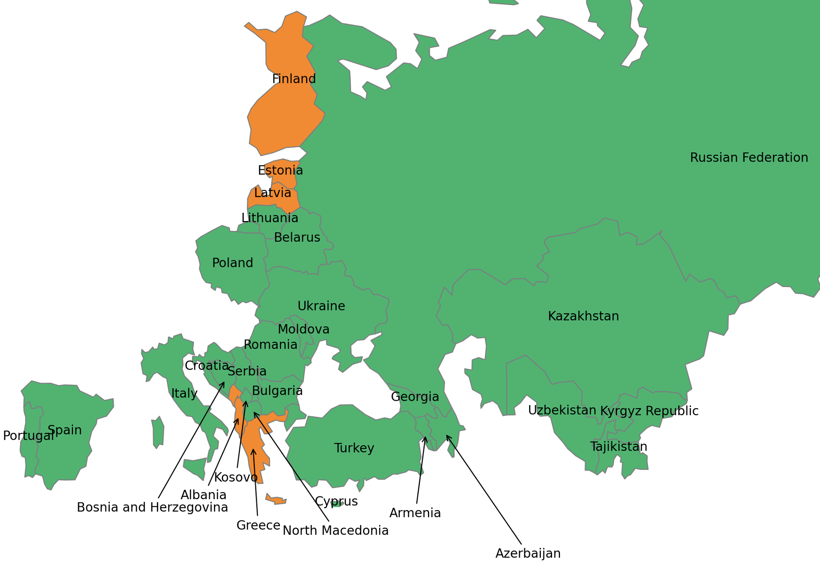
Most recent two-week span: percent increase in total cases
This map shows the % change in the total cases in the current week (February 6th to February 12th) compared to the preceding week (January 30th to February 5th).
Albania (9%), Estonia (8%), and Latavia (7%) have recorded the highest percentage increases in total cases.
Color | Percent Increase | Countries
 | 0% - 5% | Kazakhstan, Uzbekistan, Russian Federation, Tajikistan, Kyrgyz Republic, Armenia, Belarus, Ukraine, Poland, Moldova, Romania, Lithuania, Bulgaria, Turkey, Croatia, Portugal, Spain, Italy, Azerbaijan, Georgia, Cyprus, Bosnia and Herzegovina, North Macedonia, Serbia, Kosovo.
 | 5% - 10% | Latvia, Estonia, Greece, Albania, Finland, Montenegro.
 | > = 10% | -
Note: Boundaries were cleared by the World Bank Map Design Cartography and Map Clearance Teams.

Slide 9
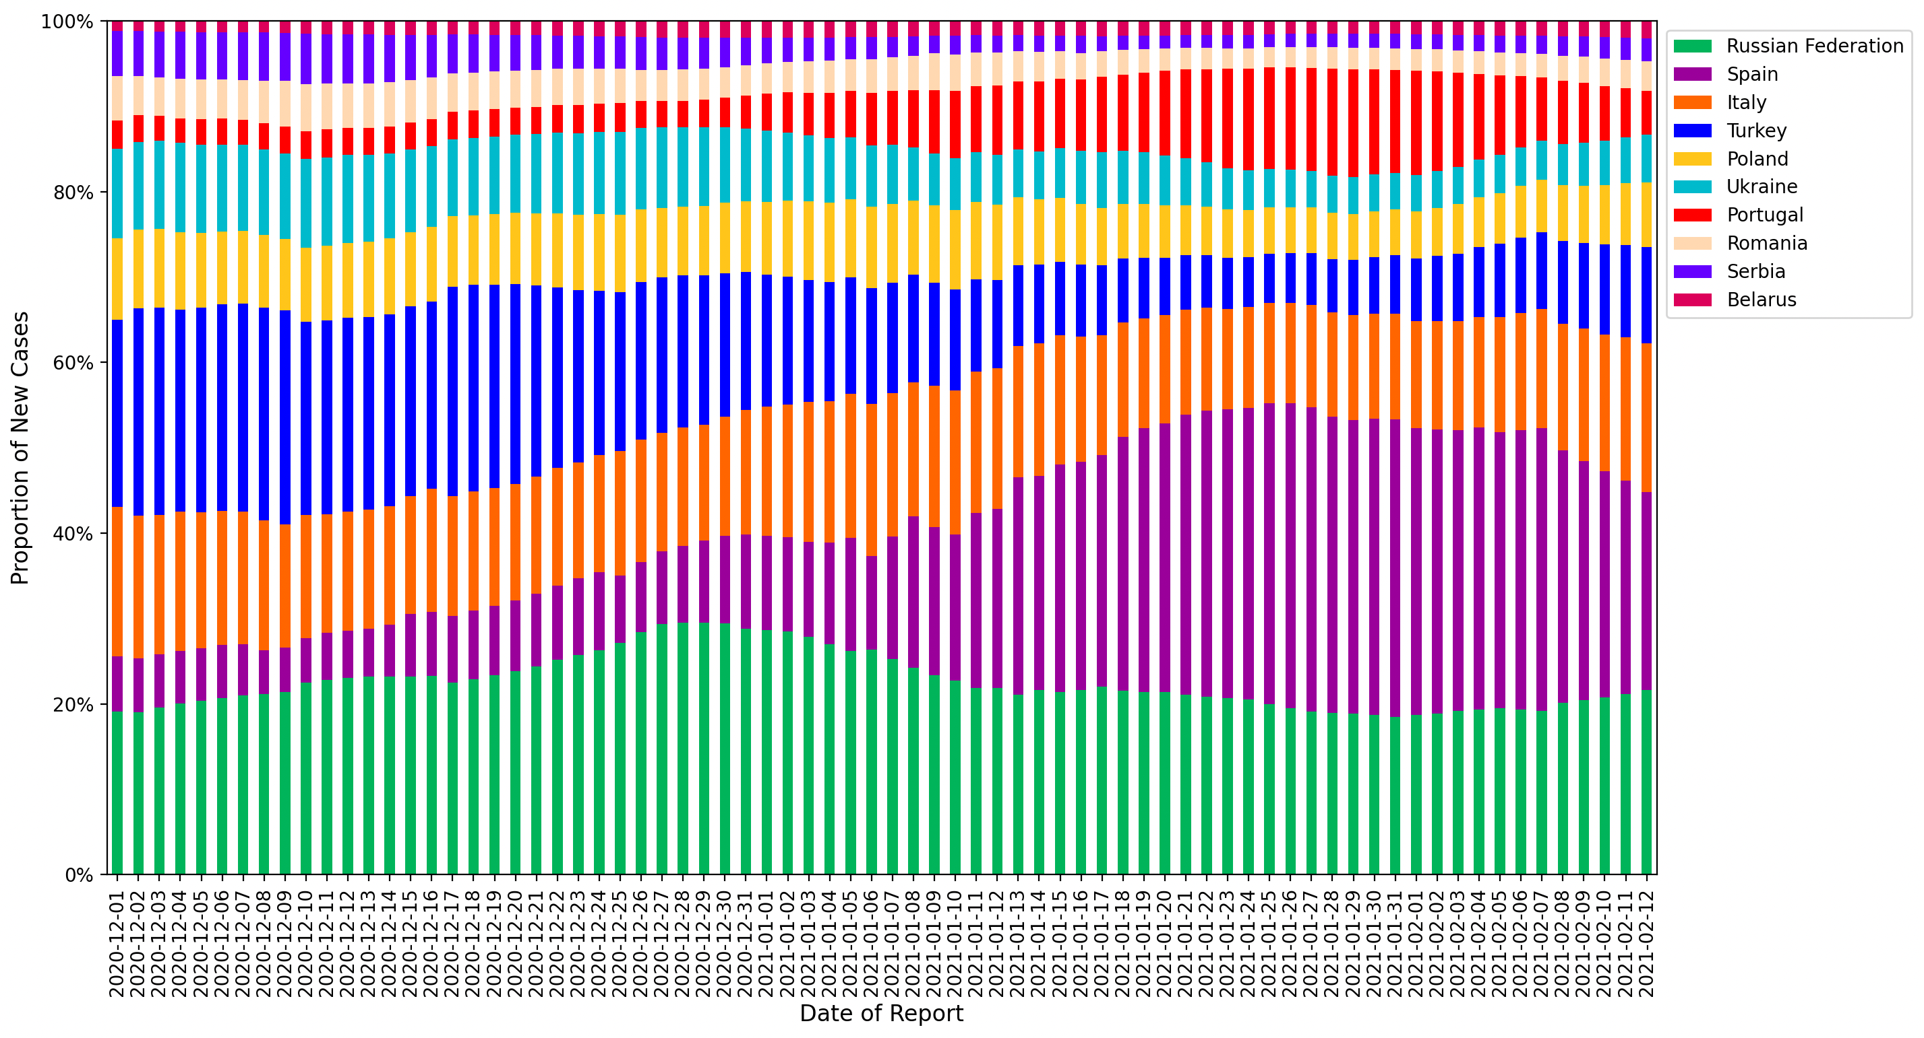
Relative contributions of the 10 client countries with highest case incidence
​This chart plots the proportion of new cases of the total cases in the region between December 1st and February 12th among countries with the highest levels of case incidence.
The 7-day rolling average is computed to adjust for variation in reporting.
The percentage contribution of cases in Turkey, Russian Federation and Italy is increasing.

Slide 10
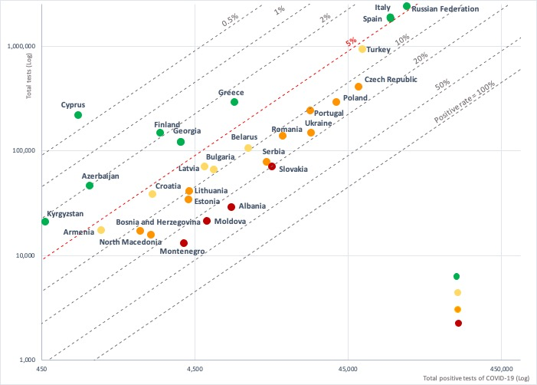

Test positivity rate: total positive COVID-19 tests versus total tests conducted
A test positivity rate of less than 5% is one criterion for informing adjusting of public health and social measures by WHO.
The following countries have testing rates above 5% indicating the need to increase testing and strengthen measures to slow transmission:
Albania, Moldova, Montenegro, and Slovakia have positive rates of above 20%;
Bosnia and Herzegovina, Czech Republic, Estonia, Lithuania, North Macedonia, Poland, Portugal, Romania, Serbia, and Ukraine have positive rates of 10-20%;
Armenia, Belarus, Bulgaria, Croatia, Latvia, and Turkey have positive test rates of 5-10%.

Slide 11
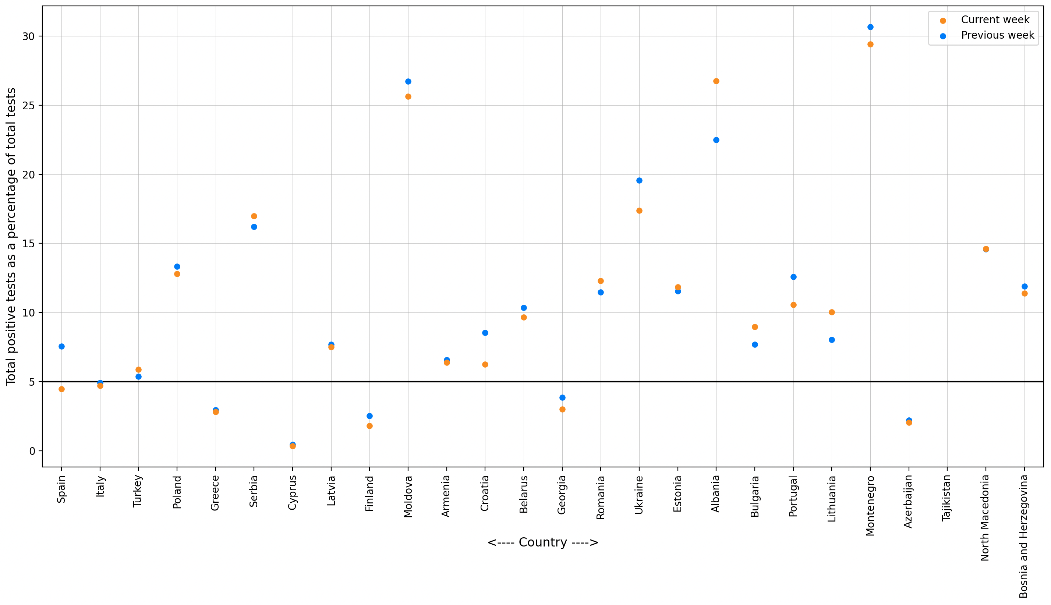
Most recent two-week span: change in test positivity rate
This graph plots the test positivity rate the current week (February 6th to February 12th) compared to the preceding week (January 30th to February 5th)
Over the past week, the test positivity rates in Spain decreased from below 5% to above 5%.
Albania, Moldova and Montenegro have recorded rates above 25% for two consecutive weeks.

Slide 12
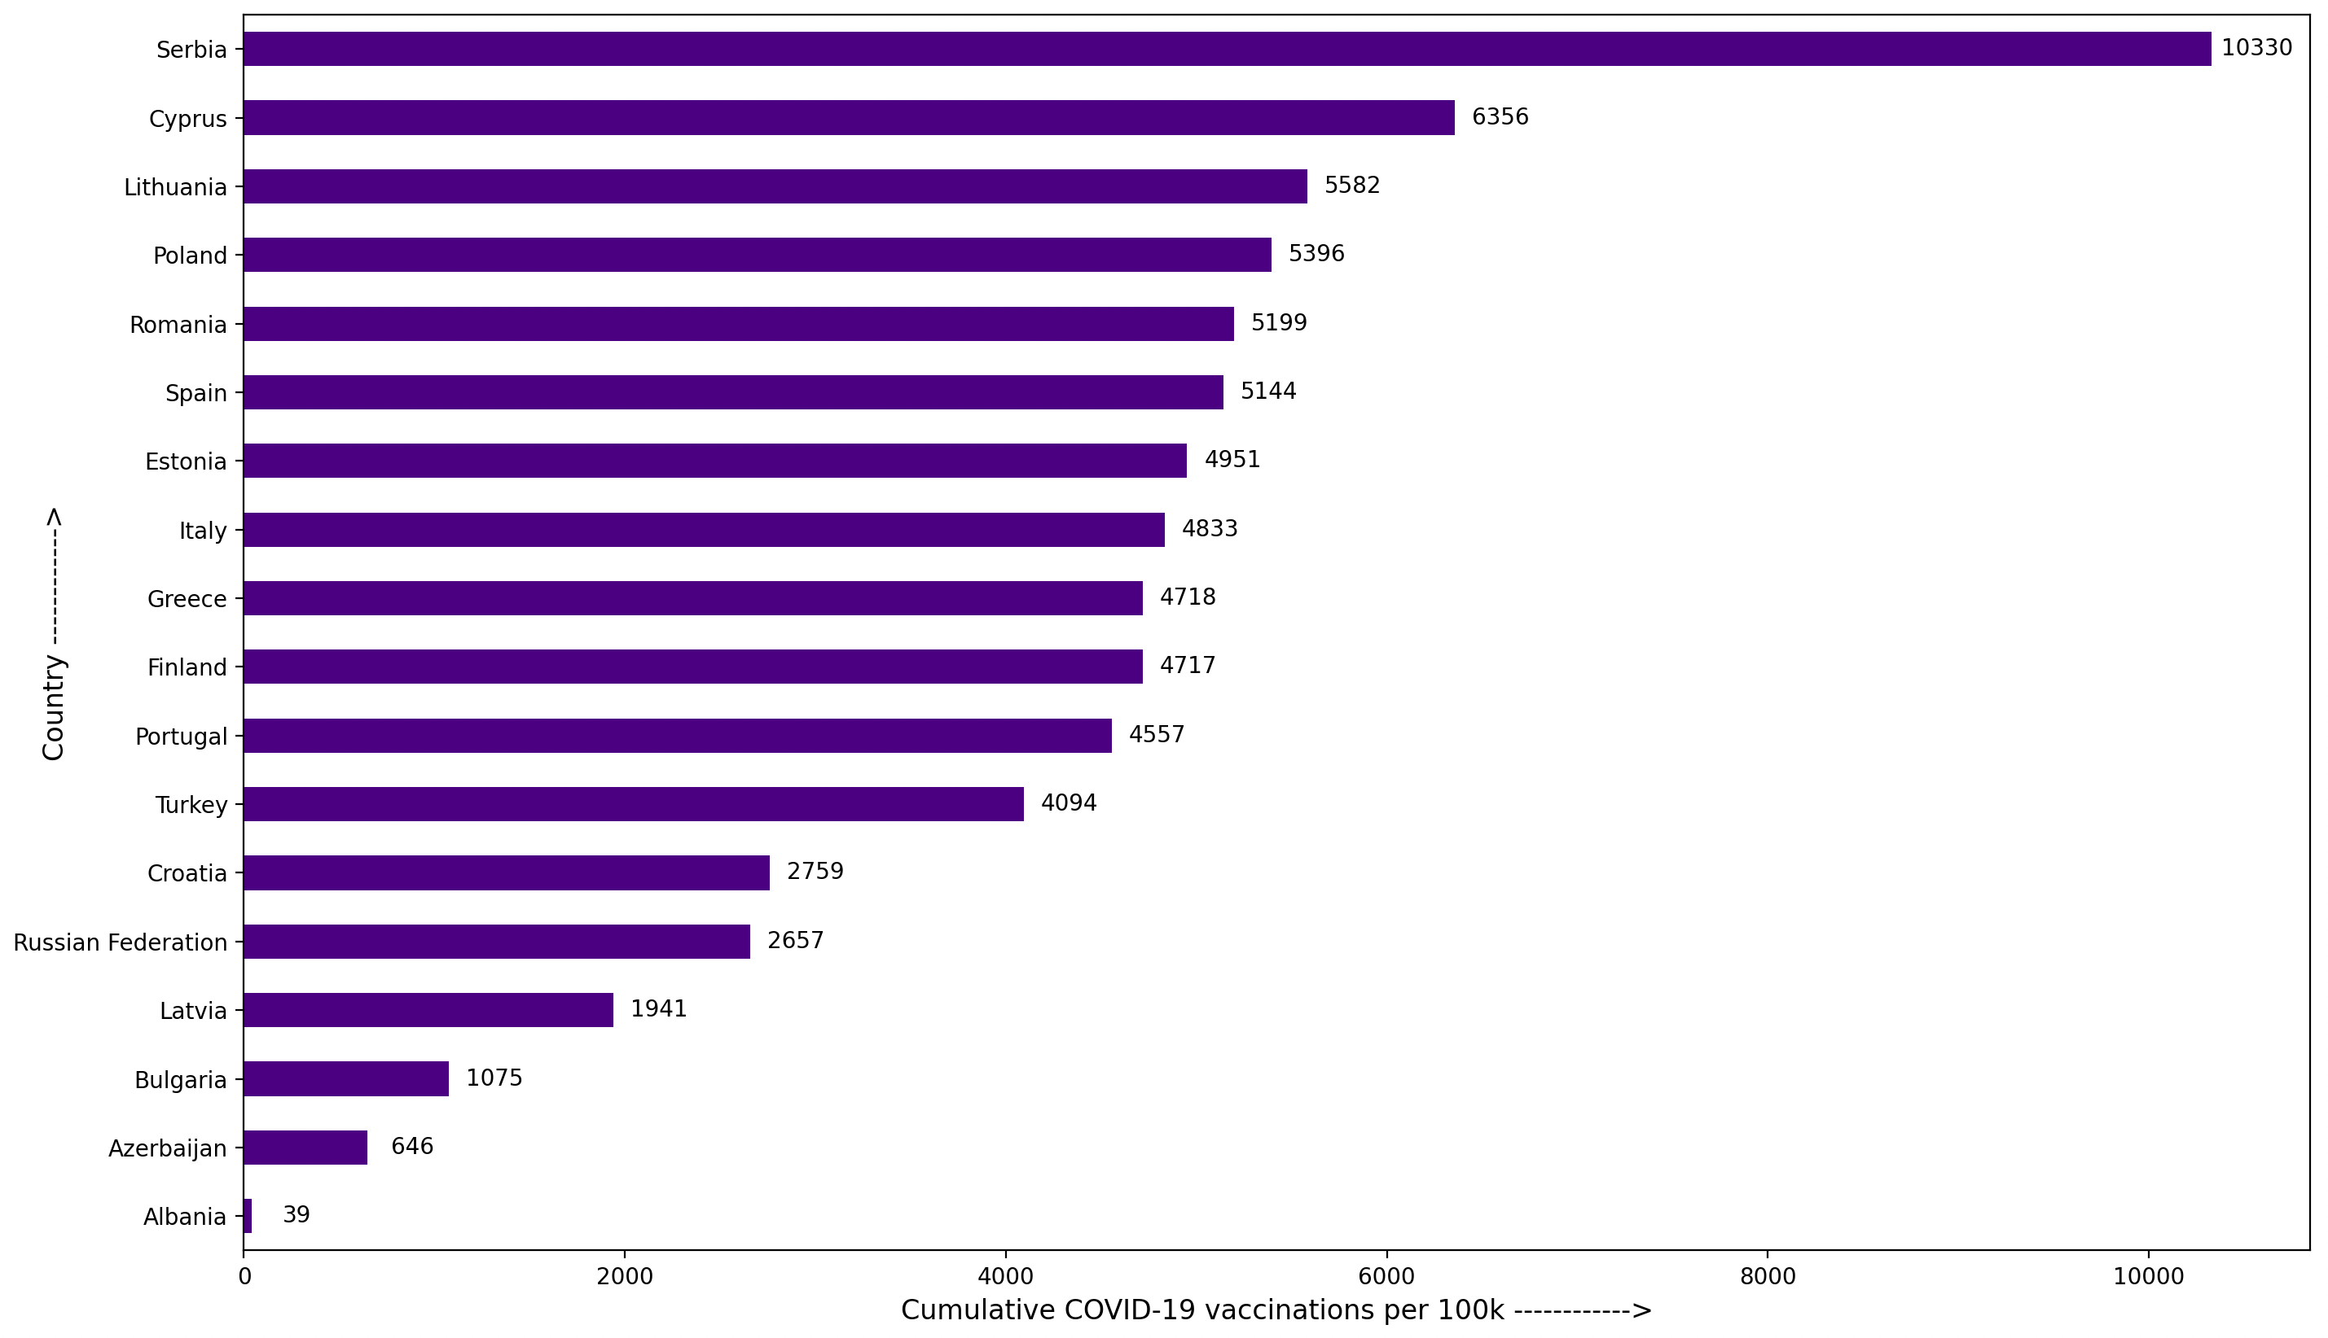
Total COVID-19 vaccines administered per 100,000 population
This chart plots the total vaccines administered per 100,000 population up until February 12th among client countries.
Serbia (10,330), Cyprus (6356) and Lithuania (5,582) have administered the highest number of vaccines per 100,000 population.

Slide 13
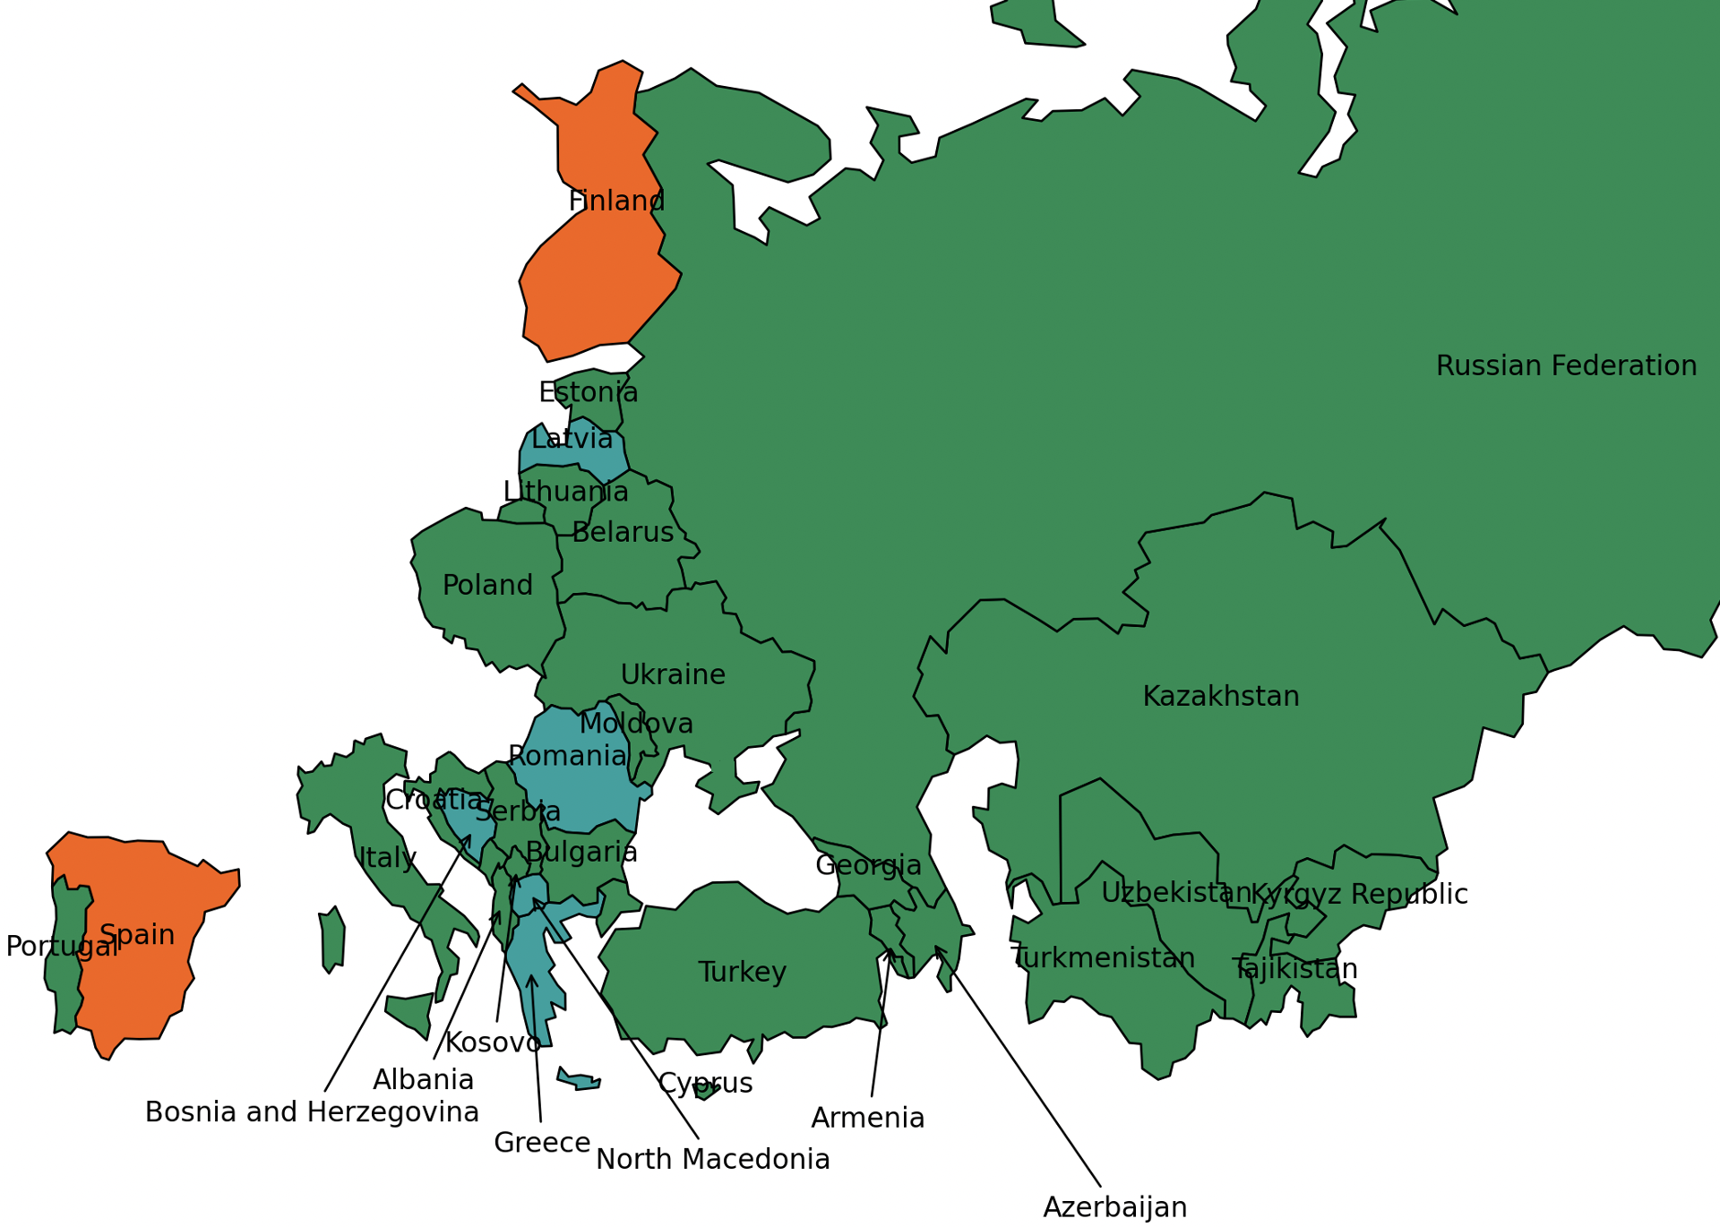
Spread of Coronavirus variants of concern among client countries
This map shows the number of Coronavirus variants of concern (B1.1.7, B.1.351, P.1) present in the client countries up until February 12th.
Variants of concern appear to be more infectious than other circulating Coronaviruses.
Coronaviruses from the B.1.1.7 lineage are 50 percent more infectious and were first reported in Britain.
Clinical trials of vaccines are showing that they offer less protection against B.1.351 than other variants.
P.1, first found in Japan is a close relative of the B.1.351 lineage and may be able to overcome the immunity developed after infection by other variants.
Finland (B1.1.7, B.1.351) and Spain (B1.1.7, B.1.351) have the maximum number of Coronavirus variants present.
Color | Total Variants | Countries
 | 0 | Kazakhstan, Uzbekistan, Russian Federation, Tajikistan, Kyrgyz Republic, Turkmenistan, Armenia, Belarus, Ukraine, Poland, Moldova, Lithuania, Estonia, Bulgaria, Turkey, Albania, Croatia, Portugal, Italy, Azerbaijan, Georgia, Cyprus, Serbia, Montenegro, Kosovo.
 | 1 | Romania, Latvia, Greece, Bosnia and Herzegovina, North Macedonia.
 | 2 | Spain, Finland.
Note: Boundaries were cleared by the World Bank Map Design Cartography and Map Clearance Teams.

Slide 14
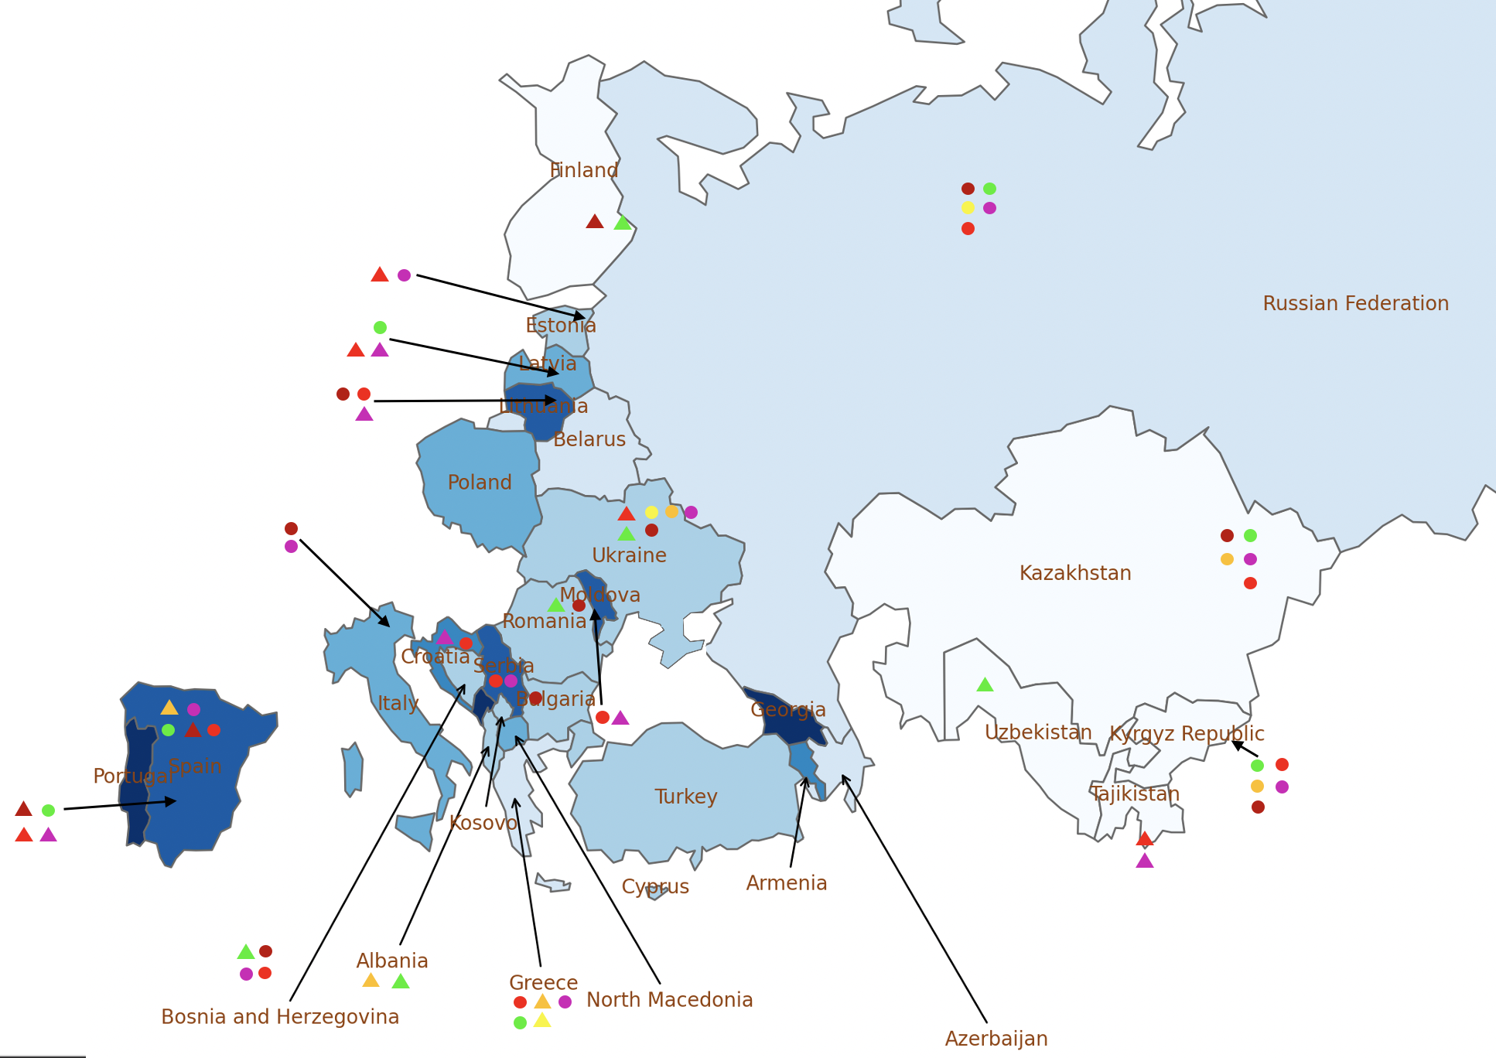
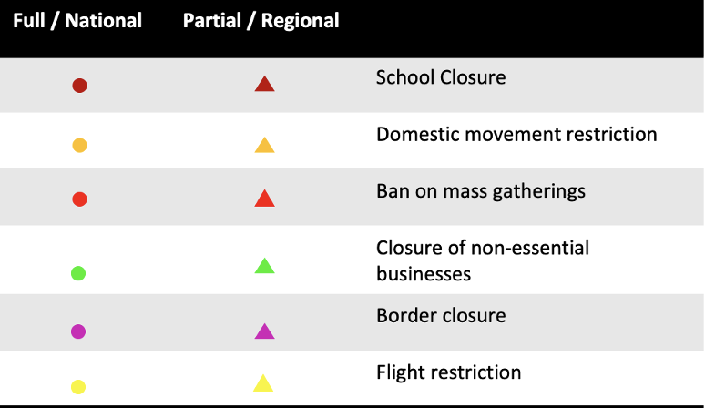
Public health and social measures implemented in the region
Color | Total cases /100,000 | Countries
 | 0 - 1000 | Kazakhstan, Uzbekistan, Tajikistan, Kyrgyz Republic, Finland.
 | 1000 - 1500 | Russian Federation, Belarus, Greece, Azerbaijan.
 | 1500 - 2500 | Ukraine, Romania, Estonia, Bulgaria, Turkey, Albania, Cyprus, Bosnia and Herzegovina, Kosovo.
 | 2500 - 3000 | Poland, Latvia, Italy, North Macedonia.
 | 3000 - 4000 | Armenia, Croatia.
 | 4000 - 5000 | Moldova, Lithuania, Spain, Serbia.
 | 5000+ | Portugal, Georgia, Montenegro.
Tashkent (Uzbekistan) has barred travelers from eight nations from entering the country amid reports about a new coronavirus strain and an increase of COVID-19 cases in those countries.
Spain will not administer the Oxford-AstraZeneca vaccine to anyone over the age of 65. That was the decision made on Thursday by the public health committee of Spain’s National Healthcare System, made up of health experts from the central and regional governments.
The Covid-19 vaccine from the British firm AstraZeneca has met the safety and effectiveness requirements at all stages of clinical trials and has been approved by the World Health Organization for emergency use in Armenia.
Turkey launched its mass-vaccination (by the Chinese pharmaceutical company Sinovac) program against the coronavirus disease with the goal of first inoculating 1 million health workers.
Note: Boundaries were cleared by the World Bank Map Design Cartography and Map Clearance Teams.

Slide 15
Countries and data sources
Albania | Georgia | Poland
Armenia | Greece | Portugal
Azerbaijan | Italy | Romania
Belarus | Kazakhstan | Russian Federation
Bulgaria | Kosovo | Serbia
Bosnia and Herzegovina | Kyrgyz Republic | Slovak Republic
Croatia | Latvia | Spain
Cyprus | Lithuania | Tajikistan
Czech Republic | Moldova | Turkey
Estonia | Montenegro | Turkmenistan (no cases)
Finland | North Macedonia | Ukraine
 |  | Uzbekistan
The monitor focuses on client countries in Europe and Central Asia with any lending or non-lending operations, and with available data, as in the Table.
Data:
Cases and deaths: https://ourworldindata.org/coronavirus
Testing: https://www.worldometers.info/coronavirus/
Policy responses: https://ourworldindata.org/policy-responses-covid
Population: provided by task teams or imputed from “our world in data”.
Variants:
https://cov-lineages.org/global_report.html
https://www.nytimes.com/interactive/2021/health/coronavirus-variant-tracker.html

