Slide 1
Fourth North and Central Asian Multi-Stakeholder Forum on Implementation of the SDGs
Четвертый многосторонний форум Северной и Центральной Азии по реализации ЦУР
Session 3: Human Well-being and the SDGs: Recovering after the COVID-19 crisis
Сессия 3: Благополучие человека и ЦУР: Восстановление после кризиса, вызванного COVID-19
3 September 2020 - 3 сентября 2020
Dr. Srinivas Tata
Director, Social Development Division
UN-ESCAP, Bangkok, Thailand
Доктор Шринивас Тата
Директор, Отдел Cоциального Pазвития
ЭСКАТО ООН, Бангкок, Таиланд

Slide 2
This session discusses human well-being in terms of quality and access to basic services, such as health, education, and social protection.
It looks at direct and indirect impacts of COVID-19, especially on vulnerable groups.
It highlights the importance of “leaving no one behind” - from COVID-19 recovery to long-term inclusive, resilient and sustainable development.
На этой сессии будет обсуждаться благосостояние человека с точки зрения качества и доступа к основным услугам, таким как здравоохранение, образование и социальная защита.
Будут рассмотрены прямые и косвенные воздействия COVID-19, особенно на уязвимые группы населения.
Также будет ярко освещаться важность принципа “никого не оставить без внимания” для восстановления после COVID-19, и для обеспечения долгосрочного инклюзивного и устойчивого развития.

Slide 3
Older persons & persons with disabilities - ESCAP
Health impacts - WHO
Gender equality & women’s empowerment – UN Women
Education & youth empowerment – UNESCO
Пожилые люди и люди с ограниченными возможностями - ЭСКАТО
Воздействие на здоровье - ВОЗ
Гендерное равенство и расширение прав и возможностей женщин - ООН-Женщины
Образование и расширение прав и возможностей молодежи - ЮНЕСКО

Slide 4
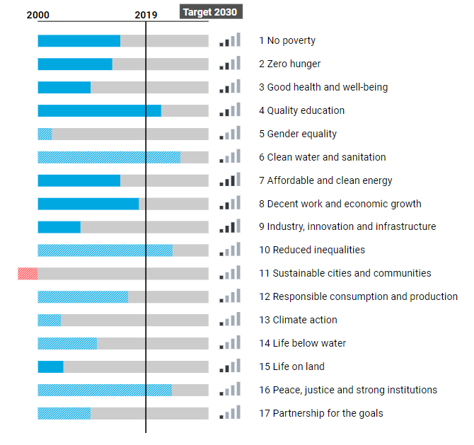
The North and Central Asian subregion was not fully on track to achieve the Sustainable Development Goals, even before the COVID-19 pandemic
Субрегион Северной и Центральной Азии был не в состоянии полностью достичь Целей устойчивого развития даже до пандемии COVID-19
Snapshot of SDG progress in 2019: North and Central Asia
Снимок прогресса ЦУР в 2019 году: Северная и Центральная Азия
Source: ESCAP, SDG Gateway Asia Pacific (accessed on 16 August 2020)

Slide 5



In the Asia-Pacific region, persons with disabilities face increased vulnerabilities compared to persons w/o disabilities
В Азиатско-Тихоокеанском регионе люди с ограниченными возможностями сталкиваются с большей уязвимостью по сравнению с людьми, у которых их нет
Poverty rates differ by 3.9 to 20.6 per cent
Уровень бедности варьируется от 3,9 до 20,6 процента
Employment is on average 2 to 6 times less likely
Вероятность трудоустройства в среднем в 2-6 раз ниже
Representation in national parliaments is only 0.4 per cent
Представительство в национальных парламентах только 0,4 процента
Source: ESCAP (2018). Building Disability-Inclusive Societies in Asia and the Pacific: Assessing Progress of the Incheon Strategy
Notes:
According to the WHO, 15 per cent of population in any given country have some form of disability [WHO, 2011. World Report on Disability]
It is estimated that in Asia-Pacific abut 690 million persons live with some for of disability
This figure includes persons with one or multiple disabilities, and the figure is expected to increase over the coming decades, owing to population ageing, longer life expectancy, and an increasing number of injuries resulting from situational and natural disasters, among other factors (World Health Organization, 2011).
Currently, disability prevalence in the region ranges from 1.1 per cent in Brunei Darussalam to 24 per cent in New Zealand. The statistical variance reflects varying concepts, definitions of disability, and purposes and methodologies of disability data collection.
ESCAP has identified some social and economic inequality between persons with and without disabilities [in the progress report of the implementation of the Incheon Strategy, 2018]. For instance,
Up to 1/5 of the person with disabilities live in poverty.
They are 2 to 6 times less likely to be employed
Their political participation is very limited
Despite their disabilities, they often do not have social protection
Education and health services are less accessible for them.

Slide 6



Coverage in government-funded disability benefit programmes is as low as 28 per cent
Охват программами пособий по инвалидности, финанси-руемыми государством, составляет всего 28 процентов
  At least 1/3 of children do not receive any early intervention services, including pre-school education
  По меньшей мере, 1/3 детей не получают никаких услуг раннего вмешательства, включая дошкольное образование
Access to reproductive health services (women) is 2 to 3 times lower
Доступ к услугам по репродуктивному здоровью (женщины) в 2-3 раза ниже
Source: ESCAP (2018). Building Disability-Inclusive Societies in Asia and the Pacific: Assessing Progress of the Incheon Strategy
Notes:
According to the WHO, 15 per cent of population in any given country have some form of disability [WHO, 2011. World Report on Disability]
It is estimated that in Asia-Pacific abut 690 million persons live with some for of disability
This figure includes persons with one or multiple disabilities, and the figure is expected to increase over the coming decades, owing to population ageing, longer life expectancy, and an increasing number of injuries resulting from situational and natural disasters, among other factors (World Health Organization, 2011).
Currently, disability prevalence in the region ranges from 1.1 per cent in Brunei Darussalam to 24 per cent in New Zealand. The statistical variance reflects varying concepts, definitions of disability, and purposes and methodologies of disability data collection.
ESCAP has identified some social and economic inequality between persons with and without disabilities [in the progress report of the implementation of the Incheon Strategy, 2018]. For instance,
Up to 1/5 of the person with disabilities live in poverty.
They are 2 to 6 times less likely to be employed
Their political participation is very limited
Despite their disabilities, they often do not have social protection
Education and health services are less accessible for them.

Slide 7
The subregion hosts aged and relatively young countries – situation of older persons differs by country
В субрегионе находятся стареющие и относительно молодые страны - положение пожилых людей различается в зависимости от страны
Source: International Labour Organization, ILOSTAT online database
Notes:
We should highlight the demographic situation of the subregion, which is very diverse. The subregion costs countries that are already “aged”, such as Georgia and the Russian Federation, where more than 15 per cent of the population are aged 65 years or over.
Others can be classified as “ageing”, which is the percentage of people aged 65 years or over is between 7 and 14 per cent, which are Armenia and Kazakshtan. Azerbaijan will also be in this category in a few years.
And then we have countries that are still primarily young, such as Uzbekistan, Turkmenistan, Kyrgyzstan, and Tajikistan.
But all countries are ageing in the sense that they will become older than they are now and the proportion of older persons will double – or more – by 2050.
The situation of older persons in the subregion also varies. Pension coverage is relatively high in this subregion due to a historic heritage of universal coverage. But benefit levels are often low. The result is that in some countries, many older persons are still working.
There are large disparities by countries, but also gender disparities in labour force participation. In Georgia, almost half of older men aged between 65 and 75 years old still participate in the labour force, in the Russian Federation only 9.2 per cent of older men. We can also see that there are large gaps between men and women, in some cases the proportion of older women participating in the labour market is only half that of men.
Population ageing has an impact on the achievement of the SDGs because older persons are at a high risk of being left behind. Older persons are also among the most vulnerable groups in the COVID-19 pandemic.

Slide 8

Youth: high proportion not in education, employment or training, affected by school closure resulting from COVID-19
Молодежь: высокая доля, которая не учится, не работает и не приобретает профессиональных навыков, пострадала в результате закрытия школ из-за COVID-19

Slide 9
The digital divide in the subregion is by age – only in a few countries by gender
Цифровой разрыв в субрегионе определяется возрастом, и только в нескольких странах по полу
Source: ITU. World Communication/ITC Indicators Database, online, 24th edition
Notes:
In North and Central Asia, the digital divide is less so by gender (as it is the case in other subregions), but it is clearly a digital age divide, with internet access decreasing by age group. While at least 80 per cent of young people have access to the internet, less than one quarter of older people have access to the internet.
When a lot of services, including medical services go digital, those without access to the internet are being left behind.

Slide 10

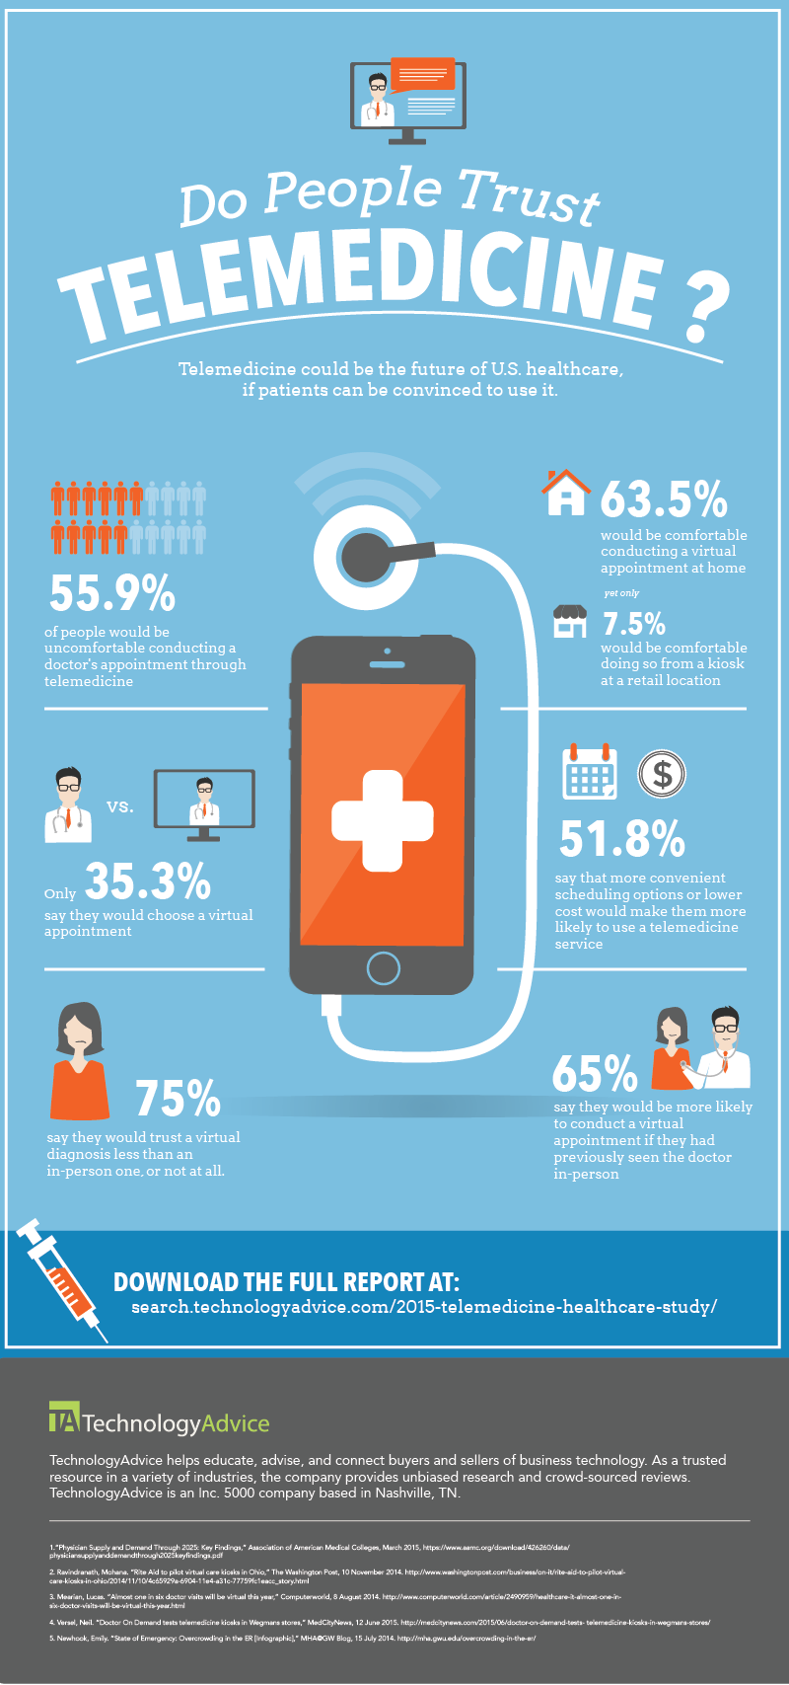
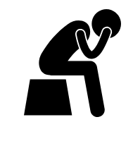
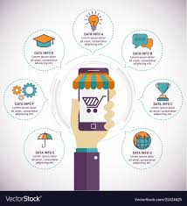
Access to
Information
Доступ к информации
Tele-
Medicine
Телемедицина
Digital divide exacerbates social exclusion of vulnerable groups
in the wake of COVID-19
Цифровой разрыв усугубляет социальную изоляцию уязвимых групп
вследствие COVID-19
Social
Isolation & Loneliness
Социальная изоляция и одиночество
E-Services
Электронные услуги
Notes:
As COVID-19 has impacted the entire world and all countries in Asia and the Pacific, digital technologies have become more important, not only in fighting the pandemic but also facilitating the daily activities of the people, especially during the lockdown, social distancing, and other measures.
More governments and the private sector are offering more information and services through online or digital platforms.
Health care providers are relying more on remote health consultation or telemedicine.
We also see increasing uses of social media, video conferencing for social connection which help reduce social isolation and loneliness.
Unless we overcome the digitial divide in Asia and the Pacific, the increasing use of digital technologies in the wake of COVID-19 by some but not by many others, will intensify the exclusion of vulnerable groups, in particular older persons and persons with disabilities

Slide 11




COVID-19 makes some population groups more vulnerable
COVID-19 способствует уязвимости некоторых групп населения
 | Women Женщины | Older Persons Пожилые | Persons with disabilities Люди с ограниченными возможностями
Increased risk of infection Повышенный риск заражения | 70% of workers in social and health sectors 70% работников социальной сферы и здравоохранения | Higher morbidity rate, underlying NCDs Более высокий уровень заболеваемости, обусловленное НИЗ | Social distancing from support persons impossible Социальная дистанция от поддерживающих людей невозможна
Conditions of lock down Условия локдауна | Gender-based violence Гендерное насилие | Isolation and abuse Изоляция и жестокое обращение | Essential support services unavailable Основные службы поддержки недоступны
Notes:
Vulnerable population groups often live in the margins of our societies and economies, working in insecure informal employment, or depending on what is often inadequate social protection systems. (optional)
As Covid-19 crisis unfold, the situation of vulnerable groups become much more vulnerable than ever.
Women
At higher risk of exposure as women make up 70% of workers in the health and social sectors
The pandemic exacerbates the already disproportionate burden of unpaid care work for women
Economic vulnerability is heightened, with risk of women falling back into poverty
Conditions of lock down increases gender-based violence
Older persons
At risk of infection due to underlying NCDs
Economic turmoil + lack of social protection => loss of income and survival on meagre earnings + handouts
Lack of access to health care => increased risk of infection and no treatment
Social distancing => isolation and abuse
Persons with disabilities
Poorer than general population; often employed in vulnerable employment with inadequate social protection
Social distancing difficult: support required from personal assistants to manage daily activities
Lockdowns may cut access to essential items and support services
Public information not available in accessible formats
Those in facilities particularly at risk of cross-infection and abuse

Slide 12
COVID-19 makes some population groups more vulnerable
COVID-19 способствует уязвимости некоторых групп населения
 | Women Женщины | Older Persons Пожилые | Persons with disabilities Люди с ограниченными возможностями
Immediate economic impact Немедленный экономический эффект | Loss of jobs due to increased unpaid care responsibilities Потеря работы из-за увеличения неоплачиваемых обязанностей по уходу | Survival dependent on savings and handouts Выживание зависит от сбережений и милостыни | Further decrease in employment opportunities Дальнейшее снижение возможностей трудоустройства
Lack of access to health care Отсутствие доступа к медицинской помощи | Sexual and reproductive health and services Сексуальное и репродуктивное здоровье и услуги | Treatment for NCDs and any other health services Лечение НИЗ и другие медицинские услуги | Prescription medicines, respirators, oxygen tanks Лекарства, отпускаемые по рецепту, респираторы, кислородные баллоны
Notes:
Vulnerable population groups often live in the margins of our societies and economies, working in insecure informal employment, or depending on what is often inadequate social protection systems. (optional)
As Covid-19 crisis unfold, the situation of vulnerable groups become much more vulnerable than ever.
Women
At higher risk of exposure as women make up 70% of workers in the health and social sectors
The pandemic exacerbates the already disproportionate burden of unpaid care work for women
Economic vulnerability is heightened, with risk of women falling back into poverty
Conditions of lock down increases gender-based violence
Older persons
At risk of infection due to underlying NCDs
Economic turmoil + lack of social protection => loss of income and survival on meagre earnings + handouts
Lack of access to health care => increased risk of infection and no treatment
Social distancing => isolation and abuse
Persons with disabilities
Poorer than general population; often employed in vulnerable employment with inadequate social protection
Social distancing difficult: support required from personal assistants to manage daily activities
Lockdowns may cut access to essential items and support services
Public information not available in accessible formats
Those in facilities particularly at risk of cross-infection and abuse

Slide 13
Long-term policies & challenges/ Долгосрочные стратегии и вызовы
What is the impact of the COVID-19 pandemic & related crises on pre-existing inequalities & what does this mean for the mid- to long-term future of different vulnerable groups? Какое влияние пандемия COVID-19 и связанные с ней кризисы оказывают на существовавшие неравенства и что это означает для различных уязвимых групп в среднесрочной и долгосрочной перспективе?
Looking at the existing systems of social protection & social services in NCA, how were they able to respond to the COVID-19 crisis? – Strengths/ challenges? What are key lessons learned & priorities going forward to deliver basic services to vulnerable groups? Учитывая существующие системы социальной защиты и социальных услуг в странах СЦА, как они смогли отреагировать на кризис COVID-19? Какие у них сильные стороны и какие имеются трудности? Каковы основные извлеченные уроки и приоритеты в отношении предоставления основных услуг уязвимым группам?
COVID-19 has highlighted the need to achieve the SDGs. What are innovative & workable approaches to put countries on a sustainable development path as we are responding to & recovering from the COVID-19 pandemic? COVID-19 выявил и усилил необходимость достижения ЦУР. Каковы инновационные и действенные подходы, позволяющие вывести страны на путь устойчивого развития в процессе реагирования и восстановления после пандемии COVID-19?

