Slide 1



Referral mechanisms, hospital selection criteria and steps toward strategic purchasing
Technical Assistance to Social Welfare in Georgia
MoH, Georgia
Friday 24 Jan, 2020
Experts: Annie Bourdil, Taavi Lai

Slide 2
Outline
Reminder from last mission
Selection criteria for providers revisited
Referral mechanisms
Steps toward strategic purchasing
Possible next missions

Slide 3
Reminder from previous mission
Focus on basics of contracting, process of contracting and selection criteria for contracting
Proposal of potential topics for next missions

Slide 4
Principal steps to contracting

Slide 5
Next possible topics for missions
Stepwise approach to introduction of contract that’s signed by SSA and provider
Contracting processes in detail
Contract content (if a proper contract signed by two parties will be introduced in GEO)
Performance and quality of care indicators in PHC (and hospitals if necessary)
Indicator collection mechanisms and use in provider management / health system strengthening
Levels of care and their respective roles
Provider network in PHC and hospitals (e.g. hospital network strategy)
Referral principles and mechanisms
Prescription system and its role in health system strengthening
Incentive mechanisms for (PHC) providers (with link to performance payments)
Payment mechanisms in PHC and hospital care
Quality standards and quality management systems
e-health services, electronic claims management and health statistics

Slide 6
Selection criteria for specialist care providers

Slide 7
Main types of criteria (from last mission)
Basic qualification criteria
Selection criteria
Preference criteria
Contract criteria/clauses

Slide 8
Examples of qualification and preference criteria (partly from last mission)
Licensed and accredited provider for each service contracted
Sound financial status assessed based on past fiscal reporting (need to provide fiscal reports)
No conviction on fraud
Minimum quality criteria fulfilled, e.g.
hazardous waste management in place
buildings in sound order
all necessary staffing and equipment available for contracted service
quality management developed and functional
Able to cover needs in the catchment area (i.e. certain size and location taken into account along with service profile)
Multiprofile hospitals preferred
Ownership of provider (i.e. public preferred)

Slide 9
Selection criteria for hospitals by levels of care (partly from last mission)
Lowest level of specialised care (local)
Size >50 beds
8 basic specialties on lowest level
Middle level (regional)
>100 beds
8+10 specialties
Highest level (national)
>250 beds
8+10+ most remaining specialties
Monoprofile only for the highest level of specialisation if necessary volume of service not available in multiprofile hospital

Slide 10
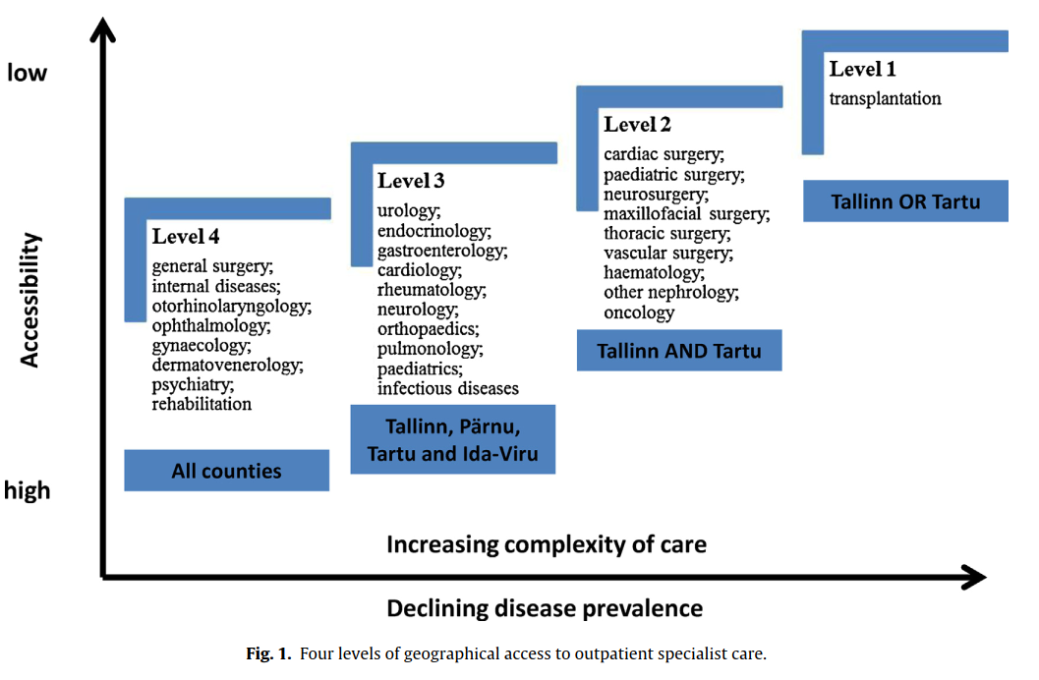
Levels of (outpatient) specialist care in Estonia

Slide 11
Referral mechanisms

Slide 12
Root causes on referral failure in India
1. Lack of skilled and motivated manpower, especially in secondary level
2. Inadequate infrastructure in the PHCs
3. Non adherence on the referral system guidelines
4. Lack of accountability in each level for controlling of unnecessary referrals
5. Lack of back referral of minor cases coming directly to higher level
6. Non-availability of universal health card like in developed countries where the health facility for primary treatment or screening is indicated for a particular population

Slide 13
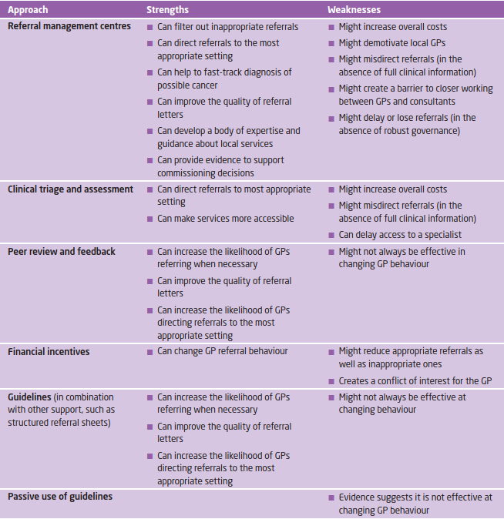
Strengths and weaknesses of refferal management approaches

Slide 14
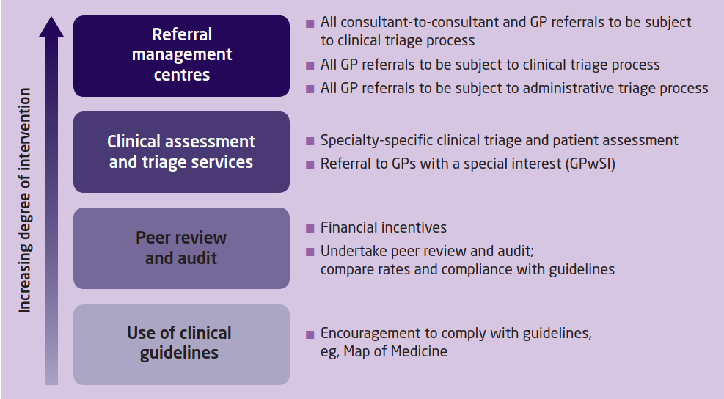
Referral management complexity

Slide 15
Possible components of referral mechanisms in Georgia (1)
Things that can help
Tasks and roles for GPs and other levels of care clearly defined
Services clearly defined by levels of care (for referral)
Treatment guidelines defined across levels of care
Rules of referrals clearly defined and linked to treatment guidelines
Monitor and link to contract payments
Campaigns to improve status of PHC
Capacity building of everyone involved
Unified electronic referral system for all providers

Slide 16
Possible components of referral mechanisms in Georgia (2)
Possible tools
Gatekeeping
no public funding if visiting specialist without GP referral
Appoint responsible person for care coordination (GP)
Use standardised referral forms with mandatory data and checklists (electronic?)
Discharge management (e.g. specialist only gets payment if patient referred back to GP with proper information)
Shift funding from specialist care to PHC (increase of salaries in PHC)
Balance financial (and other) incentives having impact on referrals
consider provider payment mechanisms in PHC and specialist care

Slide 17
Possible components of referral mechanisms in Georgia (3)
Monitoring
Whether and where to the patient was referred in specialist care (tracking care pathway)
Whether referral letter was filled (properly)
Discharge management
whether patient was referred back to GP (with proper dicharge letter)
Consequtive referrals to specialists
i.e. whether patient was „bounced“ between specialists instead of GP coordinating care (esp inside one care provider)
Measuring avoidable specialist consultation and hospitalisations for PHC-sensitive conditions

Slide 18
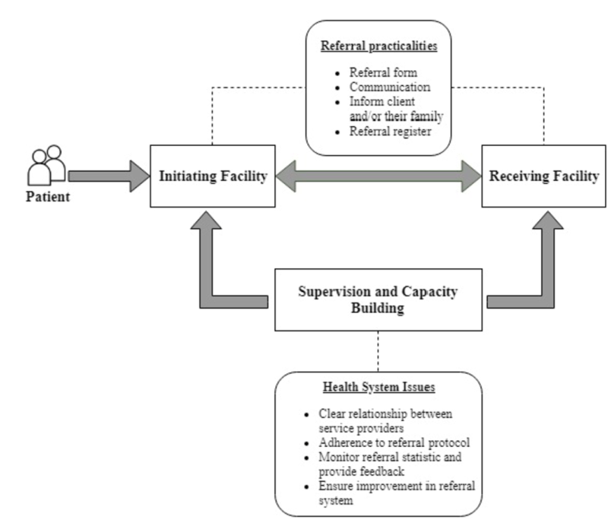
Referral flows

Slide 19
Steps toward strategic purchasing

Slide 20
Contracting in GEO HS
Slide depicting status in 8 Nov 2019

Slide 21
Crucial areas needed for implementation of complex reforms
1. a policy design with clearly delineated responsibilities;
2. a task network of organisations to engage in the broad set of functions needed;
3. more effective means of engaging with populations;
4. a range of technical and management capacities; and
5. an awareness of the multiple agency relationships that are created by the broader financing environment and the provider incentives generated by multiple financing flows.

Slide 22
Possible next missions

Slide 23
Possible next missions
10-14 Feb: Review of draft docs on hospital selection criteria and designing suitable referral mechanism
16-20 Mar TBC
27 Apr – 8 May TBC

Slide 24
Thank you for your attention!

