Slide 1
Lessons learnt from other countries: transition to DRGs
Triin Habicht
17.08.2017

Slide 2
Rationale of using different payment mechanisms
The relationship between purchaser and provider is compound
    information asymmetry
    conflicting interests
    outcome uncertainty
Incentives aim to alter providers behaviour in towards desired objectives to promote improvements in quality, access, efficiency and to ensure cost containment
    Incentives could be financial and nonfinancial
    Impact of the incentives depends on their size, design and delivery

Slide 3
Do financial incentives always deliver what is desired?
Difficult to design financial incentives that motivate better performance for complex tasks
Usually easier to incentivize to increase the “output” e.g. diagnostic tests
Shift towards incentivized activities and away from others that could have important benefit for health
Financial incentives might overplay clinicians intrinsic motivation

Slide 4
Design of the payment incentives has to fit with the expectations to the service delivery system:
What is the most appropriate care setting for the delivery of particular services?
How to ensure that care is coordinated and continuous across care settings?
Prevention
Primary health care
Outpatient specialist care
Acute hospital care
Rehabilita-tion
Long term care

Slide 5
Most common payment methods to cover base cost (full payment)
Method | Description | Usual Setting | Degree of bundling
Fee for service | Activity based billing of individual services and patient contacts and bed days | Predominantly used for GPs and for outpatient specialist services
Payment per case | Activity based payment per patient, patient classified by similar clinical condition and activities | Predominantly for hospital inpatient care
Capitation | Lump-sum payment per enrolled patient covering a range of services | Predominantly used for GPs
Global budget | Lump-sum payment covering a range of services independent of actual volume of care | Payment for public hospitals in a number of countries
Unbundeled
Bundeled
Source: Adapted from https://www.oecd.org/els/health-systems/Better-ways-to-pay-for-health-care-FOCUS.pdf

Slide 6
Case based payment: How it works
Payment depends on the patient and clinical characteristics
Providers are paid a fixed amount per admission or discharge

Slide 7
Case based payment: Provider incentives
Increase admissions
Reduce inputs per case, which may improve the efficiency of the input mix
Reduce length of hospital stays, may improve quality
Shift pre- and after care to the outpatient setting

Slide 8
Case based payment: When to use
Rather high management capacity of the purchaser and providers
Excess hospital capacity and improving efficiency is a priority
Need to monitor providers performance, provides standardized classification
Increase hospital management autonomy, reorientation from input based budgets to paying for outputs
Cost control is not a main concern

Slide 9
Case based payment: Risks
Over-hospitalization of low-cost patients
Under-treatment of high-cost patients
Up-coding: DRG-creep
Volume (cost) may escalate if other cost control mechanisms not used

Slide 10
Usual expectations to DRG system
Increase efficiency in the provision of hospital services
Achieve better planning and resource allocation in order to meet population demands for improved access to hospital care
Provide incentives for more efficient service delivery
Improve health service outcomes
Achieve greater equity in financing, in the sense that every provider receives the same payment for equal services delivered
NB! Expectations depend on what payment method was in place before DRG: fee-for-service or line-item budget or global budget

Slide 11
Building blocks of DRG systems
Data collection
2
  Demographic data
  Clinical data
  Cost data
  Sample size, regularity
Price setting
3
Actual reimbursement
4
Patient
classification
system
  Volume limits
  Outliers
  High cost cases
  Quality
  Innovations
  Negotiations
1
  Cost weights
  Base rate(s)
  Prices/ tariffs
  Average vs “best”
  Diagnoses
  Procedures
  Severity
  Frequency of revisions
Source: Adapted from Busse, EURO-DRG project, 2012

Slide 12
Key principles to shape a classification system (Fetter 1991)
Patient
classification
system
1
  Diagnoses
  Procedures
  Severity
  Frequency of revisions
The definition of groups is to be based on information routinely collected in computerized hospital abstracts
There is to be a “manageable” number of groups
Each group is to contain cases with similar patterns of resource use (“resource homogeneous”)
Each group is to contain cases that are similar from a clinical perspective (“clinically meaningful”)

Slide 13
Patient grouping
medical and management decision variables
patient variables
gender, age,
main diagnosis, other diagnoses, severity
mix and intensity of procedures, length of stay
Group of clinically similar patients with homogenous resource use
= DRG
Notes:
Objective: To provide fair reimbursement of hospital costs (not too much but not too little)

Slide 14
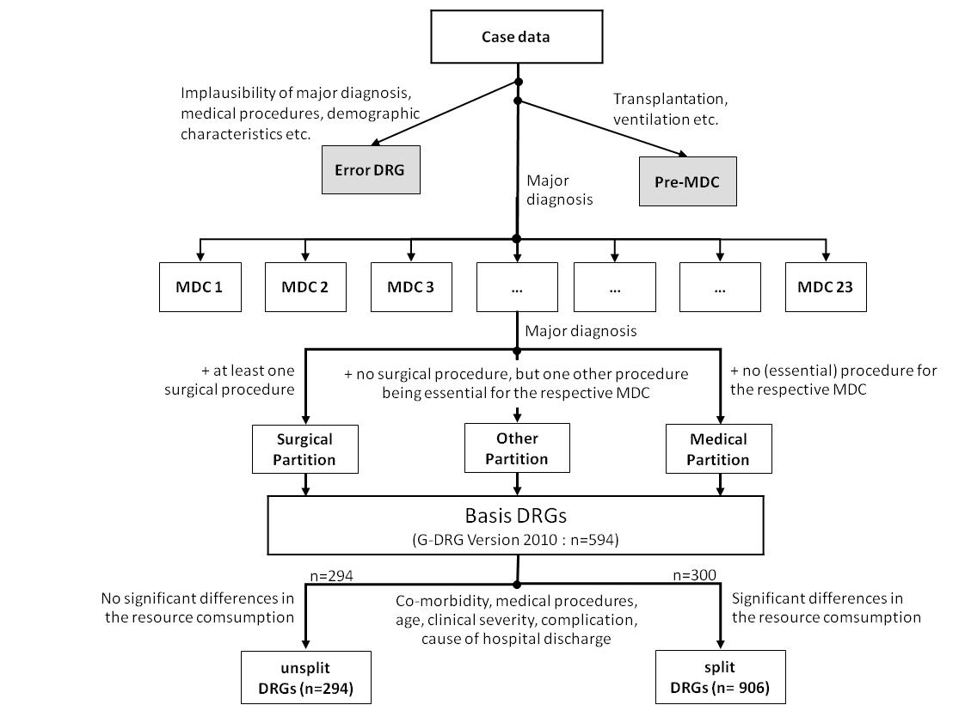
German DRG example
NordDRG manual http://www.norddrg.net/norddrgmanual/NordDRG_2012_NC/index.htm

Slide 15
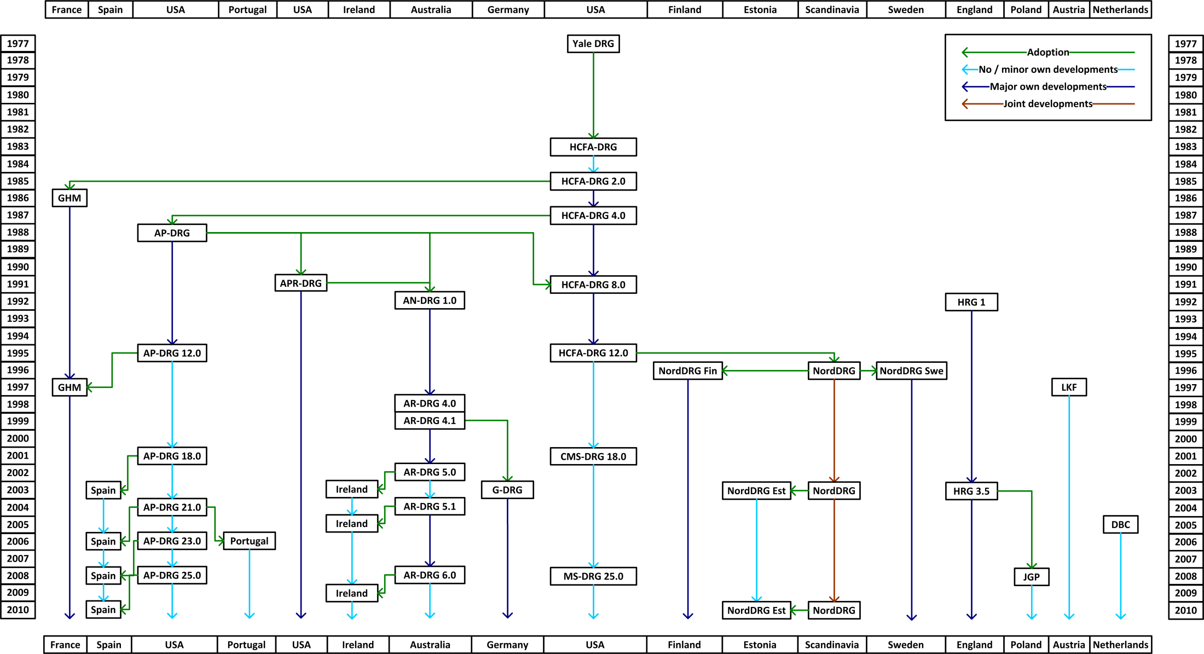
Choosing patient classification system
Patient
classification
system
1
  Diagnoses
  Procedures
  Severity
  Frequency of revisions
Find more: http://perspectives.ahima.org/disease-groupings-what-are-they/

Slide 16
Data requirements to define case groups and prices
Patient
classification
system
1
  Diagnoses
  Procedures
  Severity
  Frequency of revisions
Type | Input Data
No grouping | Average cost per hospital case
Department/specialty level grouping | Department level activity data: number of cases, cost, length of stay
Diagnosis-based grouping | Provider/department and individual level activity data: number of cases, cost, length of stay, diagnosis, age, sex, surgical procedure etc

Slide 17
Data requirements to define case groups and tariffs
Data collection
2
  Demographic data
  Clinical data
  Cost data
  Sample size, regularity
High quality clinical data on diagnoses and (surgical) procedures
Cost data to define relative weights of DRG groups and to set a base rate
    Option to import cost data but difficult to contextualize
    Good cost data requires standardized cost accounting – easier to define a sample of hospitals
    Decision what costs (recurrent/capital) costs are included
Cost does not have to be equal to the tariff/price
    Actual vs best practice
    Price incentives
Price setting
3
  Cost weights
  Base rate(s)
  Prices/ tariffs
  Average vs “best”

Slide 18
Decision making process in the hopsital
Hospital
decisions
Clinician
decisions
Inputs
Intermediates
Outputs
Labour
Bed-days
DRG 001 Craniotomy age > 17 except for trauma
Materials
Catering
Devices
Lab tests
DRG 167 Appendectomy w/o complicated principal diag w/o cc
Buildings
Surgical procedures
Management
Pharmaceuticals
…
…
…
Service production efficiency
Patient treatment efficiency

Slide 19
DRG’s for actual reimbursement
Actual reimbursement
4
  Volume limits
  Outliers
  High cost cases
  Quality
  Innovations
  Negotiations
Short and long stay adjustments
Exemptions based on clinical characteristics e.g. psychiatric care
Additional payments e.g. high cost drugs, ICU, dialysis
Quality adjustments e.g. no extra payment for readmissions, quality deductions or bonuses
Volume ceilings

Slide 20
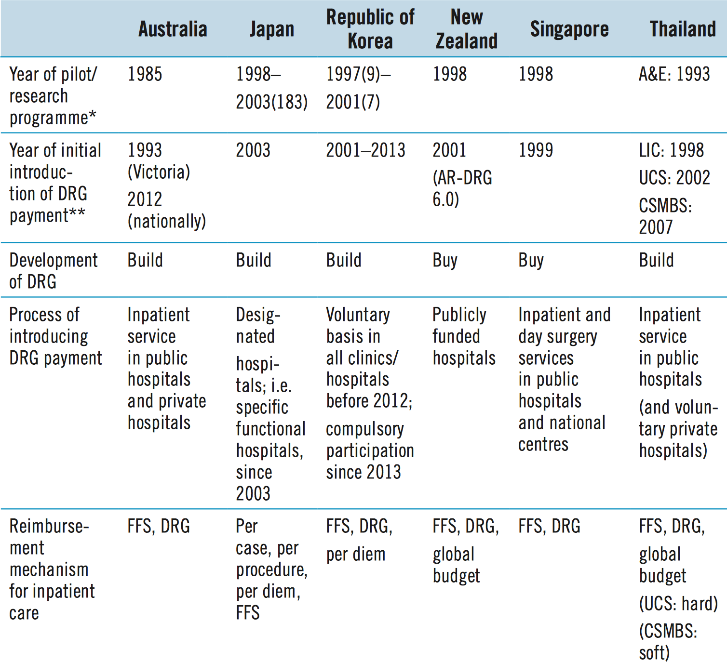
Experiences with DRG’s in Pacific Asia
Source: http://www.wpro.who.int/asia_pacific_observatory/country_comparative_studies/who_apo_drg.pdf

Slide 21
Features of DRG systems: evidence from 29 low and middle income countries
In many countries, DRG-based payments applied to both public and private sector providers
Hospitals need a certain degree of autonomy in management and spending
All countries for which information was available had a budget ceiling in place
Most of the countries used 500–800 DRG case groups (which is consistent with OECD countries)
The base rate value was ultimately a reflection of the overall amount of funding available
Most countries had adjusted cost weights in some way to their country context
The lack of standardized data generation and coding procedures had slowed down the introduction of DRGs
Source: Bull World Health Organ 2013;91:746–756A | doi: http://dx.doi.org/10.2471/BLT.12.115931

Slide 22
Impact of DRG: summarizing global evidence
Length of stay tends to decrease, in particular during the initial period following the introduction of a DRG system
Volume of hospitalizations tends to increase in countries that use DRGs to set hospital budgets, while it tends to decrease in countries that shifted from a cost-based reimbursement system to a DRG-based payment
Evidence regarding technical efficiency (cost per admission) is mixed
DRGs may also impact in an indirect way upon the non-hospital sector, as cost-shifting from inpatient to outpatient and patient-shifting to long-term or home care may take place
Evidence regarding the impact on quality is very limited but no associated detrimental impact on quality of care was observed
Source: http://www.wpro.who.int/asia_pacific_observatory/country_comparative_studies/who_apo_drg.pdf

Slide 23
Implementation: Options to phase in DRG system
Phasing of the proportion of inpatient activity covered, e.g. phasing of the number of DRGs subject to case-based payment or those with long wait times
Phasing of the proportion of the average price to be paid under new, standardized arrangements, and what proportion to be paid based on a hospital’s own, historic level of funding
Phasing the nature of costs covered by case-based payments, e.g. non-salary costs might be covered but salary costs might be paid as input-based subsidies
  “Shadow funding” arrangements can also be used, whereby hospitals are advised of what they would have received if the new funding method were implemented;
Phasing of the number of participating hospitals, e.g. voluntary participation (e.g. Republic of Korea)
Phasing the proportion of patients covered by the scheme, e.g. separation by funders
Source: http://www.wpro.who.int/asia_pacific_observatory/country_comparative_studies/who_apo_drg.pdf

Slide 24
Phase in of DRGs in Germany
2000-2002
2003 - 2004
2005 - 2009
2010 - 2014
1) Phase of preparation
2) Budget-neutral phase
3) Phase of convergence
to state-wide base rates
4) Further developments
Historical Budget (2003)
Transformation
DRG-Budget
(2004)
Nationwide base rate
Dual Financing or Monistic
Introduction of DRG-like reimbursement for psychiatric hospitals
Selective or uniform negotiations
Quality Assurance (adjustments)
Hospital specific base rate
15 %
20%
20%
20%
Statewide
base rate
25%
25%
20%
20%
20%
15 %
Hospital specific base rate

Slide 25
Key contextual factors of DRG implementation
The purpose and objective for introducing DRGs and their place in health-care financing reform need to be clear
The design and strength of hospital information systems must be adequate to describe, track and monitor changes in the volume and type of services provided
The degree of hospital autonomy in decisions regarding resource allocation and management in relation to financial incentives
The availability of DRG cost estimates is not a prerequisite for the introduction of a DRG-based payment system - several countries have adjusted to the local context DRG weights imported from other countries to set prices when phasing in the system
To be effective, DRG-based payment systems should be supplemented by regulatory mechanisms, such as activity ceilings, marginal pricing, data audit, monitoring of the care process, and measurement of patient satisfaction and health outcomes
The political and economic environment is important
Source: http://www.wpro.who.int/asia_pacific_observatory/country_comparative_studies/who_apo_drg.pdf

Slide 26
Innovating with payment methods: bundle payments example
Single payment for a full cycle of care, potentially across different care settings and/or providers
  E.g. bundling pre-hospital and/or post- hospital care into a single payment
Objectives of payment methods innovations:
  Behavioral change
  Service integration
  Cost saving
  Pathway reconfiguration
  Improvement in patient outcomes and experiences
Source: https://www.pwc.co.uk/government-public-sector/healthcare/assets/pwc-grafton-group-contracting.pdf

Slide 27
Bundle payments: risks
Needs very good data collection and monitoring system and capacity
Clinical guidelines and patient pathways that guide best practice have to be in place
  Becomes more difficult for multimorbidites, complicated and less common cases
The greater the extent of bundling, the less explanatory power for price setting and patient cost sharing
Increases the risk of adverse selection, gaming and inequity between providers

Slide 28

IN SUMMARY
Always remember that health systems consist of complex interaction of a range of factors – public expectations, professional culture, regulatory systems and governance
Payment systems are an important policy tool…but it is important not to overestimate their potential impact
There is no ideal payment. Best way is to deploy a range of different payment methods, each country has its own optimal blend depending on policy objectives
Payment systems development needs good-quality data on activity, cost and outcomes

