Slide 1
Finance topics
Riho Peek
Head of finance department
31.10.2018

Slide 2
2017 report

Slide 3
Contracts
Planning principles:
Contract plan has to be in compliance with financed demand (=budget of EHIF)
Strives towards regionally comparable access to medical services;
Temporal availability of the services (waiting times)
Takes into account actual treated cases of service providers in past period and patients movement to the treatment in terms of care providers
Considers changes in health service prices and new services as well as service structure by specialities and care types of service providers (level average cost of treated cases among similar healthcare providers)
Focuses to increase the share of outpatient care, day-care and nursing care; to concentrate the more sophisticated and expensive specialized care to regional and central hospitals
Capability of health care institutions to provide the service
Applies the criteria of geographical availability

Slide 4
Electronic channels
Pipe
Digital prescription
SAP CRM
E-invoice center

Slide 5
Information systems in the Estonian Health Insurance Fund (benefits in kind)
PIPE
SAP (ERP)
SAP (SEM-BW)
Data Warehouse
Interface
of health care providers for benefits in kind
SAP (CRM)

Slide 6
What is PIPE? Fast, reliable, secure channel sending e-documents to the EHIF´s information system, since 2002
PIPE is unified solution
sending e-documents to the EHIF´s information system
by different contractors,
Data exchange is:
electronical,
structured, based on XML,
without paper
The development of the pipe has been in process every year.
There are:
50 format controls
135 content controls
PIPE is able to receive up to 2500 invoices with one summary invoice, previous month invoices may be uploaded to PIPE until 7th date every month
Positive: high quality data for statistics, reports, analyses (in SAP BW)

Slide 7
Specialized medical care bills
Manual processing of invoices compared to contracts:
Expensive treatment (from 65 th euros)
So called open obligations (for example childbirth, organ transplant)
Special cases (biological treatment)
Periodical fees
Specialities

Slide 8
Digital prescription
Since 2010
Reimbursable pharmaceuticals
Medical devices

Slide 9
SAP CRM
Since 2002
Benefits for temporary incapacity to work
Dental care for grownups
Dentures

Slide 10
E-invoice center
Since 2017
Ambulance service (2018)
Operating expenses

Slide 11
Fraud detection
Means of control
Pipe
Standardized queries
Control hypothesis based on analytics
If fraud is detected
Credit bills
Claims

Slide 12
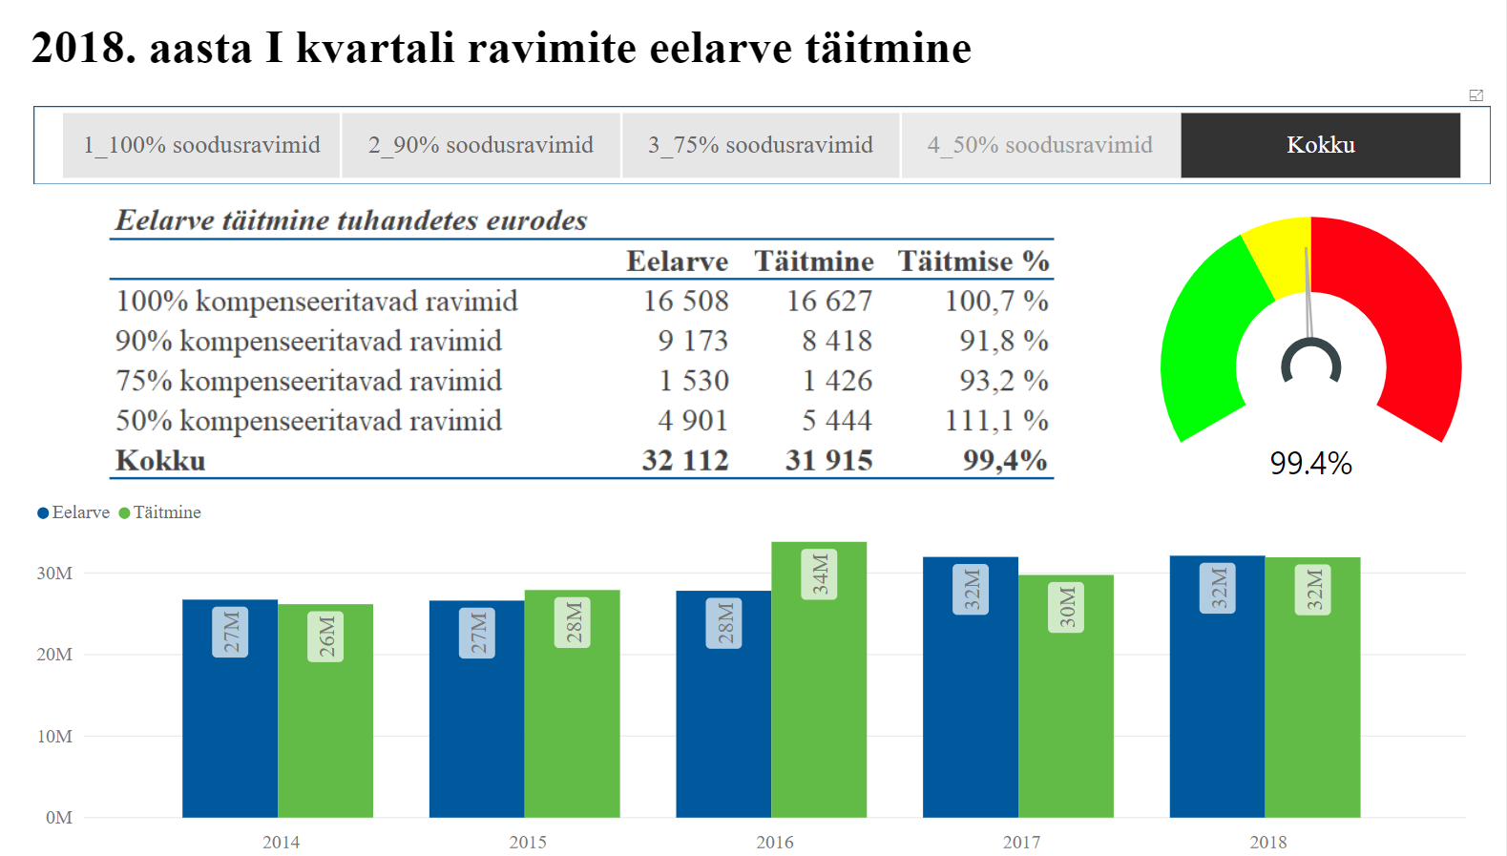
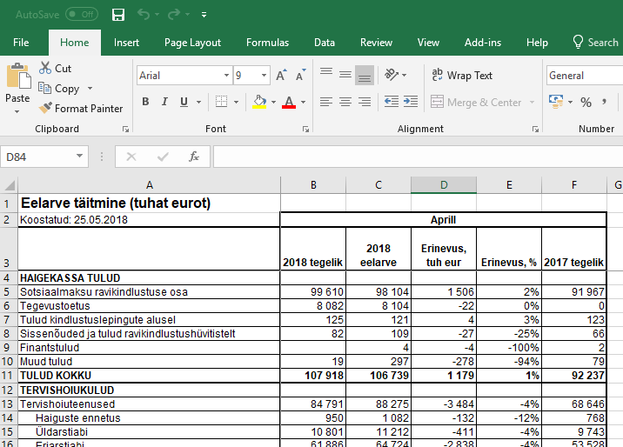
Reporting and analytics
SAP BW + Portal
Power BI
Excel

Slide 13
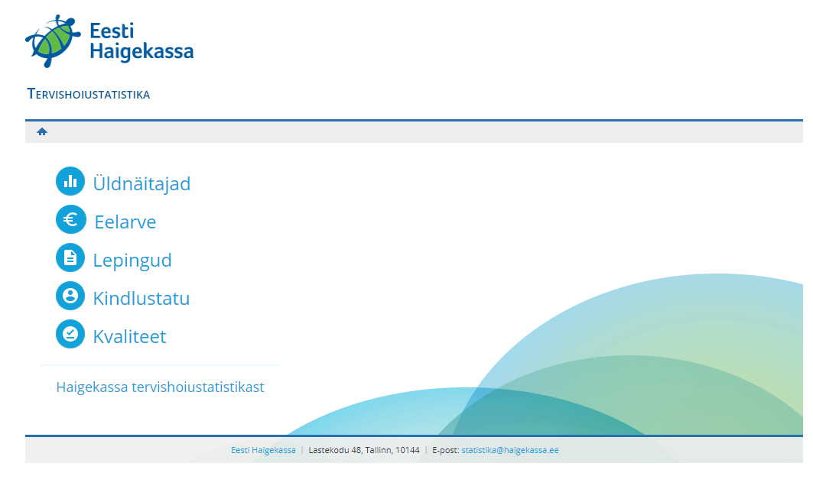
Statistics
General statistics is available in our homepage:

Slide 14
Thank You!

