Slide 1
Opportunities to improve the monitoring and reporting (focus on hospitals)
Triin Habicht, Kristiina Kahur
15 of November 2017
Tbilisi

Slide 2
Objectives of monitoring and reporting in general
measure hospital performance
detect clinical variation
detect coding issues
use of information to improve performance
rise providers’ awareness during DRG transition period
For monitoring and reporting, specific indicators should be developed and used
In general, the SSA’s invoicing database is suitable for improving the monitoring and reporting system

Slide 3
Using DRGs for monitoring and reporting
DRGs were first designed and developed in order to create an effective framework to monitor service utilization within hospital
DRGs can help highlight differences in care delivery through benchmarking and comparison of hospitals by using different indicators
DRGs help to analyze and develop the casemix system itself

Slide 4
Levels of monitoring and reporting
Type of providers
All providers
Single provider
Single provider
Department/specialty
Department/specialty
Department/specialty
Department/specialty
Type of providers
Single provider
Single provider
Department/specialty
Department/specialty
Department/specialty
Department/specialty

Slide 5
Main steps to develop a monitoring and reporting system
Develop the indicators according to the agreed methodology
Develop templates for standard queries based on the content of the indicators
Schedule extraction of the data from the database (e.g. monthly, quarterly, yearly)
Extract the data according to schedule
Conduct data quality checks
Communicate the data to end-users (target audience)
Review the monitoring system (indicators and technical tools) regularly, fine-tune if needed

Slide 6
Potential target audience
MOLHSA
Providers
Policy- makers
SSA
Media
Beneficiaries
……….
International organizations

Slide 7
Examples of indicators are based on the data of grouping exercise
Single hospital
შპს ჯეო ჰოსპიტალს
All providers
# of cases 5669 (Jan-March 2017), 5,2% of total cases
Multi-profile stationary institution
Providing services in 5 different regions
# of cases 108778 (Jan-March 2017)
All range of different health care providers
Providing services all over the country

Slide 8
Example of indicators (see Appendix 1)
Performance related indicators
Top 10 DRGs
Pattern of MDC
Length of stay (LOS)
% of cases performed in day surgery (selected DRGs)
E.g. cataract surgery, tonsil- or adenoidectomy, appendectomy, laparoscopic repair of inguinal hernia
Coding quality indicators
Coding of co-morbidities and complications (selected DRGs)
Number of diagnoses codes per case
Use of unspecific codes/R codes
Cases in error DRGs (470), cases with rare diagnosis-procedure combination (468/O, 477/O)
Cost and resource utilization indicators
Casemix Index (CMI)

Slide 9
International experience (from DRG perspective -> to broader hospitals’ performance perspective)
Estonia
https://www.haigekassa.ee/partnerile/tervishoiuteenuste-kvaliteet/indikaatorite-raport-ja-aruanded/aruannete-arhiiv#tab-hva-aruanne-2015
Australia
https://www.myhospitals.gov.au/about-myhospitals/overview#performance-indicator-reporting
Sweden
http://www.socialstyrelsen.se/Lists/Artikelkatalog/Attachments/19072/2013-5-7.pdf

Slide 10
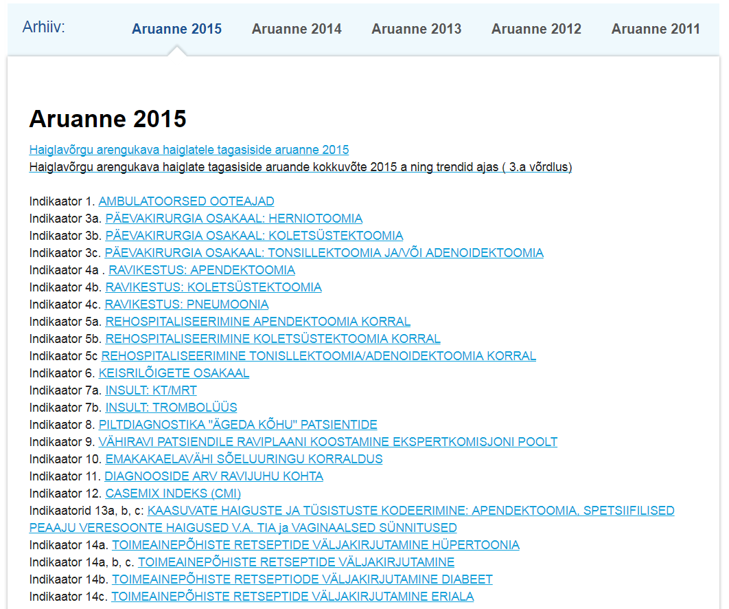
Starting from 2011
Data per single provider is available publicly on EHIF webpage
Updates once a year
Revision of content annually
20+ indicators
incl DRG system related ones
https://www.haigekassa.ee/et/indikaatorid/

Slide 11
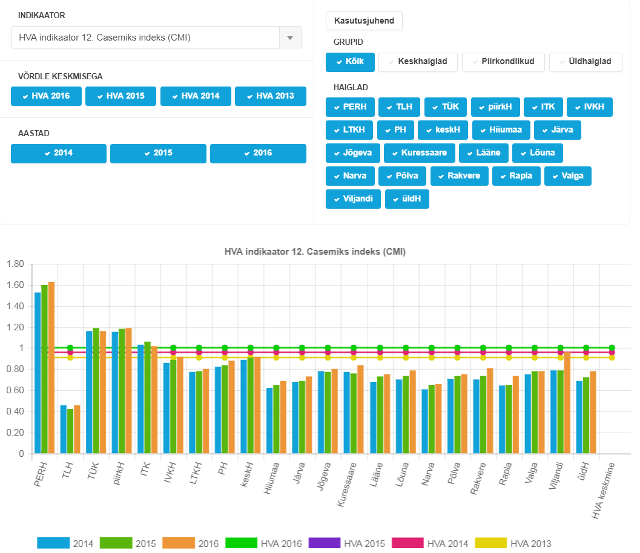
CMI
https://www.haigekassa.ee/et/indikaatorid/

Slide 12
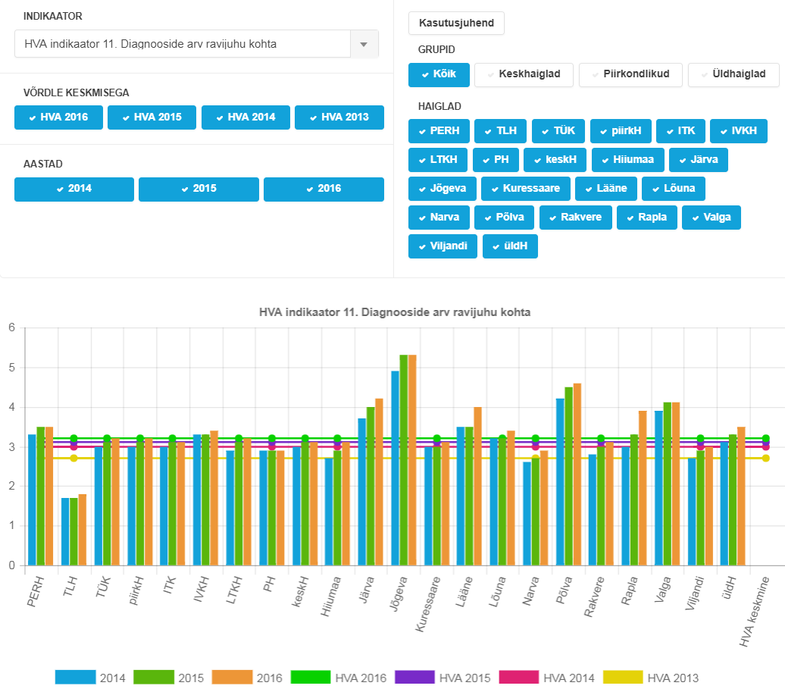
Diagnoses per case
https://www.haigekassa.ee/et/indikaatorid/

Slide 13
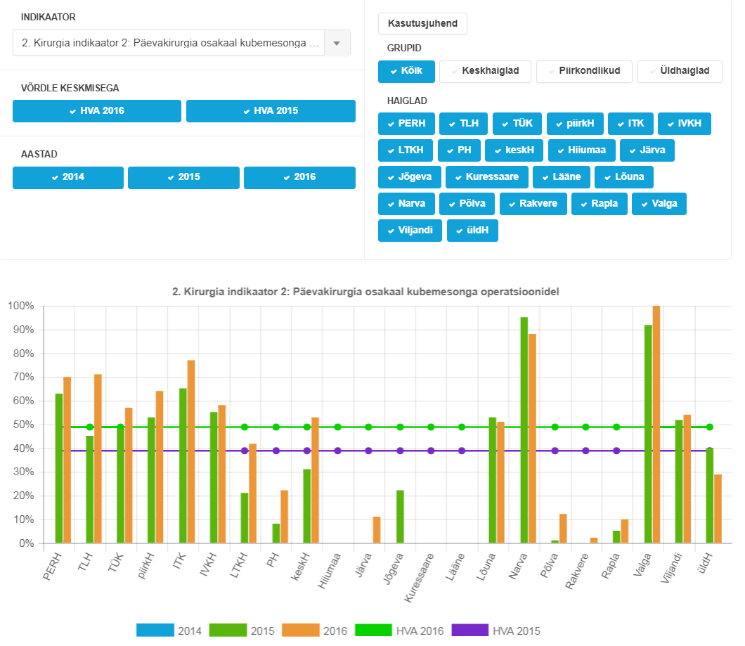
Share of day surgery
Hernia inguinalis
https://www.haigekassa.ee/et/indikaatorid/

Slide 14
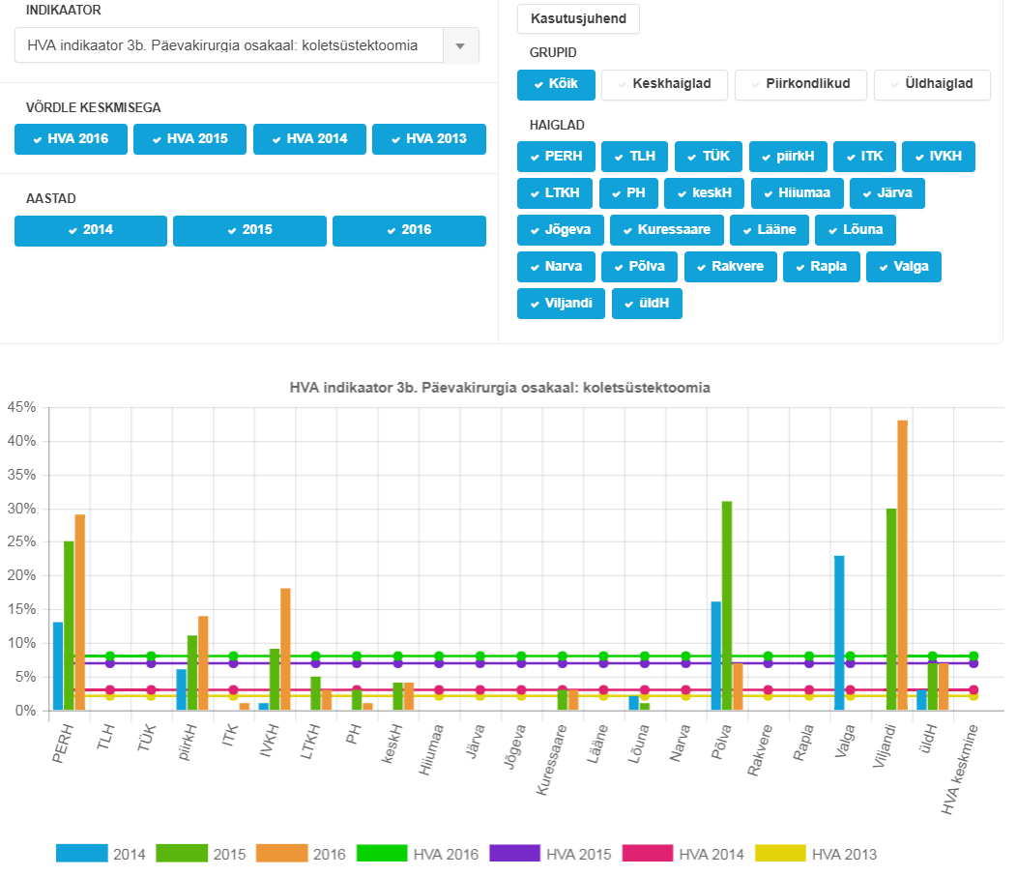
Share of day surgery
Cholecystectomies
https://www.haigekassa.ee/et/indikaatorid/

Slide 15
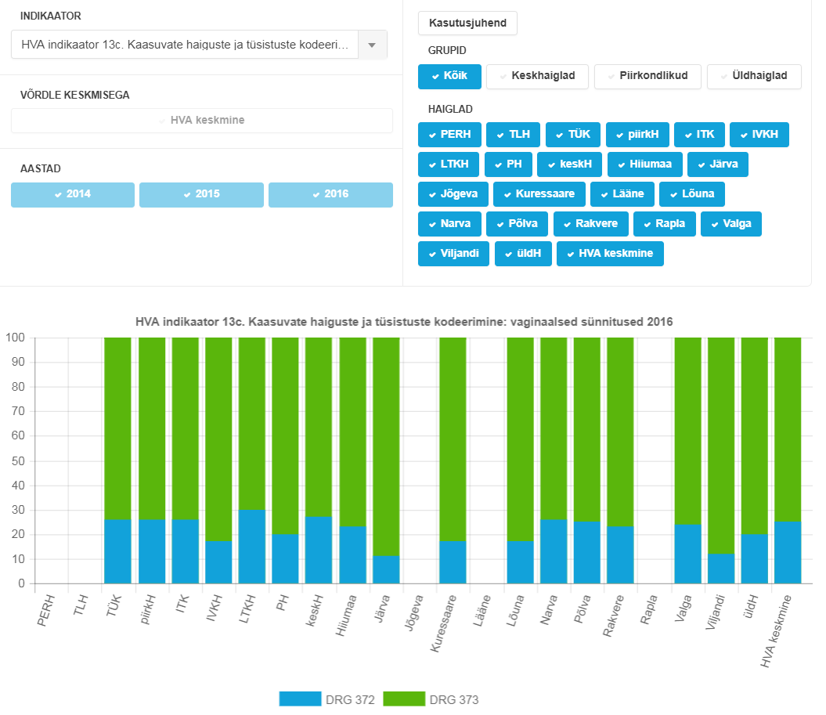
Vaginal deliveries
Non-CC/CC
https://www.haigekassa.ee/et/indikaatorid/

Slide 16
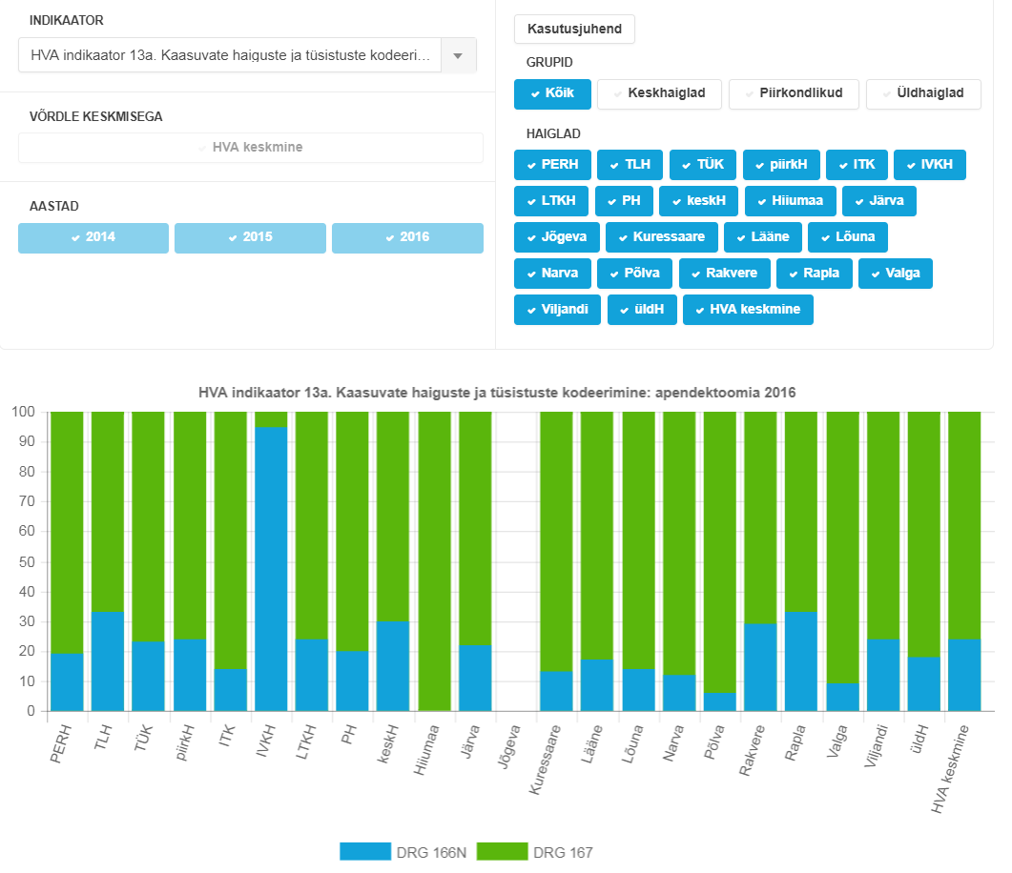
Appendectomies
Non-CC/CC
https://www.haigekassa.ee/et/indikaatorid/

