Slide 1
Estonian Health Insurance Fund
Pille Banhard
Member of the Management Board
31.10.2018

Slide 2
Background
Estonian health insurance is a social insurance and it relies on the principle of solidarity: the Estonian Health Insurance Fund (EHIF) covers the cost of health services required by the person in case of illness regardless of the amount of social tax paid for the person concerned.
Population: 1,3 million
Social health insurance coverage: 96% of population
Health Expenditure (2017) 6,7% of GDP: EHIF (70%) + OOP (ca 20%) + govt
Financed: 13 % earmarked health insurance tax on salaries paid by employers
Starting from January 2018 – additional transfers from state budget
Notes:
Member of EU since 01.05.2004 Euro-zone since 01.01.2011
Estonian health insurance system adheres internationally recognized principles:
coverage breadth: 95% of population is insured
wide scope of services in benefit package
out-of-pocket payments are at a reasonable level (20%, pharmaceuticals and dental care)
Primary care system is continuously developing
Hospital Network ensures availability of specialist care, incl emergency care
EHIF is the strategic buyer in health care system: 68% of the market

Slide 3
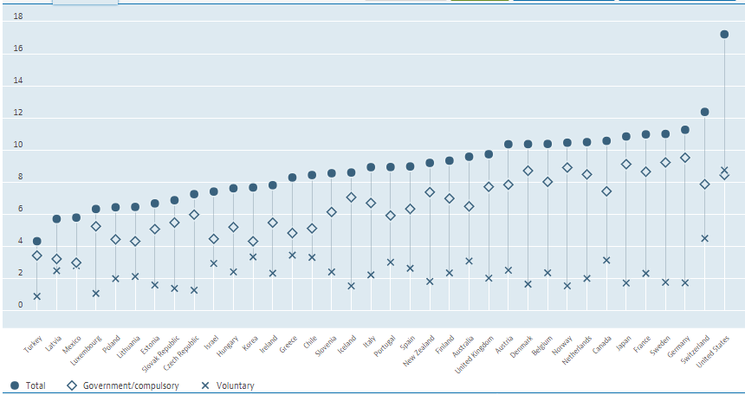
OECD (2017) Health spending

Slide 4
Number of insured persons
618 289
578 221
44 417
Notes:
Seisuga 31.12.2017

Slide 5
History of health insurance in Estonia
Until 1991: soviet Healthcare system
  Financed from the state budget, centralized state governance
  Exceptionally big number of hospitals
Important changes since 1991:
  1991 health insurance law: early developments for a solidary health insurance
  1992 Regional non-competing sickness funds (22 in total)
  1994 Regional sickness funds coordinated by central sickness fund
  Since 2001 One Estonian Health Insurance Fund (EHIF), where number of regional departments was reduced to 4
Today:
  One single health insurance fund - EHIF
  Hospital Network: 20 facilities across Estonia, plus selected partners outside the Network (approx. 30 hospitals in total)
  Over 800 primary care pracitioners

Slide 6
Estonian Health Insurance Fund
EHIF is legal person in public law
One central Estonian Health Insurance Fund (EHIF) with 4 regional departments
Supervisory Board – starting from September 2018 represented by state, employers and employees proportionally 2:2:2 (before 5:5:5)
Management board – starting from August 2018 4 members (before 3)
204 employees as of end of June 2018

Slide 7
Five goals of EHIF strategy
Ensure equal access to health services, pharmaceuticals and financial benefits;
Develop the quality of the health care system
Shape the awareness and healthy behaviour of people
Ensure efficient use of health insurance resources and sustainable development of health insurance system
Improve the operation of the organization

Slide 8
EHIF’s main functions
Strategic and long term planning
Budgeting and managing of benefits in kind and cash
Managing Health services benefit package = Health service list (HSL)
    HSL includes services that are reimbursed to health service providers by EHIF
Contracting with providers and monitoring the performance of the providers

Slide 9
Planning process of Estonian Health Insurance Fund
Long term forecast of health insurance expenses (up to 30 years)
4 year budget planning principles and financial prognosis
4 year forecast of health services
Detailed plan of next year demand of health services
Next year (annual) budget
Contracts with health services providers

Slide 10
Health insurance package
Primary care
Specialist care (incl. rehabilitation care)
Nursing care
Dental care (under age of 19 and urgent medical care for all, dental care reimbursement)
Compensation of pharmaceuticals (including supplementary compensation)
Compensation of medical devices
Benefits in cash as temporary incapacity to work
Cross-border health care
Starting from 2018 – functions from state budget as ambulance, covering the emergency care of non-insured people, etc.

Slide 11
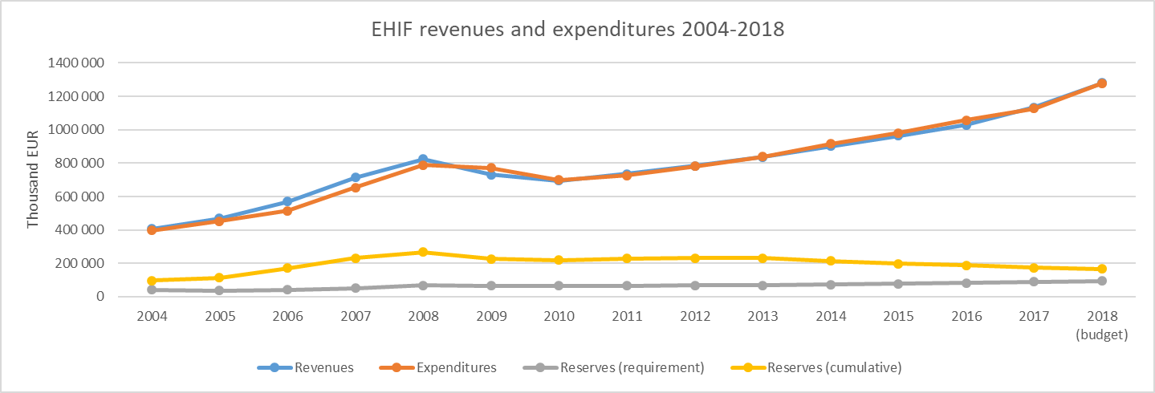
EHIF revenues, expenditures and reserves (2004 -2018)
Source: EHIF, www.haigekassa.ee

Slide 12
EHIF’s Reserves Policy
By law required
Solvency reserve
5,4% of total budget to balance macroeconomic risks, needs Government approval
Risk reserve
2% of health insurance budget to balance the risks of health insurance obligations, needs EHIF’s Supervisory Board approval
EHIF initiative – Surplus
Difference between forecasted revenues and expenditures, needs EHIF’s Supervisory Board Approval (<30% of total surplus, <7% of previous period’s health care services budget)

Slide 13
EHIF’s 4 year budget prognosis (approved by EHIF´s Supervisory Board)
(th EUR) | 2019 | % of a budget | 2020 | % of a budget | 2021 | % of a budget | 2022 | % of a budget
REVENUES | 1 445 643 | 100,0% | 1 549 517 | 100,0% | 1 655 507 | 100,0% | 1 711 448 | 100,0%
HEALTH INSURANCE EXPENSES
Health services | 1 063 958 | 73,6% | 1 130 043 | 72,9% | 1 210 199 | 73,1% | 1 293 484 | 75,6%
Health promotion | 2 101 | 0,1% | 2 515 | 0,2% | 2 950 | 0,2% | 3 250 | 0,2%
Pharmaseuticals | 168 404 | 11,6% | 175 719 | 11,3% | 183 581 | 11,1% | 192 007 | 11,2%
Temporary incapacity for work | 166 648 | 11,5% | 176 412 | 11,4% | 187 420 | 11,3% | 145 162 | 8,5%
Medical devices | 11 078 | 0,8% | 11 854 | 0,8% | 12 683 | 0,8% | 13 571 | 0,8%
Cross boarder expenses | 15 161 | 1,0% | 16 961 | 1,1% | 18 961 | 1,1% | 21 161 | 1,2%
Other expenses | 4 992 | 0,3% | 20 912 | 1,3% | 23 412 | 1,4% | 25 912 | 1,5%
Health insurance expenses in total | 1 432 343 | 99,1% | 1 534 417 | 99,0% | 1 639 207 | 99,0% | 1 694 548 | 99,0%
Operating expenses of EHIF | 13 300 | 0,92% | 15 100 | 0,97% | 16 300 | 0,98% | 16 900 | 1,0%
Total expenses | 1 445 643 |  | 1 549 517 |  | 1 655 507 |  | 1 711 448
Budget outcome | 0 |  | 0 |  | 0 |  | 0

Slide 14
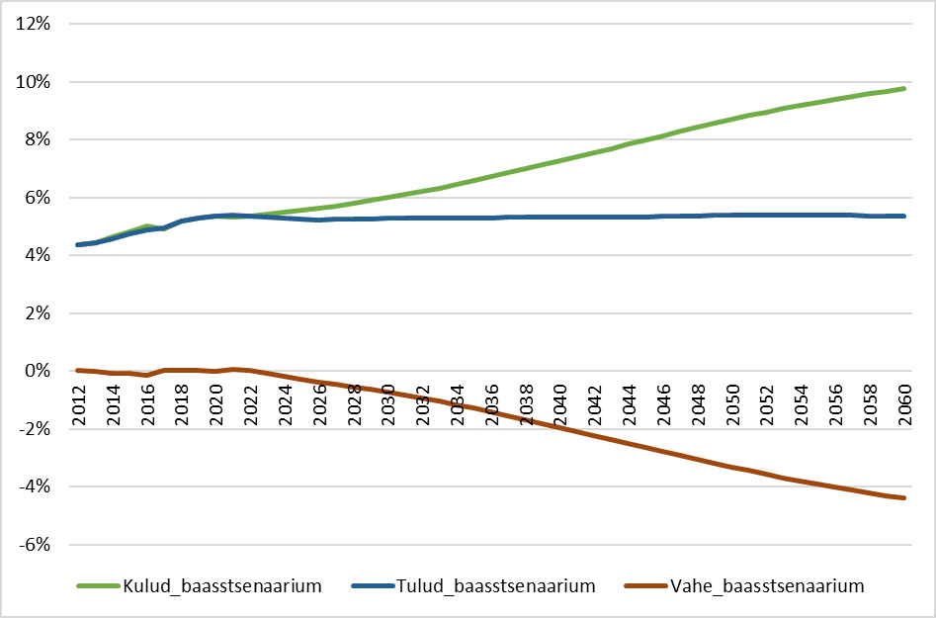
Estonian Health Insurance Fund revenues and expenses on health in 2012 -2060 ( % of GDP)
Source: EHIF, long-term forecast
Notes:
The strengths of health financing policy in Estonia are internationally recognized.
However, there is need to broaden revenue base.

Slide 15
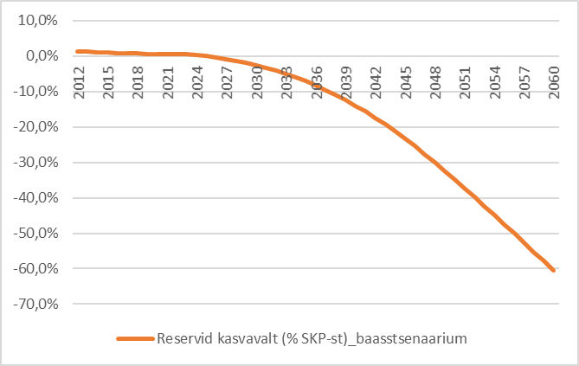
Otherwise, we will start entering the deep red territory in some 5 years’ time
Change of reserves of Estonian Health Insurance Fund, % of GDP

Slide 16
Strengthen financing
  There are different options to ensure financial soundness:
    increase allocations from the central government
    social tax to dividends from capital investment
    health insurance part of social tax of pensioneers to be paid by state
    alcohol and tobacco tax to health care
  Increase the share OOP? Is it an efficient solution? Likely not, but could the current pattern be re-balanced?
  Modify parameters of active working life (e.g., pension age)

Slide 17
10 years of developing e-services in Estonian health insurance system
E-billing system – 2004 (5 million invoices p.a.)
Health Insurance Data Exchange – 2005
Supplementary compensation for pharmaceuticals – 2006
European Health Insurance Card – 2007
Other health insurance e-services for citizens in Governmental Citizen Portal (www.eesti.ee) – 2005-2010
ePrescription – 2010 (10 million prescriptions p.a.)
eTVL (electronic sickness benefit system) – 2012-2015 (340th claims p.a.)
Plus interoperability (e.g. insurance eligibility, prescriptions) with govt e-health system (e.g. patients’ gateways)
Notes:
Number of people working here: 450 people in 2001 vs 207 people in 2018
Number of accountants: 28 in 2001 vs 7 in 2018
50% decrease in overall staff working in financing
Before the e-billing system, it tooks us 30 days to pay a bill. Now it’s 5-7 days
Smallest administrative fees in Europe: under 1% of our total budget.

Slide 18
The development of e-services has become an increasingly important factor for ensuring the quality and accessibility of health care services
E-prescription system development
  Pharmaceutical interactions to minimize risks for multi-medication
  Availability of patient data to evaluate and manage active and ongoing treatments to avoid underuse, misuse or overuse of drugs
Better e-services for hospitals
  E-invoicing
  Quality measurement
  Management of contracts (financial and general part)
Care integration and accessibility
  E-consultation – Consultations between doctors throughout different care settings
  E-referral
  Digital registration

Slide 19
THANK YOU FOR YOUR ATTENTION!
For questions: pille.banhard@haigekassa.ee

Slide 20
Pillars of socially efficient health care system
Estonian health insurance system adheres internationally recognized principles:
  coverage breadth: 95% of population is insured
  wide scope of services in benefit package
  out-of-pocket payments are at a reasonable level (20%, pharmaceuticals and dental care)
Primary care system is continuously developing
Hospital Network ensures availability of specialist care, incl emergency care
EHIF is the strategic buyer in health care system: 68% of the market

Slide 21
Pillars of socially efficient health care system (2)
Earmarked uniform contribution for health
Centralized pooling of funds and risks
Mandatory participation and solidarity ensures financial protection
Health financing is transparent and accountable to the public
No fragmentation - single payer with central pricing system using activity based costing
… and in reality – solidarity-based system is uniquely beneficial for poor and rich alike

Slide 22
Who is insured?
An insured person is
a permanent resident of the Republic of Estonia
social tax is payed for that person (employer pays)
retired people
people with disabilities
children up to the age of 19
students
pregnant women, maternity leave
unemployed people
defence forces
caretakers for disabled people

Slide 23
Social Insurance
Board
Ministry of Social Affairs
EHIF
Unemployment
Insurance Fund
Health Board
State Agency
of Medicines
National institute
for Health
Development
Contracts
Health care provider
private law, public or private
ownership

Slide 24
EHIF as a health care strategic buyer
Buying services from the right care level with the right price
    focus on primary care and integration
    accessibility and demand assessment for specialist care lead to efficient contracts with hospitals
Developing integrated care models while including a personal approach,
    clinical guidelines with decision support IT solutions
    patient pathways and e-services
    quality measures (indicators systems for GPs and specialists alike)
    financing mechanisms (risk sharing, focus on the results)

Slide 25
Providers in Estonian health care system
Emergency care
Primary health care (every Estonian has a personal FP)
Specialized medical care
  Hospitals
  Outpatient specialized medical care
  Dental care
  Nursing care, midwives
All health care providers are independent entities operating under private law
They may belong to both public or private ownership

Slide 26
Provider performance monitoring
Continuous contract monitoring by EHIF and by provider
fully automated IT-based processing of bills and payments
Medical record check-ups by trustee doctors
Since 2011 EHIF has been publishing hospital’s feedback report
public report with additional data tables enabling comparison by providers
19 indicators covering access to care, care process and efficiency

Slide 27
Out of pocket payments
Visit or in-patient fee | Fee in 2018
Family doctor | Free
Home visit | Up to 5 euro (6 USD)
Specialist | Up to 5 euro
In-patient fee in hospital | Up to 2.5 euro per day A maximum of 25 euro per stay
In-patient fee for nursing care | 6.78 euro per day
Compare with:
Average net monthly salary 1200 EUR (1400 USD)
Rent per month in City center 400 EUR (490 USD)
Utilities 170 EUR (210 USD)
Meal at a mid-range restaurant for two people 35 EUR (43 USD)

Slide 28
E-Health in Estonia
Each person in Estonia that has visited a doctor has an online e-Health record.
Allows doctors to access a patient’s records easily from a single electronic file.
Doctors can read test results as they are entered, including image files such as X-rays.
The system also compiles data for national statistics, so the ministry can measure health trends, track epidemics, and make sure that its health resources are being spent wisely.

Slide 29
How does it work in everyday practice?
The Information Centre for Health and Wellbeing is responsible for the central health information system.
All doctors and nurses practising in Estonia have the legal obligation to enter treatment related information in the health information system.
Each doctor in Estonia uses their own information system. Medical practices that don’t have their own information system can use the doctors’ portal developed by the state (free).
Health records are open by default, which means that healthcare professionals can ask for data unless the patient has opted out.
People access it through the patient portal.

