Slide 1
HEALTH SYSTEM ACHIEVEMENTS AND CHALLENGES GEORGIA
Ministry of Labor, Health and Social Affairs
November 28, 2017

Slide 2
25 years: Collapse, Stabilization, Acceleration …
Civil war

Slide 3
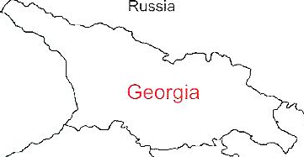
Demographic and Socio-Economic Situation, 2016
Population – 3 719 300
Birth rate (per thousand population) – 15.2
Mortality rate (per thousand population) – 13.7
Life expectancy at birth – 72.7
Maternal Mortality (per 100000 live birth) – 22.9
Infant mortality (per 1000 live birth) – 9.0
Under 5 mortality rate (per 1000 live birth) – 10.7
GDP per capita (at current prices), (2016) – 3852 $US
GDP real growth – 2.7%
Government expenditure on health per capita – 104 $US
Government expenditure on health as % of GDP – 2.8%
Government expenditure on health as % of State Budget – 8%
Government expenditure on health as % of GDP – 3%
General Government expenditure on health per capita (USD) – 102

Slide 4
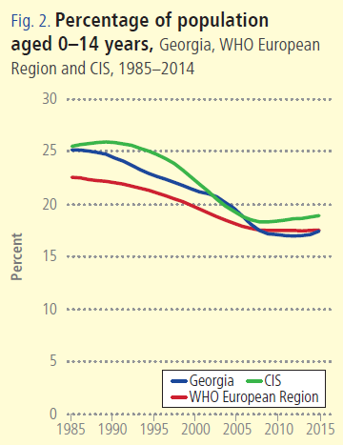
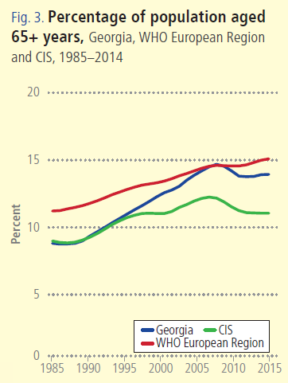
Source: WHO/EURO, Highlights on health and well-being, Georgia, 2017

Slide 5
Non-communicable diseases are the primary driver of overall disease burden
Cause of Burden of Disease (DALYs)
Injuries
Communicable
diseases
1990
2005
Non-communicable
diseases
2015

Slide 6
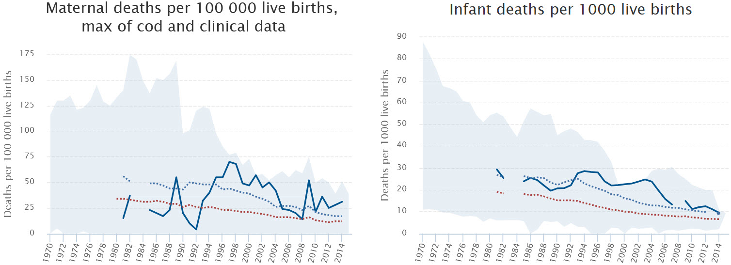
Source: WHO/EURO, Highlights on health and well-being, Georgia, 2017

Slide 7
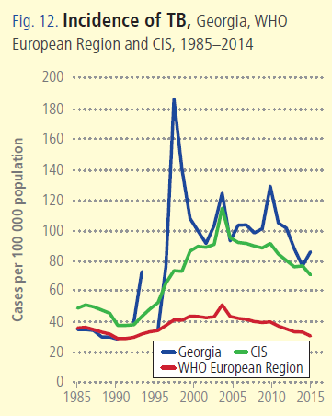
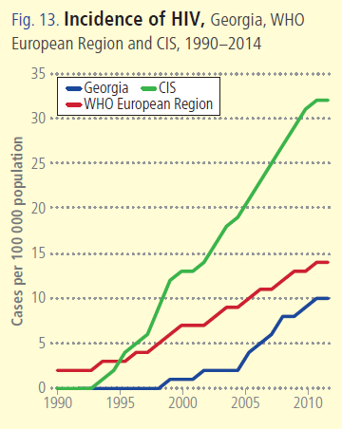

Source: WHO/EURO, Highlights on health and well-being, Georgia, 2017

Slide 8

Poverty Reduction and Shared Prosperity

Slide 9
Reforms have moved Georgia closer to universal health coverage
Better access to care
Better user experience
Better financial protection
WHO Barcelona Office for Health Systems Strengthening

Slide 10
Health sector expenditures
Source: WHO European Health for All Data Base
Source: Georgia NHA 2005 -2016 (MoLHSA, 2017)
Notes:
Total Health expenditure (%) of GDP are relatively low in Georgia at 7.4% (2014). The WHO European Region average is at 8.2%. Average for CIS is at 6.6%.

Slide 11
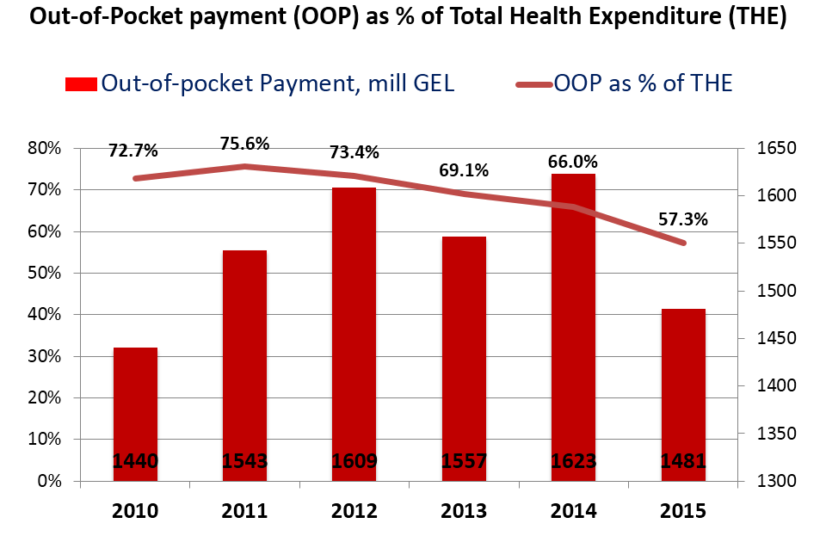
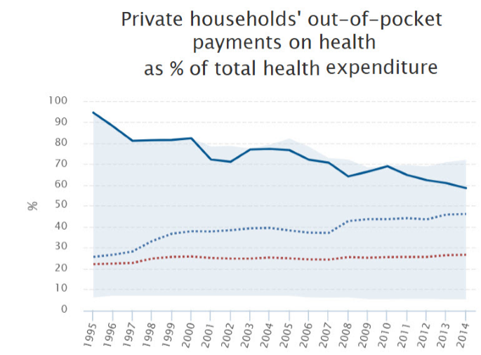
Out-of-pocket health expenditures
Source: Georgia NHA 2010-2015 (MoLHSA, 2016)
Source: WHO/Euro, Highlights on health and well-being, Georgia, 2017

Slide 12
Covering people: major increase population entitlement to publicly financed health services
Source: HUES 2007, 2010, 2014

Slide 13
Expanding benefits
I Phase - 28 February 2013 (minimum package)
- Planned ambulatory care
- Urgent outpatient and inpatient care
II Phase - July 1, 2013 (basic package)
- Planned ambulatory care
- Urgent outpatient services
- Urgent inpatient and critical are
- Elective surgical care
- Chemo-, hormone- and radiotherapy
- Maternity services
- Basic drugs for target groups
III Phase - May 1, 2017 - Service stratification according to revenue groups using “social justice approach”
- Outpatient drugs benefit for chronic conditions

Slide 14
Number of ambulatory care visits per capita
Patterns of health care use:
health service utilization has been steadily increasing
Number of hospital admissions per capita
Source: NCDC&PH, 2017

Slide 15

Better user experience
80.3% beneficiaries satisfied with the outpatient service and 96.4% expressed satisfaction with hospital level emergency care
Over 77% of the population notes increased financial access to outpatient and inpatient services
Source: USAID, Universal health care program evaluation, 2014

Slide 16
2020 Targets: 90-95-95
Hepatitis C Elimination Program in Georgia
Results to date:
screened – 1,210,000
treated – 43,000
currently involved in treatment – 7,000
90% of people living with HCV are diagnosed
95% of those diagnosed are treated
95% of those treated are cured
Sofosbuvir-based regimens
SVR achieved: 82%
Harvoni-based regimens
SVR achieved: 98.2%

Slide 17

Maternal and Child Health
Georgia Maternal & Newborn and Reproductive Health Strategy 2017-2030 and Action Plan 2017-2019
Regionalization of maternal and newborn health services
Congenital syphilis and mother-to-child transmission (MTCT) of HIV elimination plan
Universal newborn hearing screening program
Essential Nutrition Action Plan - folic acid and iron supplements for all pregnant women, breastfeeding promotion, multiple micronutrient supplementation for 6-23 months children

Slide 18
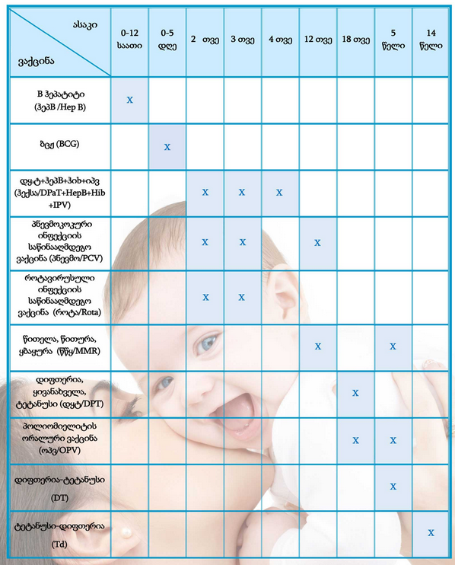
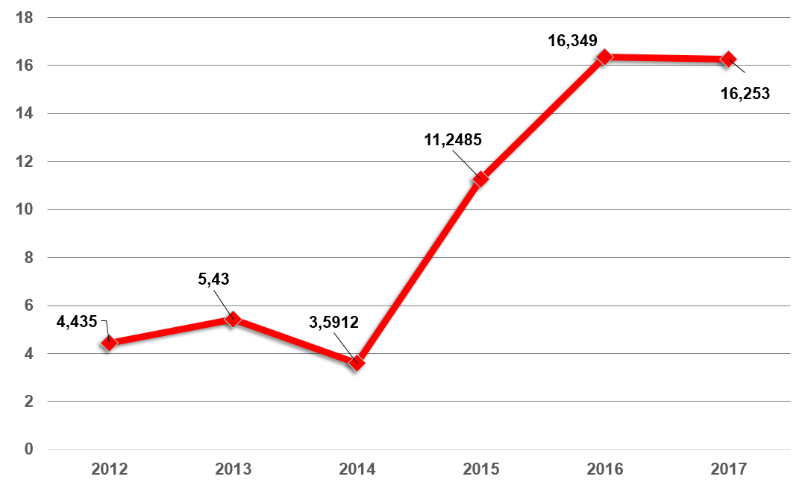
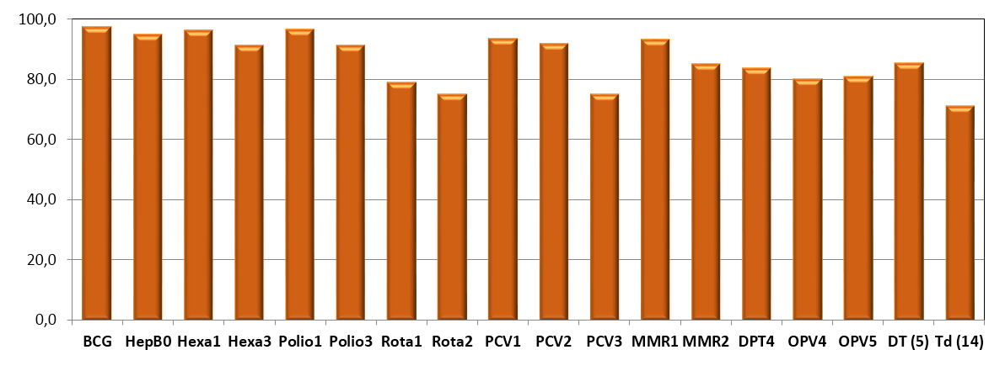
Vaccination Schedule
National Immunization Program
Immunization Program Budget, GEL
Vaccination coverage
Notes:
18

Slide 19
Health management information system
▪ Electronic system and regulatory mechanisms for vital events registration (since 2011)
▪ Electronic case-based reporting systems for in- and outpatients in health-care institutions (since 2014)
▪ Population-based cancer registry (since 2015)
▪ Birth registry - new electronic registration for antenatal and obstetric services and the surveillance of maternal and child health (since 2016)
▪ E-prescription (2017)
▪ Electronic health records (2017)

Slide 20
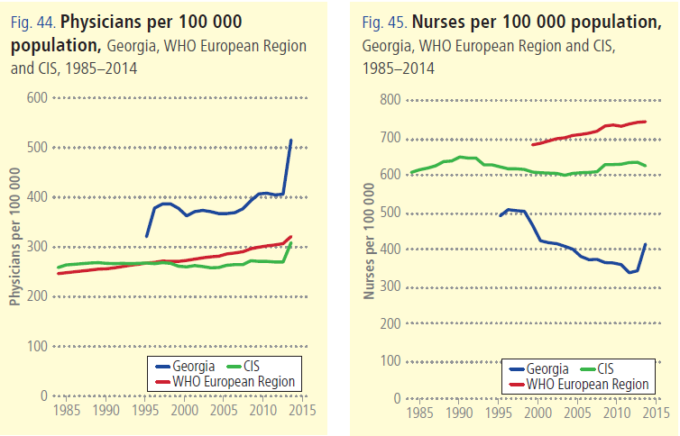
WHO/Euro – Highlights on health and well-being – Georgia, 2017

Slide 21
Human Resources
▪ HRH regulation and accreditation
- Medical specialties and sub-specialties aligned with EU
- Medical residency programs updated/prepared in 56
medical specialties
▪ Certification exam system revised
- New instrument for accreditation of continuous medical education program developed
▪ Labor market analyses initiated
▪ Medical residency programs in several specialties funded by the
government

Slide 22
Challenges ...
▪ Still very low public spending on health
▪ Still very high out-of-pocket payments
▪ Expenses on outpatient medications are high
▪ Service delivery model is biased towards
hospital/emergency services, and less primary care
centered
▪ Purchasing strategies are low effective at ensuring quality
and containing costs

