Slide 1

Universal Health Coverage: Direct way to financial protection and satisfaction of population
Dr. David Sergeenko
Minister of Internally Displaced Persons from Occupied Territories, Labour, Health and Social Affairs of Georgia
May, 2019

Slide 2
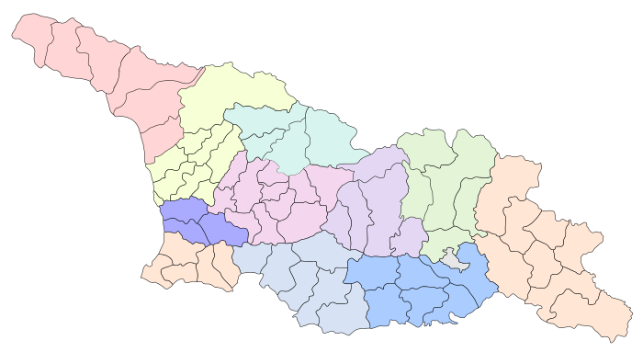




Demographic and Socio-Economic Situation
Maternal Mortality (per 100000 live birth) – 13.1 (2017)
Infant mortality (per 1000 live birth) – 8.1
Under 5 mortality rate (per 1000 live birth) – 8.7
Population – 3 726 500
Birth rate (per thousand population) – 13.7
Mortality rate (per thousand population) – 12.5
Life expectancy at birth – 74.0
GDP per capita (at current prices), (2016) – 4346 $US
GDP real growth – 4.7%
Government expenditure on health as % of GDP – 3%
General Government expenditure on health per capita (USD) – 123

Slide 3
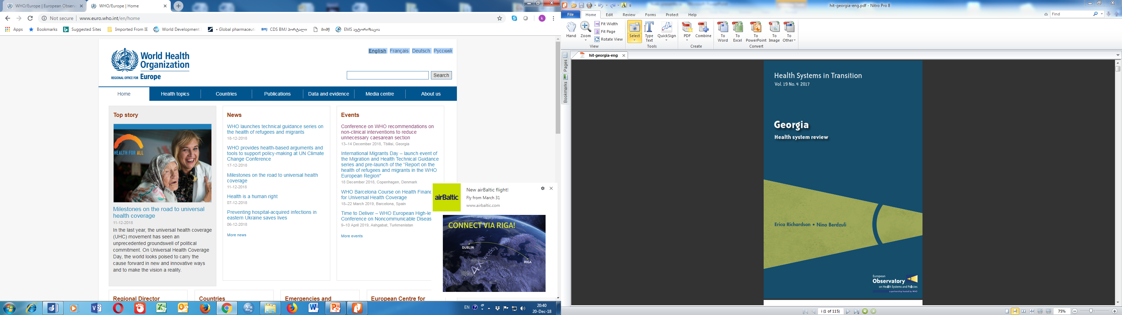


Universal Health Care – Socially Oriented Political Platform
February, 2013
WHO evaluation - Reforms have moved Georgia closer to universal health coverage
    Increased Services utilization
Increased State Budget for Health care (365 mill GEL in 2012 → 1135 Mill Gel in 2018)
    Improved financial Protection
HUES 2017
    Improved access to services
    Decreased Financial barriers
    Increased trust on state-funded health services

Slide 4
Health sector expenditures
Out-of-Pocket Payment as % of Total Health Expenditure, Georgia
Public Health Expenditure, Georgia
Source: Georgia NHA 2010-2017 (MoLHSA, 2019)

Slide 5
Coverage of Healthcare services
Services utilization
Hospitalization per 100 population
  UHC Program has led to a major expansion in population entitlement to publicly financed health services (HUES)
Ambulatory care visits per person per years

Slide 6

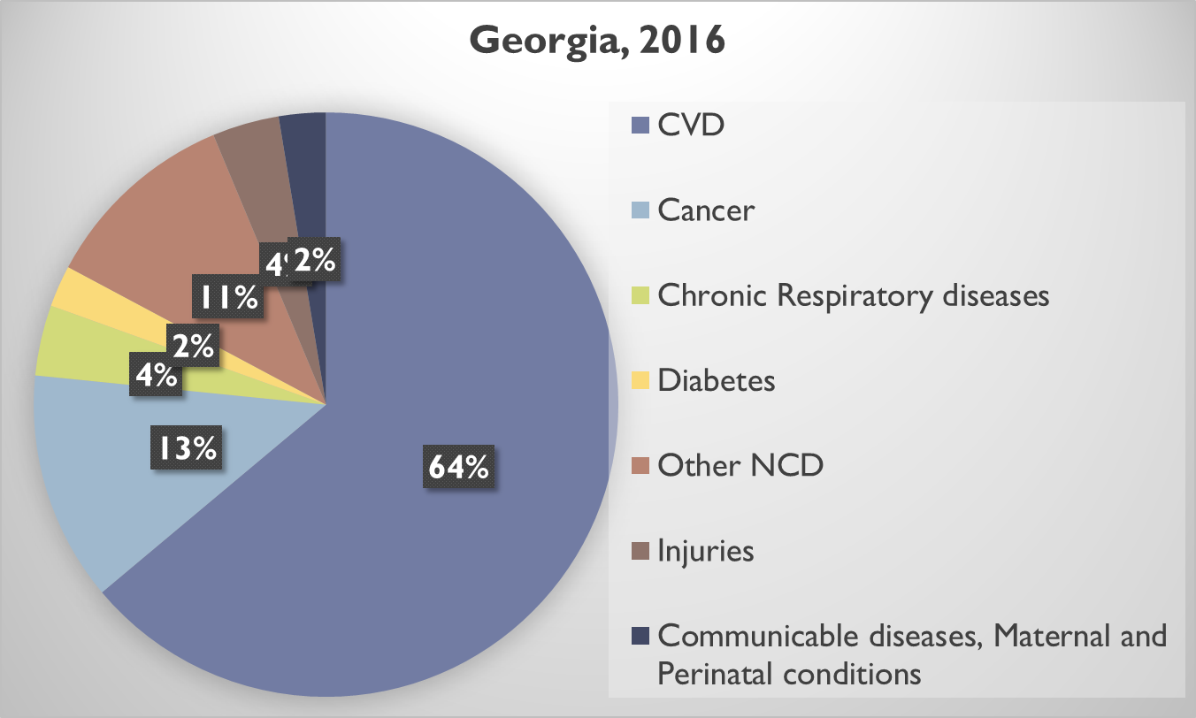

Drugs for Major Non-Communicable Diseases
  2017
    Cardio-vascular diseases
    Type 2 diabetes
    Obstructive pulmonary disease
    thyroid conditions
  2018
  Epilepsy
  Parkinson’s diseases
Deaths due to NCDs account for 94% of all cases of Deaths
socially vulnerable families – Less than 1 GEL
Pensioners and disabled persons - 50%-80% discount

Slide 7


Road Towards HCV Elimination
48% (1.38million) of the adult population is has been screened for HCV
56,318 people (43.9% of the target) are enrolled in treatment
Patient inclusion criteria removed
Long-term Elimination
Strategy 2016-2020 approved
Geographic and financial access to
diagnostic services - significantly increased
2016
2018
Georgia was awarded as a center of excellence in viral hepatitis elimination at the International Liver Congress, 2019
LDV/SOF based regimens
introduced to the program
Moving from vertical to horizontal service delivery systems through active engagement of PHC centers
TAG established
Decentralization of HCV services
Overall SVR rate 98%
Elimination through Decentralization
2nd World Hepatitis Summit
First Regional Consultation on Viral Hepatitis in the WHO European Region Held in Tbilisi
World Hepatitis Summit
Enhancement of electronic information systems
6th National HCV Workshop in March
Memorandum of Understanding between Georgian Government and Gilead Sciences
2015
Expansion of HCV service decentralization
2019
HCV Screening Protocol approved by the Ministry
2017
New Medication Vosevi (SOF/VEL/VOX) to be introduced
Initial phase of HCV elimination action plan and start of the program
TAG recommendation on decentralization
Initiating integrated screening on the
whole country level

Slide 8

Next Steps
Link universal health coverage to Sustainable Development Goal 3
WHO-EU-LUX UHC Partnership (UHCP)
  Sustainable improvement of UHC – leaving no-one behind
  Sustainable improvement of UHC – leaving no-one behind
Improve quality of healthcare through the accreditation, certification, licensing and human resources development
Promote the development of preventive medicine, PHC and Integrated care system
  Expanding of reimbursement of drugs for Chronic Diseases
  Implement strategic purchasing, selective contracting and performance based financing

