Slide 1
Strategic planning for GPW13
Promote Health, keep the world safe, serve the vulnerable

Slide 2
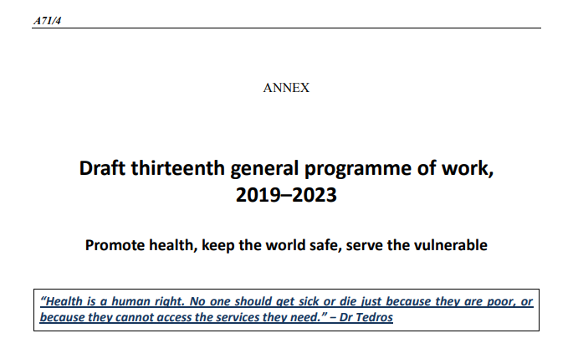
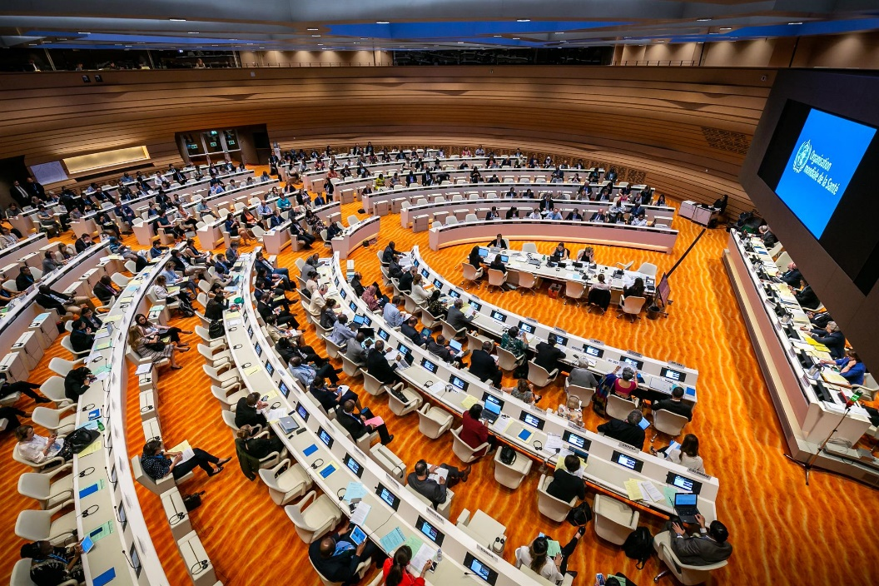
World Health Assembly: 13th General Programme of Work (GPW13)

Slide 3
GPW13
Summarizes WHO’s mission:
  Promote health
  Keep the world safe
  Serve the vulnerable
Sets out WHO’s strategic direction – priorities, health impacts and outcomes, and strategic and Organisational shifts for 2019-2023
Articulates WHO’s response to the SDGs
Provides a framework for accountability and measurements to assess progress at impact and outcome level

Slide 4
3 strategic priorities and goals

Slide 5
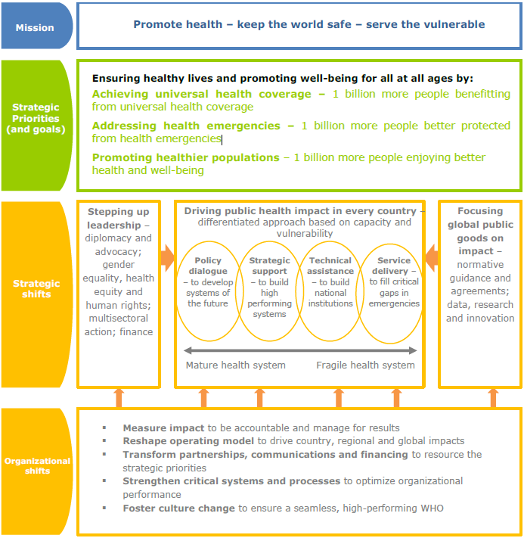
GPW13 Overview

Slide 6
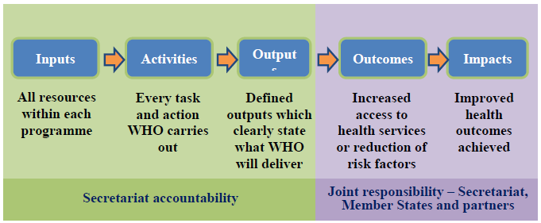
More focus on impact

Slide 7
PLANNING FRAMEWORK AND DEVELOPMENT OF PB20-21

Slide 8
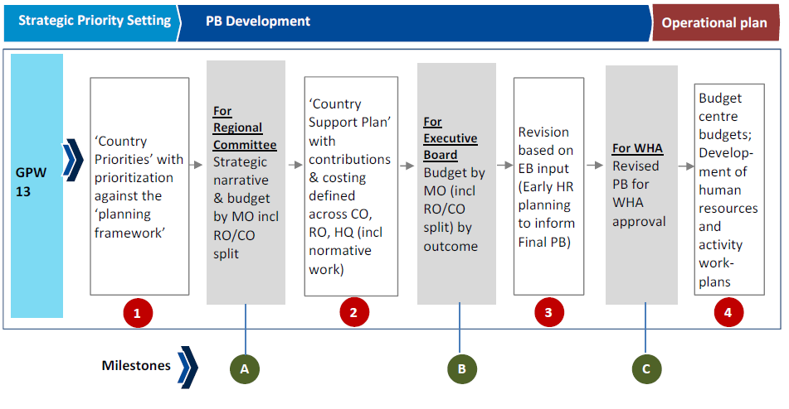
From GPW13 to operational planning

Slide 9
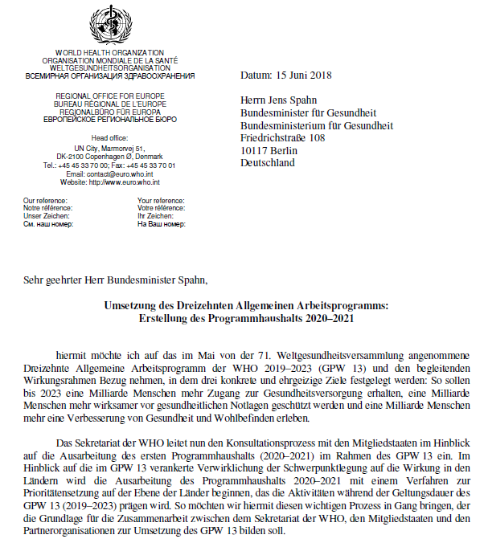
GPW13: country consultations
- to identify country priorities for 2019-2023
- to inform PB20-21 development
- to articulate country contribution to the GPW13 impacts framework

Slide 10
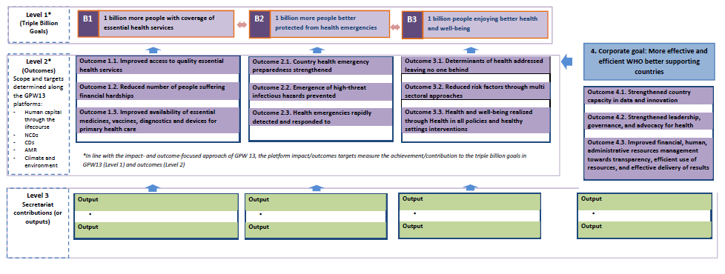
GPW13: Planning and Budgeting Framework

Slide 12
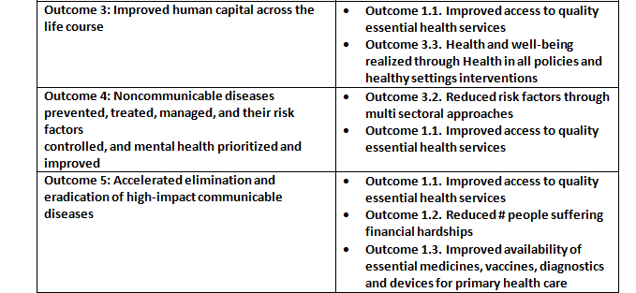
Cross-walk: Preliminary taxonomy outcomes in the GPW13 to the planning framework outcomes

Slide 13
Criteria for bottom-up prioritizing outcomes
Identified national priority in national health plan, national development strategy, SDG plan/roadmap
Priority in Country Corporation Strategy
Contribution to Regional strategies/initiatives/targets
Contribution to global targets (i.e. SDGs or other global frameworks/plans approved by Member States)
Binding international commitments and resolutions (i.e. IHR, FCTC, etc.)
Contributes to narrowing or eliminating Equity, Gender & Human Rights gaps

Slide 14
Prioritization process
1. Select among the 3 GPW13 strategic priorities
2. Based on national high-level outcomes/priorities, select the applicable GPW13 outcomes for each identified strategic priority based on
    applicable scopes
    applicable targets
3. Rate High, Medium, and Low priorities accounting for the country context
4. Select targets, to which your country will contribute
5. Define at a high-level WHO’s contribution

Slide 15
Outcome of the consultation in June-July 2018
List of outcomes prioritized
List of GPW13 impact framework targets (or additional), to which Member States will contribute
Type of support needed from WHO to achieve those results jointly
Aggregated priority setting information will form basis of the document for RC consultations

Slide 16
What we have available to support prioritization
GPW13
Defined and scoped outcomes
Crosswalk from the framework outcomes to GPW13 outcomes based on scopes
Letter from RD to launch priority setting
Current CCS where available, regional/global governing bodies commitments
National health plans, strategies, development plans…

