Slide 1


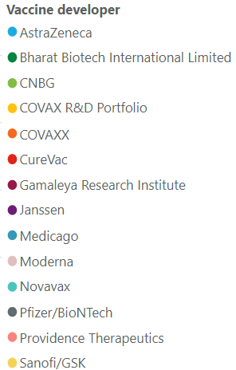
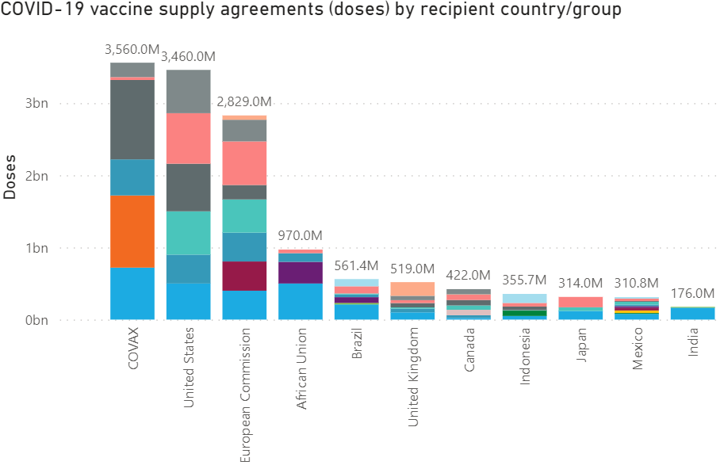
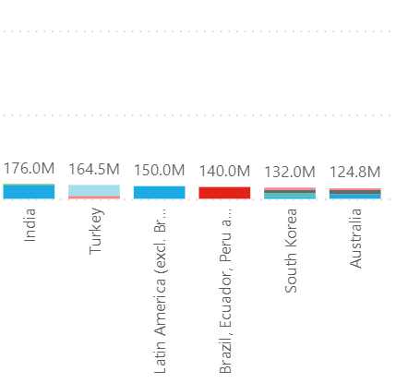
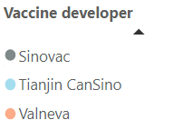
Confidential
As of 25 March 2021
Vaccines Market Intelligence
This flyer summarizes the current market trends for Covid 19 Vaccines globally including country doses procured to date and supplier contracts
Covid-19 Vaccines Global Orders
Media Headlines
Latest global press releases as at 03-25-2021
Below is a consolidation of the main media headlines regarding Covid-19 Vaccine development and distribution.
EU moves toward stricter export controls for COVID-19 shots
Financial Times – 03-25-2021
The European Union moved toward stricter export controls for coronavirus vaccines, seeking to make sure its 27 nations have more COVID-19 shots to boost the bloc's flagging vaccine campaign amid a surge in new infections. The mechanism does not apply to Covax, the EU- and World Health Organization-backed initiative to supply vaccines globally. Although the commission says no country is targeted by the mechanism, it is no secret that the biggest point of friction is with AstraZeneca, based in Britain.
Pfizer warns EU to back down on Covid vaccine threat to UK
Reuters – 03-19-2021
Pfizer and BioNtech are understood to have warned EU leaders that production at the main vaccine factory in Belgium could "grind to a halt" within weeks if the UK moved to prevent deliveries of key ingredients from crossing the Channel.
U.S. Questions Accuracy of Data for AstraZeneca Vaccine
Wall Street Journal – 03-24-2021
AstraZeneca PLC said it would update and reissue later this week efficacy data from human trials of its Covid-19 vaccine after U.S. officials took the rare move of publicly questioning their accuracy -- the latest misstep by the British drug giant as it struggles to get its shot into American arms.
Tech Firms Set Standards For Vaccine Verification
Dow Jones Institutional News – 03-20-2021
A coalition that includes tech giants and healthcare providers is preparing to release global standards for mobile apps that verify whether someone has had a Covid-19 vaccine. The Vaccination Credential Initiative standards will incorporate digitally-verified clinical data with a name and birth date that can be also displayed as machine-readable QR codes. After the open-source standards are released next month, they can be integrated into mobile apps that people could use to verify they have been vaccinated to gain admission to offices, restaurants, bars, entertainment venues and other public places..
South Africa sells its supply of one million AstraZeneca vaccines
Reuters – 03-21-2021
South Africa has sold its reserve of one million AstraZeneca vaccines. Fears about AstraZeneca’s efficacy against the South African variant of COVID-19 effectively put the brakes on the country’s mass inoculation program. The doses were sold to 9 African Union member states.
Venezuela opposition seeks to use frozen U.S. funds to import COVID-19 vaccines
Reuters – 03-19-2021
Venezuela's opposition, recognized by the United States as the legitimate government, said it would request Washington's permission use funds frozen in U.S. accounts to pay for coronavirus vaccines.
Pakistan to start private imports of CanSino COVID-19 vaccine for sale
Associated Press – 03-18-2021
A private company in Pakistan will begin receiving shipments of China's CanSino Biologics COVID-19 vaccine this week for commercial sale. Pakistan, one of the first countries in the world to allow private imports of COVID-19 vaccines, has already received a batch of the Russian Sputnik vaccine
Hong Kong halts BioNTech COVID-19 vaccines, investigates packaging
Reuters – 03-12-2021
Hong Kong authorities halted the use of a COVID-19 vaccine developed by Germany's BioNTech, citing defective packaging, in a move that triggered scenes of confusion in inoculation centres across the city. The suspension comes as the Asian financial hub has faced a sluggish take-up of vaccines due to dwindling confidence in China's Sinovac vaccine and fears of adverse reactions...
Pricing data is drawn from the UNICEF COVID-19 Vaccine Market Dashboard with additional data included where available. This charts below reflect data as at 03-25-2020.

Slide 2
Confidential
As of 25 March 2021
Vaccines Market Intelligence
This flyer summarizes the current market trends for Covid 19 Vaccines globally including country doses procured to date and supplier contracts
Vaccine Regulatory Approvals
Regulatory Approval Headlines
Latest Regulatory approval news as at 03-25-2021
Swiss approve Johnson & Johnson COVID-19 vaccine
Reuters – 03-22-2021
Swissmedic approved Johnson & Johnson's COVID-19 vaccine, the third shot to be approved by the country with vaccines from Pfizer and BioNTech and from Moderna.
China's CanSino Biologics COVID-19 vaccine receives emergency use approval in Hungary
Reuters – 03-22-2021
Convidecia - the second Chinese-produced vaccine approved in Hungary after the Sinopharm vaccine in February - is a single-dose viral vector jab currently approved for use in China, Pakistan and Mexico.
CanSinoBIO gets China nod for inhaled COVID-19 vaccine trial
Reuters – 03-22-2021
China's CanSino Biologics Inc (CanSinoBIO) said it won approval for a clinical trial in the country to develop a COVID-19 vaccine for inhalation.
Green light for AstraZeneca vaccine to be made Down Under
Daily Mail – 03-21-2021
The Therapeutic Goods Administration approved CSL to manufacture the AstraZeneca vaccine in Melbourne. The approval does not extend to use, however, with the regulator still needing to test to ensure they meet manufacturing standards.
China's Sinovac says its jabs safe for children
South China Morning Post – 03-25-2021
Sinovac, said the company's vaccine was able to provoke an immune response – indicating it could be effective at preventing Covid-19 infection – in a trial that included children aged three to 17.
Sputnik V vaccine for use against COVID-19, becoming the 54th country to do so.
Other Approval news
The following countries have approved Sputnik V for Emergency Use in Cameroon (RDIF) Philippines (RDIF) and the Seychelles (RDIF)
Two additional countries have approved Pfizer/BioNTech COVID-19 vaccine for Emergency Use: Maldives (Maldives Food and Drug Authority) and South Africa (SAHPRA)
The following countries approved Sinopharm's vaccine during the last week: Belarus (Belarus Ministry of Health) and Maldives (Maldives Food and Drug Authority)
Nepal has approved for Emergency Use the COVID-19 vaccine developed by Bharat Biotech (Nepal's Ministry of Health and Population)

Slide 3
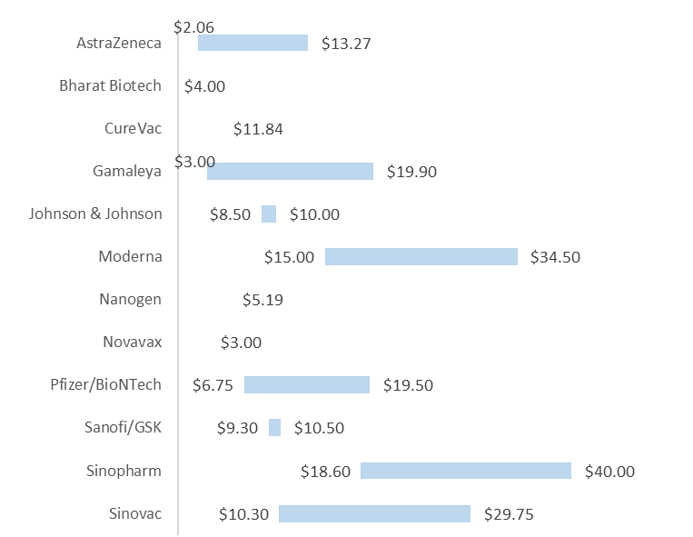
Confidential
As of 25 March 2021
Vaccines Market Intelligence
This flyer summarizes the current market trends for Covid 19 Vaccines globally including country doses procured to date and supplier contracts
Pricing
Pricing data is drawn from the UNICEF COVID-19 Vaccine Market Dashboard with additional data included where available. This data reflects publicly available pricing information as at 03-25-2020.
Price ranges for vaccines
Pricing details by Developer and Purchaser

Slide 4
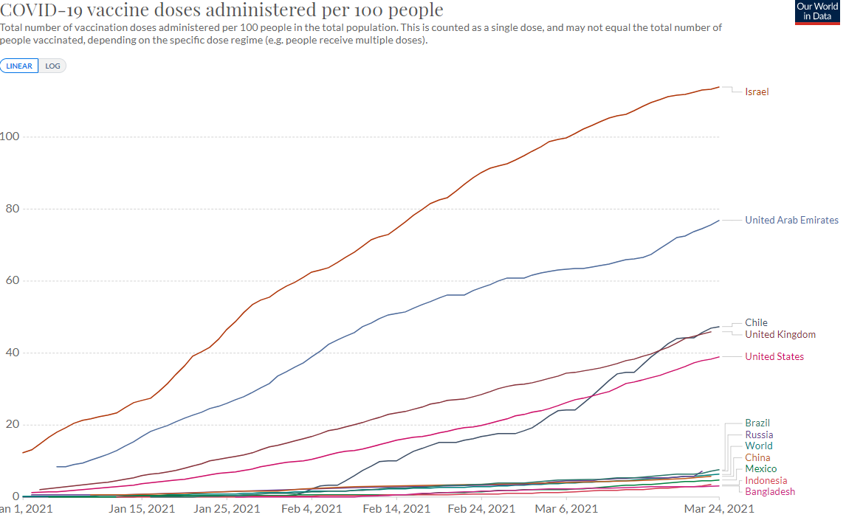
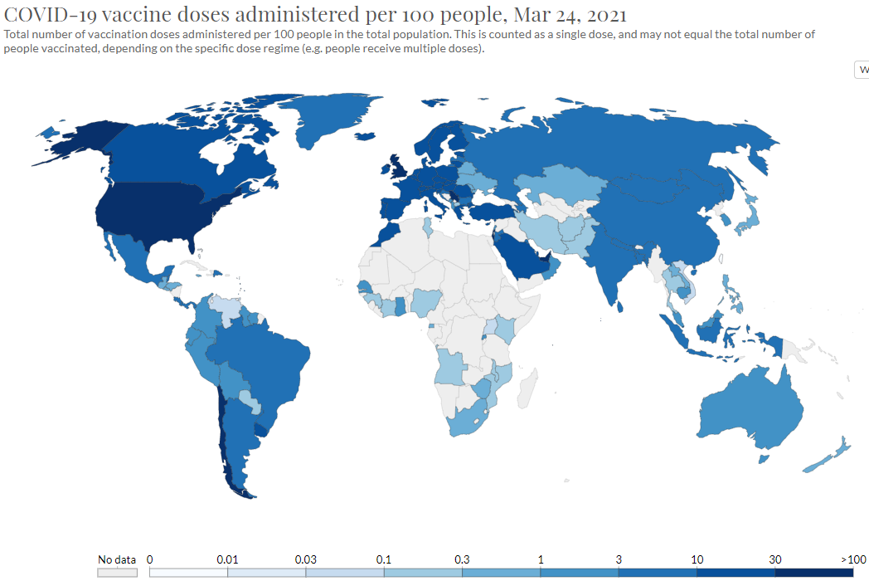
Confidential
As of 25 March 2021
Vaccines Market Intelligence
This flyer summarizes the current market trends for Covid 19 Vaccines globally including country doses procured to date and supplier contracts
Vaccinations
Vaccination data is from the Our World in Data database. This charts below reflect data as at 03-25-2020.
More than 486 million doses (Last week: 400 million) have been administered across 137 countries (Last week: 132 countries), according to data collected by Bloomberg. The latest rate was roughly 11.9million doses a day (Last week: 9.64 million doses a day) .

