Slide 1

Liliana La Sala M.D.
(l.lasala@sanita.it)
Ministry of Health
Directorate General for Preventive Health-Unit 6
40 years from the approval
of the Basaglia Law: the Italian model of taking care of patients with mental health disorders

Slide 2
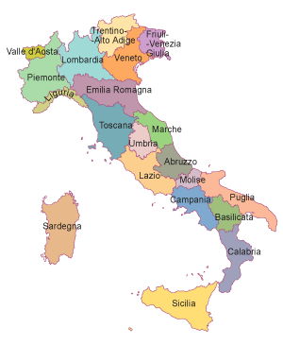
Italy at a glance
Area: 301,340 sq km
Population: 59,394,207 (1° January 2012)
% urban population (2010): 68.36
Life expectancy at birth (2011): 82
Male: 79.4
Female: 84.5
Total fertility rate (2011): 1.39
Source: ISTAT
WHO European health for all database
CIA – Central Intelligence Agency
Notes:
2

Slide 3
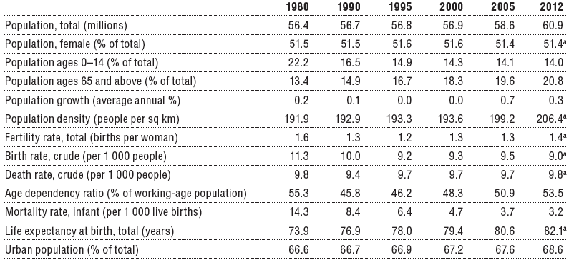
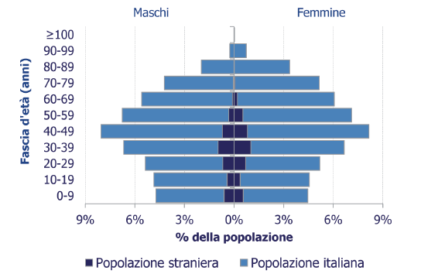

Slide 4
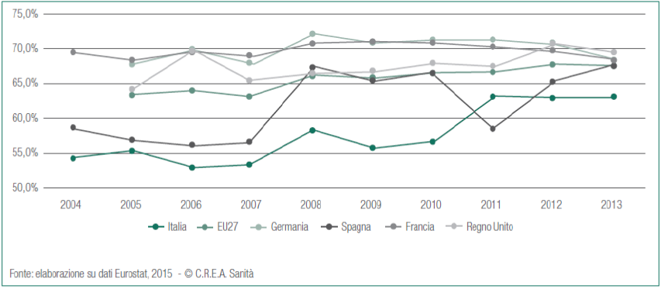
Population ≥ 75 with long standing sickness or health constraints, 2004-2013

Slide 5
Organization of National Health Service (NHS) 1978 Law Act n. 833
A regionally organized system that provides universal coverage largely free of charge at the point of delivery.
At national level, the Ministry of Health (supported by several specialized agencies) sets the principles and goals of the health system, determines the core benefit package of health services guaranteed across the country, and allocates national funds to the regions.
The regions are responsible for organizing and delivering health care in their setting.
At local level, geographically based local health authorities deliver public health, community health services and primary care (GPs and pediatricians) directly, and secondary and specialist care directly or through public hospitals or accredited private providers.

Slide 6
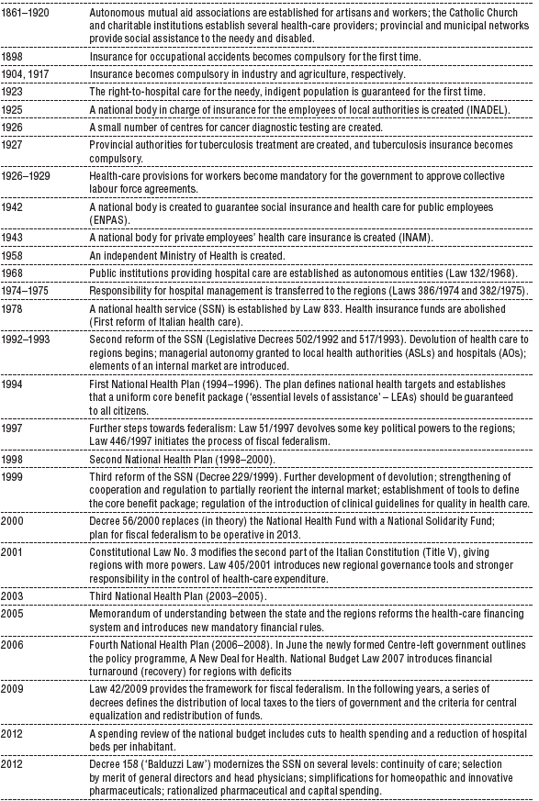
1978: NHS foundation.
1992-93: First Update:
local health authorities
and hospital trusts
The health reforms pathway
1999-2001: Devolution
to subnational
Governments (Regions)
2009: Fiscal federalism

Slide 7
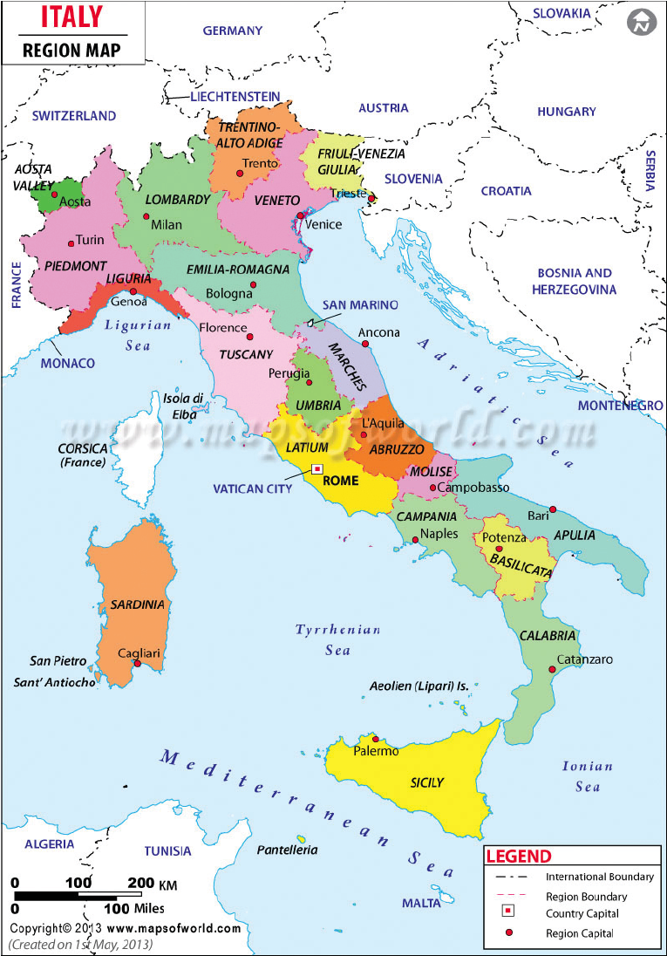
Total cost of the NHS
112 B€/year government (6.9% GDP)
  5% prevention
  45% hospital care
  50% district (primary) care
19B€/year oop (2.3% GDP)
  mainly copayment for clinical and rehabilitation services

Slide 8
The main source of financing is national and regional taxes, supplemented by co-payments.
Public sources made up 78.2% of total health-care spending.
Private spending, mainly in the form of out-of-pocket (OOP) payments (17.8%), accounting for the remainder – mainly for diagnostic procedures (laboratory tests and imaging), pharmaceuticals, specialists visits.
Only about 3% of total health-care expenditure is funded by private health insurance.
Production, distribution and pricing of pharmaceuticals are regulated by a national regulating agency (AIFA).

Slide 9
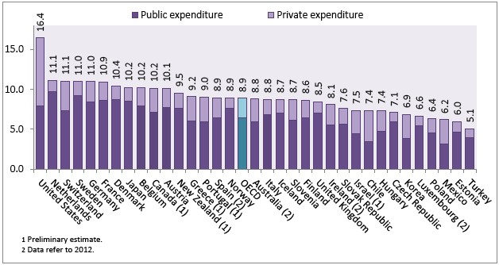
Health care spending, OECD countries, 2015

Slide 10
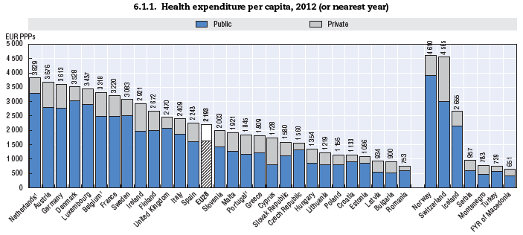
Ministero della Salute
Direzione Generale della Prevenzione Sanitaria

Slide 11
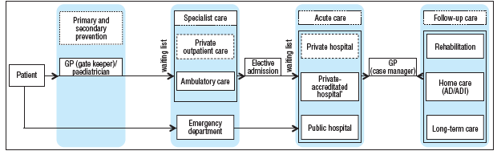
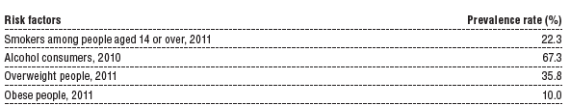
Clinical services
Typical patient’s pathway
Prevention at war

Slide 12
Doctors and nurses employed by NHS Service are civil servants.
General practitioners and pediatricians are contracted professionals, paid via a combination of capitation and fee-for-services.
All doctors are allowed to practise privately with additional incomes on a fee-for-service basis.
With 3.7 practising doctors ‰ people, Italy is slightly above the EU average of 3.4 – though the number of nurses is relatively low, at 6.3 ‰ people, with a ratio nurses/doctors of 1:1) among the lowest in the EU (2.5 nurses/doctor)

Slide 13
Italy 1978: the “golden” year of public health.
Organization of National Health Service (SSN) established by Law Act n.833
Organization of Mental Health Care
Law Act n.180

Slide 14
Italian Mental Health care system
Ministry of Health is responsible for framework laws and general indications on basic principles and methodologies aimed at defining guidelines and consensus procedures concerning good practices (to be approved by the State/Regions Council)
Regional and Local Administrations directly organise, manage and monitor mental health care services, financing them out of a global budget for health transferred to Regions by State (5%)

Slide 15
The central issues of Laws 180 and 833/1978
Civil rights of mentally ill people are to be fully acknowledged
Psychiatric Hospitals must be gradually closed: no more patients can be admitted in the existing hospitals, and old residents should be moved to outpatient services or therapeutic communities
Whole system of treatment based on a network of community oriented facilities
Treatment for acute problems delivered in General Hospitals, in wards named “Psychiatric Service for Diagnosis and Care”
Compulsory treatments should be limited, both in number and length and be considered only as a first step in a treatment programme to be delivered in community services.

Slide 16
Major mental health plans over time
MH Plan 1994-1996 first defined the contents of the community approach as alternative to mental hospitals
MH Plan 1998-2000 designed the network of services, organised in the framework of the MH Department
MH National strategy 2008 defined priorities focusing on equity, quality, inclusion and participation

Slide 17
Italian Mental Health Action Plan 2013 (MHAP)
A new strategy updating general and mental health Acts of the previous years
Addresses the most challenging problems concerning prevention, treatment, rehabilitation, services, staff training, information systems
Refers to both adults and minors

Slide 18
Priority areas (MHAP)
Early onset – early intervention (psychosis)
Common disorders with high prevalence/incidence (depression, anxiety disorders)
Severe and complex disorders
Mental disorders in children and adolescents

Slide 19
Methodology (MHAP)
For each area it defines:
Objectives
Related actions
Tools for evaluation
Indicators for monitoring
Protocols are expected to be officially shared by all involved Agencies
National evaluation of Regional strategies

Slide 20
The National Information System for MH (SISM)
SISM, jointly approved by Government and Regions, in 2010, started collecting data from 20 Regions and MH Departments in 2012, based on individual patient records.
From 2015 SISM data (number and organization of services, number of beds, types of disorders and number of staff, number of patients) are available on Ministry of Health web site, with update every year.

Slide 21
Prevalence (absolute numbers) of MH diseases Italy
 |  | ITALIA
Depression |  | 190698
Nevrosis and psychosomatic disorders |  | 106625
Personality and behaviour disorders |  | 55724
Maniac and bipolarism disorders |  | 61111
Schizofrenia and other psycosis |  | 160165
Fonte: NSIS - Sistema informativo salute mentale (SISM) – anno 2016

Slide 22
Staff for MH diseases Italy
 |  | ITALIA
Medical doctors |  | 27,5%
Nurses |  | 44,7%
Psicologists, educators, others |  | 27,8
Fonte: NSIS - Sistema informativo salute mentale (SISM) – anno 2016

Slide 23
Organization of MH services
MENTAL HEALTH DEPARTMENTS including the following services
Mental Health Centres
Psychiatric Services for Diagnosis and Care
Day Hospitals
Day Centre Residential Facilities
Plus University clinics and psychiatric wards in general hospitals

Slide 24
Mental Health Departments
183 in 2015, coordinating prevention, care and rehabilitation activities, responsible for management of human and financial resources attributed.
At least 1 for any ASL, work through the following facilities:

Slide 25
1246 Mental Health Centres, outpatient clinic for diagnosis, definition and delivery of individual care programs, coordination with GPs and other services, open 12 hours/day and 6 days/week
908 Day Centres, community semi-residential facility that delivers individual treatment/rehabilitation programmes promoting the development of competences in personal care, daily life activities, social inclusion

Slide 26
329 Psychiatric Services for Diagnosis and Care inpatient unit in general hospital for short term crisis interventions. It provides both voluntary and compulsory treatment. Each Unit can have no more than 16 beds; the rate is 1 bed every 10,000 inhabitants
Day Hospitals 317 beds , semi-residential facility for complex diagnostic intervention and short/mean term care, aimed at reducing hospitalisation

Slide 27
2271 Residential Facilities, community residential services for rehabilitation programmes, defined by MHD staff.
They are classified according to three levels of required professional attendance (24 hours of staff presence, 12 hours, only time periods during the day).
Each RF can host no more than 20 people.

Slide 28
Forensic Hospitals 2014 Law Act n.81
6 Forensic Hospitals in 5 Regions completely closed in 2017
Opened Small Residential Health facilities (each with a maximum of 20 beds)
Distributed all over the country according to the general population of each Region
Only external security control

Slide 29
40 years since Psychiatric Reform Law
Network of community services to meet the needs of mentally ill persons, on the basis of a global approach
Organisation of such services based on a departmental model to coordinate different treatments, different phases of the process, different types of staff
Closing of all Psychiatric Hospitals completed in 2001, with the definition of alternative care programmes for all inpatients
Closing of Forensic Hospitals completed in 2017
Compulsory admissions have steadily declined
Fight against stigma, social inclusion of people with mental problems, empowerment of patients and families have been promoted and supported, both at central and regional levels
Professional/cultural competences have been improved (staff, families, associations)

Slide 30
The Italian approach to MH can be traced in all International documents:
WHO (MH Global Action Plan 2013-2020 and European MH Action Plan, 2013)
EUROPEAN UNION (2005 Green Paper, 2008 European Pact, 2013-2016 JA on MH and EU COMPASS for Action on MH and well being)

Slide 31
Ministero della Salute
Direzione Generale della Prevenzione Sanitaria
An emphasis on prevention

Slide 32
Ministry of Health: the prevention subsystem
Directorate General for Preventive health
10 central offices:
  Environmental health
  Communicable diseases, outbreaks and pandemics
  NCDs
  Addictions, doping
  Mental Health
  Women, children, vulnerable population groups’ health
  Cancer, genomics, epigenetics
  Global health (EU, ECDC, WHO/EURO, WHO/HQ, OECD, G7)
8 border control offices: inspection and control on humans, animals, animal products, food, chemicals, trade products; migrants’ health.
Regions: Departments of Prevention in Local Health Units (almost 100)

Slide 33
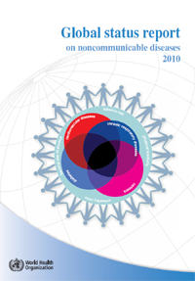
Chronic diseases are a worldwide emergency
57 million deaths
63% (36 millions) due to chronic diseases
25% are premature (below 60 years)
cardiovascular diseases
cancers
chronic respiratory diseases
diabetes
Mental health
Notes:
33

Slide 34
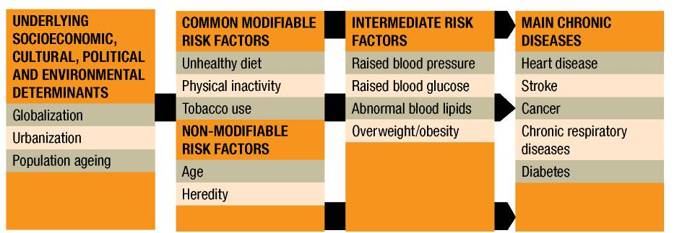
Determinants
Modifiable risk factors are:
few
shared by different pathologies
Impacting on childhood development

Slide 35


Italian strategy
National health plan
Preventive networks
Health promotion:
Schools, working places, cities, domestic environment
National prevention plan
Physical activity
Nutrition
Smoking
Healthy lifestyles
Living and working environments
healthy behaviors and
individual healthy choices
Alcohol
Notes:
35

Slide 36


Empowerment of citizens to be responsible and accountable for their own health
Stakeholders and Institutions responsibility to promote and sustain
healthy lifestyles
Decrease Inequities
Create contexts and invest in settings
Increase Knowledge
04/06/10
Notes:
36
36

Slide 37





Thank you for attention
l.lasala@sanita.it

